Slide 1
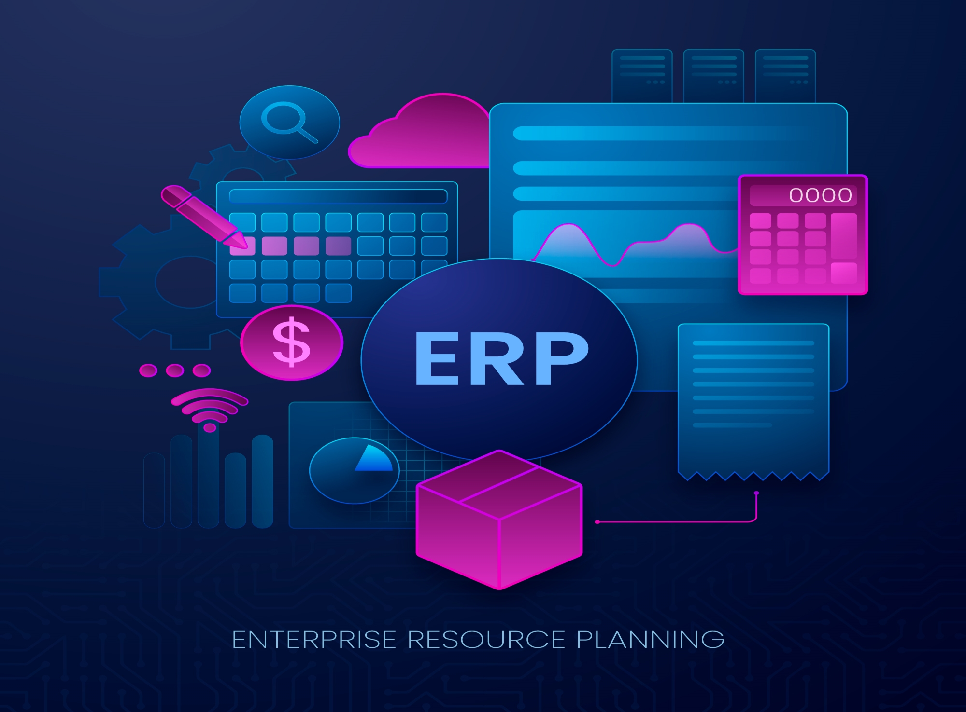
Introduction to
How ERP Software Works in Organizations
By: Ahmad Bilal “Omari”

Slide 2
What is ERP?
ERP stands for Enterprise Resource Planning.
It is software used to manage and integrate all parts of a business.
Key point: One system to manage sales, accounting, HR, inventory, etc.

Slide 3
Why Do Companies Use ERP?
Better coordination between departments
Reduces manual errors and duplicate data
Real-time data and reports
Saves time and increases productivity

Slide 4
How ERP Works (Simple Example)
A customer places an order
Sales enters the order in ERP
Inventory checks stock
If stock is low , ERP system notifies the production team to manufacture more units.
Accounting

Slide 5
Main Features of ERP Systems
Financial Management
Human Resource Management
Inventory and Supply Chain
Customer Relationship Management (CRM)
Project Management

Slide 6
Popular ERP Software Examples
SAP ERP (for large companies)
Oracle NetSuite (cloud-based ERP)
Microsoft Dynamics 365 (integrates with Office)
Odoo (open-source, flexible)
ERPNext (simple and free)

Slide 7
Benefits of ERP Systems
Better decision making with real-time data
Data security
fast implementation
Improved customer service
One database for the whole company

Slide 8
Challenges of ERP Implementation
High cost of setup
Training employees takes time
Customization can be complex
Data migration from old systems

Slide 9
Conclusion
ERP helps businesses become more organized and efficient.
Choosing the right ERP depends on company size and needs.
It is an investment that improves long-term performance.

Slide 10
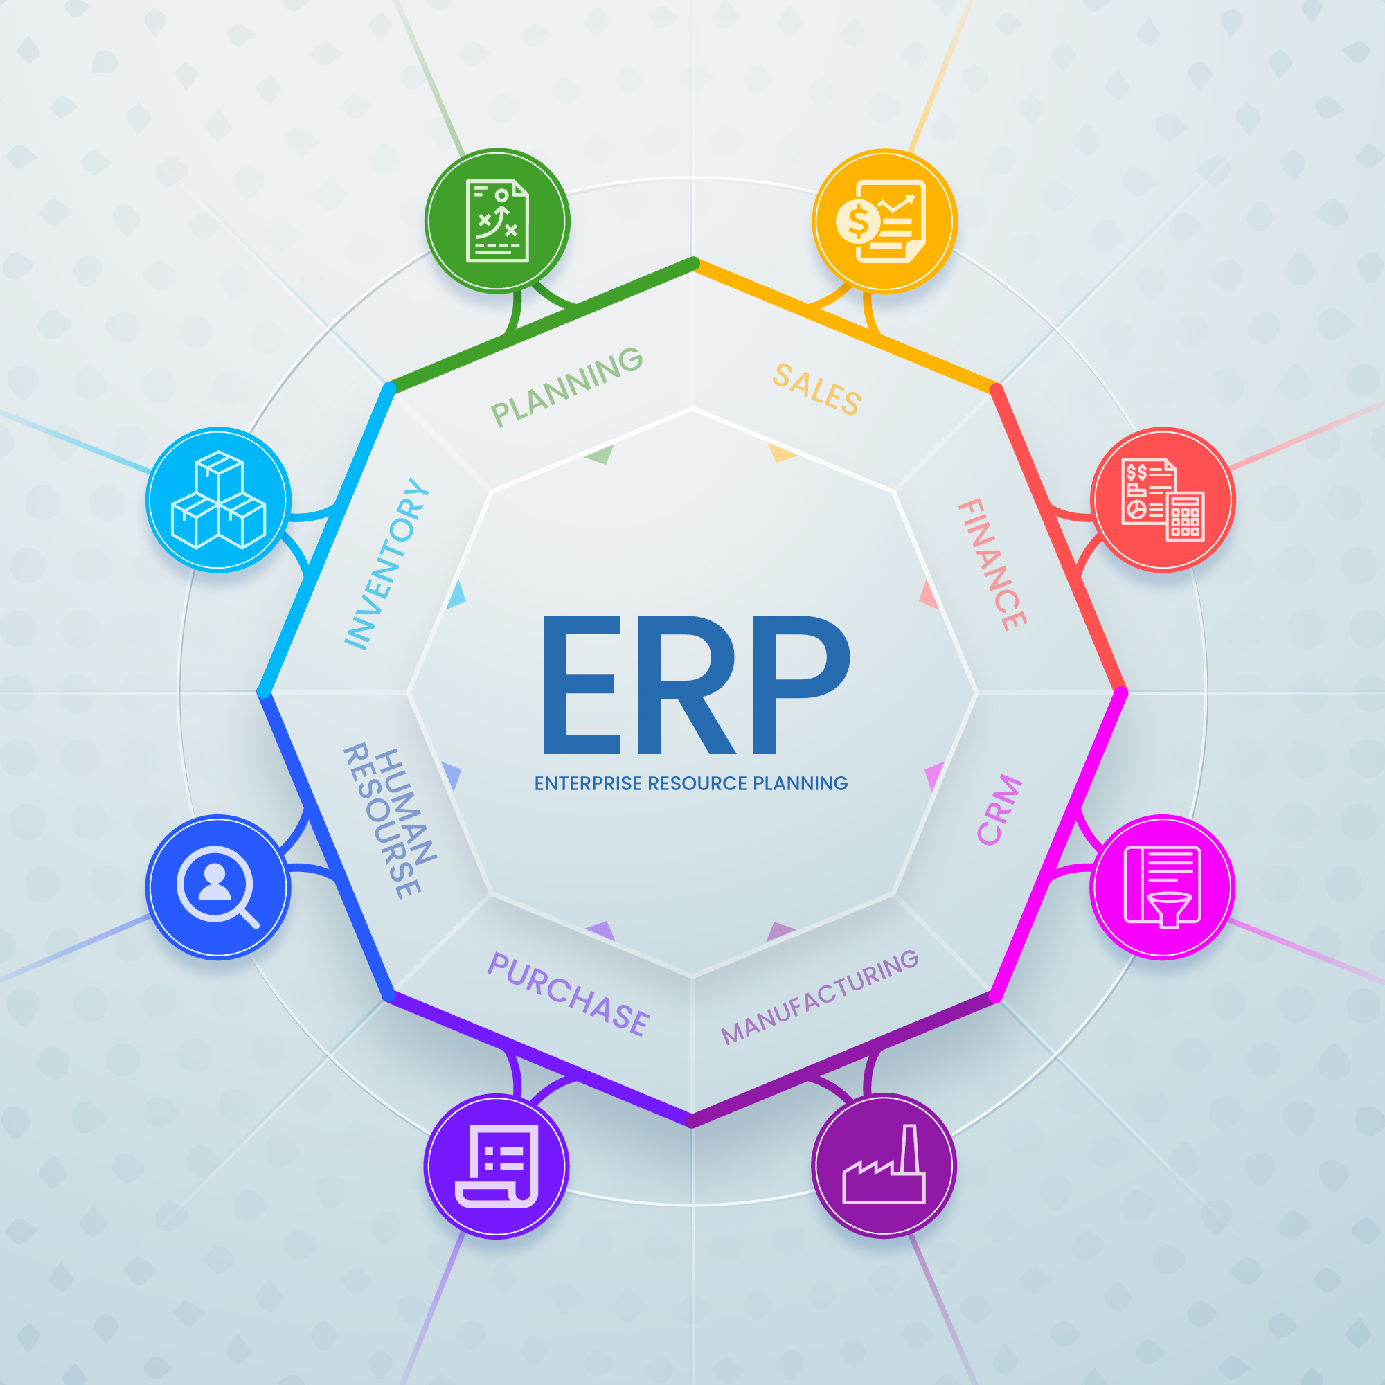

Slide 11
Thank you for your attention!

