Slide 1
Accelerating GATK Using GPUs via an Automated SPARK-to-OpenCL Flow
Max Grossman, Vivek Sarkar
PhD Student
Habanero Extreme Scale Software Research Group
Rice University

Slide 2
Outline
Completed Work: SWAT v0.1
Summary
Example App
Evaluation
Ongoing Work: Port and Optimization of CS-BWAMEM on SWAT
Plus necessary extensions to SWAT

Slide 3
Outline
Completed Work: SWAT v0.1
Summary
Example App
Evaluation
Ongoing Work: Port and Optimization of CS-BWAMEM on SWAT
Plus necessary extensions to SWAT

Slide 4



Spark SWAT
Project Tungsten: “majority of Spark workloads are not bottlenecked by I/O or network, but rather CPU and memory”
Solution: execute user-written Spark kernels on accelerators.
Code generation vs. fixed-function solutions, fixed-function doesn’t work for novel algorithms (e.g. Jonathan Flint’s work)
Perfect match
val rdd = CLWrapper.cl(sc.objectFile(inputPath))
val nextRdd = rdd.map(i => 2 * i)

Slide 5
Spark SWAT
Key contributions:
Full compatibility with a modern data analytics platform (Spark).
Extensions to the state-of-the-art in bytecode-to-OpenCL code generation.
Asynchronous, event-driven, resource-aware runtime for managing JVM and accelerator resources.
Multi-GPU memory management and caching layer.
An evaluation of SWAT on six diverse machine learning benchmarks.

Slide 6
Spark SWAT : Example App
val rdd = CLWrapper.cl(sc.objectFile(inputPath))
val nextRdd = rdd.map(i => 2 * i)
Master
Executor
Executor
Executor
CPU
GPU
CPU
GPU
CPU
GPU
GPU
GPU
GPU

Slide 7
Spark SWAT : Example App
Launch Spark job, ship transformations and data to executor nodes.
Master
i => 2 * i
i => 2 * i
Executor
Executor
Executor
CPU
GPU
CPU
GPU
CPU
GPU
rdd Partion 0
GPU
rdd Partion 1
GPU
rdd Partion 2
GPU

Slide 8
Spark SWAT : Example App
SWAT Initialization: page-locked host buffer pre-allocation.
Executor
CPU
GPU
rdd Partion 0
Page-Locked Input Buffers
GPU
Page-Locked Output Buffers

Slide 9
Spark SWAT : Example App
SWAT Initialization: kernel code generation.
Executor
CPU
GPU
rdd Partion 0
i => 2 * i
static int Multiply$$anon$1__apply$mcII$sp(
This *this, int in) {
return((in * 2));
}
for (int i = get_global_id(0); i < N;
i += get_global_size(0)) {
out[i] = Multiply$$anon$1__apply$mcII$sp(this,
in0[i]);
}
Page-Locked Input Buffers
GPU
Page-Locked Output Buffers

Slide 10
Spark SWAT : Example App
SWAT Initialization: device mem pre-allocation.
Executor
CPU
GPU
rdd Partion 0
clAlloc Buffer
Page-Locked Input Buffers
GPU
clAlloc Buffer
Page-Locked Output Buffers
Multiply$$anon$1__apply$mcII$sp Kernel

Slide 11
Spark SWAT : Example App
Input buffering, deserialization, and asynchronous transfer to GPU
Executor
CPU
GPU
clAlloc Buffer
rdd Partion 0
Deserialization supports primitives, arrays, user-defined objects, and Spark-specific datatypes (e.g. SparseVector).
Transfer is asynchronous, input host buffers are automatically released on completion.
Page-Locked Input Buffers
GPU
clAlloc Buffer
Page-Locked Output Buffers
Multiply$$anon$1__apply$mcII$sp Kernel

Slide 12
Spark SWAT : Example App
Kernel launch and retrieval of output.
Executor
CPU
GPU
rdd Partion 0
clAlloc Buffer
Multiply$$anon$1__apply$mcII$sp Kernel
Kernel launch
Page-Locked Input Buffers
Asynchronous transfer of output data to host output buffers.
GPU
Page-Locked Output Buffers
clAlloc Buffer

Slide 13
Spark SWAT : Example App
Output serialization, val nextRdd = rdd.map(i => 2 * i)
Executor
CPU
GPU
rdd Partion 0
clAlloc Buffer
Page-Locked Output Buffers
Page-Locked Input Buffers
GPU
nextRdd Partion 0
clAlloc Buffer
Multiply$$anon$1__apply$mcII$sp Kernel

Slide 14
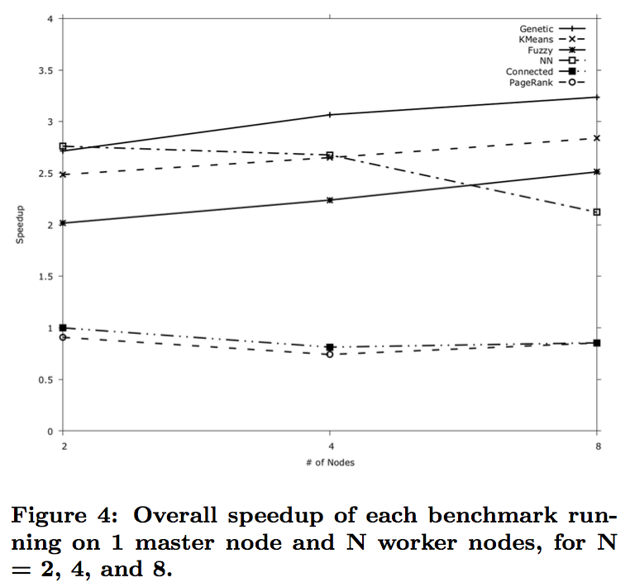
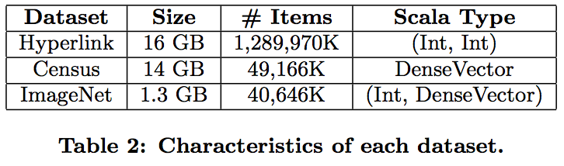
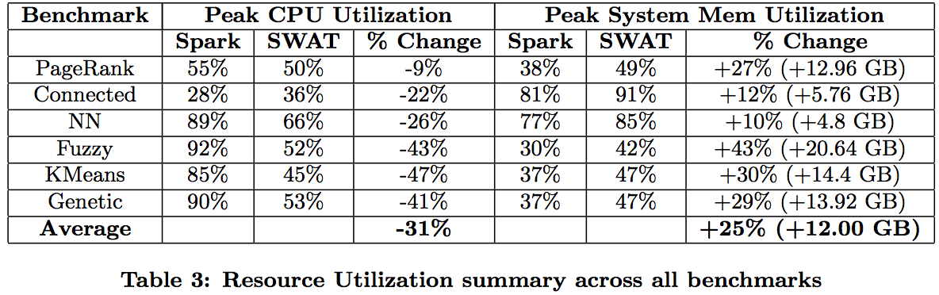
Spark SWAT : Evaluation
Each node: 12-core 2.80GHz Intel X5660 CPU with 48GB of system RAM and two NVIDIA M2050 GPUs each with 2.5GB of device memory
For appropriate apps, 2-4x speedup relative to Spark

Slide 15
Outline
Completed Work: SWAT v0.1
Summary
Example App
Evaluation
Ongoing Work: Port and Optimization of CS-BWAMEM on SWAT
Plus necessary extensions to SWAT

Slide 16
CS-BWAMEM + SWAT
Application of SWAT to a real-world, large-scale application.
Challenge: deeply nested computational kernel
Solution: introduce a new SWAT API for task-internal parallelism
CS-BWAMEM
+
SWAT?
at cs.ucla.edu.bwaspark.worker1.MemChainToAlignBatched$.memChainToAlnBatched(MemChainToAlignBatched.scala:633)
at cs.ucla.edu.bwaspark.worker1.BWAMemWorker1Batched$.bwaMemWorker1Batched(BWAMemWorker1Batched.scala:122)
at cs.ucla.edu.bwaspark.worker1.BWAMemWorker1Batched$.pairEndBwaMemWorker1Batched(BWAMemWorker1Batched.scala:163)
at cs.ucla.edu.bwaspark.FastMap$.cs$ucla$edu$bwaspark$FastMap$$it2ArrayIt_W1$1(FastMap.scala:290)
at cs.ucla.edu.bwaspark.FastMap$$anonfun$memPairEndMapping$2.apply(FastMap.scala:298)
at cs.ucla.edu.bwaspark.FastMap$$anonfun$memPairEndMapping$2.apply(FastMap.scala:298)
at org.apache.spark.rdd.cl.CLAccelMapPartitionsRDD.compute(CLAccelMapPartitionsRDD.scala:47)
at org.apache.spark.rdd.RDD.computeOrReadCheckpoint(RDD.scala:297)
at org.apache.spark.rdd.RDD.iterator(RDD.scala:264)
at org.apache.spark.rdd.MapPartitionsRDD.compute(MapPartitionsRDD.scala:38)
at org.apache.spark.rdd.RDD.computeOrReadCheckpoint(RDD.scala:297)
at org.apache.spark.CacheManager.getOrCompute(CacheManager.scala:69)
at org.apache.spark.rdd.RDD.iterator(RDD.scala:262)
at org.apache.spark.rdd.MapPartitionsRDD.compute(MapPartitionsRDD.scala:38)
at org.apache.spark.rdd.RDD.computeOrReadCheckpoint(RDD.scala:297)
at org.apache.spark.rdd.RDD.iterator(RDD.scala:264)
at org.apache.spark.scheduler.ResultTask.runTask(ResultTask.scala:66)
at org.apache.spark.scheduler.Task.run(Task.scala:88)
at org.apache.spark.executor.Executor$TaskRunner.run(Executor.scala:214)
at java.util.concurrent.ThreadPoolExecutor.runWorker(ThreadPoolExecutor.java:1145)
at java.util.concurrent.ThreadPoolExecutor$Worker.run(ThreadPoolExecutor.java:615)
at java.lang.Thread.run(Thread.java:745)

Slide 17
CS-BWAMEM + SWAT
rdd.mapPartitions((iter : Iterator[...], cl : SWATAccel) => {
var fpgaExtResults : Array[ExtRet] = cl.map(
(i) => extension(...),
taskIdx,
taskIdx > 2500)
})
New SWAT API for task internal parallelism
Internal parallel kernel
Number of parallel tasks
Run on accelerator or fallback to JVM?

Slide 18
CS-BWAMEM + SWAT
With this new API, have CS-BWAMEM running on GPUs through automatic code generation.
Performance results are in-progress, initial runs show no improvement but no detailed performance analysis has been performed yet.
CS-BWAMEM
+
SWAT?

