Slide 1
Vehicle Traffic and Congestion at KPA Gates
Prepared by: Policy and Research Section, Kenya Ports Authority

Slide 2
Table of Contents
1. Introduction
2. Methodology
3. Findings
4.Recommendations
5. Annexes

Slide 3
EXECUTIVE SUMMARY
The Port of Mombasa remains a critical trade gateway for East Africa but faces persistent gate congestion, especially at Gates 18 and 24, due to rising truck volumes. This leads to increased logistics costs, delays, and inefficiencies. The study—based on traffic counts, surveys, and Kerner’s traffic theory—found peak congestion occurs in the afternoon and evening, with over 33% of truck drivers waiting more than five hours. Causes include poor infrastructure, manual processes,

Slide 4
To address this, the report recommends implementing a Truck Appointment System (TAS), developing an off-port marshalling yard, digitizing gate infrastructure, strengthening staff deployment, and promoting the use of rail for long-haul cargo. These interventions aim to enhance port efficiency, reduce delays, and modernize logistics operations at KPA

Slide 5
BACKGROUND
The Port of Mombasa plays a key role in driving regional economic growth by handling high cargo volumes for Kenya and East Africa. However, persistent vehicle congestion at KPA gates—especially involving trucks—has led to serious operational challenges. These include increased transport costs, environmental impact, reduced port efficiency, and socio-economic losses for stakeholders like truck drivers, port users, and surrounding communities. Although automation and infrastructure improvements (e.g., ISS) have been introduced, they have not adequately addressed gate-specific traffic issues due to a lack of targeted data and analysis.

Slide 6
To address this gap, the Manager of Corporate Planning and Strategy commissioned a detailed study on vehicle traffic at KPA access gates. The study aims to generate evidence-based insights into traffic congestion patterns, identify root causes, and evaluate the effects on key performance indicators such as turnaround time and customer satisfaction. Ultimately, the goal is to inform actionable solutions that will improve port efficiency by 41%, raise customer satisfaction to 75%, reduce delays, and solidify Mombasa’s position as a competitive logistics hub in the East African region.

Slide 7
Need of the study
Improving Operational Efficiency: The study identifies traffic patterns and causes of congestion to help
KPA streamline gate operations and reduce delays at the Port of Mombasa.
Boosting Economic Competitiveness: Minimizing transport costs and delays supports trade growth,
benefiting truck operators port users, and regional economies and traffic
management systems.
Contributing to Knowledge and Best Practices: The study fills a critical research gap, offering insights
for policymakers, port authorities, and logistics professionals
regionally and beyond.

Slide 8
Objective of the study
Understand Traffic Patterns: Measure daily vehicle volumes and peak-hour trends to identify congestion hotspots at KPA gates.
Identify Root Causes of Congestion: Analyze contributing factors like infrastructure gaps, poor gate management, and rising cargo volumes.
Evaluate Operational Efficiency: Assess how traffic impacts clearance times, truck turnaround, and gate processing capacity—including the role of automation.
Recommend Improvement Strategies: Provide data-driven policy and operational recommendations to streamline traffic flow and boost port performance.

Slide 9
TURNAROUND TIMES
Sharp Growth in Cargo & Truck Volume: Container throughput rose by 14% in 2024, hitting 2.005 million TEUs, with over 70% of the cargo moved by road, significantly increasing truck volumes at port gates.
Infrastructure Overload and Gate Congestion: Gates 18 and 24, among the busiest, face heavy congestion, causing long truck queues and operational delays during peak hours.
Turnaround Time at Mombasa Port (Jan–May 2025): Monthly truck turnaround times consistently exceeded the target, indicating inefficiencies in processing and clearance.
Turnaround Time at ICD Nairobi: Similar delays were observed, suggesting systemic traffic flow and coordination challenges beyond the port itself.

Slide 10
SCOPE OF THE WORK
Geographical Scope: The focus of the study was on KPA-controlled access points and gates, primarily KPA Mombasa and ICD Nairobi, including key entry/exit routes.
Time Frame: We analyzed traffic data for I year, such as the past 1-3 years for historical trends, with current data collection spanning weeks or months (e.g., peak vs. off-peak seasons) to capture seasonal variations and understand congestion trends.
Traffic Types: the research covered cargo trucks and other service vehicles that incudes Transit Trucks, Local /CFS Trucks, Export Trucks, Loose Cargo Trucks, empty Container Trucks, fuel tankers.
Membership: The committee co-opted staff members from security gates and operations to enhance the quality of the research and data verification.

Slide 11
LIMITATIONS
Lack of response from some stakeholder whenever indicated the reason for non-participation.
Data collection may miss rare events (e.g., accidents) or be affected by weather.
Stakeholder bias e.g., exaggerated delays or causes) that could skew qualitative data.

Slide 12
METHODS OF DATA COLLECTION.
Traffic Counts & Gate Data: Manual counts and KPA system records captured vehicle types, volumes, wait times
and turnaround times at key gates during peak/off-peak hours.
Interviews & Surveys: Semi-structured interviews and questionnaires gathered stakeholder views on congestion causes, delays, costs, and clearance challenges.
Field Observations: Teams assessed queue lengths, road conditions, and safety risks by directly observing gate operations and traffic behavior.
Secondary Data Review: Analyzed historical KPA records and traffic trends across various truck categories to supplement field data.
Target Population: Included truck drivers, KPA staff, security personnel, logistics firms, importers/exporters, and government agencies.

Slide 13
DATA ANALYSIS
Quantitative: traffic volume was calculated (vehicles/hour), average wait times, and congestion metrics using SPSS, excel and python. Peak congestion periods were identified and correlated against gate processing delays.
Qualitative: Coding interview/survey responses using thematic analysis to identify recurring issues.
Triangulation: Cross-verification of findings from traffic data, interviews, and observations was done to ensure reliability.

Slide 14
KPA ACCESS POINTS
Gate Clusters by Function: Gates 9A–10F handle export, import, loose cargo, new vehicles, and small cars;
some like 10A are bidirectional.
Specialized Access Points: Gate 12 cluster serves small vehicle traffic and labor compound exits; Gate 15 connects to oil terminals and the Makua Transit Shed.
High-Traffic & Critical Gates: Gate 18A–18F is the busiest, managing both import/export flows, loose cargo, and vehicle entries via Changamwe roundabout.
Rail & Strategic Terminals: Gate 19 (Train Gate) supports rail logistics; Gate 26 links directly to the Standard Gauge Railway (SGR) terminal.
Additional Key Operations: Gates 20–25 support container traffic (local/CFS), exports, wide loads, and access to key agencies like the Kenya Pipeline company

Slide 15
STUDY FINDINGS.
Nationality: The majority of respondents were Kenyan—88.4% of truck drivers, 96.8% of clearing agents, and 100% of customs officials, KPA staff, and traffic police. Regional representation among truck drivers highlights the port's importance to neighboring countries, especially Uganda (6.2%).
Gender Distribution: Males dominate across all categories, especially truck drivers (98%) and clearing agents (96%). Female representation is relatively higher among KPA staff (36.4%) and customs officials (30%), aligning with gender equality efforts.
Experience – Truck Drivers & KPA Staff: Nearly half of the truck drivers (45.9%) and 50% of KPA staff have over 10 years of experience, indicating a stable and experienced workforce in logistics and administration.
Experience – Customs & Clearing Agents: Customs officials show varied tenure, with 30.6% having over 10 years. Clearing agents are mixed, with both new entrants (30% under one year) and experienced personnel (40% over 10 years).
Traffic Police: All traffic police respondents had less than five years of experience, suggesting frequent rotations or recent deployment to KPA duti

Slide 16
TRUCK TURNAROUND TIME
Sharp Growth in Cargo & Truck Volume: Container throughput rose by 14% in 2024, hitting 2.005 million TEUs, with over 70% of the cargo moved by road, significantly increasing truck volumes at port gates.
Infrastructure Overload and Gate Congestion: Gates 18 and 24, among the busiest, face heavy congestion, causing long truck queues and operational delays during peak hours.
Turnaround Time at Mombasa Port (Jan–May 2025): Monthly truck turnaround times consistently exceeded the target, indicating inefficiencies in processing and clearance.
Turnaround Time at ICD Nairobi: Similar delays were observed, suggesting systemic traffic flow and coordination challenges beyond the port itself.

Slide 17
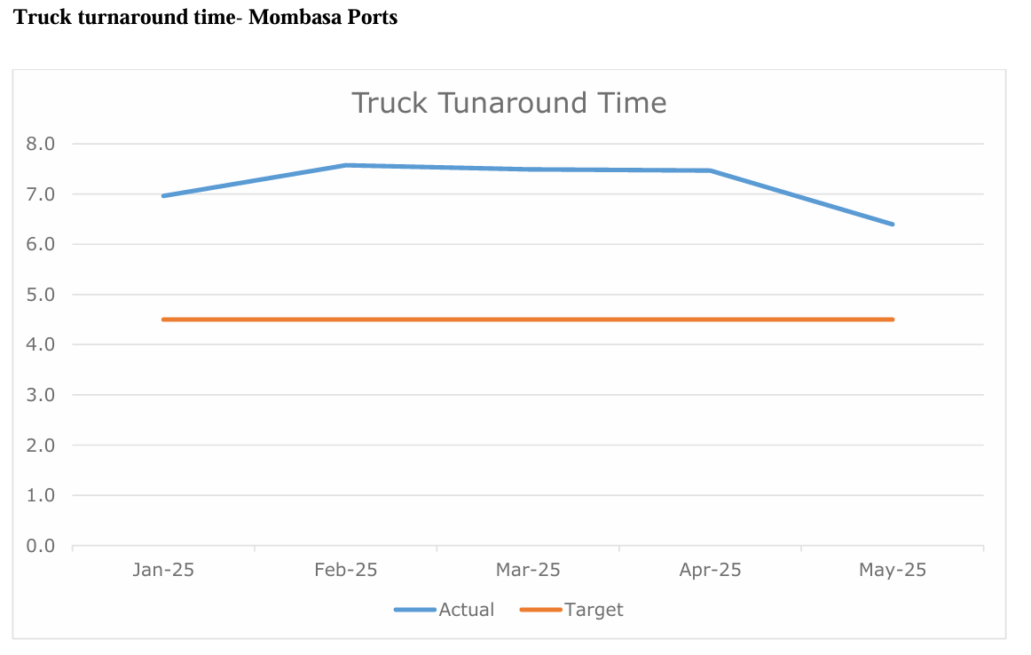

Slide 18
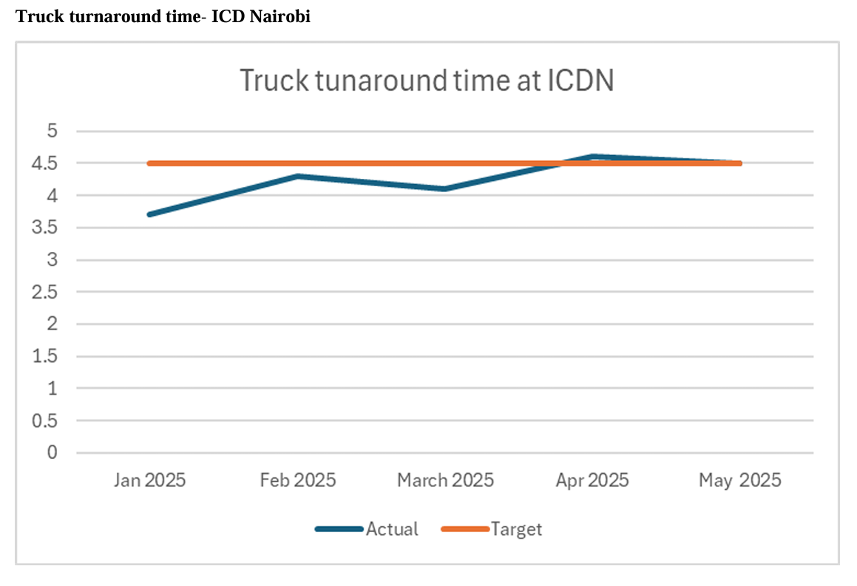

Slide 19
TRAFFIC VOLUME AND PATTERNS
High Truck Volumes Recorded (Jan–June 2025): Truck entries and exits show rising monthly volumes, with May registering the highest at over 33,000 vehicle movements across various categories (e.g., local/CFS, transit, loose cargo, empty, exports).
May 2025 Breakdown – Mombasa Port: Local/CFS trucks made up the largest share (36%), followed by transit trucks (30%), confirming the port’s strong regional logistics role.
Peak Movement During 2nd Shift: Most truck traffic occurred between midday and evening (2nd shift), with the 1st and 3rd shifts showing slightly lower activity.
Weekday Peaks and Weekend Lulls: Thursday and Friday saw the highest truck traffic, while Sunday recorded the lowest, reflecting operational rhythms and delivery timelines.
ICD Nairobi Activity & Daily Time Patterns: ICDN handled over 10,948 import containers in May. Daily traffic peaks were noted between 2–6 PM, with additional congestion in the early mornings, affecting both truck and staff vehicle flow.

Slide 20
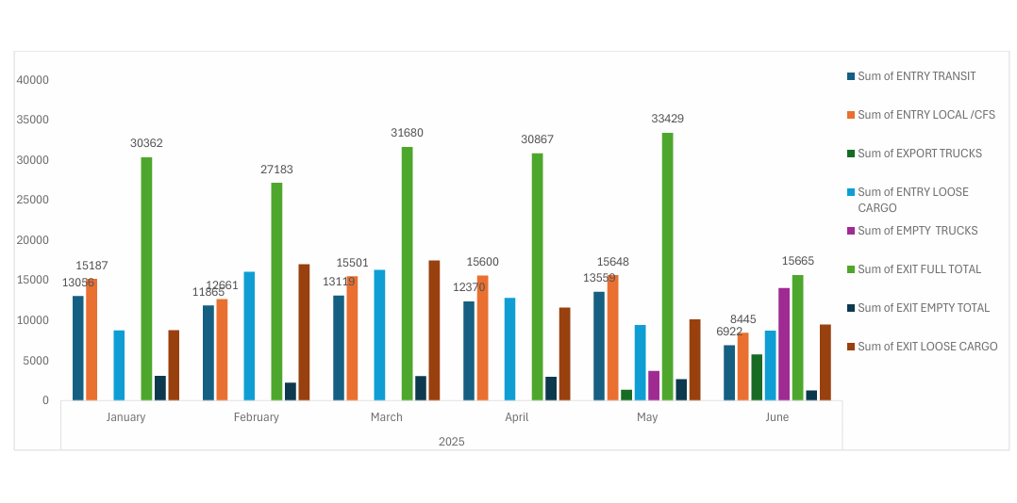
Truck traffic date for JAN-JUNE 2025

Slide 21
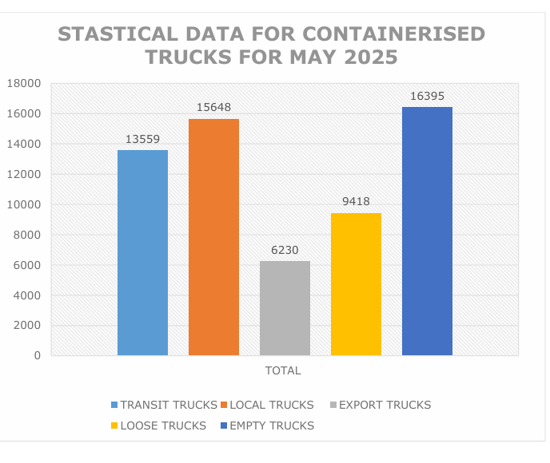
Monthly truck traffic for Mombasa port in the May 2025.

Slide 22
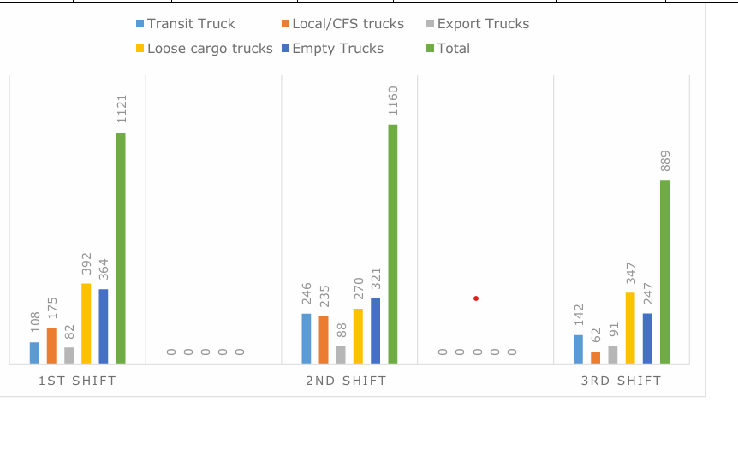
Distribution of Trucks movements across the 3 shifts in Mombasa Port.

Slide 23
MOST FREQUENTLY USED GATES AT KPA
Gate 24 is the Most Used: Nearly half of truck drivers (48.1%) use Gate 24, making it the busiest access point, followed by Gate 18 at 31.2%.
Main Gate 9/10 Shows Moderate Use: About 9.4% of truck drivers use Gate 9/10, with lower activity reported at Gates 12, 15, and 16.
Clearing Agents Favor Gates 18 and 24: 40% of clearing agents prefer Gate 24, and 34.1% use Gate 18, confirming their central role in port logistics.
Customs and Police Concentrated at ICD Gates: All customs officials (100%) and traffic police (100%) operate from ICD gates, indicating these are specialized enforcement zones.
KPA Staff Spread Across Locations: KPA staff are mostly based at ICD gates (32.4%) and Main Gate 9/10 (16.2%), with little activity at smaller gates.

Slide 24
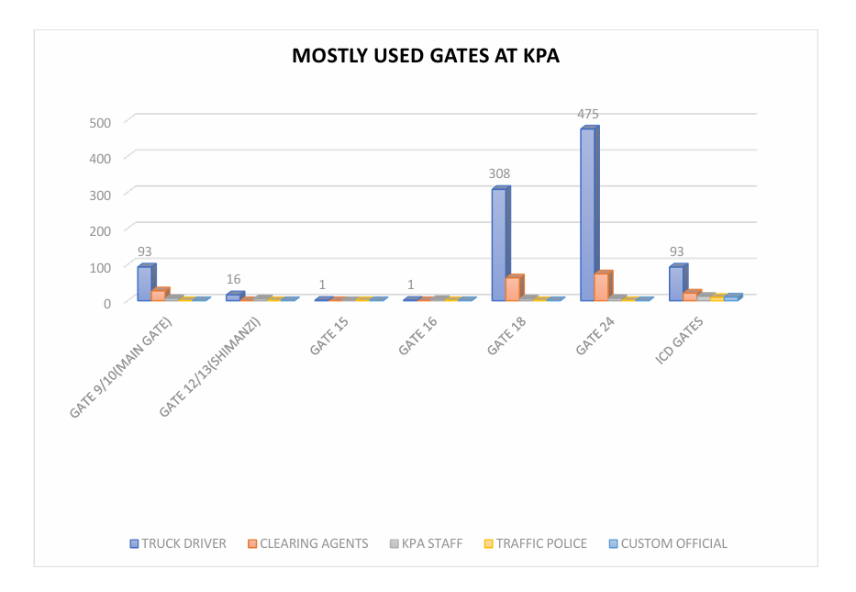

Slide 25
Frequency of Gate Visits by Respondents
Truck Drivers Visit Gates Most Frequently: 39.9% of truck drivers reported visiting KPA gates daily, showing their continuous operational role.
Clearing Agents Visit Several Times Weekly: 64.5% of agents reported visiting 2–4 times a week, indicating a consistent but slightly less intense presence.
Customs Officials Have Limited Visits: Most customs officers visit gates weekly or a few times a month, with only 40% reporting daily presence.
Traffic Police Presence Is Highly Focused: 100% of traffic police respondents reported daily visits, reflecting concentrated enforcement roles.
KPA Staff Visit Periodically: While 63.6% visit several times weekly, only 36.4% reported daily activity, showing less frequent gate engagement compared to truckers.

Slide 26
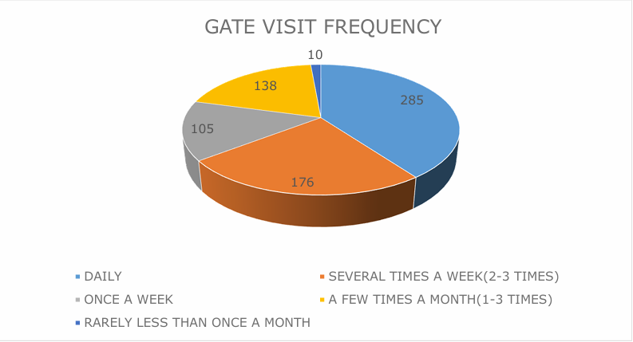

Slide 27
TRAFFIC CONGESTION EXPERIENCE
High Congestion Frequency Among Truck Drivers: 34% of truck drivers reported that they always experience traffic at KPA gates, indicating a significant and ongoing challenge in port access.
Clearing Agents Face Even Greater Delays: 59% of clearing agents stated they always encounter congestion, showing that clearance operations are heavily impacted by traffic flow.
Evidence of Persistent Congestion: The data clearly reveals that traffic congestion is a regular and systemic issue at KPA gates, affecting both logistical operations and efficiency.

Slide 28
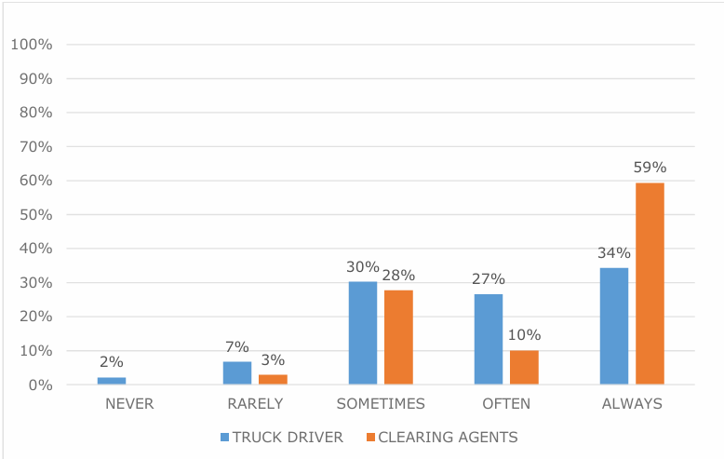

Slide 29
WAITING TIME AT KPA GATES
Majority of Truck Drivers Face Long Delays: Over 57% of truck drivers wait more than 2 hours per visit—25.9% wait 2–5 hours, and 31.5% wait over 5 hours.
Clearing Agents Also Affected: Although their delays are slightly shorter, 74 clearing agents (58.9%) report waiting over 1 hour per visit.
Short Waits Are Rare: Only 12.2% of truck drivers and 21.8% of clearing agents experience wait times under 30 minutes, indicating limited operational efficiency.
Delays Disrupt Operations: Extended waiting times contribute directly to congestion, delaying cargo movement and increasing logistical costs.

Slide 30
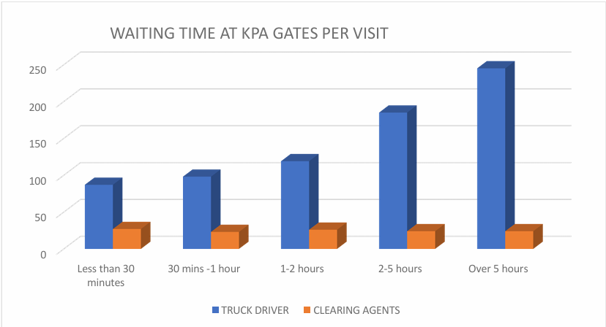

Slide 31
PEAK CONGESTION TIMES AT KPA GATES
Afternoon and Evening Are Most Congested: Majority of stakeholders, especially truck drivers (67.2% in afternoon, 51.5% in evening), reported the worst congestion between 2 PM–6 PM and 6 PM–6 AM.
Clearing Agents and Customs Officials Mirror Pattern: Clearing agents noted peaks in the afternoon (40.2%) and evening (41.4%), while 50% of customs officials cited the afternoon as the most congested period.
Minimal Congestion in Morning and Midday: Morning (6–10 AM) and midday (10 AM–2 PM) were reported as less congested, indicating better flow during these hours.
Operational Implications: The consistent congestion pattern across roles suggests a need for targeted strategies like extended staffing, traffic control, and staggered truck scheduling during peak hours.

Slide 32
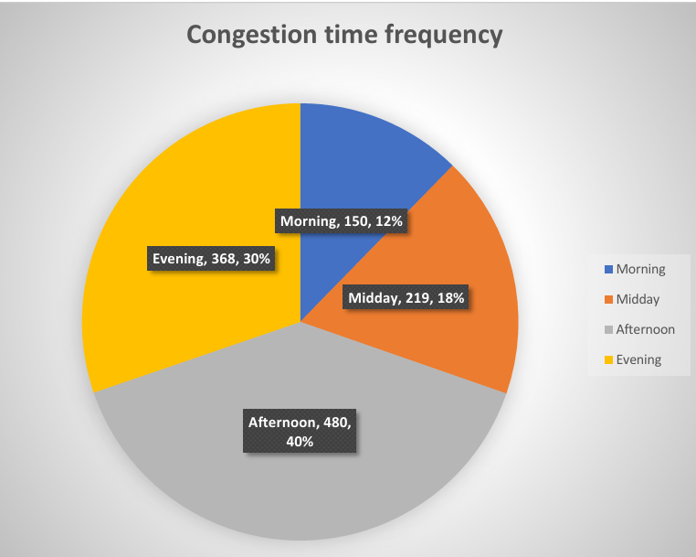

Slide 33
MAIN CAUSES OF TRAFFIC CONGESTION BY THE RESPONDENTS
Gate Processing and Security Delays Dominate: Truck drivers cited slow gate processing (440) and slow security checks (377) as the leading causes of congestion, indicating inefficiencies in clearance procedures.
Documentation Challenges Are Significant: High responses from drivers and agents on clearance documentation delays (302) and KRA tracker issues (316) reflect administrative bottlenecks as major contributors.
Infrastructure Limitations: Issues such as too many trucks arriving at once (214), limited gate lanes, poor road conditions, and insufficient port space were identified as aggravating physical constraints.
Lack of Truck Scheduling and Staffing: The absence of a Truck Appointment System (TAS) and insufficient staffing, especially during peak hours, contributes to disorganized truck arrivals and extended wait times.

Slide 34
EFFECTS OF TRAFFIC CONGESTION AT KPA GATES
Extended Working Hours: Truck drivers (26.7%) and clearing agents (19.4%) reported longer work hours due to congestion, reducing overall efficiency and increasing fatigue.
Increased Costs: Congestion led to higher storage fees (18.3% for drivers; 11.5% for agents), fuel costs (14.5% for drivers; 9% for agents), and demurrage charges (8.1% for agents; 23.4% for KPA staff).
Missed Delivery Schedules: 12% of truck drivers and 13.2% of clearing agents cited consistent delays in delivery timelines, affecting service reliability and cargo flow.
Operational Disruptions: Customs officials and KPA staff experienced delays in stacking export cargo (up to 31%) and general workflow disruptions due to inefficiencies at gates.
Mental and Physical Strain: Clearing agents highlighted stress and fatigue (17.1%) .

Slide 35
GENERAL SOLUTIONS PROPOSED BY THE RESPONDENTS
Introduce Truck Scheduling Systems: Systematic pre-booking of trucks was a top recommendation (e.g., 37.5% by traffic police), aimed at reducing vehicle clustering and regulating gate access.
Expand and Upgrade Infrastructure: Proposals included increasing gate lanes, improving surrounding roads, and adding smart gate technology to improve traffic flow and entry/exit efficiency.
Automate Clearance and Inspection Processes: Stakeholders advocated for fully automated documentation systems and advanced inspection technology (e.g., scanners) to reduce delays and human errors.
Enhance Coordination and Staffing: Improved collaboration between KPA, KRA, and agents, coupled with hiring more staff, better supervision, and structured shift systems, were emphasized to streamline operations.
Implement Strict Traffic and Anti-Corruption Measures: Enforcing traffic discipline, minimizing illegal parking, and combating corruption through audits and transparency were seen as key to improving gate efficiency.

Slide 36
RECOMMENDATIONS TO REDUCE GATE CONGESTIONS
Implement a Truck Appointment System (TAS): Digitally schedule truck arrivals in time slots to reduce bulk arrivals, ease congestion, and improve gate utilization.
Establish an Off-Port Marshalling Yard: Create a dedicated truck holding area away from the port to prevent early gate arrivals and staging-related congestion.
Digitize and Expand Gate Infrastructure: Upgrade gate lanes and introduce smart systems (e.g., RFID, electronic passes, ANPR) to accelerate processing and reduce manual checks.
Develop a Coordinated Traffic Management Policy: Formalize multi-agency coordination (KPA, KRA, Police, MoT) on enforcement, signage, scheduling, and include incentives for off-peak operations.
Promote Modal Shift to Rail for Long-Haul Cargo: Encourage use of the Standard Gauge Railway (SGR) to divert cargo from road transport, easing gate congestion and improving logistics efficiency.

Slide 37
CONCLUSION
The study found that traffic congestion at KPA gates is caused by slow gate processing, documentation delays, and limited infrastructure, worsened by a 14% cargo increase in 2024. This has led to long truck turnaround times and higher operational costs. To address this, the study recommends introducing a Truck Appointment System (TAS), automating clearance, expanding gate lanes, and improving staffing and road infrastructure to enhance efficiency and reduce delays

