Slide 1

MEDIA & PUBLIC OPINION

Slide 2

Our Team
Omar Walid 231000554
Karim Bassem 231000797
Omar Salama 231000674
Ahmed Fahmy 231000587
.Nadeem Diaa 231000857
Ahmed Shalaby 231000514

Slide 3

The preprocessing steps
Data Collection: Articles were fetched from The Guardian and The New York Times APIs for specific topics and monthly ranges (Jan 2024 - June 2025).
Structuring: Extracted article details were organized into pandas DataFrames.
Cleaning: Duplicate articles were removed, and rows with missing headlines were dropped.
Merging: DataFrames from both sources were combined.
Saving: The final dataset was saved to final_10_dataset.csv.

Slide 4

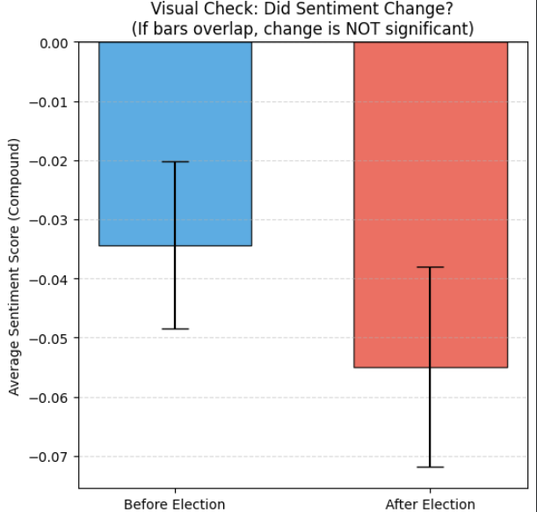
Does the sentiment of political headlines change significantly before and after election dates?
The confidence intervals for the 'Before Election' and 'After Election' sentiment scores overlap. Therefore, the change in sentiment is NOT statistically significant.

Slide 5
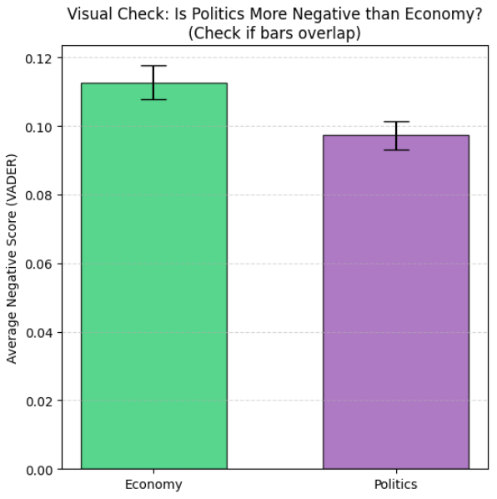
Are news outlets more likely to use negative sentiment words in political coverage compared to economic news?
Economy news headlines are actually MORE negative than political news headlines, on average, within this dataset.

Slide 6
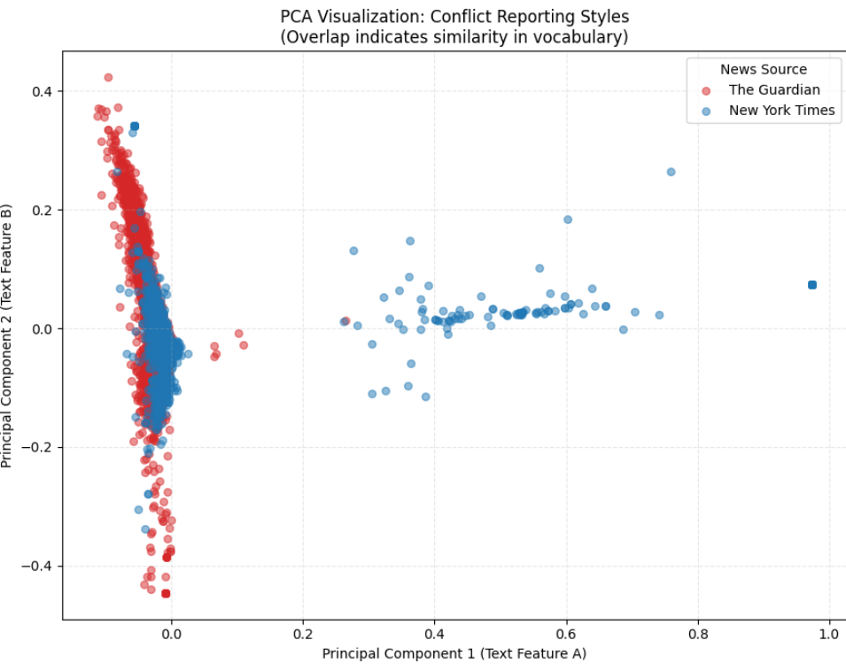
Is there a clustering pattern in how different news sources report global conflicts?
This significant overlap indicates that there is NO distinct clustering pattern based on the news source. Both 'The Guardian' and 'New York Times' use highly similar vocabulary and framing when reporting on global conflicts, suggesting a common approach or thematic focus in their coverage.

Slide 7


Data Sources
The Guardian API
The New York Times API

Slide 8
Main analysis & Conclusions
We focus on collecting and preparing the data from The Guardian and The New York Times APIs. So far, we've successfully gathered articles on politics, economy, and conflict topics from January 2024 to June 2025, merged them, and performed initial cleaning (deduplication and handling missing headlines).
Main analysis and conclusions have not yet been performed or drawn. This dataset (final_10_dataset.csv) is now ready for further analysis, such as:
Topic modeling to identify prevalent themes.
Sentiment analysis to understand the general tone of articles.
Trend analysis over time for different topics and sources.
Comparative analysis between The Guardian and The New York Times coverage.

Slide 9
THANK YOU

