Slide 1

Final Project
Virtual Internship
15-May-2021

Slide 2
Background – Bank marketing campaign case study
Problem Statement: ABC Bank wants to sell it's term deposit product to customers and before launching the product they want to develop a model which help them in understanding whether a particular customer will buy their product or not (based on customer's past interaction with bank or other Financial Institution).
Why ML Model: Bank wants to use ML model to shortlist customer whose chances of buying the product is more so that their marketing channel (telemarketing, SMS/email marketing etc) can focus only to those customers whose chances of buying the product is more. This will save resource and their time ( which is directly involved in the cost ( resource billing)).
Data Set Information : The data is related with direct marketing campaigns of a Portuguese banking institution. The marketing campaigns were based on phone calls. Often, more than one contact to the same client was required, in order to access if the product (bank term deposit) would be ('yes') or not ('no') subscribed. The classification goal is to predict if the client will subscribe (yes/no) a term deposit (variable y).
Objective: Obtain a model that determines whether or not X customer will buy your product, based on past interactions with the bank and other financial institutions.

Slide 3
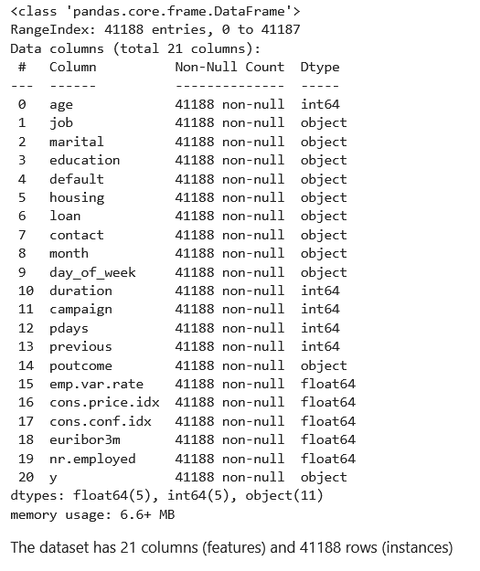
Data Exploration
Dataset shape:
21 Features
41188 instances
Assumptions:
Outliers are present in age, duration, campaign, pdays.
“Unknown” values are treated as NaN values

Slide 4
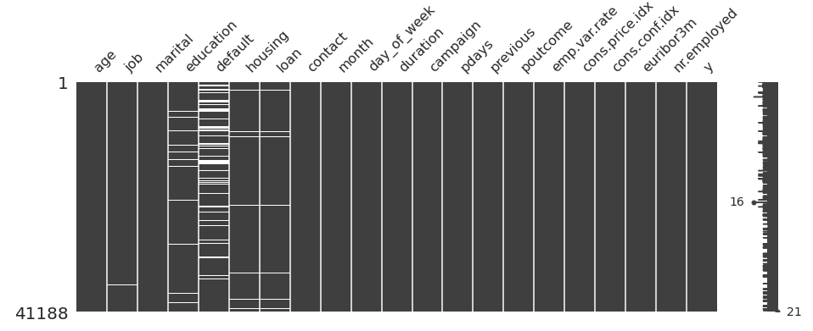
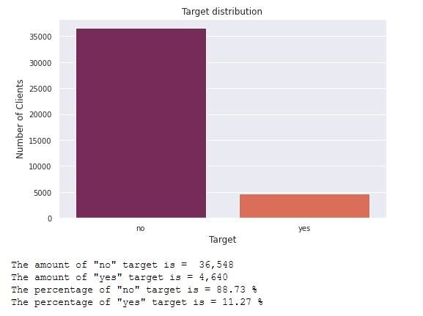
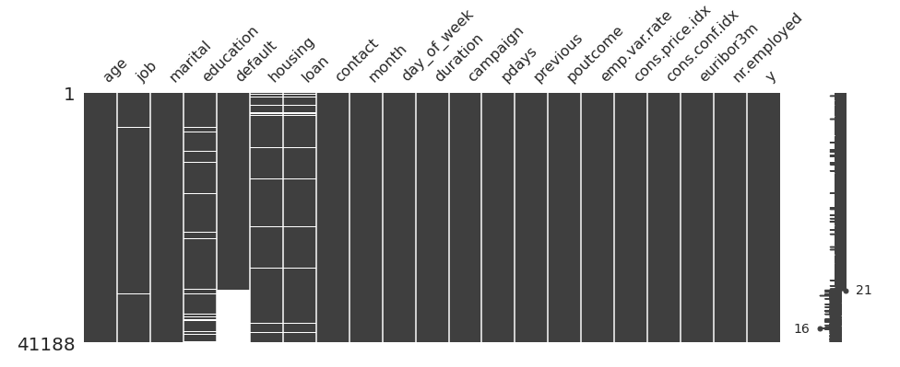
Profit Analysis
Brief EDA

Slide 5
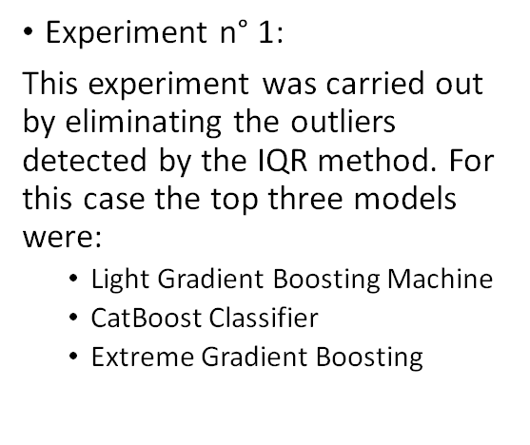

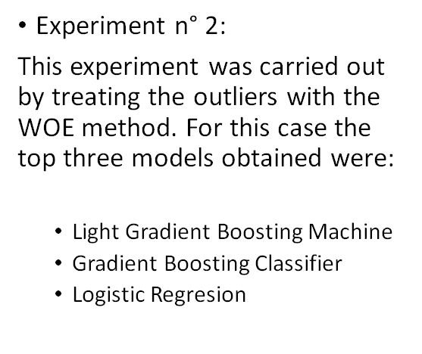
Recommended models

Slide 6
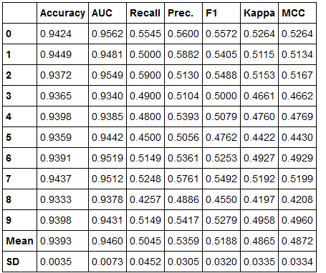
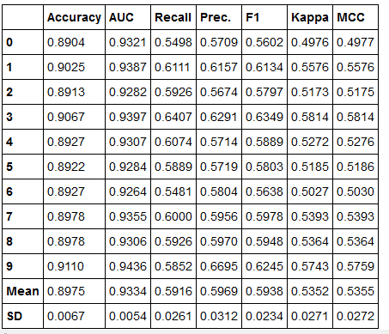
Best Models Metrics
VotingClassifier (Blending) for experiment n°1
LightGBM for expermient n°2

Slide 7
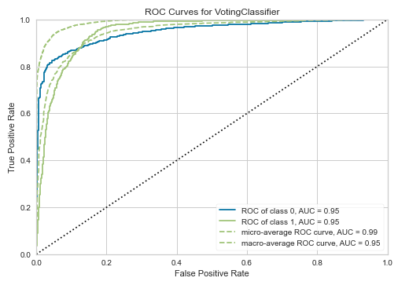
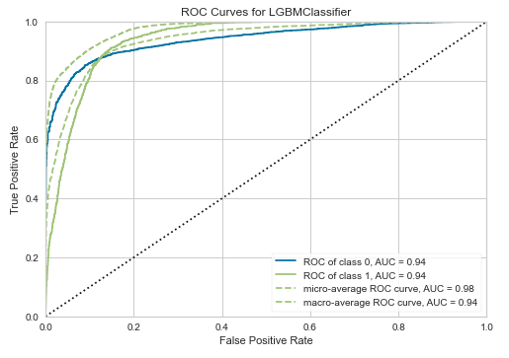
Best Models Evaluation
Experiment n°1
Experiment n°2

Slide 8
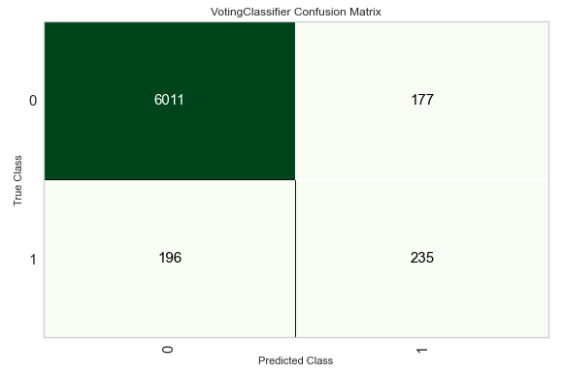

Best Models Evaluation
no: 0
yes: 1

Slide 9
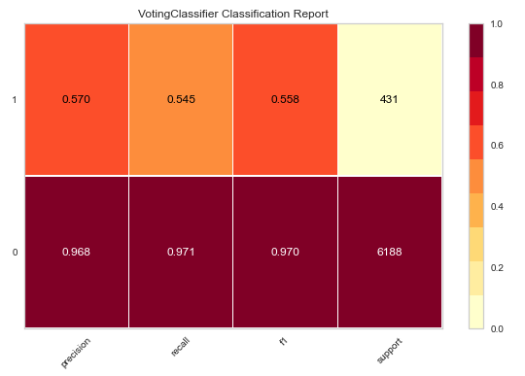
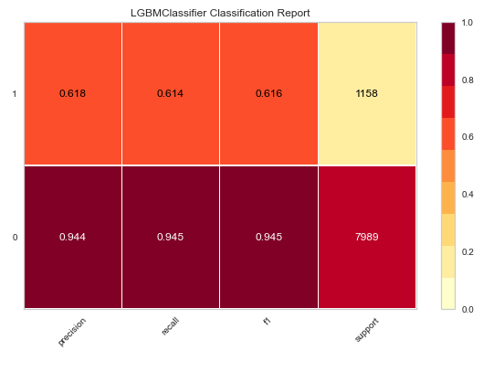
Best Models Evaluation

Slide 10
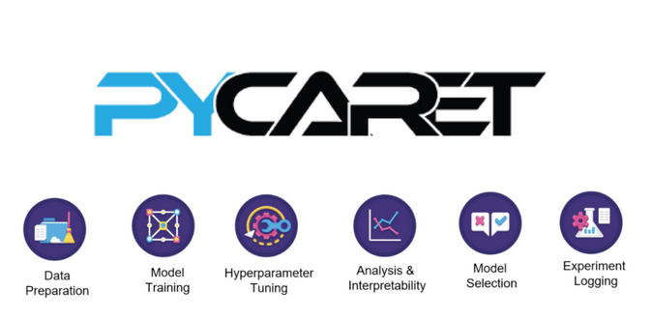
Best Model
Blending: VotingClassifier
The best model is found treating outliers with IQR method and deleting all NaNs values from the dataset.
The best model is found blending four models: lightGBM Classifier, CatBoost Classifier, XGBoost Classifier, Random Forest Classifier. The resulting Voting Classifier is better than individual models.

Slide 11
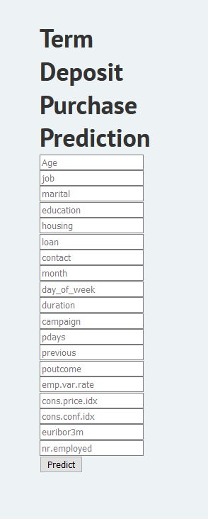

Model Deployment
https://bankmkt.herokuapp.com/

Slide 12
Conclusions
Different machine learning experiments were developed to find the best model to predict whether a given bank customer will buy a fixed term deposit.
Blending of LightGBM, CatBoost, Random Forest and XGBoost yield the best model for predicting fixed term deposit.
The Voting Classifier obtained has good Accuracy and AUC values but poor Recall and Precision values.
Threshold optimization will be required for further improvement of the model performance.

Slide 13
Thank You

