Slide 1

Fast Food Industry : The Business Case
By
Omar J. Nasir, MBA

Slide 2
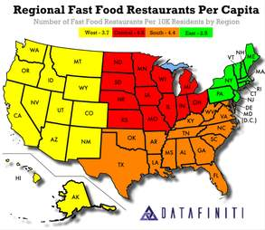
The Growth and Investment Opportunity
Number of Fast Food Restaurants=
196,000
Income=$200Billion +
Employes=4.5 Million
Growth: 2200 per month
Franchise Costs= $100,000- $ 1 Million
Franchise Owner Makes= $80.000+
Worker: $15/hr. so dissatisfaction is high
MBA Salaries = $100,000 +

Slide 3
Fast Food Restaurants in the USA

Slide 4
The Growth Rate of Fast Food Industry
The growth of the Fast Food industry is predicated on:
Affordability
Service Time-Drive Ins
Income Levels patronizing Fast Food Industry:
$50,000 to $199,000- Household Income
$12.50 per hour to $50 per hour
This is the American Middle Class
As more people join the middle class, the growth of the industry becomes certain. Therefore. we study GDP and Income Distribution through Machine Learning and Mathematical Models

Slide 5
Components of GDP
Key:
kEY1 | Personal Consumption |  |  | 70
2 | Business Investment |  |  | 18
3 | Government Spending |  |  | 17
 | Net Exports |  | -5%

Slide 6
Components of GDP
Components of Real GDP (2019)
Component | Amount (trillions) | Percent
Personal Consumption | $13.28 | 70%
Goods | $4.76 | 25%
Durable Goods | $1.77 | 9%
Non-durable Goods | $3.01 | 16%
Services | $8.56 | 45%
Business Investment | $3.42 | 18%
Fixed | $3.34 | 17%
Non-Residential | $2.74 | 14%
Commercial Real Estate | $0.54 | 3%
Capital Goods | $1.27 | 7%
Intellectual (Software) | $0.97 | 5%
Residential | $0.59 | 3%
Change in Inventories | $0.07 | 0%
Net Exports | ($0.95) | -5%
Exports | $2.53 | 13%
Imports | $3.49 | 18%
Government | $3.30 | 17%
Federal | $1.28 | 7%
Defense | $0.77 | 4%
State and Local | $2.02 | 10%
TOTAL GDP | $19.07 | 100%
(Source: Bureau of Economic Analysis. "Concepts and Methods of the U.S. National Income and Product Accounts: Table 1.1.6. Real GDP."

Slide 7
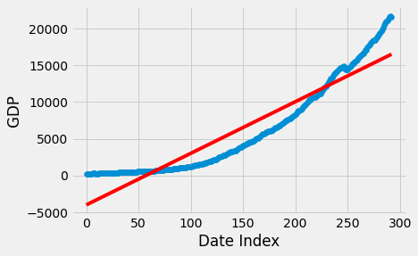
Predicting GDP Growth
Supervised Machine Learning
The Linear Regression Model is checked against existing data.
RED LINE: Regression Model
Blue Line: Actual Results

Slide 8
Machine Learning-Python Notebook

Slide 9
GDP GROWTH FROM 1947 to 2020

Slide 10
Mathematical Model
It is based on experiential knowledge and some theory. It is a practical model . It is a 5 year model updated every year. It is like a rolling forecast.

Slide 11
Mathematical Model Prediction

Slide 12
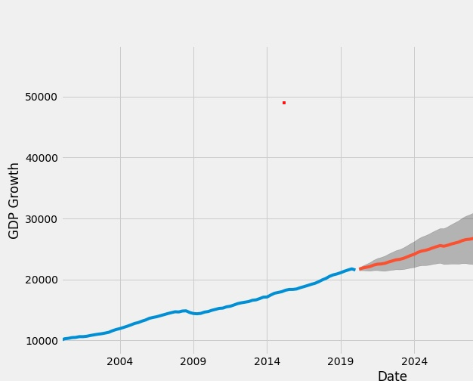
Machine Learning Model Prediction

Slide 13
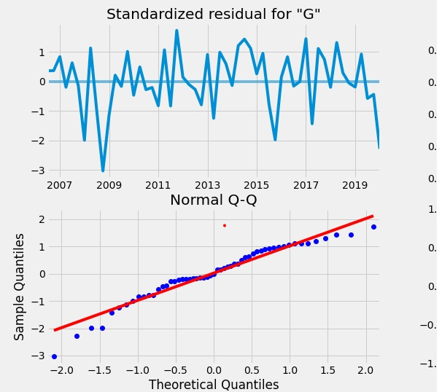
Standardized Residuals & Possibility Plot

Slide 14
Warning
CAVEAT:
Fast Food is high in sodium, saturated fat, trans fat, and cholesterol, it isn't something you should eat often. Eating too much over a long period of time can lead to issues such as high blood pressure, heart disease, and unwanted weight gain.
US Population Growth: 0.1%-the growth of the industry is dependent on population growth in the middle classes.

Slide 15
Fast Food Industry
Fast Food Industry is growing rapidly, you can invest in it directly and/or you can be franchise owner, if you invest $100,000 to $1 Million

