Slide 1

By: omar kamel AI Engineering undergraduate student

Slide 2
Agenda:
1: Explore Data and Cleaning
2:Answer the question
3:Overview

Slide 3
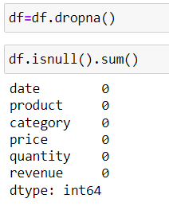
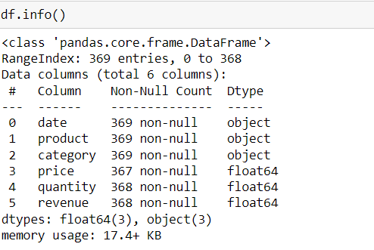
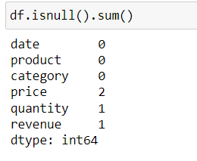
1:Explore Data and Cleaning

Slide 4
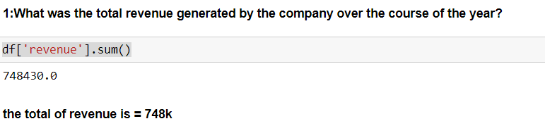
2:Answer the question

Slide 5
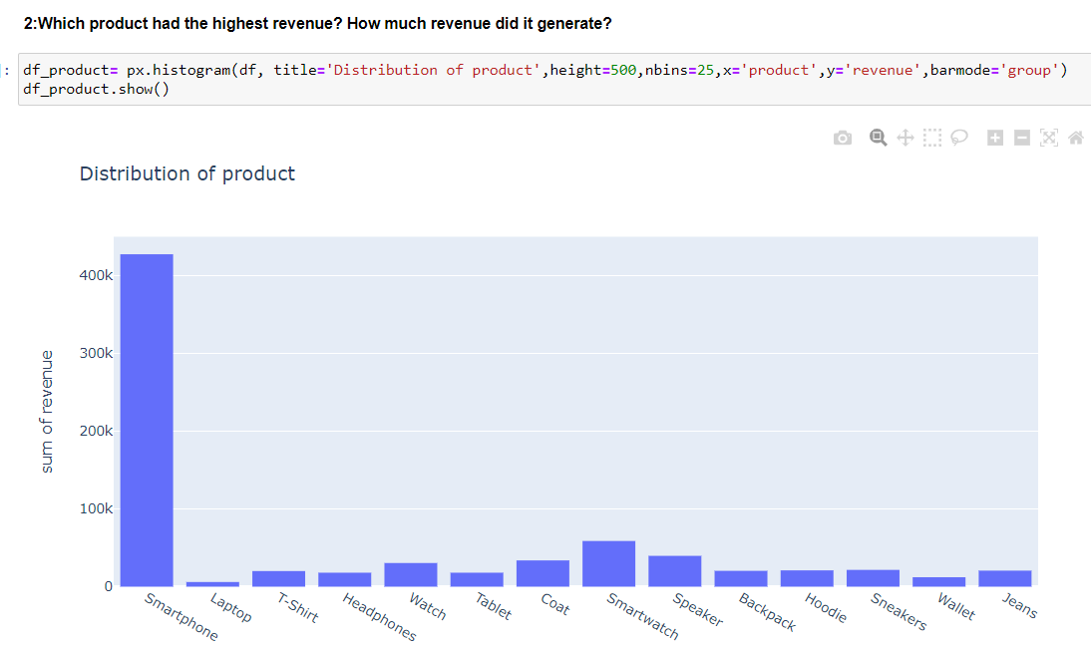

Slide 6
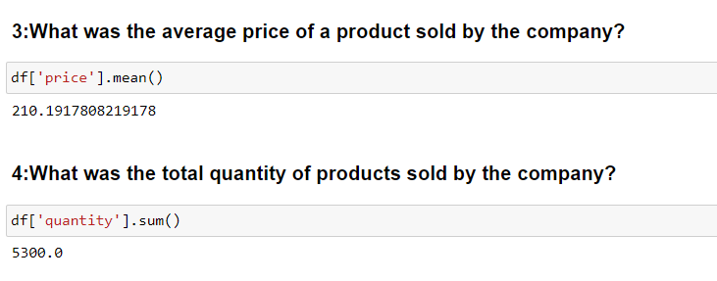

Slide 7
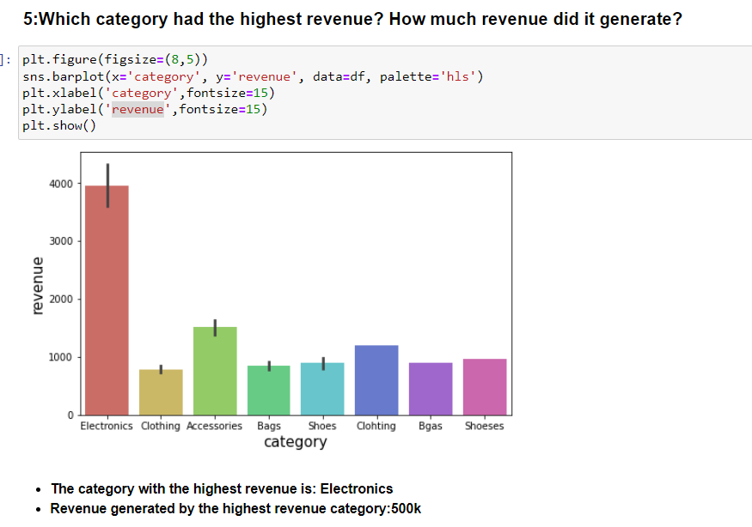

Slide 8
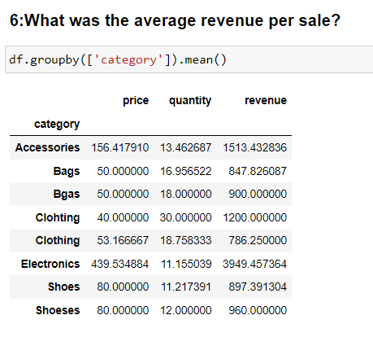

Slide 9
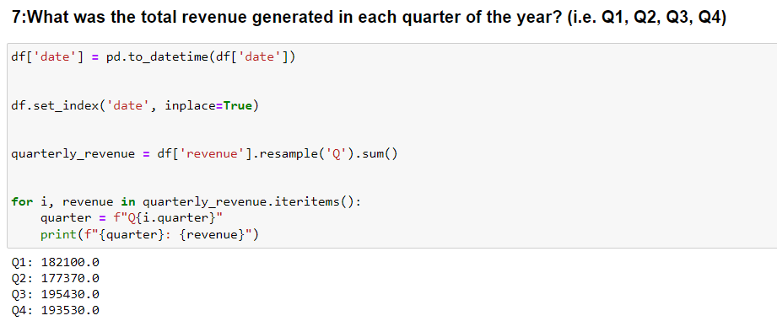

Slide 10

3: Overview
I see that we make some offers on laptops in order to increase the profit and others, but we focus on laptops because they are the least one.
Throughout the year, we achieved an increase in profits, but it occurred in the second quarter of the year, and we returned again in the third quarter, and we achieved a gain.

