Slide 1
DENSISCOPE
Densest Subgraph
Discovery at Scale
Approximation • Exact verification • Triangle density • Interactive visualization
Analysis & Algorithms Project
5 collaboration networks • 4 algorithms • up to 317,080 vertices

Slide 2
PROBLEM
Two notions of “dense”
Edge density finds many connections per vertex. Triangle density rewards tightly interlocked triples.
EDGE DENSITY
TRIANGLE DENSITY
ρ(S) = |E(S)| / |V(S)|
τ(S) = T(S) / |V(S)|
Goal: find the induced subgraph with the most edges per selected vertex.
Goal: find the subgraph with the most closed 3-way relationships per vertex.
DensiScope evaluates both objectives because they can return different communities on the same graph.

Slide 3
SYSTEM
What we built
A memory-aware pipeline that goes from raw graph files to verified results, scalability analysis and live visualization.
1
2
3
4
5
6
Load
Compress
Solve
Verify
Analyze
Visualize
Matrix Market / edge lists
CSR sparse graph
4 algorithms
Independent metrics
Runtime + quality + RAM
MP4 + dashboard
Memory strategy
One dataset at a time • compact NumPy arrays • indexed heap • exact-safe reductions • structural certificates
All final results are independently verified and persisted to CSV / NPY outputs.

Slide 4
ALGORITHMS
Four algorithms, four roles
The project deliberately combines fast approximations with exact baselines and a higher-order objective.
1
Charikar
2
Greedy++
3
Goldberg Exact
4
Triangle Exact
FAST APPROXIMATION
ITERATIVE REFINEMENT
EDGE-DENSITY GROUND TRUTH
HIGHER-ORDER EXACT
Peel the minimum-degree vertex and keep the best intermediate subgraph. Very fast and surprisingly accurate.
Repeat peeling with persistent vertex loads. Can repair Charikar misses, but repeated rounds are more expensive.
Binary search over density + max-flow/min-cut decision. Used to measure approximation quality.
Maximizes triangles per vertex using flow, triangle cores and exact certificates.
Greedy++ uses 10 rounds in the experiments. Goldberg is the exact reference for ordinary edge density.

Slide 5
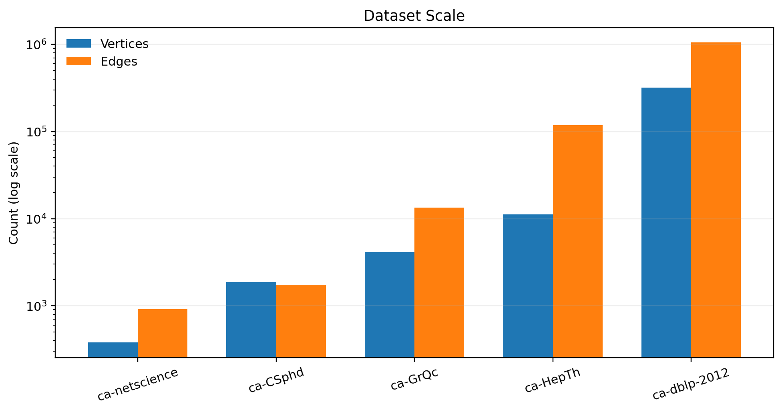
DATASETS
Five collaboration networks — 836× span in vertices
The benchmark grows from hundreds of nodes to a 317k-node DBLP graph, while all graphs stay sparse in CSR format.
379
smallest graph
ca-netscience
317,080
largest graph
ca-dblp-2012
1,049,866
largest edge count
ca-dblp-2012
Actual sizes are taken from the processed datasets used in the notebook.

Slide 6
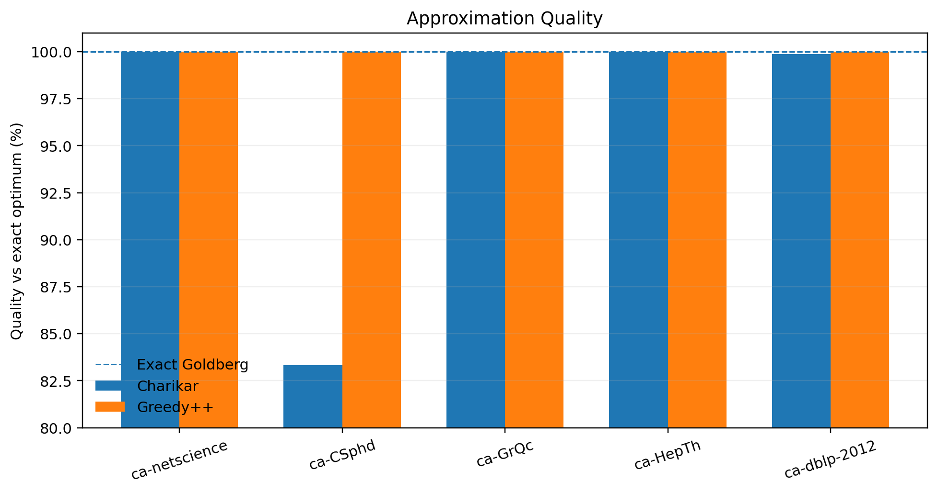
ACCURACY
Greedy++ fixes the two Charikar misses
Approximation quality is measured against Goldberg’s exact optimum on each dataset.
ca-CSphd
83.3% → 100%
Greedy++ raises density from 1.25 to the exact 1.50.
ca-dblp-2012
99.885% → 100%
Greedy++ improves 56.500000 to the exact 56.565217.
On ca-netscience, ca-GrQc and ca-HepTh, Charikar already reached the exact edge-density optimum.

Slide 7
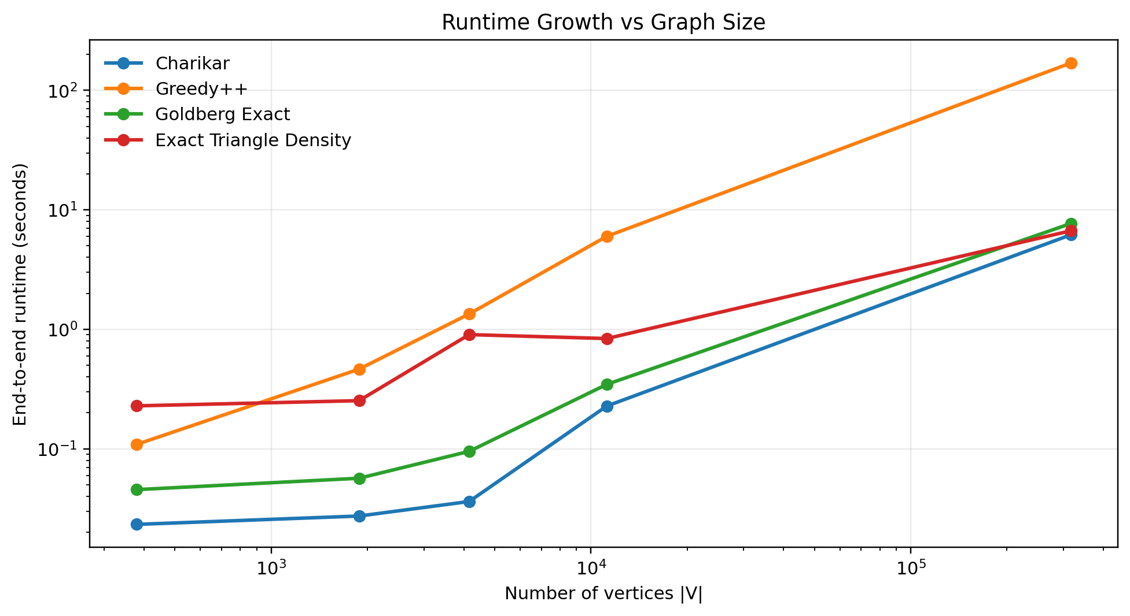
SCALABILITY
Quality comes at a runtime cost
End-to-end runtime is shown on log-log axes; exact methods include the prerequisite Charikar lower-bound stage.
6.19 s
Charikar on DBLP
169.83 s
Greedy++ on DBLP
10 rounds
7.70 s
Goldberg E2E on DBLP
after safe reduction
≈27× slower
The largest gap is Greedy++: a very small density improvement costs repeated full peeling passes.

Slide 8
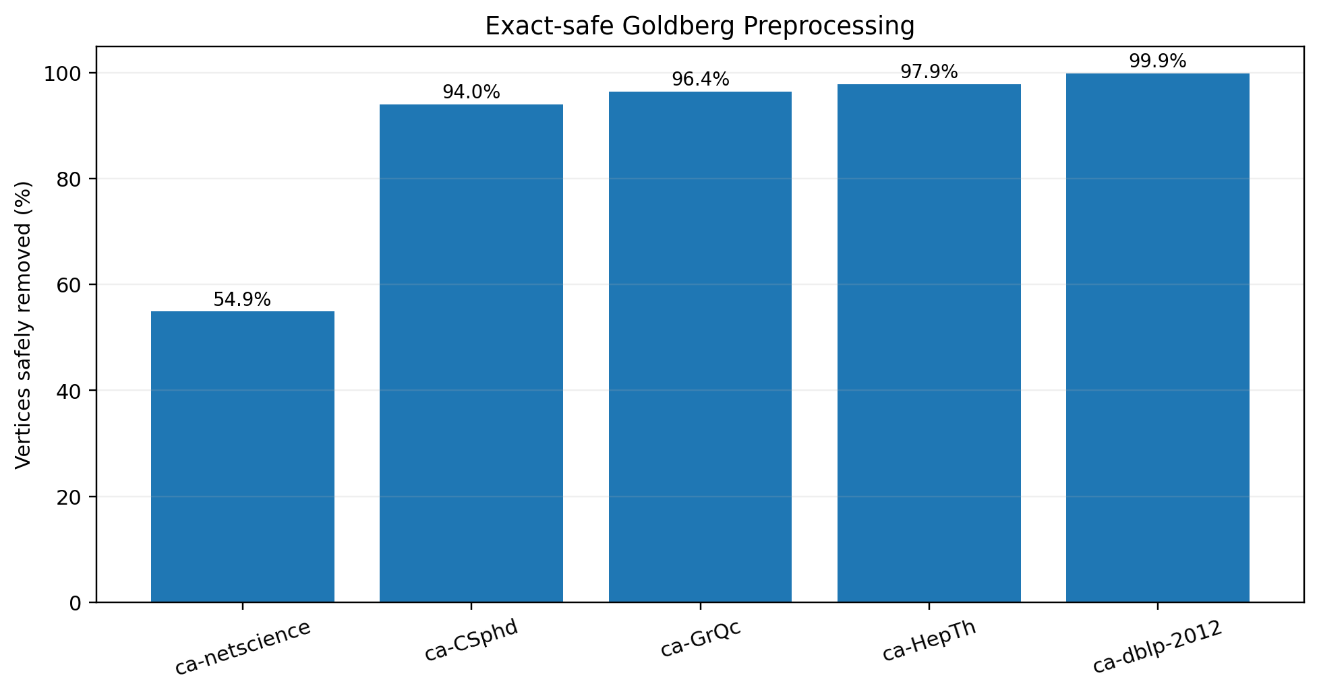
ENGINEERING BONUS
BONUS
Exact-safe preprocessing makes exact search practical
A greedy lower bound gives a mathematically safe core threshold before Goldberg constructs any flow network.
DBLP BEFORE
317,080
280
vertices
safe-core vertices
DBLP EDGES
1,049,866
13,609
98.70% of edges safely removed
DBLP node reduction: 99.91%. The exact optimum is preserved — this is not random sampling.

Slide 9
HIGHER-ORDER EXACTNESS
Triangle Exact avoids huge flow graphs when proof is enough
The solver uses three exact modes: max-flow binary search, complete-core certificate, or provable upper-bound certificate.
FLOW MODE
COMPLETE-CORE CERTIFICATE
UPPER-BOUND CERTIFICATE
ca-netscience
ca-CSphd
ca-GrQc
ca-HepTh
ca-dblp-2012
K239
216-node triangle core
Binary search + exact triangle max-flow
2,246,839 triangles
τ* = 9,401
Lower bound = upper bound
τ* = 2,109.333333
20 • 9 • 13 flow calls
0 flow calls
0 flow calls
The largest triangle-density instances are solved exactly without constructing their full auxiliary flow networks.

Slide 10
CASE STUDY
DBLP proves the two objectives are genuinely different
On the same 317,080-vertex network, edge density and triangle density prefer different communities.
EDGE-DENSITY OPTIMUM
TRIANGLE-DENSITY OPTIMUM
Goldberg Exact / Greedy++
Exact Triangle Density
115
6,505
56.565217
114
6,441
2,109.333
vertices
edges
ρ*
vertices
edges
τ*
Optimizes direct connectivity per vertex.
Optimizes closed 3-way structure per vertex.
1 vertex difference • 64 edges difference
This is the clearest evidence that higher-order density is not just a re-labeling of ordinary edge density.

Slide 11
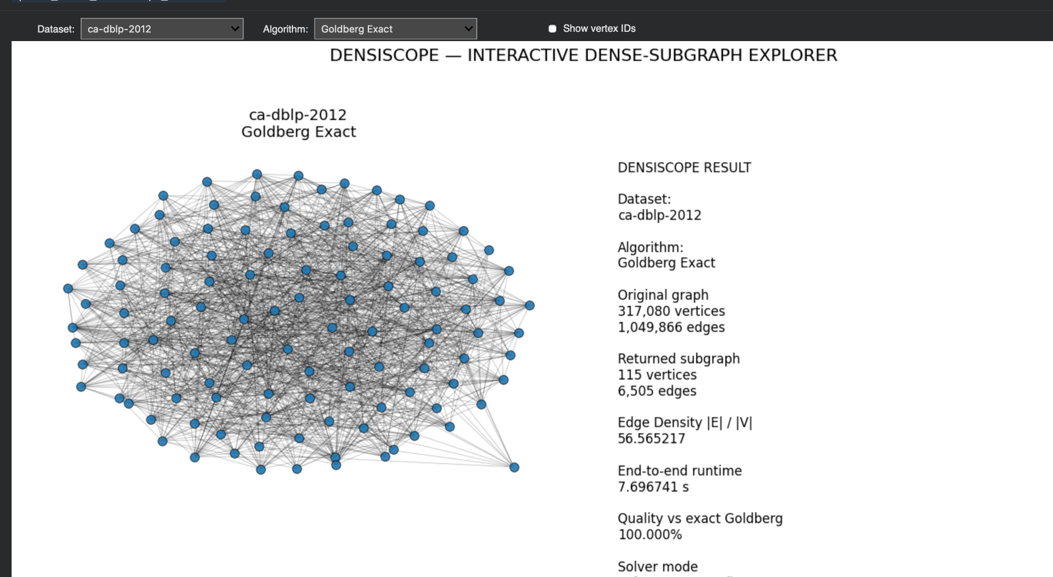
LIVE DEMO
BONUS
Interactive DensiScope Explorer
Select any dataset and algorithm, then inspect the returned dense community, metrics, exactness and runtime.
Dropdowns
dataset + algorithm
Exact metrics
full unsampled graph
Readable drawing
edge sampling only for display
Solver mode
shows max-flow / certificate path
Screenshot shown: ca-dblp-2012 + Goldberg Exact (115 vertices, 6,505 edges, ρ*=56.565217).

Slide 12
TAKEAWAYS
What DensiScope demonstrates
The project is not only an algorithm comparison — it is an end-to-end strategy for making exact graph analysis scalable.
Fast baseline
Quality refinement
Charikar is extremely fast and often exact.
Greedy++ fixes the two Charikar misses.
Exact verification
Higher-order structure
Goldberg establishes ground truth for edge density.
Triangle density can select a different community.
Scalable exactness
Presentation-ready
Safe reductions and certificates avoid giant flow graphs.
Live dashboard, MP4s, plots and reproducible outputs.
Fast approximation. Exact verification. Higher-order density. Scalable visualization.

Slide 13
REFERENCE
Appendix — core benchmark results
Dataset
|V|
|E|
Charikar ρ
Greedy++ ρ
Exact ρ*
Charikar %
Triangle τ*
ca-netscience
379
914
4.000
4.000
4.000
100.0
9.333
ca-CSphd
1,882
1,740
1.250
1.500
1.500
83.3
0.667
ca-GrQc
4,158
13,422
22.391
22.391
22.391
100.0
325.348
ca-HepTh
11,204
117,619
119.000
119.000
119.000
100.0
9,401
ca-dblp-2012
317,080
1,049,866
56.500
56.565
56.565
99.885
2,109.333
Edge-density quality is measured against Goldberg Exact. Triangle τ* optimizes a different objective and is therefore not directly comparable to ρ*.

