Slide 1
Thermal Management of a Battery-Powered Medical Payload Pod
Heat Transfer · MEP 311s — Project Summary Team 14 — Salma Saeed · Jana Mohamed · Omar Ahmad Keshk · Omar Khaled

Slide 2
The Problem
Drone-delivered medical payload pod (Zipline-style): three thermally managed enclosures — power, control, plant
The plant module dissipates ~17 W (2× 8 Ω resistors + IRF530 MOSFET)
Constraint: every module must stay ≤ 40 °C in steady state
Judged on thermal performance and cost-to-weight ratio

Slide 3
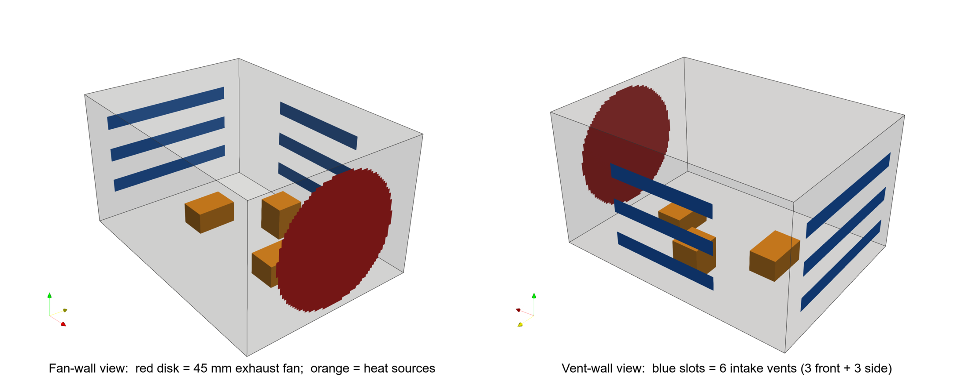
Design: Forced-Air Fan + Vents
One 50 mm 5 V exhaust fan + six intake slots, 90 × 65 × 50 mm PLA box — chosen over a heavier fin array
Enclosure geometry — 45 mm fan (red), six intake slots (blue), heat sources (orange)

Slide 4
Analytical Thermal Analysis
Power: P = V²/R = 8²/4 = 16 W resistive (~17 W total)
Fin array (rejected): needs ~0.30 m² of fins over two faces — heavy & bulky
Forced-air energy balance: ΔT = Q/(ρ·V̇·c_p) ≈ 4.6 °C → cavity ~30–35 °C
Bracketed by the sealed-box bound (118 °C); validated by CFD and experiment

Slide 5
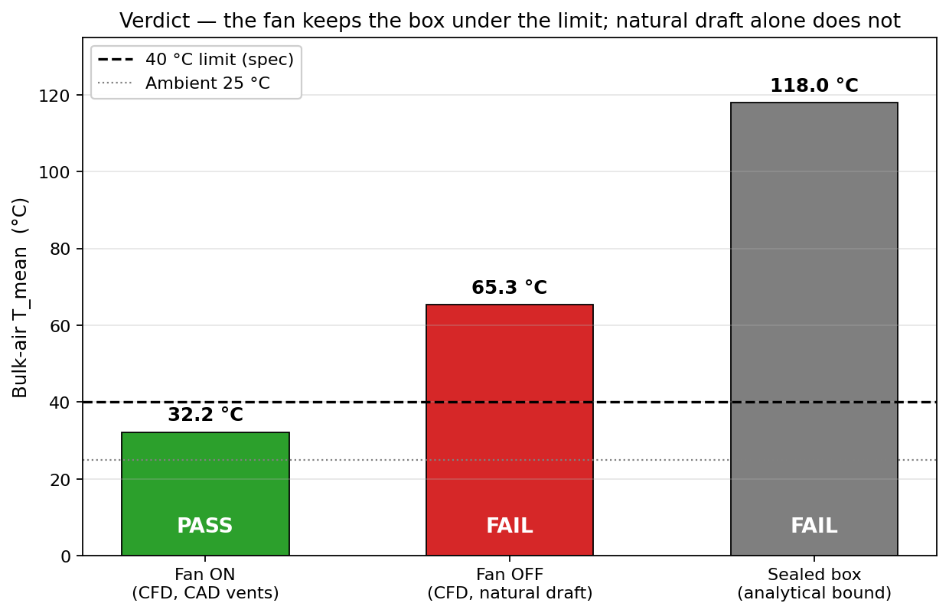
CFD Simulation (Bonus)
OpenFOAM, k-ω SST, 528 k cells · Fan ON 32 °C → PASS · Fan OFF 65 °C → FAIL
Heat hugs the floor and leaves mostly as warm fan exhaust; energy balance closes on 17 W
Verdict: fan keeps the box under the 40 °C limit

Slide 6
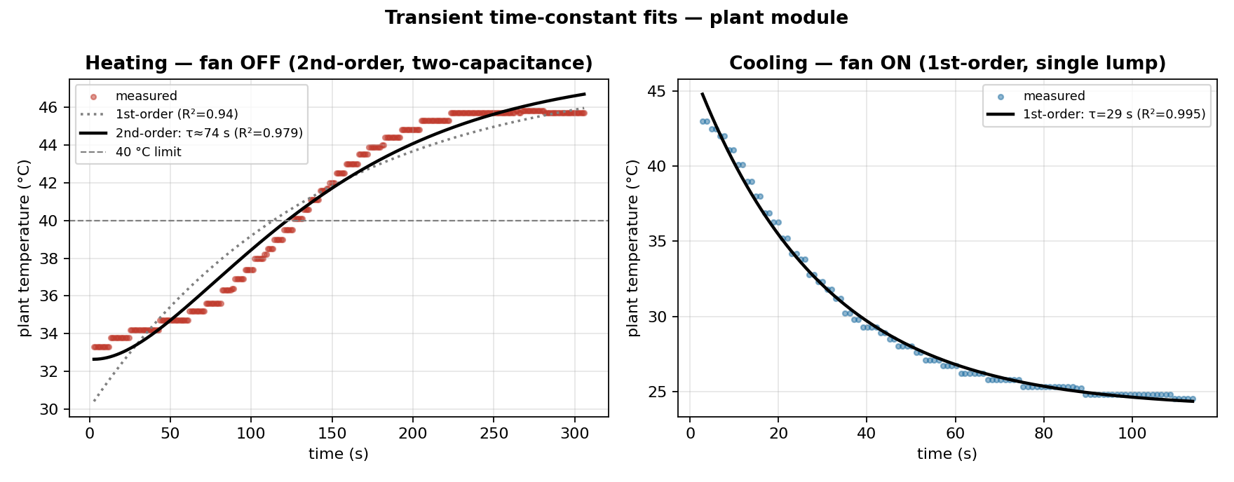
Transient Response
Cooling (fan on): clean first-order, τ = 29 s (R² = 0.995); predicted C/UA ≈ 20–30 s
Heating (fan off): second-order — two cascaded thermal capacitances
Time-constant fits

Slide 7
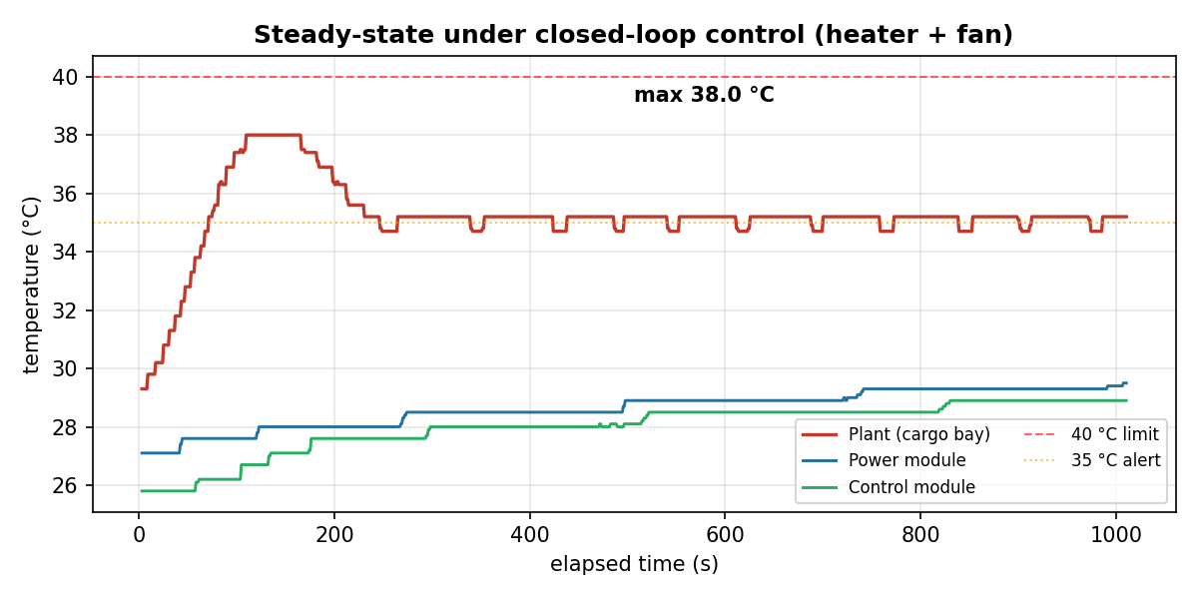
Experimental Results
Plant regulated at ~35 °C (< 40 °C); power & control modules ~29 °C
Measured full-heat draw 17.1 W — matches the 17 W analysis
Steady state under closed-loop control

Slide 8
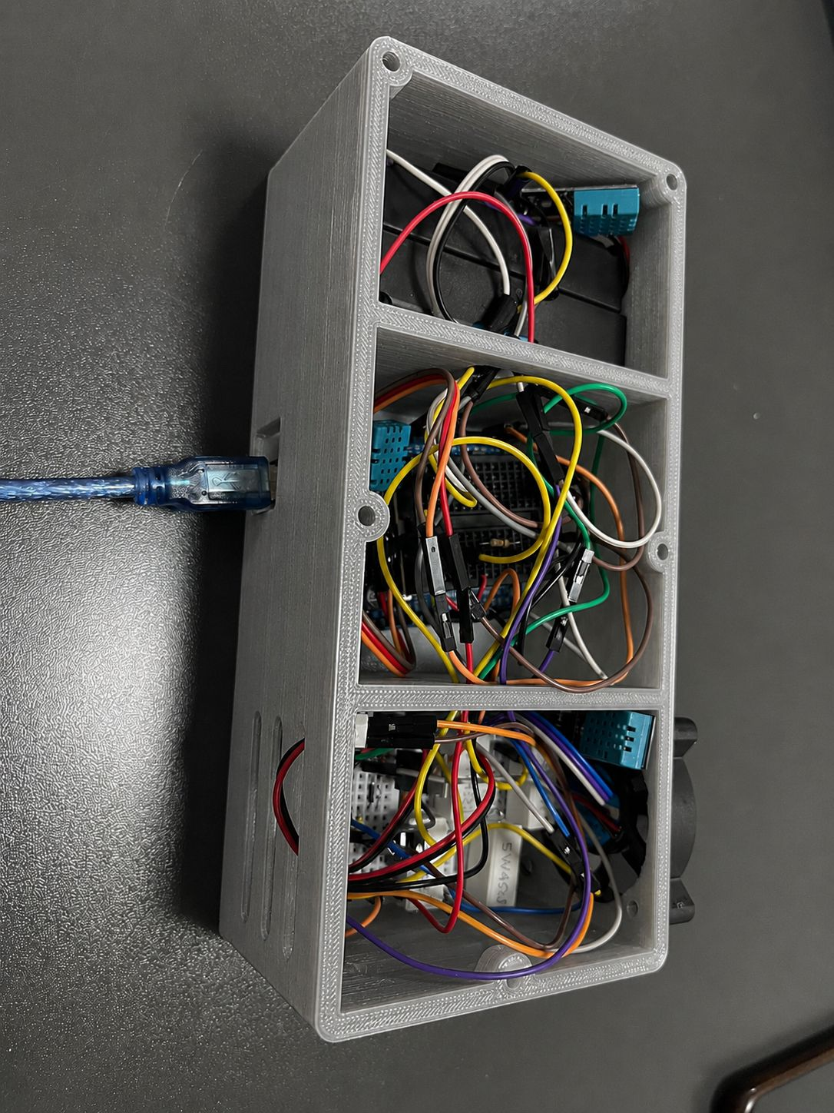
Prototype & Cost
Arduino PWM control of the MOSFET; 3× DHT sensors; LED alert + 40 °C cutoff
Thermal-management cost-to-weight: 80 EGP / 55 g ≈ 1.45 EGP/g
3-D-printed three-compartment pod

Slide 9
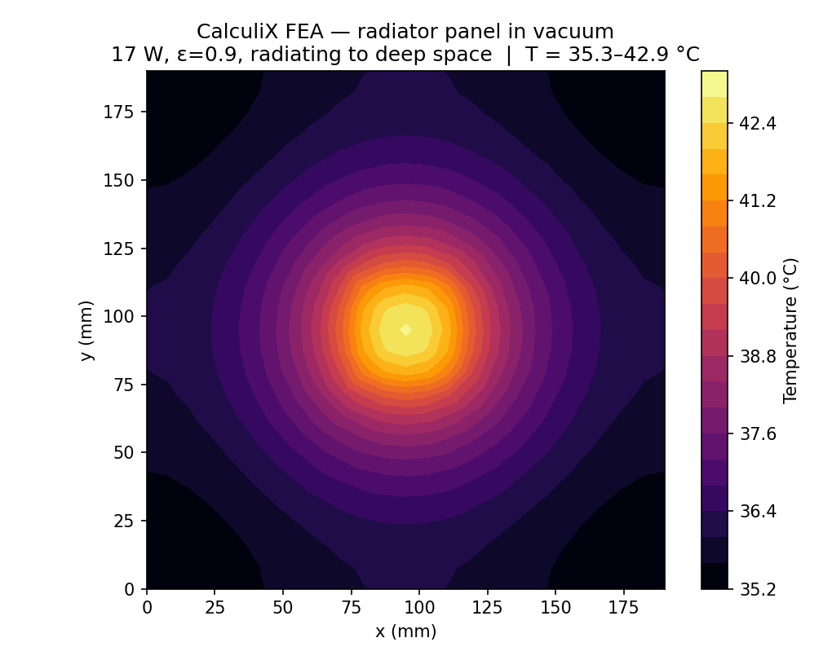
Space-Environment Variant (Bonus)
Vacuum: no convection → reject heat by radiation
~0.035 m² high-emissivity radiator holds 40 °C · CalculiX FEA: 35–43 °C (mean ~37 °C)
CalculiX radiator FEA in vacuum

Slide 10
Conclusion
All modules ≤ 40 °C in steady state — constraint met and experimentally confirmed
The fan is mandatory (removes 33 °C); the vents are a passive safety net
Two analytical methods + CFD + experiment all agree (~32–37 °C)
Bonuses delivered: numerical (CFD + CalculiX FEA) and the space variant
Code & data: github.com/omarkeshk/medical-payload-pod-thermal

