Slide 1

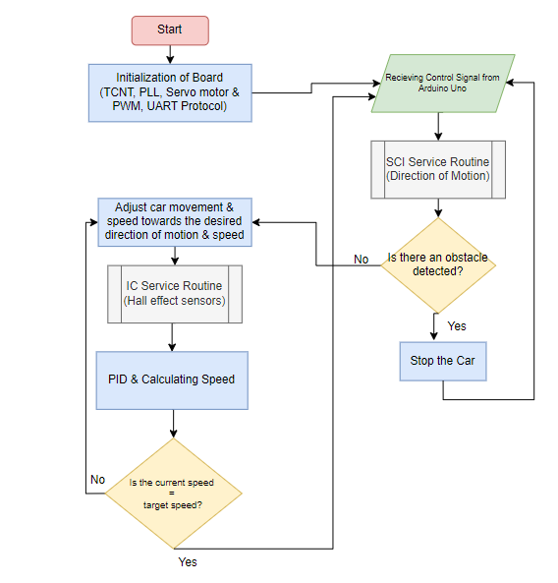
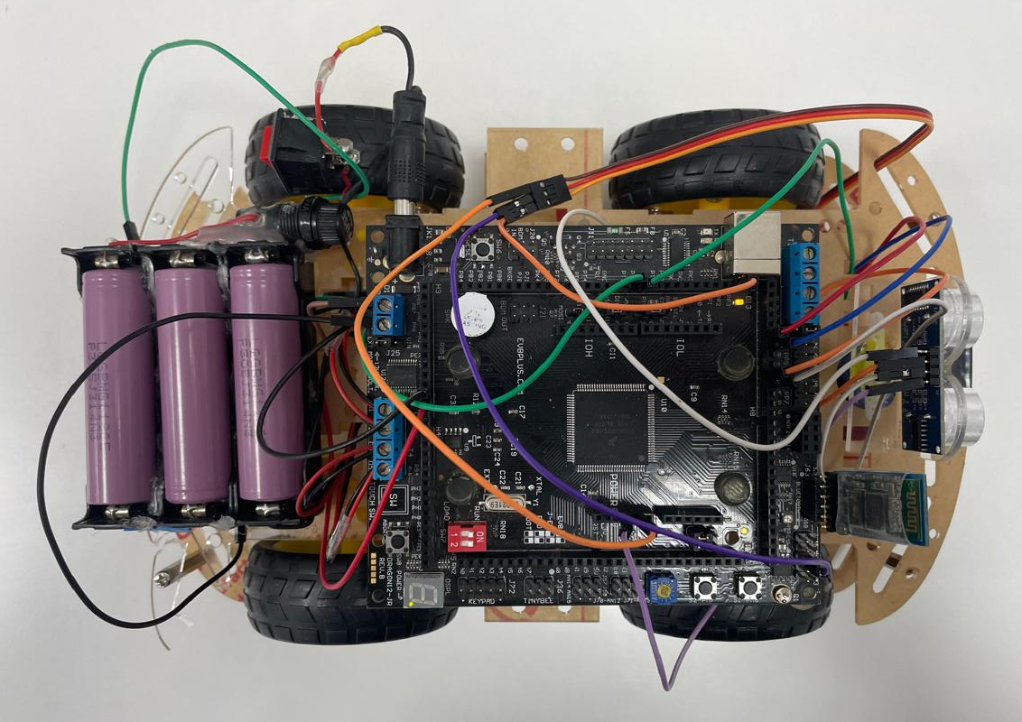
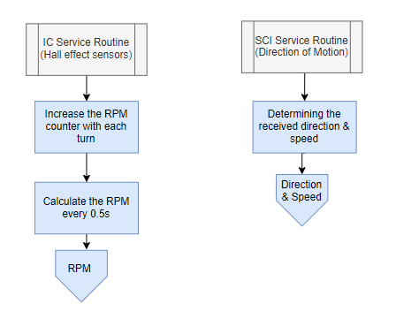
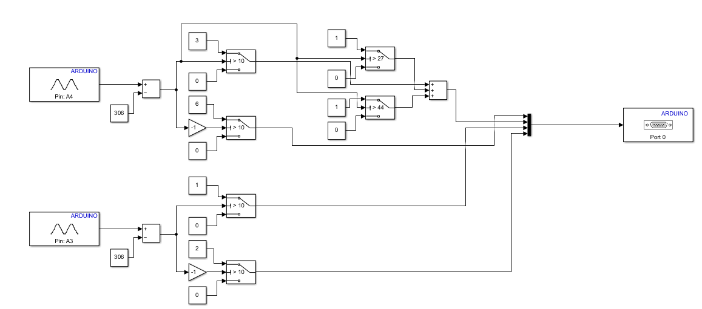
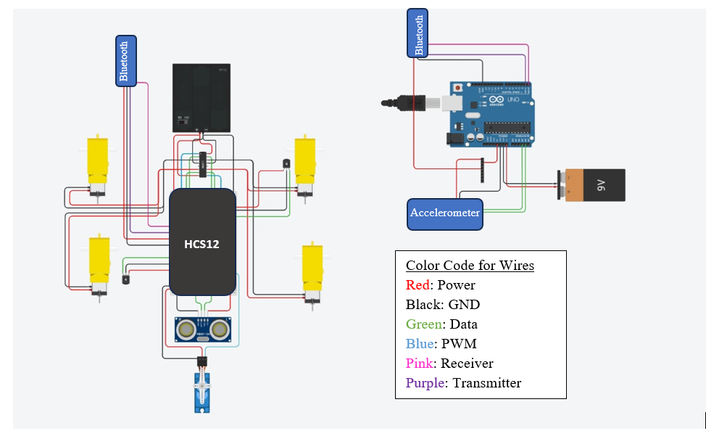
HAND GESTURE CONTROLLED ROBOT CAR WITH OBSTACLE DETECTION
Students: Jumana Abu Hamad, Omar Khader
Supervisor: Dr. Belal Sababha Embedded Systems Design, Final Design Project, Spring 2024 King Abdullah II School of Engineering
Princess Sumaya University for Technology
Abstract
The goal of this project is to develop and create an automobile robot that can be controlled via hand gestures. The HCS12 microcontroller will be used to read hand gestures from the accelerometer attached on the Arduino Uno board. These hand gestures will be relayed to the HCS12 via Bluetooth communication, which will then control the car's movement and speed. The primary goal of the project is to be able to move the car in all directions using hand gestures. Moreover, a cruise control feature will be available and is automatically activated through PID controller. The automobile will also include an obstacle detection capability that will use an ultrasonic sensor to detect these obstacles.
Project Objectives
Develop a gesture-controlled robot car capable of interpreting hand gestures via accelerometer and capable of moving in all directions.
Incorporate cruise control functionality to maintain a constant speed irrespective of terrain.
Implementing Obstacle Detection for the car.
Software System Flowchart:
Figure 5: Software System Flowchart.
Figure 3: Software System Flowchart.
System Interrupts Flowchart:
Figure 4: Interrupt Service Routines Flowchart.
Accelerometer MATLAB Simulink Model:
Figure 5: Accelerometer MATLAB Simulink Model.
The code first collects analogue data from an accelerometer, measuring both the x and y axes to capture hand movements. These raw values are then processed to fit within a standardized range, typically between -62 and 62, ensuring uniformity across different movements. Next, through a series of conditional checks, the system determines the direction of the hand movement based on these processed values. For instance, if the x-axis reading suggests a tilt to the left and the y-axis indicates forward motion, the system infers a combined action of turning left while advancing. Each potential movement is associated with a specific control value, where 0 represents no action or a complete stop, 1 denotes a leftward turn, 2 signifies a rightward turn, and 3 through 6 corresponds to various speeds and directions of forward and backward motion. These control signals are then serially sent through the Bluetooth module to the HCS12 MCU to be translated into actions on the car's movement.
Design
Mechanical Design
The prototype used in this project is composed of a 4 wheels car with four DC motors that include gearboxes within them. A servo motor is used to steer the ultrasonic sensor in 180-degree motion to scan for obstacles and stop the car when there is an obstacle Infront if it (obstacle avoidance feature). In addition to the HSCS12 microcontroller on the car with its on-board H-bridge, the following components have been attached to the car body using screws and adhesive tape: ultrasonic sensor (HC-SR04), servo motor, two hall effect sensors (near the wheels of the car) and three 1865 batteries used to power up the HCS12. The basic prototype is shown in Fig. 1 and the complete prototype with all the components is shown in figures 2-3.
Electrical Design
The electrical design for this project is displayed in figure 4. The main electrical connections are those of the HCS12 microcontroller and those of the Arduino Uno board. The main electrical components connected to the HCS12 are the following: H-bridge, ultrasonic sensor, servo motor, Bluetooth module for receiving, four DC motors, three lithium ion 1865 batteries and two hall effect sensors. On the other hand, the main electrical components connected to the Arduino Uno board are the following: 9v battery, accelerometer and a Bluetooth module for transmitting
Figure 2: Electrical System Design.
Software Design
The provided code is designed for an HCS12-based car system that can be controlled via hand gestures from a separate Arduino system with an Accelerometer to read those gestures and send them using Bluetooth. It includes functionalities for movement control, speed regulation using a PID controller, and obstacle detection using an ultrasonic sensor. The robot can perform various actions, such as moving forward, reversing, turning left, turning right, and stopping. It uses Pulse Width Modulation (PWM) to control the motors and a servo to direct the ultrasonic sensor.
Figure 1: Complete prototype of car with all components.
Conclusion
The proposed gesture-controlled robot car project offers an exciting opportunity to explore embedded systems, microprocessor programming, and sensor technology. By using an accelerometer and advanced control algorithms, the project aims to develop a functional prototype capable of intuitive and efficient hand gesture control. Additional features such as cruise control and obstacle avoidance are included to further enhance the robot car’s capabilities, making it a versatile and practical application of embedded systems technology. Overall, this project was successful at building the car porotype and ensuing that it moves and successfully transmitting the accelerometer hand gesture movement signals. Several problems where encountered, however due to time constraints some of these problems were solved in time and others were not. This project can be further expanded in the future to include a live camera recording feed where the car can be moved and can simultaneously record the scenery around it.

