Slide 1


EMBEDDED SYSTEMS DESIGN
SECOND SEMESTER 2023/2024
FINAL PROJECT: HAND GESTURE CONTROLLED ROBOT CAR WITH OBSTACLE DETECTION
Jumana Abu Hamad & Omar Khader Dr. Belal Sababha
1

Slide 2
01
Introduction
02
Background Information
Outline
03
Design
04
Problems & Recommendations
05
Conclusion
2

Slide 3
01 - Introduction
3

Slide 4
Project Idea
PV
This project aims to design and build a hand gesture-controlled car robot. The HCS12 microprocessor will be utilized to read the hand gestures from the accelerometer mounted to the Arduino Uno board, these hand gestures will be sent via Bluetooth communication to the HCS12 which will in turn accordingly control the motion of the car.
The main aim of the project is to be able to move the car in all directions and at different speeds through hand gestures. Moreover, a cruise control feature will be available and is automatically activated through PID controller. The obstacle detection feature will also be implemented onto the car using an ultrasonic sensor.
4

Slide 5
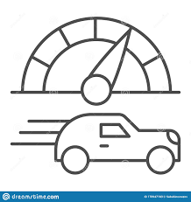


Project Objectives
PV
Develop a gesture-controlled robot car capable of interpreting hand gestures via accelerometer and capable of moving in all directions and at different speeds.
Incorporate cruise control functionality to maintain a constant speed irrespective of terrain.
Implementing Obstacle Detection for the car.
5

Slide 6
02 – Background Information
6

Slide 7
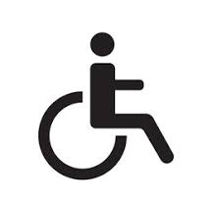
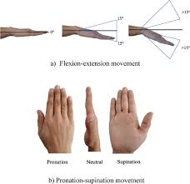
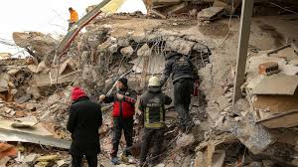
Background Information
PV
In the present day, there is an apparent increase the number of physically unfit people who are uncappable of driving themselves or need some assistance is driving due to certain disabilities. Therefore, the first application of this project would be that is going to help these unfit people to drive around by simply using their hand gestures to control the movement of their car. Furthermore, the ability to control a car using small hand gestures can also serve to help in navigating small or tight places that humans cannot access themselves. Simple hand gestures can control the car which is equipped with a camera that can record a love video of the inaccessible area (additional feature). This application is extremely useful in navigating destructed areas resulting from war or natural catastrophes. The hand gesture-controlled robot car can easily make its way into these areas to for example, help rescue teams look injured people under the rubbles.
7

Slide 8
03 - Design
8

Slide 9
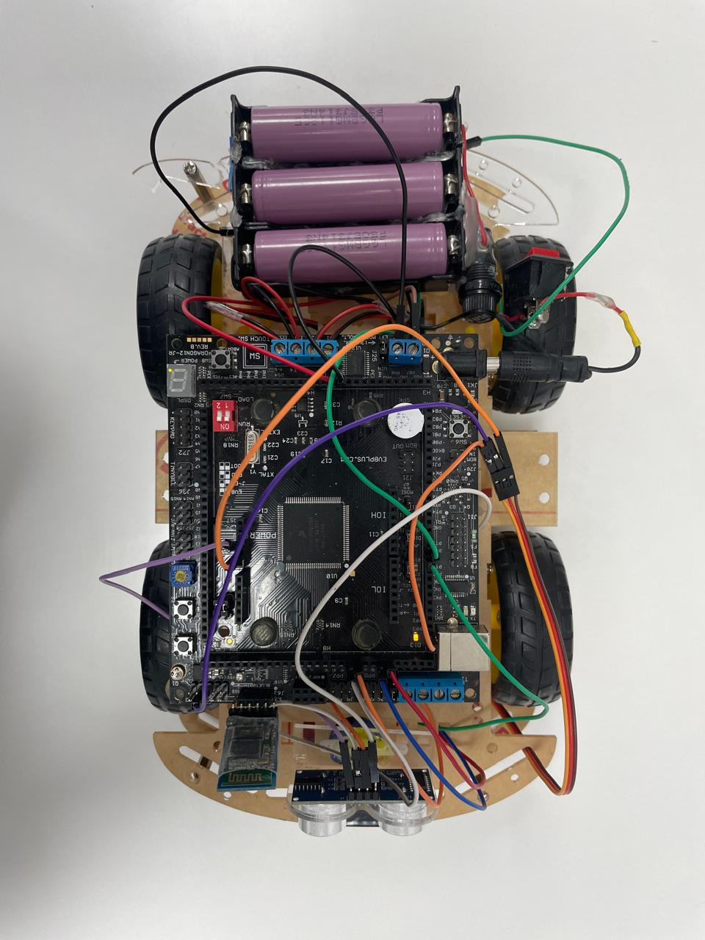
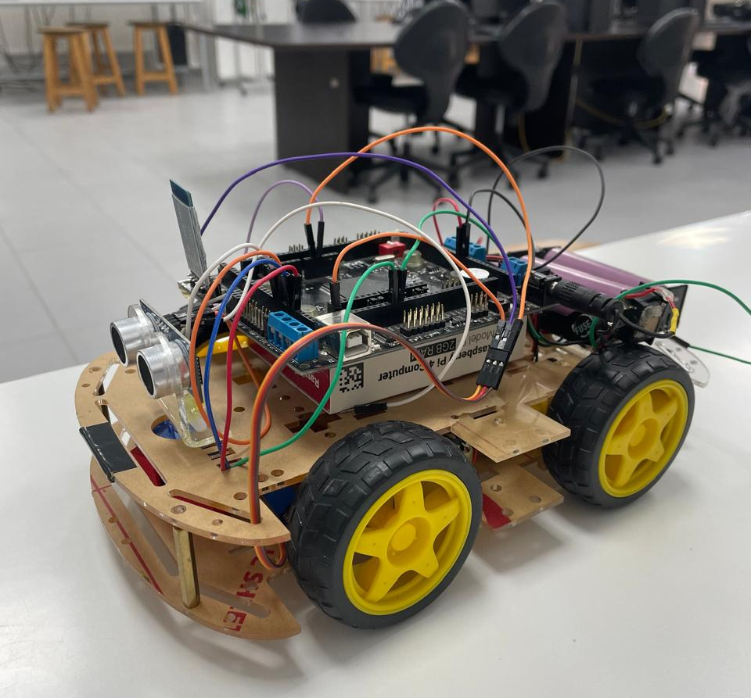
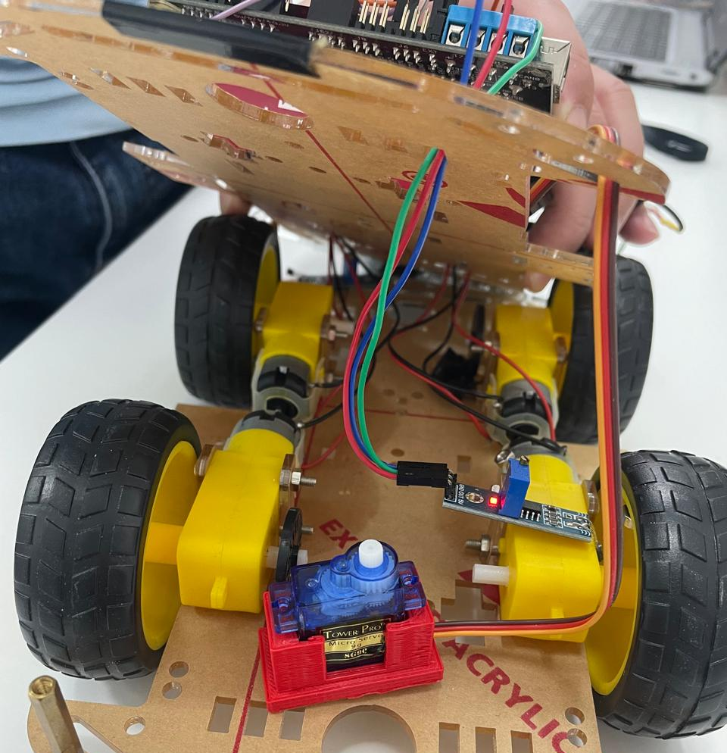
Mechanical Design
PV
A car with 4 wheels & four DC motors is used. A servo motor is used to steer the ultrasonic sensor in 180-degree motion to scan for obstacles and stop the car when there is an obstacle Infront if it. In addition to the HSCS12 microcontroller on the car with its on-board H-bridge, the following components have been attached to the car body: ultrasonic sensor (HC-SR04), servo motor, two hall effect sensors (near the wheels of the car) and three lithium ion 1865 batteries used to power up the HCS12.
Figure 1: Complete prototype of car with all components.
9

Slide 10
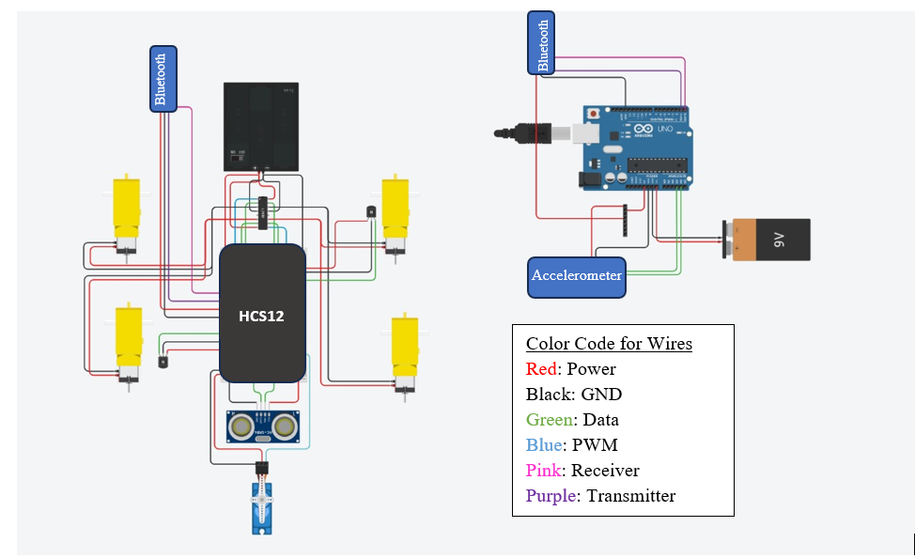
Electrical Design
PV
The main electrical connections are those of the HCS12 microcontroller and those of the Arduino Uno board. The main electrical components connected to the HCS12 are the following: H-bridge, ultrasonic sensor, servo motor, Bluetooth module for receiving, four DC motors, three lithium ion 1865 batteries and two hall effect sensors. On the other hand, the main electrical components connected to the Arduino Uno board are the following: 9V battery, accelerometer and a Bluetooth module for transmitting.
Figure 2: Electrical System Design.
10

Slide 11
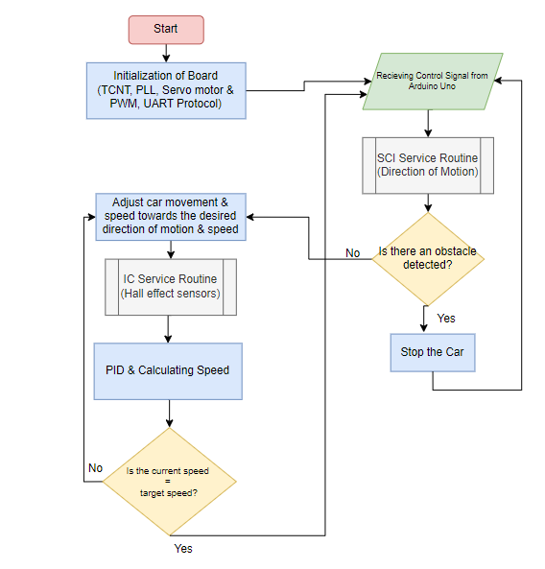
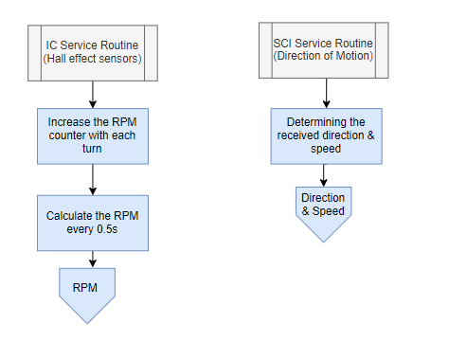
Software Design
PV
Figure 4: Interrupt Service Routines Flowchart.
Figure 3: Software System Flowchart.
11

Slide 12
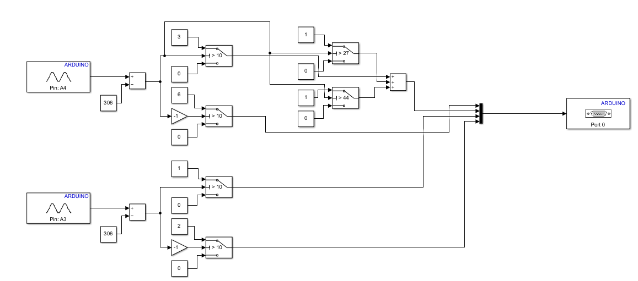
Software Design
PV
Figure 5: Accelerometer MATLAB Simulink Model.
12

Slide 13
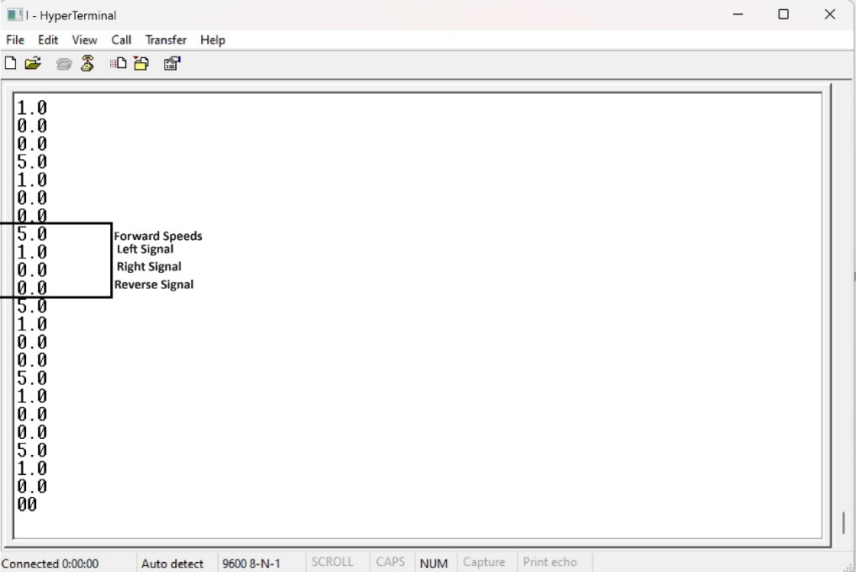
Transmitted Data Output
PV
0: No action or a complete stop
1: Leftward turn
2: Rightward turn
3-6: Various speeds and directions of forward and backward motion
Figure 6: Accelerometer Transmitted Data Output on Terminal Port.
13

Slide 14
04 – Problems & Recommendations
14

Slide 15
Problems & Recommendations
PV
The flex sensor was supposed to be used for interpreting the hand gestures, however, the two flex sensors that we intended to use were corrupted and damaged and were not displaying any correct readings.
We faced difficulties in initiating and controlling the servo motor that was intended for moving the ultrasonic sensor to be able to detect and avoid obstacles.
The signals interpreted from the hand gestures through accelerometer were correctly being transmitted from the Uno board to the HCS12. This was checked by using the terminal port to view the transmitted signals and they were in fact correctly being transmitted as required. However, these signals were not being received correctly by the HCS12 and thus the car did not move as intended.
15

Slide 16
05 - Conclusion
16

Slide 17
Conclusion
PV
The proposed gesture-controlled robot car project offers an exciting opportunity to explore embedded systems, microprocessor programming, and sensor technology. By using an accelerometer and advanced control algorithms, the project aims to develop a functional prototype capable of intuitive and efficient hand gesture control. Additional features such as cruise control and obstacle avoidance are included to further enhance the robot car’s capabilities, making it a versatile and practical application of embedded systems technology. Overall, this project was successful at building the car porotype and ensuing that it moves and successfully transmitting the accelerometer hand gesture movement signals. Several problems where encountered, however due to time constraints some of these problems were solved in time and others were not. This project can be further expanded in the future to include a live camera recording feed where the car can be moved and can simultaneously record the scenery around it.
17

Slide 18
Thank You
18

