Slide 1
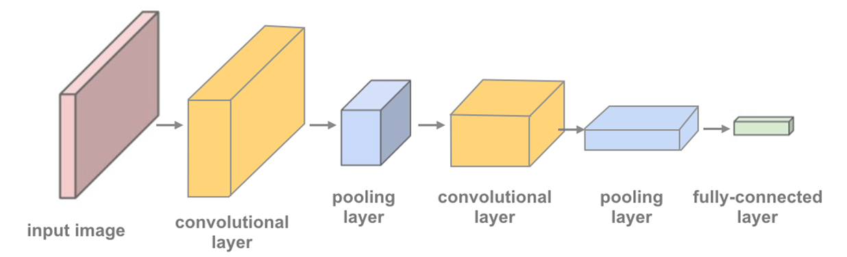
DEEp learning implementation

Slide 2
Steps
Loading data
Pre-processing data
Viewing data
Model structure
Model training
Model testing
Viewing samples

Slide 3

Data loading
We load and devid the data into 3 defferant loaders :
Traing set
Test set
Validation set

Slide 4
Number of records of training dataset: 16504
Number of records of validation dataset: 2058
Number of records of test dataset: 2076

Slide 5
Number of classes
15 classes
12 disease
3 healthy classes
Peper bell
Pottato
Tomato

Slide 6
Data
'Pepper__bell___Bacterial_spot' 'Pepper__bell___healthy'
'Potato___Early_blight' 'Potato___Late_blight' 'Potato___healthy'
'Tomato_Bacterial_spot' 'Tomato_Early_blight' 'Tomato_Late_blight'
'Tomato_Leaf_Mold' 'Tomato_Septoria_leaf_spot'
'Tomato_Spider_mites_Two_spotted_spider_mite' 'Tomato__Target_Spot'
'Tomato__Tomato_YellowLeaf__Curl_Virus' 'Tomato__Tomato_mosaic_virus'
'Tomato_healthy'

Slide 7
Data pre-processing
transform the image to "tensor" datatype that pytoch uses.
rotate the image romdamly by 10 degrees (to avoid over fiting).
flip the image horizontaly rondomly (to avoid over fitting).
normalizing the image tensor (from 0 to 1 instead of from 0 to 255).
resize the images to 32 by 32.

Slide 8
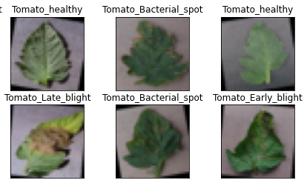
View of the results

Slide 9
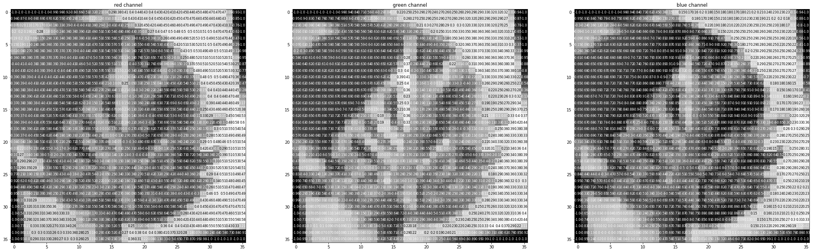

Slide 10
Network Architecture

Slide 11
defintion of CNN architecture
Convolutional layers: which can be thought of as stack of filtered images.
Maxpooling layers: which reduce the x-y size of an input, keeping only the most active pixels from the previous layer.
The usual Linear + Dropout layers to avoid overfitting and produce a 10-dim output.

Slide 12
Net(
(conv1): Conv2d(3, 16, kernel_size=(3, 3), stride=(1, 1), padding=(1, 1))
(conv2): Conv2d(16, 32, kernel_size=(3, 3), stride=(1, 1), padding=(1, 1))
(conv3): Conv2d(32, 64, kernel_size=(3, 3), stride=(1, 1), padding=(1, 1))
(pool): MaxPool2d(kernel_size=2, stride=2, padding=0, dilation=1, ceil_mode=False)
(fc1): Linear(in_features=1024, out_features=500, bias=True)
(fc2): Linear(in_features=500, out_features=15, bias=True)
(dropout): Dropout(p=0.25, inplace=False))

Slide 13
Training the model

Slide 14
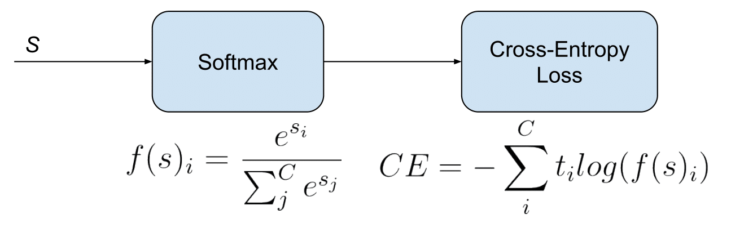
Loss fucntion
•we use the cross entropy loss for the loss function.

Slide 15
Optimization
Optimization function is resposble for updating the weights after calculating the loss

Slide 16
Actual training
After making the loss and optimization fuctions
here we are looking at how the training and validation loss decreases over time
if the validation loss ever increases it indicates possible overfitting.
The best results we had was with 30 epochs

Slide 17

Veiw of the last 4 epoches

Slide 18
Test the Trained Network
Here we compare the result from training on the training data set and the test set to measure our accuracy.

Slide 19
Test Accuracy of Pepper__bell___Bacterial_spot: 89% (71/79) Test Accuracy of Pepper__bell___healthy: 99% (113/114) Test Accuracy of Potato___Early_blight: 98% (78/79) Test Accuracy of Potato___Late_blight: 84% (71/84) Test Accuracy of Potato___healthy: 86% (13/15) Test Accuracy of Tomato_Bacterial_spot: 94% (172/182) Test Accuracy of Tomato_Early_blight: 81% (56/69) Test Accuracy of Tomato_Late_blight: 91% (137/150) Test Accuracy of Tomato_Leaf_Mold: 94% (72/76) Test Accuracy of Tomato_Septoria_leaf_spot: 94% (134/142) Test Accuracy of Tomato_Spider_mites_Two_spotted_spider_mite: 93% (132/141) Test Accuracy of Tomato__Target_Spot: 96% (106/110) Test Accuracy of Tomato__Tomato_YellowLeaf__Curl_Virus: 98% (257/261) Test Accuracy of Tomato__Tomato_mosaic_virus: 100% (30/30) Test Accuracy of Tomato_healthy: 99% (131/132)

Slide 20
Last term accuacy was 87%

Slide 21
Test Accuracy (Overall): 94% (1573/1664)

Slide 22
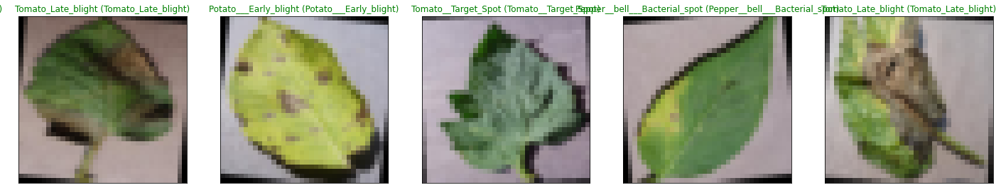
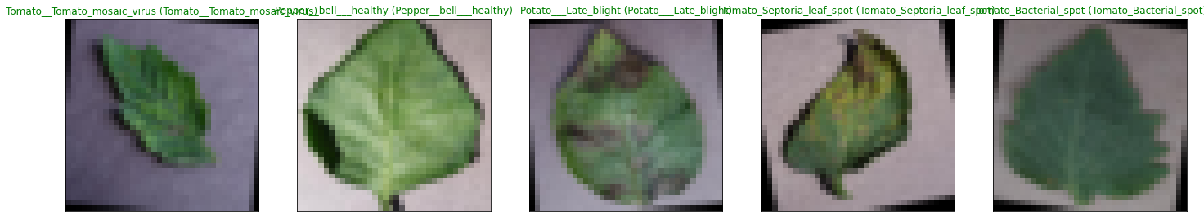

Slide 23
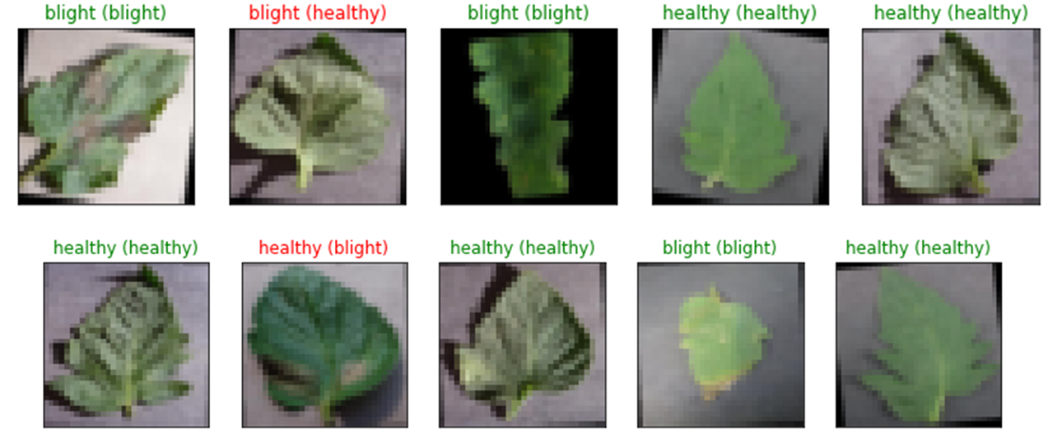
Last term results

