Slide 1
Compiler
Possible IR forms
❖ Graphical representations: such as
AST (Abstract Syntax Trees)
DAG (Directed Acyclic Graph)
❖ Postfix notation
❖ Three address code

Slide 2
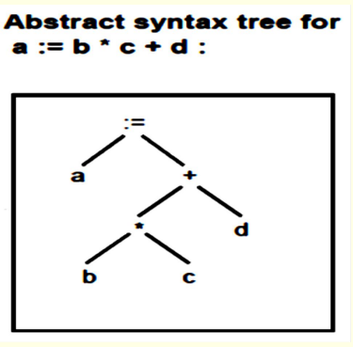
Compiler
AST (Abstract Syntax Trees):

Slide 3
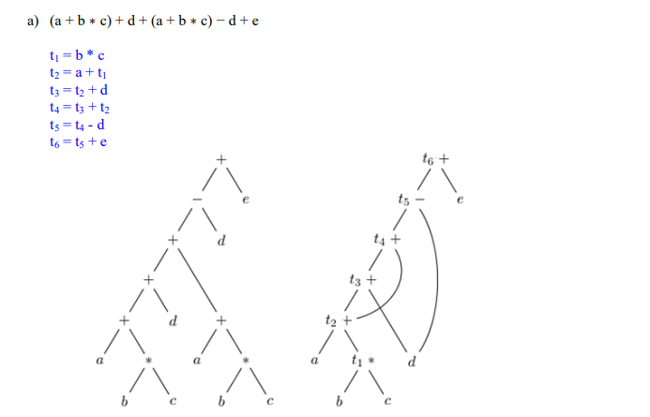
Compiler

