Slide 1
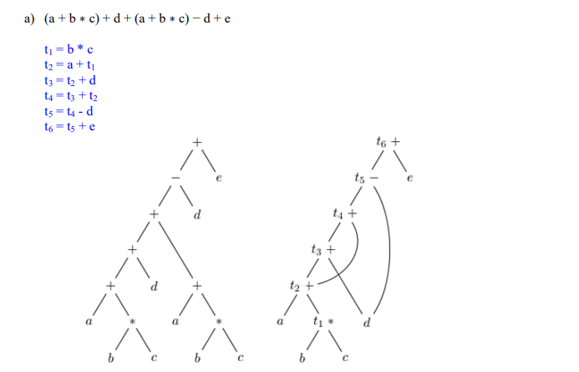
Compiler
DAG (Directed Acyclic Graph)

Slide 2
Compiler
AST DAG

