Slide 1
Compiler
Programming language:
Symbols for describing computations to people and machines.
All software was written in a programming language.
Before a program can be run.
First must be translated into form to be executed by a computer.
The translation is named a compiler.

Slide 2
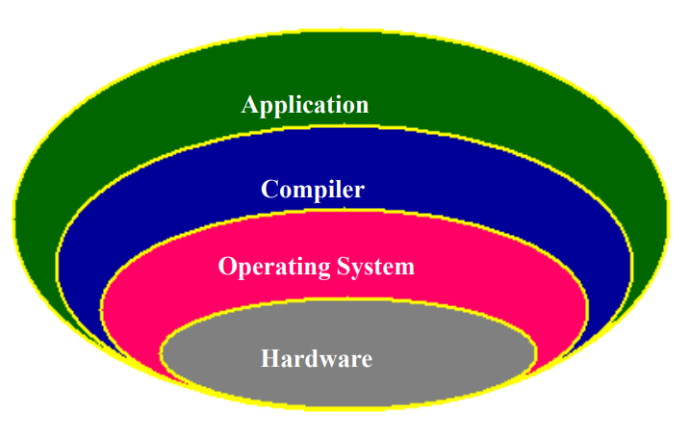
Compiler

