Slide 1
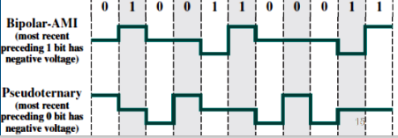
Data Communication
Bipolar-AMI (BAMI)
0 > No signal
1 > positive or negative

