Slide 1
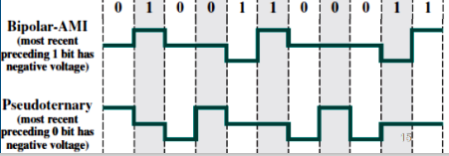
Data Communication
Pseudoternary
1 > No signal
0 > positive or negative

