Slide 1
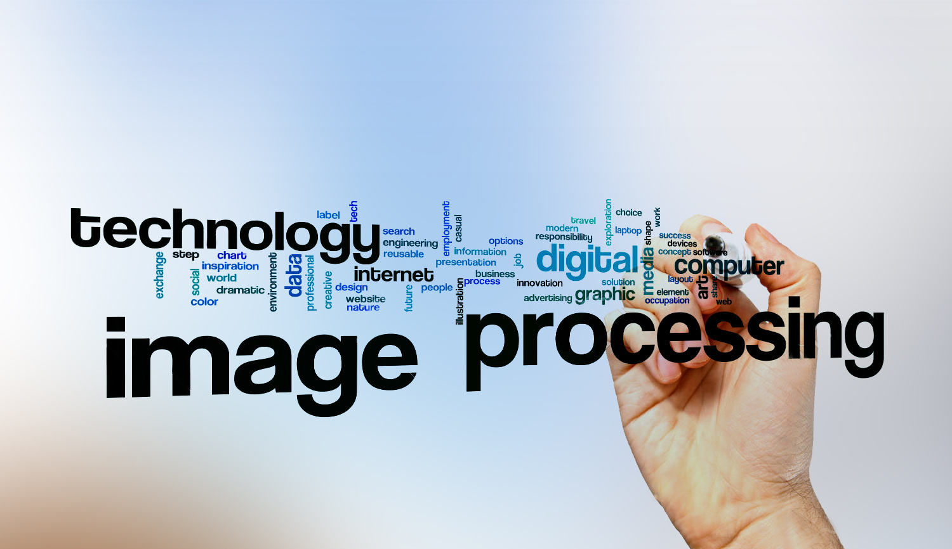
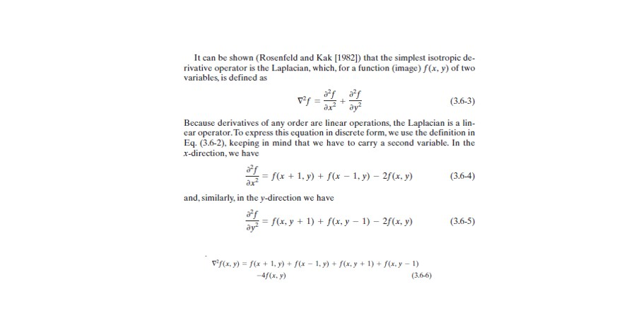
Digital Image Processing
24-Using mathematical derivation find a representation for the Laplacian Mask.

Slide 2
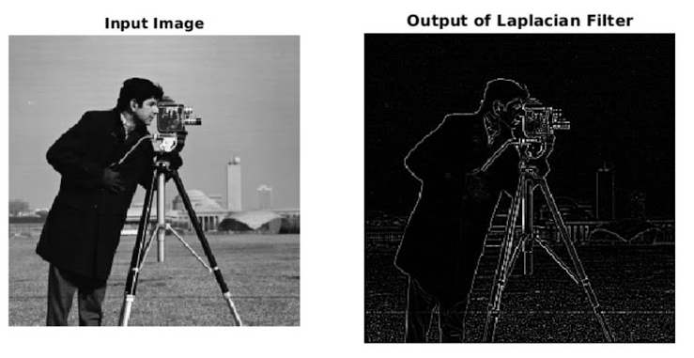
Digital Image Processing
24-Using mathematical derivation find a representation for the Laplacian Mask.
Laplacian of Gaussian…
used to detect the edges in the images.

