Slide 1
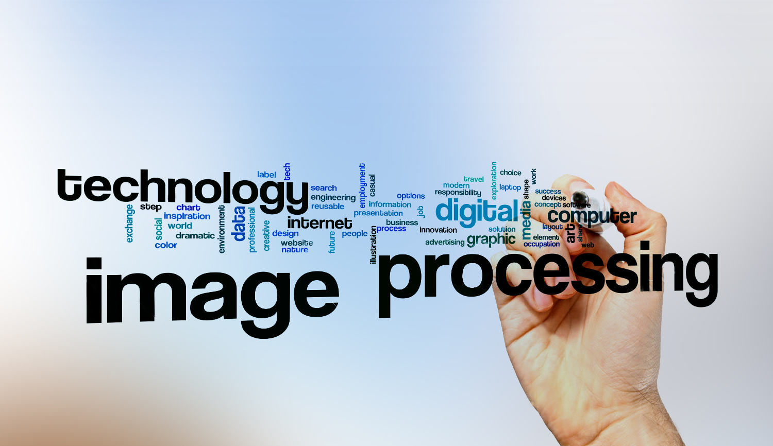
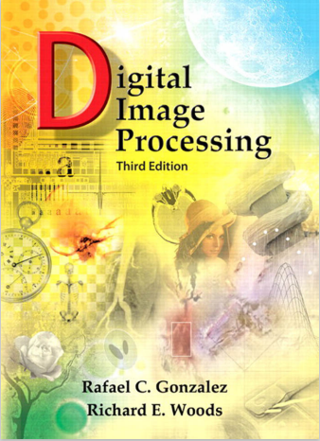
Digital Image Processing
Content:
5 chapters
-solve 3 sheets.
-min 30 video
-Each video contains the main concept.
-Each Video < 5 min
-DIP project (python) – (streamlit)

