Slide 1
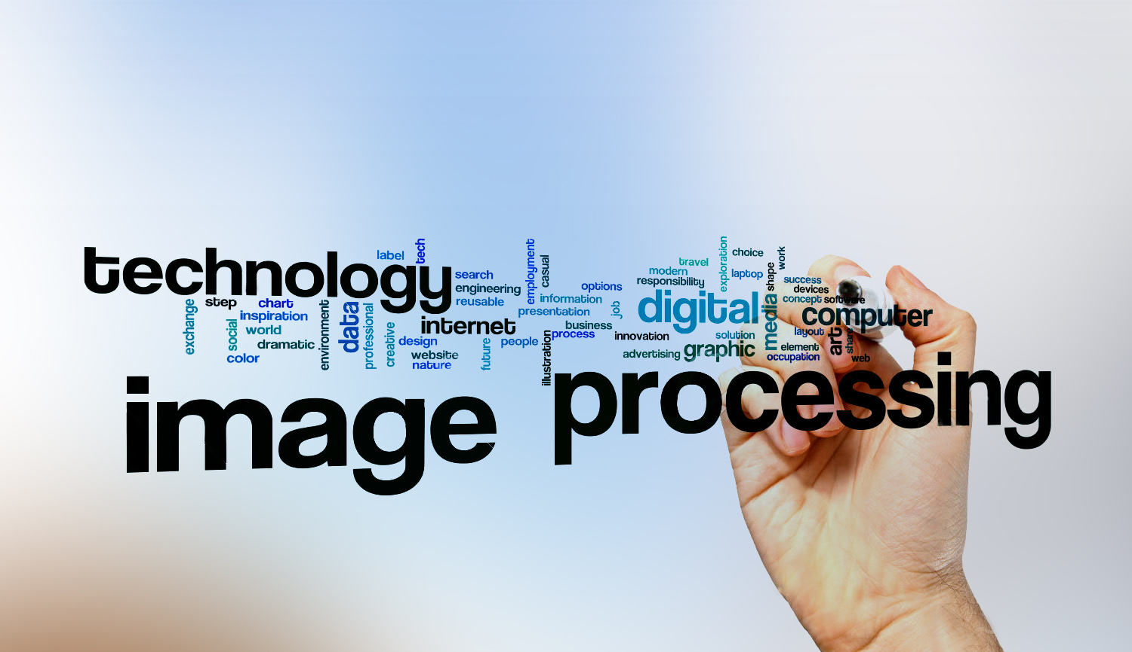
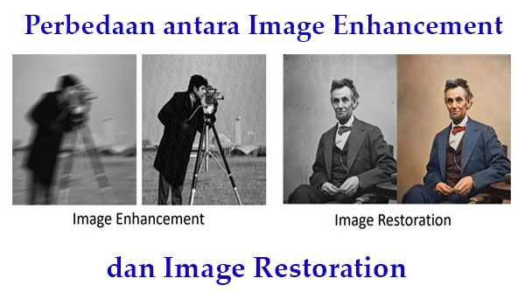
Digital Image Processing
1- What’s DIP?
-is the use of a digital computer to process digital images through an algorithm.
-helps to improve images for human interpretation.

