Slide 1

Insurance Cost Prediction
Subject: AI2
Dr.sara elmatwally

Slide 2
Our Team
Amr Ahmed Emam Elbakary
Youns Mohamed Ibrahim Elhady
Omar Mohamed Reda Mohamed
Amr Elsayed Tawfik Mohamed
Mohamed Hassan Saber

Slide 3
Introduction
Medical insurance costs are rising globally, and it’s important for insurance companies to predict these costs accurately. By understanding factors like age, gender, BMI, and lifestyle habits (e.g., smoking), insurers can better price their policies and manage financial risks.
This project aims to build a predictive model using Linear Regression to estimate medical insurance costs based on these factors. The goal is to help insurance companies offer more accurate pricing and improve their financial forecasting.

Slide 4
Our aim
Rising medical costs require accurate insurance pricing.
Using machine learning, specifically linear regression, to predict costs.
Helps insurers price policies fairly and anticipate financial risks

Slide 5
Goals
Develop a Predictive Model
Identify Key Cost Drivers
Evaluate Model Accuracy
Provide Data-Driven Insights
To create a linear regression model that can predict medical insurance costs based on specific personal and health-related data inputs.
To analyze which personal and demographic factors have the most significant impact on insurance costs, helping to inform decision-making in policy pricing.
To assess the performance and accuracy of the model, ensuring it meets the reliability standards for predictive analytics in the insurance industry.
To enable insurance companies to make more informed, data-driven decisions for policyholders by using the model’s insights on medical cost patterns.

Slide 6
Challenges
Challenges in accurately pricing insurance policies.
Unpredictable medical costs affect financial stability.
Need for a predictive model based on demographic and health data.

Slide 7
Methodology Overview
2.Exploratory Data Analysis
1. Data Collection & Preprocessing
Dataset overview (insurance.csv).
Handling missing data and encoding categorical features
Age, BMI, smoker, and region distributions (visualizations).
3. Model Training
4. Evaluation Metrics
Linear Regression , Ridge Regression , Lasso Regression, Decision Tree Regression and Random Forest Regression.
R-squared values for training and test data.

Slide 8
Accuracy For Each Algorithm
Algorithm | Training R2 | Testing R2
Linear Regression | 0.751505643411174 | 0.7447273869684077
Ridge Regression | 0.7514846144151406 | 0.7448008334274915
Lasso Regression | 0.7515056425277682 | 0.7447271103401147
Decision Tree Regression | 1.0 | 0.6856556499360399
Random Forest Regression | 0.9773033000325817 | 0.8369815346329773

Slide 9
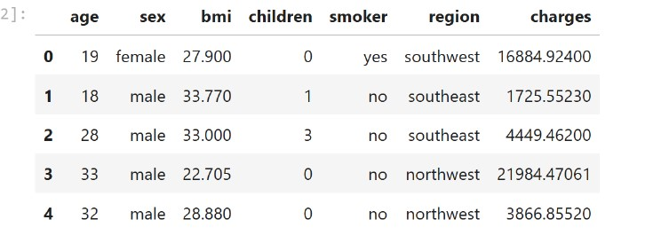
Data Set

Slide 10
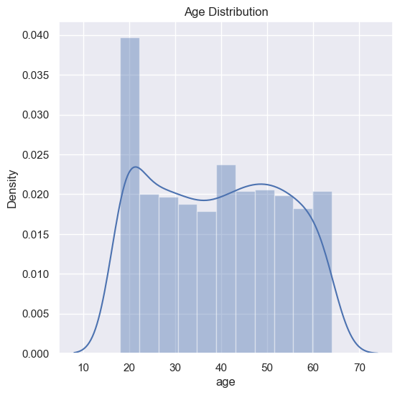
Project data
We started by visualizing the distribution of ages using the sns.distplot() function. This plot is crucial to understand whether the ages are evenly distributed or concentrated around specific values. It helps us identify if the dataset has diversity in age groups or if it is dominated by certain age ranges.

Slide 11
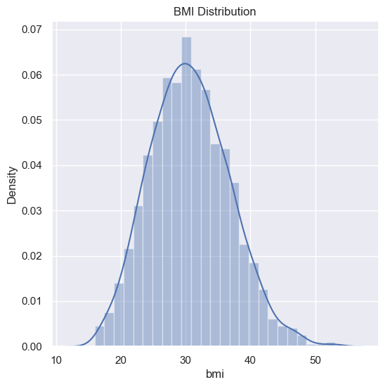
Project data
Next, we visualized the Body Mass Index (BMI) distribution using the same function. This plot reveals whether the BMI values are concentrated in specific ranges, such as whether most individuals are underweight, overweight, or within the normal range. Understanding BMI distribution is significant as it can have a substantial impact on predicting insurance costs.

Slide 12
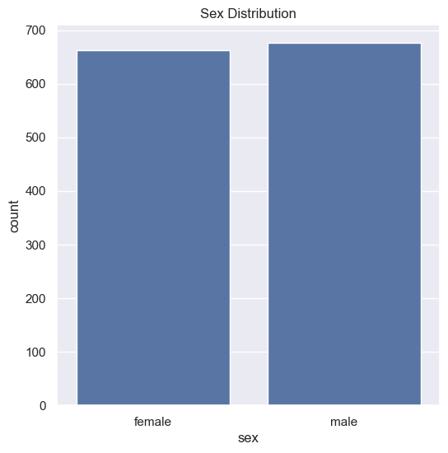
Project data
We then visualized the gender distribution using sns.countplot(). This plot shows the number of males and females in the dataset. It’s essential to identify whether the dataset is balanced in terms of gender or if there’s a disproportionate representation. If the distribution is imbalanced, different approaches may be needed to ensure robust analysis.

Slide 13
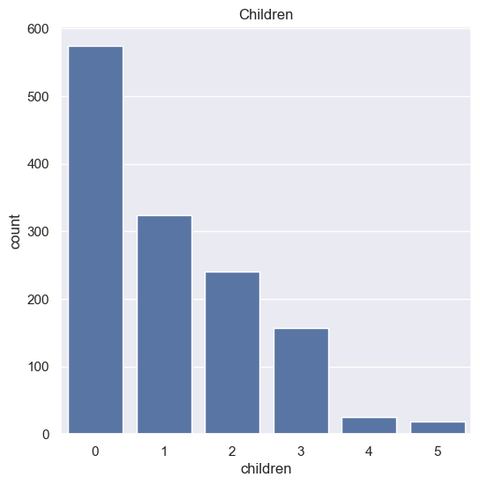
Project data
We also explored distributions for Number of Children: To analyze how having children impacts insurance costs.

Slide 14
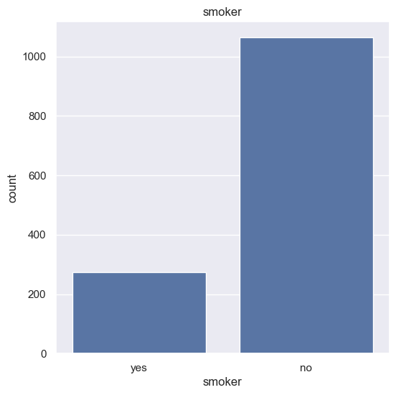
Project data
We also explored distributions for Smoking Status: To understand the prevalence of smokers and their potential influence on insurance costs.

Slide 15
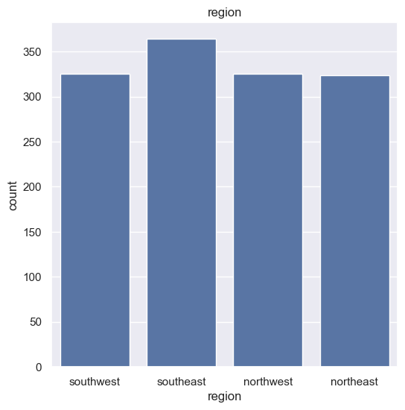
Project data
We also explored distributions for Geographic Region: To check the distribution across different regions and identify any regional trends.

Slide 16
Thanks!

