Slide 1

Sprocket Central Pty Ltd
Data analytics approach
Omar mohamed

Slide 2
Agenda
Introduction
Data Exploration
Model Development
Interpretation

Slide 3
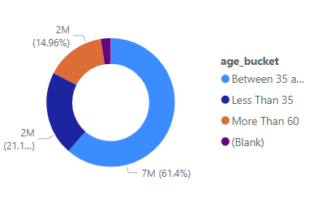
Introduction
The analysis of sales data was on purpose to increase revenue, this analysis demonstrates the following:
Relation between age and sales
Revenue by brand
Times of high and low sales actions

Slide 4
Data Exploration
Data provided includes tables for transactions and customers.
After understanding we used the two tables combined together to drive our suggestions

Slide 5
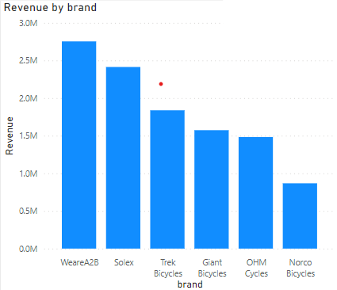
Model Development
Using visualizations to demonstrate the relation between different parameters, we found the follows:
WeareA2B product is the most profitable brand
Customers of age between 35 and 60 seems to be do most purchases
Peak sales is in April and October

Slide 6
Interpretation
Based on our insights, we suggest the following:
Give promotions to customers in February and June (months with least sales)
If applicable, provide free shipping for people above 60
Place any supporting images, graphs, data or extra text here.

