Slide 1
FunnelStream
16,617
Sessions
Real-time e-commerce and campaign analytics: from the first click to the next morning's report
16,120
Product views
Kafka | Spark | Delta | Databricks | Postgres | Grafana | Power BI
5,578
Cart
Presented By:
Omar Mohamed Hosny
Fatma Moataz
Rofaida Ramadan
Asmaa Saleh
Somaia Mahmoud
2,486
Checkout
1,723
Orders
Notes:
[0:45] Good morning. We are the FunnelStream team. FunnelStream is a data platform for an online store: it takes every click, order, delivery, ad number and stock movement, and turns them into two things: a live view for the people who run the store today, and a trusted report for the people who spend the advertising money. The funnel on the right is a real page of our report: 16,617 sessions end in 1,723 orders. The data is simulated, and I will say so whenever it matters. In 20 minutes I will show the business problem, the architecture, how we keep the data clean, and the two dashboards.
Planned time: 0:45.

Slide 2
1 BUSINESS CONTEXT
Three questions a store cannot answer from one place
1
2
3
Which campaign really pays?
Ads are paid per click, but cash-on-delivery orders are often cancelled or fail delivery. Return on ad spend measured on placed orders overstates the result.
Where do shoppers drop out?
View, cart, checkout, order. Which step, on which channel and platform, should be fixed first?
What needs action right now?
Which products and dark stores are out of stock, is the 20-minute express promise holding, and is advertising still sending shoppers to empty shelves?
Operations user
Acts within a minute. Needs live traffic, real stock and the express promise.
Marketing user
Reads yesterday each morning. Needs trusted campaign, funnel and sales numbers.
FunnelStream
2
Notes:
[1:15] An online store in Egypt spends money on Meta and Google ads, ships mostly cash on delivery, and in the quick-commerce case promises delivery from a dark store in 20 minutes. Three questions are hard to answer in one place. First: which campaign really pays. Cash-on-delivery orders are often cancelled or fail delivery, so return measured on placed orders flatters the campaign. Second: where shoppers drop out between view, cart, checkout and order. Third: what needs action right now, which products are out of stock and whether ads are still sending shoppers to empty shelves. Two different people ask these questions: an operations user who must act within a minute, and a marketing user who reads yesterday's results.
Planned time: 1:15.

Slide 3
1 BUSINESS CONTEXT
One stream of events, two lanes, two users
The online store
Customers browse, add to cart, check out
Orders are packed, shipped, delivered, cancelled or returned
Eight dark stores hold stock
Campaigns bring the traffic
All simulated
Live lane: seconds to a minute
Postgres and Grafana, 8 alert rules.
For operations: which product is out of stock, is express on time, is the pipeline healthy.
Kafka, Bronze, Silver
Every event is kept raw.
Then checked, typed and deduplicated once.
One trusted copy feeds both lanes.
Batch lane: next morning
Databricks Gold with 66 quality checks, Power BI.
For marketing: spend, ROAS, funnel, customers, delivered revenue.
The bridge only a joined platform can make advertising spend sent to products that were out of stock
FunnelStream
3
Notes:
[1:15] FunnelStream's answer is one stream of events and two lanes. Everything the store does becomes an event in Kafka. We keep every raw message, then clean it once into a trusted copy called Silver. From Silver, a live lane writes small tables to Postgres within a minute and Grafana shows them with eight alert rules: that is for operations. A batch lane publishes Silver to Databricks, builds a Gold star schema with 66 data quality checks, and feeds a seven-page Power BI report: that is for marketing. The yellow bar is the point of the whole project: because both lanes come from the same events, we can tell marketing how much advertising spend landed on products that were out of stock.
Planned time: 1:15.

Slide 4
2 ARCHITECTURE AND DATA ENGINEERING
End-to-end architecture
LIVE LANE | within a minute
Spark Structured Streaming, in Docker
Live sink + Postgres
16 live and serving tables
Grafana
6 dashboards, 8 alerts
Simulator
app events, orders, deliveries, stock of 8 dark stores
Kafka
4 topics, KRaft mode
Bronze
raw messages, append-only
Silver
validated, deduplicated, Delta MERGE
BATCH LANE | next morning
Databricks
Gold galaxy schema, 66 checks
Power BI
7 pages, 103 measures
Mock ad API
Meta and Google campaigns
Airflow
daily ad report, 03:00 UTC
Quarantine
rejected rows, with a reason
Daily marts in Postgres
inventory, express, D-1 marketing
Everything left of Databricks runs on one Windows laptop in Docker. Gold is written only by the Databricks build.
FunnelStream
4
Notes:
[1:30] This is the whole system on one slide. On the left, the simulator produces app events, orders, deliveries and stock for eight dark stores, and a mock ad API stands in for Meta and Google. Events go into Kafka. A Spark Structured Streaming job in Docker writes Bronze, the raw copy, then Silver, the validated and deduplicated copy; rows that fail validation go to a quarantine table with a reason. From Silver the system splits. The live lane, in green, recomputes small tables in Postgres after each batch and Grafana reads them. The batch lane, in blue, publishes Silver to Databricks, where the Gold star schema is built and checked by 66 SQL checks; Power BI reads Gold and the daily marts. Airflow pulls the ad report once a day. Everything left of Databricks runs on one laptop in Docker.
Planned time: 1:30.

Slide 5
2 ARCHITECTURE AND DATA ENGINEERING
Data sources and ingestion: a seeded, noisy store simulator
App and web events
Product view, cart, checkout, purchase. Anonymous sessions are keyed by session_id.
Orders and deliveries
Created only after checkout. Full lifecycle with cancel, return and failed delivery.
One envelope for every event
{
"event_id": ...,
"event_type": ...,
"event_version": ...,
"event_time": ...,
"payload": { ... }
}
Stock events
Snapshots and movements for 8 dark stores. Stock never goes below zero.
Mock ad API
Meta and Google campaigns, pulled daily by Airflow into Silver.
Noise on purpose, seeded and counted
1% duplicate events, 0.3% malformed JSON, 2% late events, 3% dirty city text, bots, out-of-order order status.
A noise manifest records what was injected. After Silver, the quarantine count must match it.
Egyptian realism
EGP, cash on delivery, Fawry, Vodafone Cash, InstaPay; Bosta, Aramex, J&T; Ramadan and Eid peaks; business day in Cairo time.
FunnelStream
5
Notes:
[1:15] Data starts in a seeded simulator, so the same seed gives the same customers and events and every demo is repeatable. It produces app and web events with a realistic drop-off at each funnel step, orders and deliveries with a full lifecycle, stock events for eight dark stores, and campaign numbers from a mock ad API. We made it Egyptian on purpose: pounds, cash on delivery, Fawry and InstaPay, Bosta and Aramex, Ramadan and Eid peaks. Every event has the same envelope: an id, a type, a version, a time and a payload. And the simulator is deliberately dirty: duplicates, malformed JSON, late events, dirty text. It writes down how much noise it injected, so later the pipeline can prove it caught all of it.
Planned time: 1:15.

Slide 6
2 ARCHITECTURE AND DATA ENGINEERING
Streaming: Kafka decouples producers from processing
Producers
The simulator. acks=all and idempotent, so a retry never writes twice.
Topic | Carries | Key | Partitions
app.events | 10 app and web event types | session_id | 6
orders | 7 order status events | order_id | 3
delivery.events | 3 delivery events | order_id | 3
inventory.events | stock snapshots, movements | store_id | 3
Kafka 3.7, KRaft, 4 topics
Keeps messages while the job is down. Replays after a crash.
Keys keep order. All events of a session, or of an order, go to one partition in sequence.
Producers and the lake never talk to each other. Either side can fail or be replaced.
Replay is safe. Silver writes are idempotent, so reading a message twice changes nothing.
Consumer: the Spark job
Reads each topic in micro-batches. Its checkpoints hold the committed offsets, so a restart resumes where it stopped.
FunnelStream
6
Notes:
[1:15] Kafka sits between the producers and everything else. Four topics: app.events with six partitions keyed by session, orders and delivery.events keyed by order id, and inventory.events keyed by store. The key matters: all events of one order land in one partition and stay in order. Our producer uses acks equals all and idempotence, so a retry does not write twice. The consumer is a Spark job that reads in micro-batches and stores the committed offsets in checkpoints. That is the point of the messaging layer: if the Spark job is killed, Kafka keeps the messages, and the restarted job resumes from its checkpoint. In the HTML version the dots show the data flowing.
Planned time: 1:15.

Slide 7
2 ARCHITECTURE AND DATA ENGINEERING
Processing: from a raw message to a trusted row
One event, end to end: an order_created message on the orders topic
1
2
3
4
5
Kafka
A new order. Topic orders, key order_id.
Bronze
Raw value plus partition, offset and ingest time. Nothing changed, nothing dropped.
Validate
Schema contract per event type. A bad row goes to quarantine with an error code.
Silver
Typed, UTC, deduplicated on event_id, written with a Delta MERGE. Status by rank.
Consumers
Live sink: Postgres within a minute. Publish: Databricks, then Gold.
Rejected rows go to quarantine with one of these reasons
BAD_JSON
MISSING_FIELD
UNKNOWN_EVENT_TYPE
BAD_VERSION
NEGATIVE_PRICE
FUTURE_TIMESTAMP
UNKNOWN_PRODUCT
Evidence, 13 October 2026: quarantine count matched the noise manifest (308 expected, 308 observed). Replaying Bronze left all 10 Silver tables unchanged.
FunnelStream
7
Notes:
[1:30] Follow one message: a new order. It arrives on the orders topic with the order id as key. Bronze stores the raw value plus the Kafka partition, offset and ingest time, and never changes it. Then the validator checks it against a versioned schema. If the JSON is broken, a field is missing, the price is negative, the timestamp is in the future or the product is unknown, the row goes to quarantine with an error code and never reaches the numbers. If it passes, Silver types it, converts the time to UTC, deduplicates on the event id and writes it with a Delta MERGE on the key, so a replay inserts nothing. Order status is decided by rank, not by arrival order. Two checks prove it: the quarantine count equals the noise the simulator injected, 308 for 308, and replaying Bronze left all ten Silver tables unchanged.
Planned time: 1:30.

Slide 8
2 ARCHITECTURE AND DATA ENGINEERING
Storage: three layers, three places
Bronze
raw, never changed
bronze_app_events
6 partitions of raw messages
bronze_orders
order status messages
bronze_delivery_events
delivery messages
bronze_inventory_events
stock messages
Silver
trusted, one row per key
silver_events
one app event
silver_orders, _status, _items
order, status change, line
silver_stock_*, _express_orders
stock and express
silver_quarantine
rejected rows
Gold
business ready, Databricks
fact_orders, _lines, _attribution
last and first touch
dim_customer, dim_product
slowly changing (SCD2)
agg_orders, funnel, campaign, city_product
daily aggregates
customer_360
one row per customer
Local lake
Bronze and Silver: Delta folders on disk, rebuildable
Databricks, Unity Catalog
Silver mirror and 12 Gold tables
Postgres 16
16 live and serving tables, daily marts
FunnelStream
8
Notes:
[1:15] Data lives in three layers. Bronze keeps every raw message and is never changed. Silver is trusted: one row per key, typed, deduplicated, with a quarantine table for rejected rows. Both run as Delta folders on the laptop, and Silver can be rebuilt from Bronze at any time. Gold is business ready and lives in Databricks: facts for orders, order lines and attribution, slowly changing dimensions for customers and products, daily aggregates for orders, funnel, campaigns and city by product, and a customer 360 table. Twelve Gold tables are built; a thirteenth slot for recommendations is empty on purpose. Operational data for Grafana lives in Postgres: sixteen small live and serving tables, plus the daily marts that Power BI also reads.
Planned time: 1:15.

Slide 9
2 ARCHITECTURE AND DATA ENGINEERING
Reliability: crash, duplicates, late and bad data
When this happens | this protects the data
The Spark job is killed | Checkpoints hold the Kafka offsets. The restart resumes from them.
A message arrives twice | Silver MERGE on the key inserts nothing the second time.
An event arrives late | Flagged is_late. Left out of live metrics, corrected by the batch.
A row is bad | Quarantined with a reason. Never in the numbers.
Databricks is unavailable | A second Gold store backend loads the tables into Postgres.
Airflow: ads_yesterday_report
Runs at 03:00 UTC. Pulls the ad API once for yesterday and stores a snapshot. Retries on HTTP 503. A rerun returns the stored report without calling the API.
Failure demo, measured twice
NO DUPLICATES
Alert "Silver job silent" fired 2 min 12 s and 2 min 54 s after the kill. The promise is within 3 minutes.
The check covers Silver only.
FunnelStream
9
Notes:
[1:15] Reliability is built in layers. If the Spark job is killed, checkpoints hold the Kafka offsets and the restart resumes from them. If a message is delivered twice, the MERGE on the key inserts nothing. Late events are flagged and left out of live metrics, and the batch corrects them. Bad rows are quarantined. If Databricks is unavailable, there is a second Gold store backend that loads the same tables into Postgres. Airflow runs one DAG, the daily ad report at 03:00 UTC, with retries on API errors; a rerun returns the stored report. The box on the right is the proof: we killed the Silver job while data was flowing, watched Grafana's alert fire 2 minutes 12 and 2 minutes 54 seconds later in two runs, restarted it, and the duplicate check said no duplicates both times. To be exact, that check covers Silver only.
Planned time: 1:15.

Slide 10
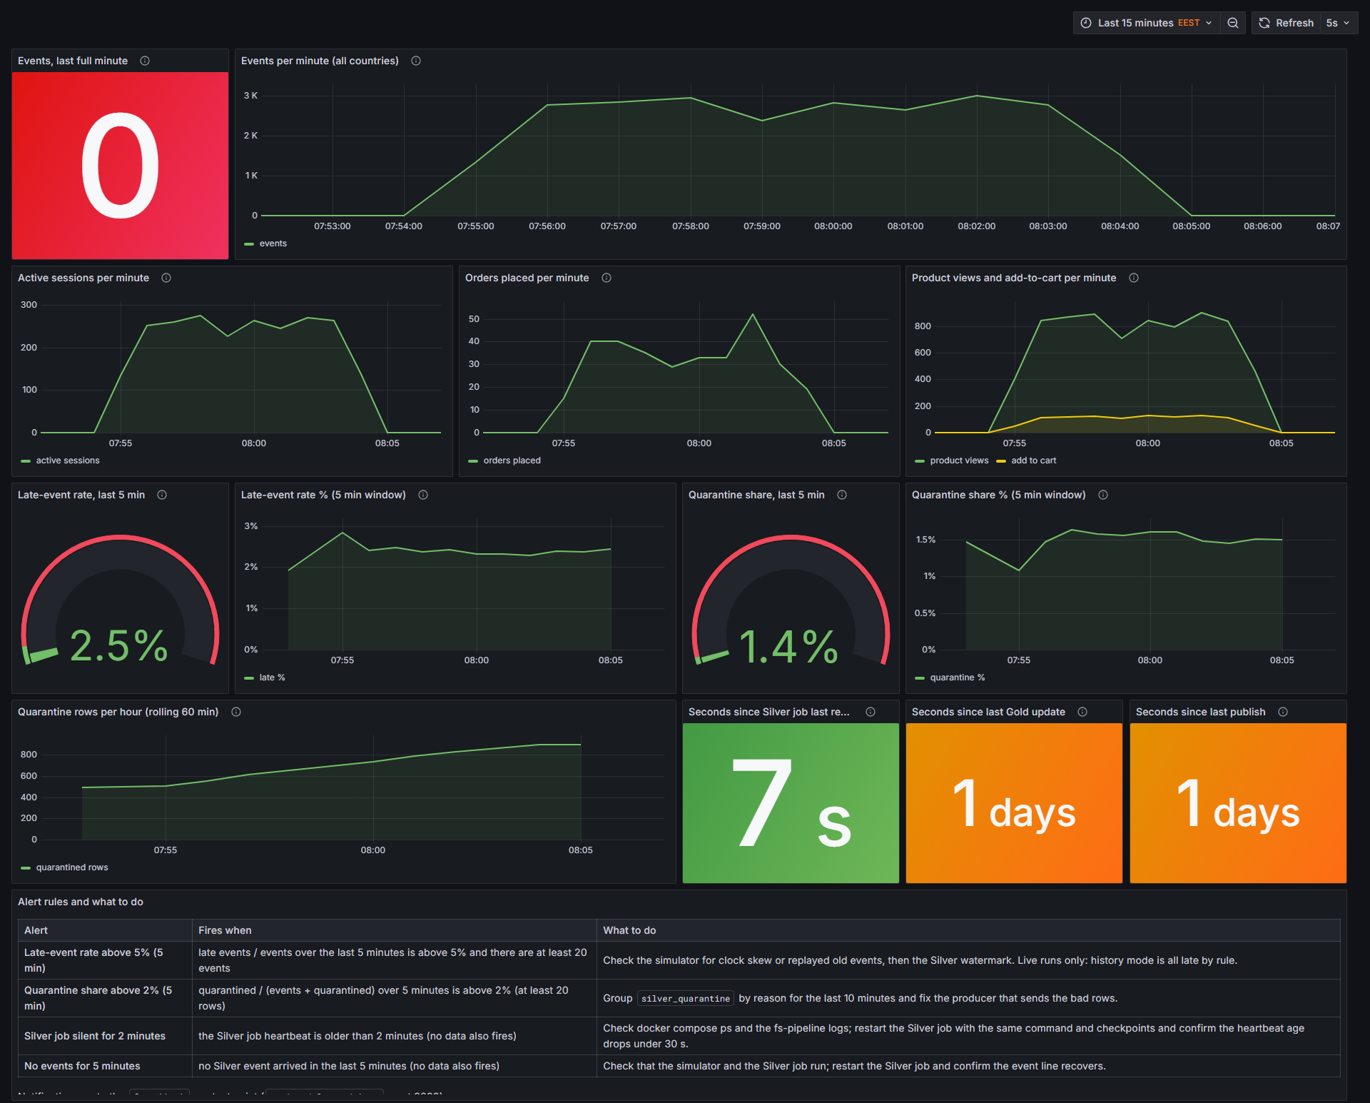
3 OBSERVABILITY AND BUSINESS INTELLIGENCE
Grafana: is the pipeline alive and clean?
What the engineer reads
Traffic. Events, active sessions and orders per minute show whether the stream is alive.
Quality. Late-event rate 2.5% and quarantine share 1.4% sit under the alert limits of 5% and 2%.
Liveness. The Silver job reported 7 seconds ago. No report for 2 minutes fires an alert.
Batch lane. Gold update and publish age show 1 day in this capture, because the batch runs on demand.
Alert table. Each rule says when it fires and what to do.
Grafana, Pipeline live, captured at the end of the 13 October 2026 rehearsal. The generator had just stopped, so events per minute is 0.
FunnelStream
10
Notes:
[1:15] Now the operational side. This is the Grafana dashboard Pipeline live, captured at the end of our 13 October rehearsal, which is why events per minute has dropped to zero: the generator had just stopped. Along the top: events per minute, active sessions, orders and product views with add to cart. In the middle are the two data quality gauges: late-event rate 2.5% and quarantine share 1.4%, both below the alert limits of 5% and 2%. Bottom right: the Silver job last reported 7 seconds ago, and if that number passes two minutes an alert fires. The orange tiles show the age of the last Gold update and publish, one day here, because the batch lane runs on demand. And at the bottom, every alert rule is written out with what to do when it fires. Six dashboards and eight alert rules are provisioned as code.
Planned time: 1:15.

Slide 11
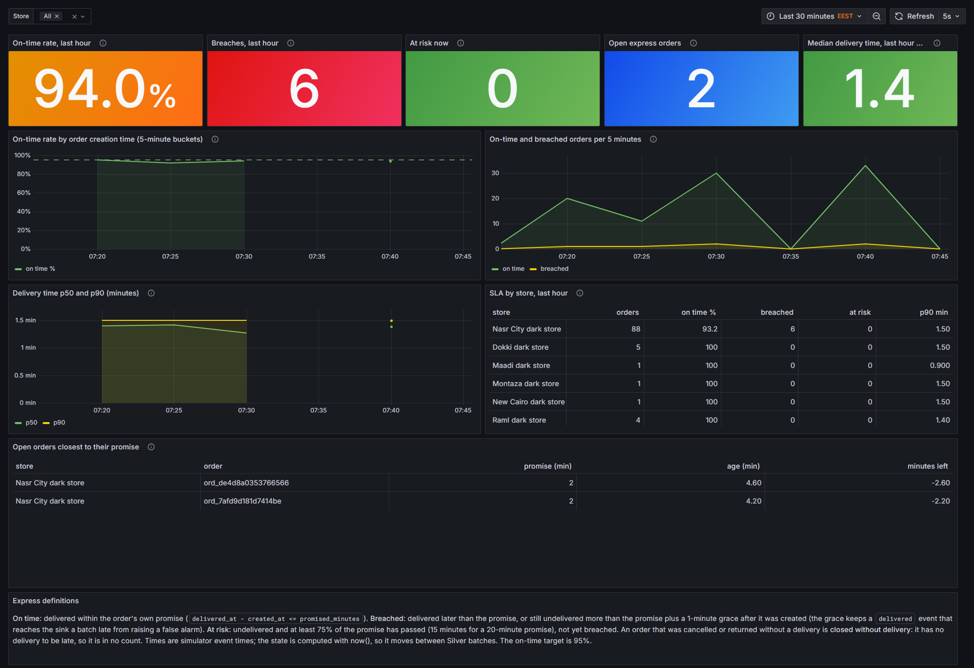
3 OBSERVABILITY AND BUSINESS INTELLIGENCE
Grafana: is the 20-minute express promise holding?
What operations reads
On-time rate 94.0% against the 95% target, so the tile is orange.
6 breaches in the last hour, 0 orders at risk now, 2 open express orders.
By store and by order. The table names the store, the open orders closest to their promise and the minutes left.
Rehearsal setting. The promise was 20 minutes and some express orders were forced late, so that a breach and its alert can be shown live.
Grafana, Express SLA, rehearsal of 13 October 2026 with the promise shortened to 20 minutes.
FunnelStream
11
Notes:
[1:00] The second Grafana view is for operations. Express orders carry their own promise, 20 minutes in production. This dashboard shows the on-time rate for the last hour, here 94.0% against a 95% target, so the tile is orange; the number of breaches; orders at risk now, meaning at least 75% of the promise has passed; and a table of the open orders closest to their promise, with the minutes left. For the demo we shorten the promise to two minutes and force some express orders late, so that a breach and its alert appear live. The same family of dashboards shows live stock per store, out-of-stock products, and demand that arrived at an empty shelf.
Planned time: 1:00.

Slide 12
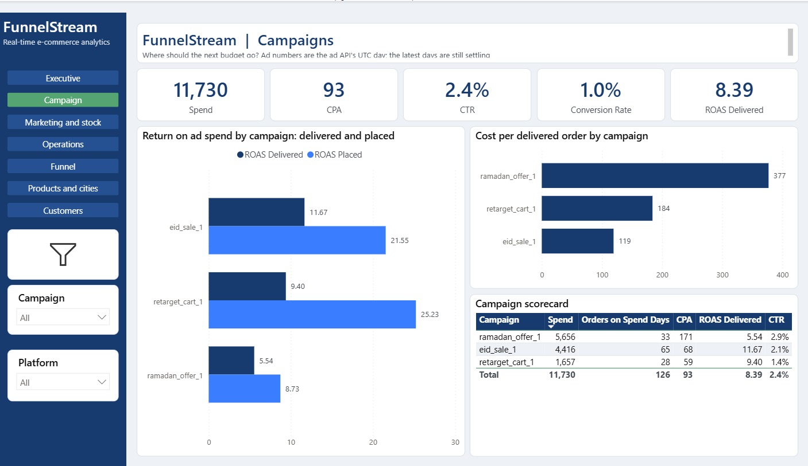
3 OBSERVABILITY AND BUSINESS INTELLIGENCE
Power BI: where should the next budget go?
What marketing reads
Headline ROAS is on delivered orders: 8.39. On placed orders it is higher everywhere (eid_sale_1: 21.55 placed, 11.67 delivered), because cash-on-delivery orders cancel or fail.
Cost per delivered order: 377 for ramadan_offer_1, 184 for retarget_cart_1, 119 for eid_sale_1.
A possible decision: move budget toward eid_sale_1 and question ramadan_offer_1. Attribution is last touch, so it is a lead, not proof.
Power BI, Campaigns page. Simulated data. Ad numbers use the ad API's UTC day.
FunnelStream
12
Notes:
[1:15] Power BI is the business layer, and it reads the Gold tables and the daily marts. This is the Campaigns page, on simulated data. The headline return on ad spend is measured on delivered orders: 8.39. Look at the chart on the left: for every campaign, return on placed orders is much higher than on delivered ones, for example 21.55 against 11.67 for the Eid sale. That gap is exactly the cancelled and failed cash-on-delivery orders, and it is the first question we set out to answer. On the right, cost per delivered order is 377 for the Ramadan offer and 119 for the Eid sale. A marketer could move budget toward the Eid sale and question the Ramadan offer. We state the limit: attribution is last touch, which favours bottom-funnel channels, and neither model proves incrementality.
Planned time: 1:15.

Slide 13
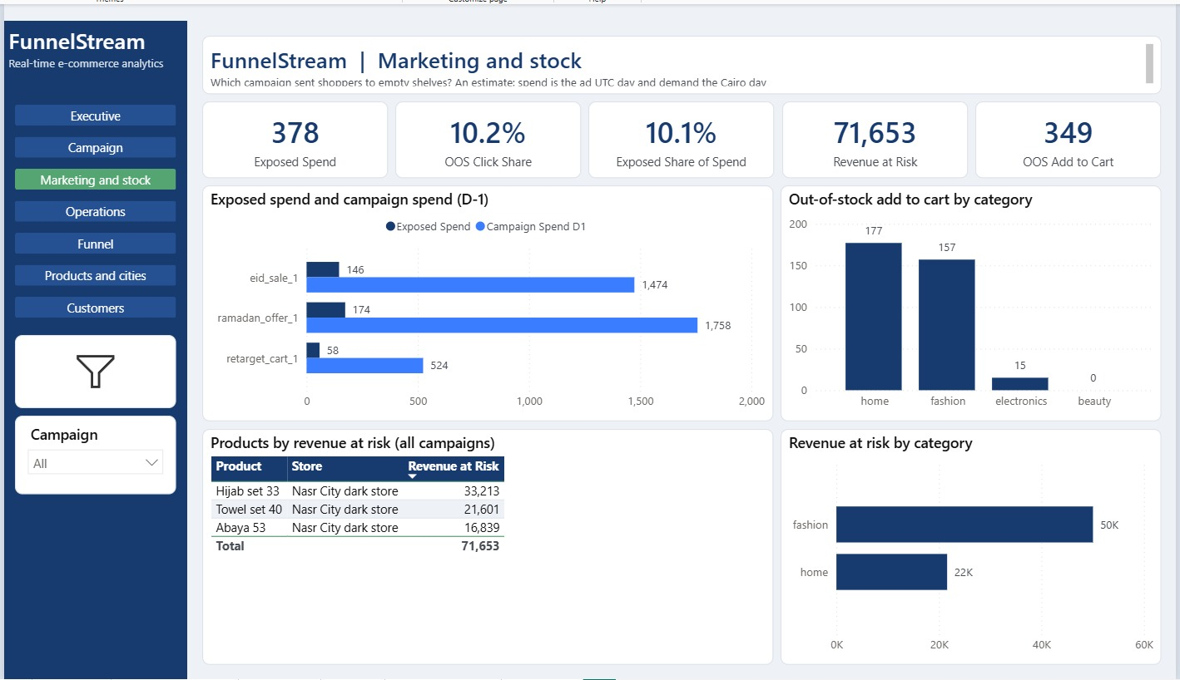
3 OBSERVABILITY AND BUSINESS INTELLIGENCE
Power BI: the bridge, ad spend sent to empty shelves
What the bridge shows
Exposed spend 378, 10.1% of spend: estimated spend that landed on products out of stock.
10.2% of landing clicks went to out-of-stock products. Revenue at risk: 71,653.
All three at-risk products are in one store: Nasr City dark store (Hijab set 33, Towel set 40, Abaya 53).
Label it honestly: a shopper may buy a substitute, so this is exposure, not loss.
Power BI, Marketing and stock page, day minus one. Simulated data. An estimate, not a measured loss.
FunnelStream
13
Notes:
[1:15] This is the page that only a joined platform can build. Marketing and stock combines the ad spend of day minus one with the out-of-stock demand that operations saw in Grafana. Exposed spend is 378, which is 10.1% of that day's spend; 10.2% of landing clicks went to products that were out of stock; and revenue at risk, meaning add-to-carts on empty shelves times price, is 71,653. The table shows that all three at-risk products are in one store: Nasr City. A marketing manager would pause or redirect ads for those products until they are restocked. We label it as an estimate: the ad API only reports spend per campaign per day, so we assume spend is spread evenly over served landing clicks, and a shopper might buy a substitute.
Planned time: 1:15.

Slide 14
3 OBSERVABILITY AND BUSINESS INTELLIGENCE
From a stock-out to next morning's report
1
2
3
4
5
6
Stock runs out
A hero product at Nasr City reaches available = 0, about 4 minutes into the demo run.
Demand continues
Shoppers still view it and add it to the cart. Empty stock does not stop demand.
Live sink flags it
Each demand minute is marked: out of stock when the minute was written.
Alert fires
Grafana alert on demand for out-of-stock products fires 1 minute after the stock-out.
Restock
About 2 minutes after the stock-out. The out-of-stock count falls to 0.
Next morning
The D-1 mart prices the exposure. Power BI shows exposed spend and revenue at risk.
How the next morning's number is computed
oos_click_share
= out-of-stock landing clicks / served landing clicks
exposed_spend
= spend x oos_click_share
revenue_at_risk
= add-to-carts on out-of-stock products x price
Measured on 12 October 2026 on the demo: Galabeya 61 at the Nasr City dark store, stock-out at 21:16:14 Cairo time, alert 1 minute later, restock about 2 minutes later. Simulated data.
FunnelStream
14
Notes:
[1:15] Let me tell the whole story once. In our demo scenario a popular product at the Nasr City dark store is deliberately made to run out. On 12 October, the Galabeya 61 reached zero stock at 21:16:14, about four minutes into the run. Shoppers keep viewing it and adding it to the cart: empty stock does not stop demand, and that lost demand is what we measure. The live sink marks each demand minute as out of stock when the minute was written. One minute after the stock-out the Grafana alert fires, and about two minutes after, the product is restocked. That is the operations ending. The marketing ending comes the next morning: the daily mart takes the out-of-stock click share, multiplies it by the spend, and Power BI shows exposed spend and revenue at risk. One set of events, two users, one bridge.
Planned time: 1:15.

Slide 15
4 QUALITY AND CLOSE
Quality and measured results
1,169
217
66
654.73 s
2 of 2
host tests passed, 0 failed
Spark tests passed in Docker, 22 files
data quality checks, 0 failed, on the Gold build
for 1,000,000 simulated events through the whole pipeline
kill and restart runs ended with NO DUPLICATES
13 Oct 2026
12 Oct 2026
scratch catalog, 13 Oct
one laptop, 12 Oct
12 Oct 2026
How to read these numbers
The benchmark measures one setup (Docker limited to about 8 GB, a Databricks Free Edition SQL warehouse). It is not a capacity claim.
Still open on 13 October
One uninterrupted green run of the full smoke test with the Spark stage. The stages passed in two parts, and the three failures of the first run were fixed in the test scripts.
FunnelStream
15
Notes:
[1:15] Quality is part of the product, so here are the measured results, each with its date. The full host test suite: 1,169 tests passed, none failed. The Spark tests, run in Docker one file at a time: 217 passed. The Gold build ran 66 data quality checks with no failure on the scratch catalog. The benchmark pushed 1,000,000 simulated events through the whole pipeline in 654.73 seconds on one laptop. And the failure demo ended with no duplicates in two runs out of two. Two honesty points. The benchmark is one setup and not a capacity claim. And one item is still open: a single uninterrupted green run of the whole smoke test including the Spark stage; its first full run had three failures that turned out to be test script issues and were fixed.
Planned time: 1:15.

Slide 16
4 QUALITY AND CLOSE
What FunnelStream shows, and what comes next
Shown
A streaming pipeline that survives a crash without duplicates
Bad data quarantined with a reason, counted against the injected noise
Two audiences served from the same events
The bridge: exposed ad spend
Honest limits
All data is simulated
Exposed spend is an estimate
Stock is not put back on cancel or return
Measured on one setup: one laptop, Databricks Free Edition
Next
Replay-safe stock intervals from Silver
Stock reversal on cancel and return
Great Expectations or dbt on the SQL checks
Delivery zones and a Store dimension in Gold
Thank you. Questions?
Notes:
[1:30] To close. FunnelStream shows a streaming pipeline that survives a crash without duplicates, bad data that is quarantined with a reason and counted against the noise we injected, and two audiences served from the same events, with one bridge between them: advertising spend sent to products that were out of stock. The honest limits: all data is simulated, exposed spend is an estimate, stock is not put back when an order is cancelled or returned, and the measurements come from one setup. What comes next: replay-safe stock intervals built from Silver, stock reversal on cancellation, Great Expectations or dbt on top of the SQL checks, and delivery zones with a Store dimension in Gold. Thank you. We are happy to take questions; the next four slides are backup.
Planned time: 1:30.

Slide 17
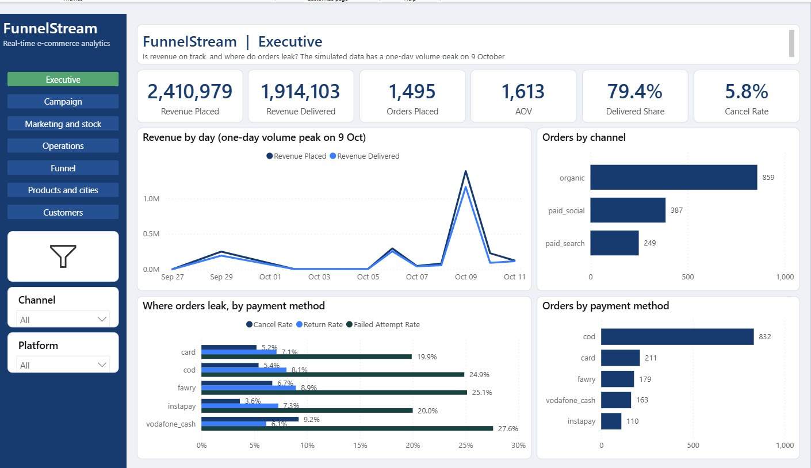
BACKUP
Power BI: Executive page
What it shows
Revenue placed 2,410,979, delivered 1,914,103: 79.4% delivered share, 5.8% cancel rate.
One-day peak on 9 October holds about 55% of all revenue in the simulated data. The page says so.
Where orders leak: failed-attempt rate is highest for vodafone_cash (27.6%) and fawry (25.1%).
Power BI, Executive page. Simulated data.
FunnelStream
17
Notes:
Backup. Executive page of the Power BI report.

Slide 18
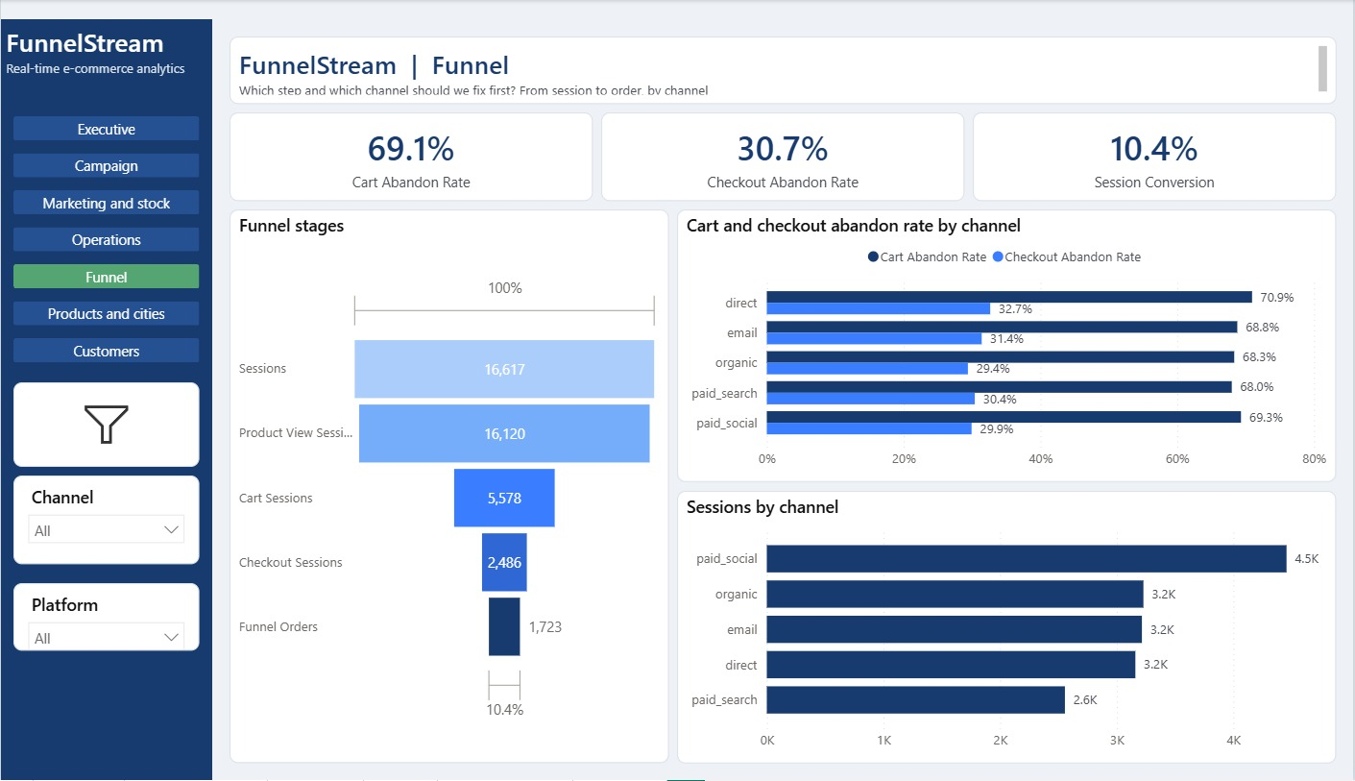
BACKUP
Power BI: Funnel page
What it shows
16,617 sessions end in 1,723 orders: 10.4% session conversion.
Cart abandon rate 69.1%, checkout abandon rate 30.7%.
By channel: direct has the highest cart abandon rate (70.9%); paid_social brings the most sessions (4.5K).
Power BI, Funnel page. Simulated data.
FunnelStream
18
Notes:
Backup. Funnel page of the Power BI report.

Slide 19
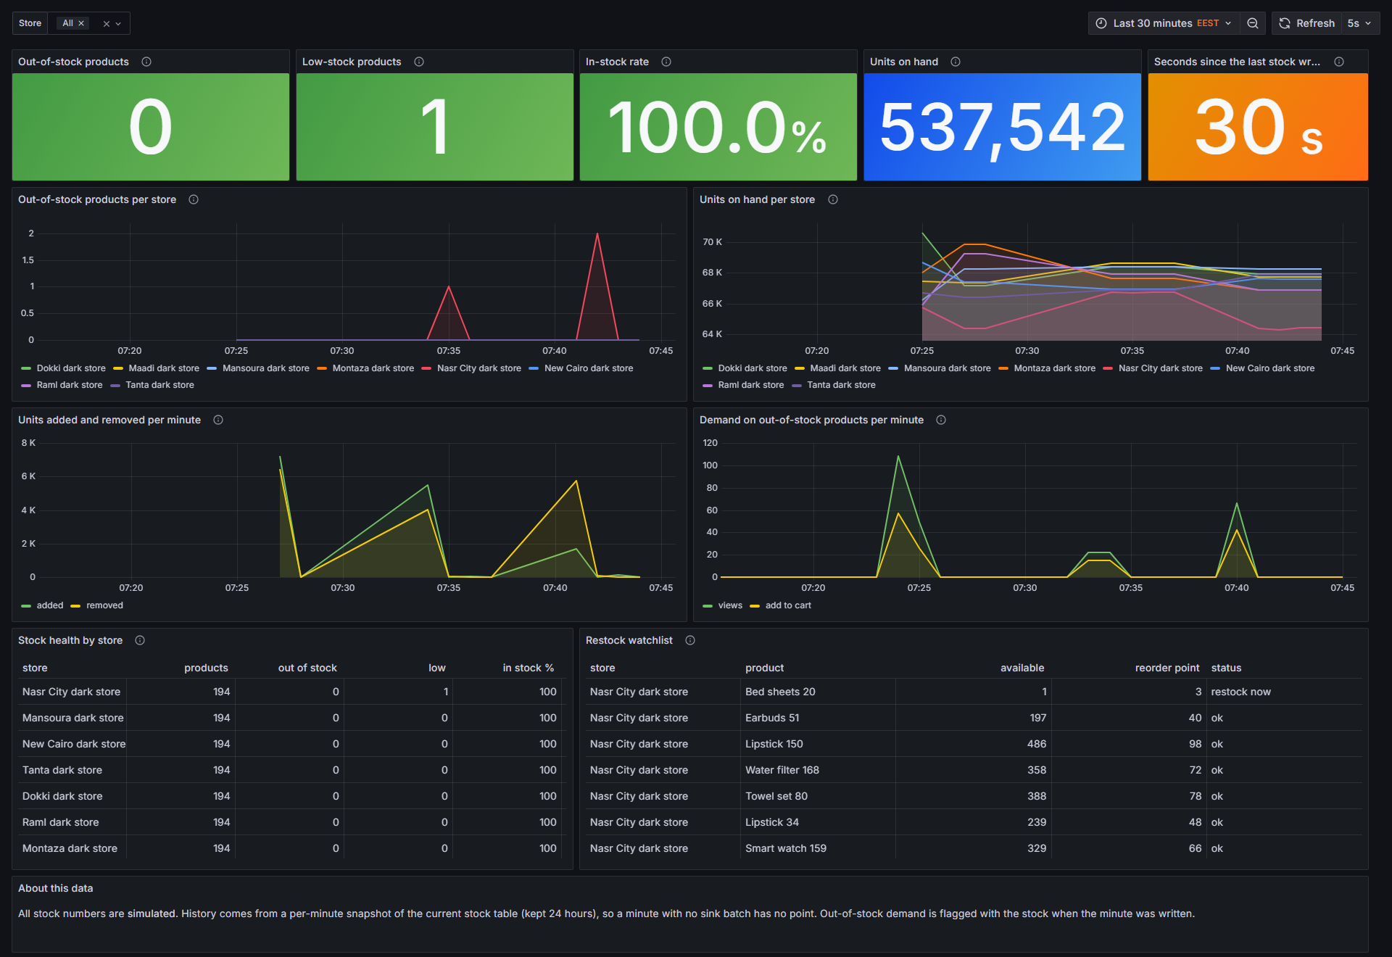
BACKUP
Grafana: live stock monitor
What operations reads
537,542 units on hand, 0 out-of-stock products, 1 low-stock product, in-stock rate 100%.
Restock watchlist: Bed sheets 20 at Nasr City has 1 unit against a reorder point of 3: restock now.
Demand on out-of-stock products per minute is the live version of the bridge.
Grafana, Live stock monitor, rehearsal of 13 October 2026. All stock numbers are simulated.
FunnelStream
19
Notes:
Backup. Live stock monitor dashboard.

Slide 20
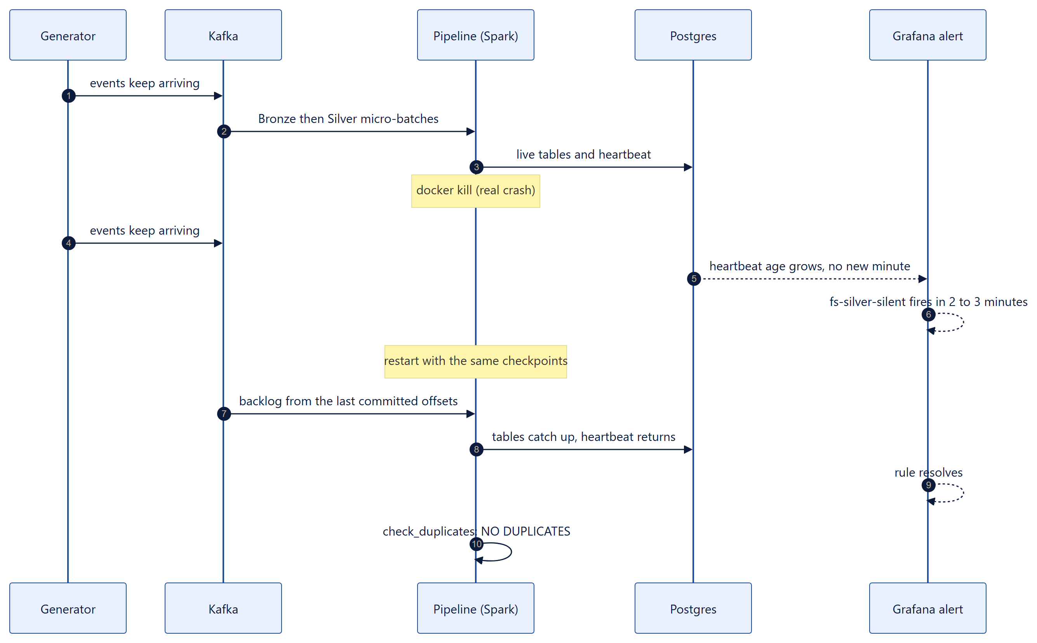
BACKUP
Failure demo: kill, alert, restart, no duplicates
Measured twice, 12 October 2026
Alert fired 2 min 12 s and 2 min 54 s after the kill.
Heartbeat back under 30 s about 40 s and 35 s after the restart.
NO DUPLICATES: 8,469 events and 16,404 events in Silver.
Scope: Silver only. It does not prove that no event was lost.
FunnelStream
20
Notes:
Backup. Sequence of the failure demo.

