Slide 1
e&
CSAT & Productivity Review
e& (Etisalat) Inbound · Mobile & TV · May – July 2021
4.01
75.7%
7:57
500,884
Avg CSAT
CSAT % (4-5)
AHT (mm:ss)
Answered calls
MIS Specialist assessment · Omar Moussa
Notes:
Purpose: summarise what the CSAT and productivity dashboard shows for the e& inbound account over May-July 2021, what is driving it, and what I recommend. Scope = agents on the monthly Active List.

Slide 2
EXECUTIVE SUMMARY
Customers are satisfied, but handling time is drifting up
Three months, 6,914 surveys and 500,884 answered calls from 232 rostered agents
4.01
20.8%
+18%
3×
Avg CSAT (1-5) · July 3.96
DSAT %: 1 in 5 surveys scores 1-2
AHT May → Jul (430s → 508s)
Hold time: Supervisor 3 vs peers
Productivity is the main risk. AHT rose 78 seconds in two months in both LOBs, mostly from longer talk (+66s) and hold (+14s).
CSAT is polarised. 64% of customers give 5 and 18% give 1. Reducing the 1-scores moves CSAT more than anything else. Knowledge (4.05) trails courtesy (4.40).
One team drives most of the gap. Supervisor 3 has the lowest CSAT (3.88) and the highest AHT (597s), with 71s of hold per call.
WFH agents are 22% faster with the same CSAT (397s vs 512s, 4.02 vs 4.01). This holds for both Mobile and TV.
2
Notes:
One-line story: satisfaction is holding around 4.0, but handle time is rising and a single supervisor group explains a large share of both the CSAT and AHT gap. WFH is a positive outlier worth studying.

Slide 3
APPROACH
One refreshable model feeds every view
1
2
3
4
5
Raw sheets
›
Power Query
›
Star schema
›
25 DAX measures
›
Dashboard
CFM · Productivity · Active List as Excel tables
src_ staging: types, #N/A → null, [n/a] → null, negatives → 0, outlier flag
Fact_CSAT · Fact_Productivity → Dim_Date · Dim_Roster (agent × month)
Avg CSAT, CSAT %, AHT = ΣHandle ÷ ΣCalls, MoM, vs-account gaps
Slicers + timeline + CUBEVALUE KPI cards, pivot charts, drill-down
Scope and data-quality decisions
Account scope = agents on the Active List that month. All surveys match. 57% of productivity calls match; the rest come from agents who never appear on the list.
Roster cleaned: 14 exact duplicates and 34 conflicting agent-month rows resolved; one #N/A Team Leader set to 'Unassigned'.
CFM blanks: only the sub-score comment fields are empty. Sub-scores that were not asked are null (never 0), so averages are not understated.
3
Notes:
Emphasise modelling best practice: staging queries are connection-only, dimensions and facts load to the Data Model, measures live in a dedicated _Measures table, and AHT is always calculated as a ratio of sums, never an average of daily AHT. Every data-quality treatment is listed live on the Data Notes sheet.

Slide 4
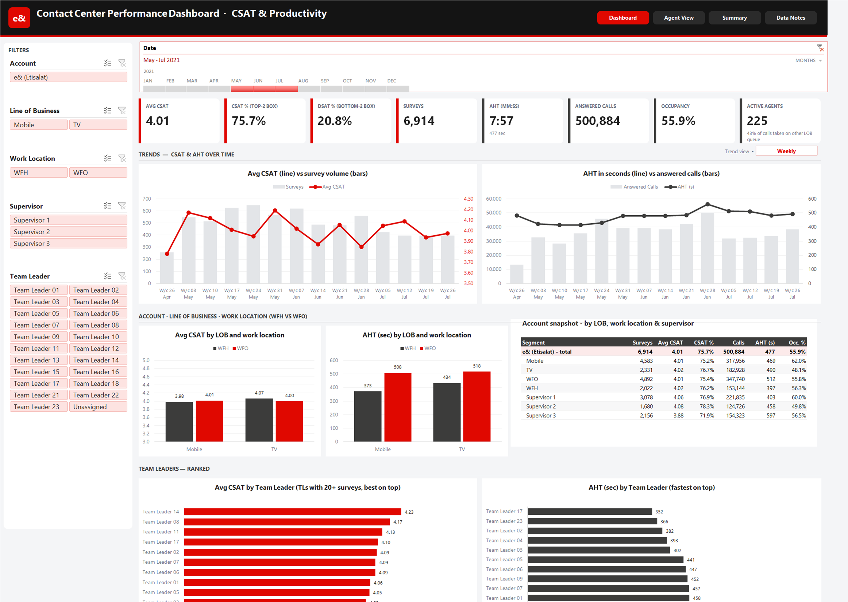
THE DASHBOARD
Four pages, one set of filters
Dashboard
KPI cards, CSAT and AHT trends with a Monthly/Weekly/Daily switch, LOB × WFH/WFO, account snapshot, Team Leader ranking
Agent View
Leaderboard (10+ surveys) with colour scales and a CSAT vs AHT quadrant for coaching
Summary
Drill-down Account → LOB → Supervisor → TL → Agent, plus WFH vs WFO by month
Data Notes
Assumptions, star-schema map, live DQ checks, DAX dictionary
4
Notes:
Demo path: pick July on the timeline (the KPI cards then show month-on-month change), filter Supervisor 3, switch the trend view to Daily, then open Agent View to see the coaching quadrant for that team.

Slide 5
TRENDS
AHT up 78 seconds since May; CSAT slipped in July
Longer talk and hold, not after-call work, drive the increase
Watch-outs Week of 28 Jun had the peak AHT (561s) and the lowest full-week CSAT (3.85). Surveys fell 28% from May to July (2,711 → 1,943) while calls held flat, so response rate needs tracking.
5
Notes:
AHT increase is broad-based: Mobile 424 → 501s, TV 442 → 521s. Hold per call grew 45% (30 → 44s), which usually points to knowledge or tool issues rather than agent effort. The first week (26 Apr) only contains 1-2 May, so it is a partial week.

Slide 6
CSAT
CSAT is polarised: fixing the 1-scores is the biggest lever
Score distribution, all 6,914 surveys
4.40
4.05
Courtesy & politeness
Knowledge
Few customers are neutral: only 3.5% score 3. Customers are either delighted or not resolved.
Moving half the 1-scores to 4 would lift Avg CSAT from 4.01 to about 4.28.
Knowledge is the weaker driver (0.35 below courtesy). It points to product and process training, not soft skills.
DSAT is spread out: the top 20% of agents with DSAT account for 42% of 1-2 scores.
6
Notes:
Maths for the lift: 1,254 one-scores; moving 627 of them to 4 adds 627 × 3 / 6,914 = +0.27. Courtesy was asked on 1,105 surveys and knowledge on 991; nulls are excluded, not counted as zero.

Slide 7
TEAMS
Supervisor 3's teams trail on both CSAT and AHT
Talk + hold per call by supervisor (seconds): hold is the clearest difference
Supervisor | Avg CSAT | DSAT % | AHT (s)
Supervisor 1 | 4.06 | 20.3% | 403
Supervisor 2 | 4.08 | 17.9% | 458
Supervisor 3 | 3.88 | 23.7% | 597
Hold is 71s per call, 3× Supervisor 1. AHT jumped 508 → 655s in June.
Bringing hold down to 25s saves ~46s per call, about 1,970 agent-hours a quarter.
Supervisor 3's CSAT is recovering (3.83 → 3.95) while Supervisor 1 declines (4.15 → 3.95).
7
Notes:
Hours saving: (71 - 25) s × 154,323 calls / 3,600 = 1,972 hours over the three months. 18 Team Leaders appear under Supervisor 3 across the three months, including several small or new teams (TL 11, 15, 16, 20-23), which also suggests a newer-agent effect worth checking against tenure data.

Slide 8
TEAM LEADERS
A 2× spread in AHT between Team Leaders
Team Leaders with 100+ surveys: CSAT and AHT (seconds), with hold per call
Highest CSAT
Needs focus
Team Leader | CSAT | AHT | Hold
Team Leader 14 | 4.23 | 723 | 91
Team Leader 08 | 4.17 | 481 | 30
Team Leader 17 | 4.10 | 352 | 16
Team Leader 02 | 4.09 | 382 | 14
Team Leader 07 | 4.09 | 457 | 27
Team Leader | CSAT | AHT | Hold
Team Leader 12 | 3.51 | 679 | 90
Team Leader 13 | 3.75 | 586 | 83
Team Leader 15 | 3.84 | 724 | 75
Team Leader 10 | 3.89 | 595 | 60
Team Leader 18 | 3.89 | 555 | 62
Two patterns. Team Leader 17 and 02 prove fast and satisfying can go together (≈365s, 4.1). Team Leader 14 buys the top CSAT with 723s calls. The 'needs focus' group all show 60–90s of hold, which is where coaching should start.
8
Notes:
On the dashboard, TL ranking only shows Team Leaders with 20+ surveys, to avoid small samples (e.g. 'Unassigned' has 3 surveys at 5.0). This slide uses a stricter 100+ survey threshold.

Slide 9
WFH vs WFO
WFH agents handle calls 22% faster with the same CSAT
AHT in seconds by LOB and work location
4.02
4.01
WFH Avg CSAT
WFO Avg CSAT
19s
46s
WFH hold per call
WFO hold per call
Same result in both LOBs, so it is not a Mobile/TV mix effect.
Caveat: 53 WFH vs 193 WFO agents. WFH may be granted to experienced agents, so validate against tenure before scaling.
9
Notes:
The gap is mostly talk (374 vs 461s) and hold (19 vs 46s). If tenure data confirms a like-for-like advantage, expanding WFH eligibility is a low-cost productivity lever; either way, WFH practices on hold usage (e.g. knowledge base access) are worth copying on the floor.

Slide 10
AGENTS
Speed does not cost satisfaction: coach by quadrant
167 agents with 10+ surveys, split by account average CSAT (4.01) and AHT (477s)
r = −0.12
45
Role models
44
Happy but slow
High CSAT · fast
High CSAT · slow
Correlation between agent AHT and CSAT: close to zero, slightly negative
Use as buddies and for call-listening sessions
Efficiency coaching: hold and call control
Shorter calls do not lower CSAT. AHT reduction can be pursued without trading off quality.
47 agents are in both-red: the most efficient place to spend coaching hours.
The Agent View quadrant updates with every filter, so each TL can see their own team.
31
Fast but unhappy
47
Priority coaching
Low CSAT · fast
Low CSAT · slow
Quality coaching: resolution and knowledge
Structured plan with weekly TL review
10
Notes:
Quadrant thresholds are the account averages for the full period. Agents with fewer than 10 surveys are excluded to avoid noise. On the dashboard the dashed reference lines move with the filters.

Slide 11
DATA QUALITY
Anomalies found and how they were handled
All counts are produced live by the DQ_Checks query in the workbook
43%
48
1
of answered calls come from agents not on that month's Active List
duplicate roster rows (14 exact, 34 conflicting TL/LOB)
#N/A Team Leader cell in the Active List
Excluded from account KPIs; roster completeness needs confirming
One row per agent per month kept
Replaced errors with null → 'Unassigned'
115
26
5.8k
productivity rows with >16h staffed or available time in one day
negative outgoing-call counters
surveys without Courtesy/Knowledge sub-scores ([n/a] or blank)
Flagged; excluded from Occupancy only
Set to 0
Null, not 0, so sub-score averages stay unbiased
11
Notes:
The biggest open question for the business is the 43% of calls from agents not on the Active List: either the roster is incomplete or the productivity extract includes other accounts sharing the same splits. Either way it should be confirmed with WFM before these KPIs are used for targets.

Slide 12
RECOMMENDATIONS
Five actions for the next 90 days
1
Cut hold time in Supervisor 3's teams
Hold 71s → 25s · ~1,970 hrs / qtr
Knowledge-base refresh and floor support for TL 10, 12, 13, 15, 18
2
Attack the 1-scores
DSAT 20.8% → 15%
Daily DSAT callback list and root-cause tagging, starting with the top 20% of DSAT agents
3
Product-knowledge refreshers
Knowledge 4.05 → 4.30
Close the 0.35 gap between knowledge and courtesy scores
4
Coach by quadrant
AHT back to ≤ 450s
Pair 45 role models with the 47 priority agents; weekly TL scorecards from Agent View
5
Fix the data foundation
100% of calls mapped
Confirm roster completeness (43% of calls unmatched); one row per agent per month; keep sub-score comments
12
Notes:
Targets are indicative starting points to agree with operations. All of them can be tracked on the existing dashboard: refresh with new monthly data (Data → Refresh All) and the KPI cards show month-on-month change when a single month is selected.

