Slide 1
Selected 2 Presentation
Team 21

Slide 2
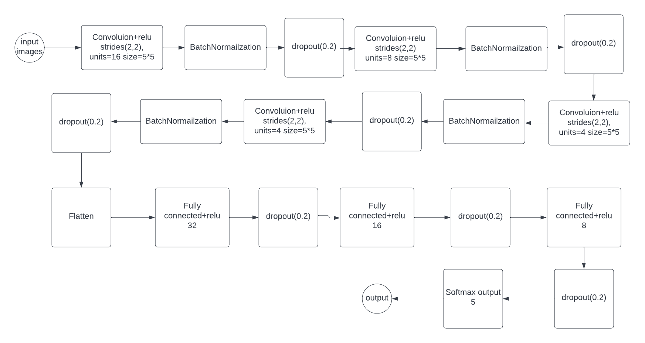
Architecture used in paper

Slide 3
Data Set details
Name: Raabin-WBC Data
Link : http://dl.raabindata.com/WBC/Cropped_double_labeled/
Total number of samples : 14514
Train : 10,175
Test: 4,339
No of classes : 5
Classes : Basophil , Eosinophil , Lymphocyte , Monocyte and Neutrophil
Image dimension : 575 * 575
Training Ratio : 60% no of images : 9159
Testing Ratio : 30% no of images: 4339
Validation Ratio: 10% no of images: 1016

Slide 4
Implementation Details
Image Preprocessing used : mobilenet_v2.preprocess_input
Model :Convolution Neural Network
Optimizer : RMSprop
Loss : categorical_crossentropy
Metrics : accuracy
Batch Size : 32

Slide 5
Hyper Parameters:
First Layer:
(Convolution(16,5) , activation function -> relu, strides(2,2),inputs size shape(120,160,3) ,padding ((Input width) / (stride width) + 1.,(Input height) / (stride height) + 1.) , Dropout = 0.2)
Second Layer:
(Convolution(8,5) , activation function -> relu, strides(2,2),padding ((Input width) / (stride width) + 1.,(Input height) / (stride height) + 1.) , Dropout = 0.2)
Third Layer:
(Convolution(4,5) , activation function -> relu, strides(2,2),padding ((Input width) / (stride width) + 1.,(Input height) / (stride height) + 1.) , Dropout = 0.2)
Fourth Layer:
(Convolution(4,5) , activation function -> relu, strides(2,2),padding ((Input width) / (stride width) + 1.,(Input height) / (stride height) + 1.) , Dropout = 0.2)
First Dense Layer:
(Size of Dense Layer = 32,activation = relu, Dropout = 0.2)
Second Dense Layer:
(Size of Dense Layer = 16,activation = relu, Dropout = 0.2)
Third Dense Layer:
(Size of Dense Layer = 8,activation = relu, Dropout = 0.2)
Output Dense Layer:
(Size of Dense Layer = 5,activation = SoftMax)

Slide 6
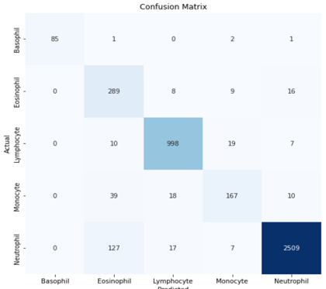
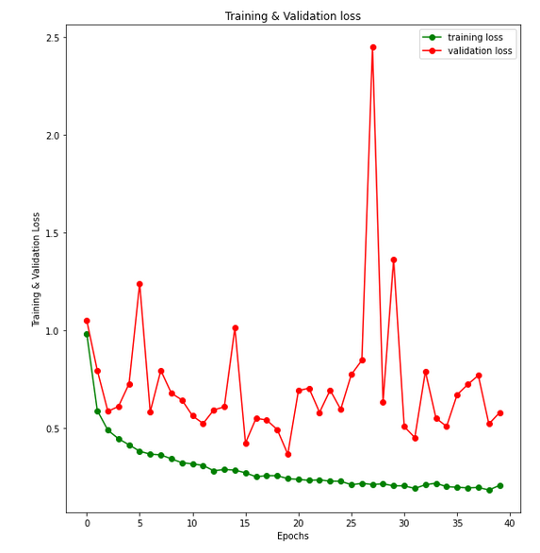
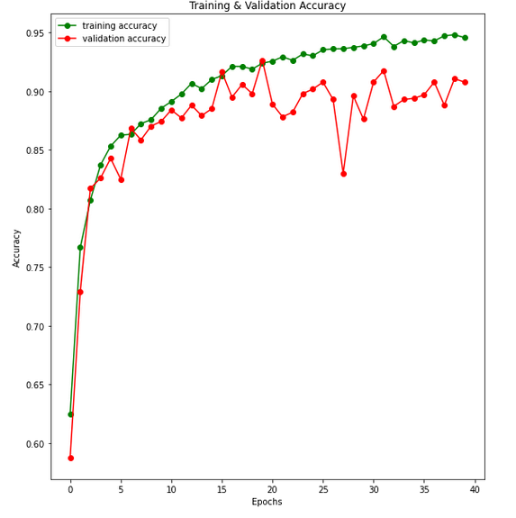
Results & Visualizations
Results:-
Train loss : 0.23
Validation loss: 0.36
Train accuracy: 92.3%
Testing accuracy: 93.293%
Validation accuracy: 92.6%
Confusion Matrix :
Loss curve:
Accuracy curve :

