Slide 1
Logic Coverage CppUTest
Presented By
Ahmed Saleh
Omar Osama
Mohamed Hamada
Mina Magdy

Slide 2
Agenda
About CppUTest
Logic Coverage
Project Demo
References

Slide 3
About CppUTest
C/C++ based unit xUnit test framework
Simple to use and small
Portable to old and new platforms

Slide 4
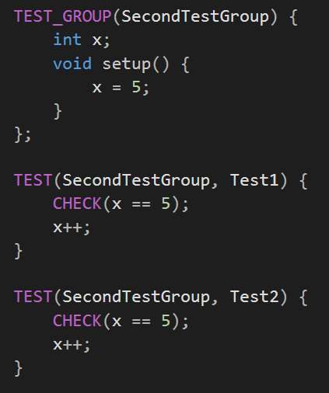
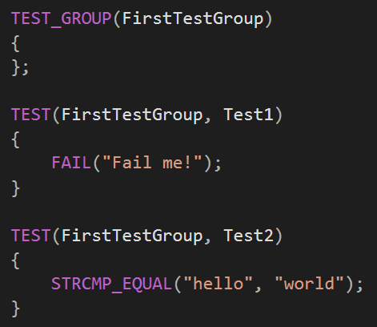
Test Macros
2 tests passed

Slide 5
2. Assertions (some macros)
CHECK(boolean condition)
CHECK_TEXT(boolean condition, text)
CHECK_FALSE(condition)
CHECK_EQUAL(expected, actual)
CHECK_THROWS(expected_exception, expression)
LONGS_EQUAL(expected, actual)
UNSIGNED_LONGS_EQUAL(expected, actual)
STRCMP_EQUAL(expected, actual)
STRNCMP_EQUAL(expected, actual, length)
STRCMP_NOCASE_EQUAL(expected, actual)
STRCMP_CONTAINS(expected, actual)
POINTERS_EQUAL(expected, actual)
DOUBLES_EQUAL(expected, actual, tolerance)

Slide 6
Project Demo
We worked on some classes from our competitive programming library
Tested classes
Some data structures
Fenwick Tree
Math utilities

Slide 7
Example 1 Testing math function indicates happy numbers. Happy number in his definition that has 2 or more features (even, has perfect square root or lucky i.e. all digits are either ‘4’ or ‘7’).
# | isLucky | isEven | hasSqrt | P | P(isLucky) | P(isEven) | P(hasSqrt) | Input
1 | True | True | True | True | False | False | False | 4
2 | True | True | False | True | True | True | False | 74
3 | True | False | True | True | True | False | True | -
4 | True | False | False | False | False | True | True | 7
5 | False | True | True | True | False | True | True | 16
6 | False | True | False | False | True | False | True | 2
7 | False | False | True | False | True | True | False | 81
8 | False | False | False | False | False | False | False | 3

Slide 8
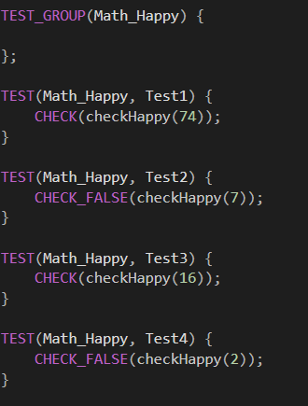
Example 1 (cont.)

Slide 9

Example 2 Testing operator[] in multiset implemented using Fenwick tree.
# | idx < 1 | idx > cnt | P | P(idx<1) | P(idx>cnt) | idx
1 | True | True | True | False | False | -
2 | True | False | True | True | False | 0
3 | False | True | True | False | True | cnt + 1
4 | False | False | False | True | True | 1

Slide 10
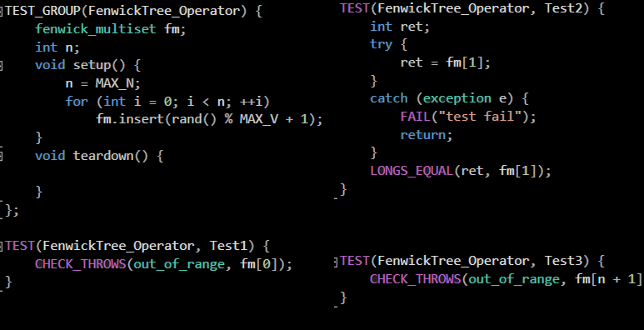
Example 2 (cont.)

Slide 11

Example 3 Testing insert function in multiset implemented using Fenwick tree.
# | val < 1 | val > N | P | P(val<1) | P(val>N) | val
1 | True | True | True | False | False | -
2 | True | False | True | True | False | 0
3 | False | True | True | False | True | N + 1
4 | False | False | False | True | True | 1

Slide 12
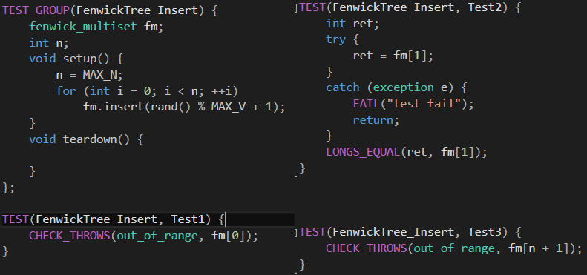
Example 3 (cont.)

Slide 13
Statistics

Slide 14
References
https://cpputest.github.io/
https://cpputest.github.io/manual.html

Slide 15
Any Question ?

Slide 16
Thank You

