Slide 1
Honeypots with Behavioral Analysis
CyberSecurity Universe
OUAFI Omar EREKYSY Anass
NAOUI Nassera

Slide 2
Sommaire
Introduction
HoneyPot Concept
Types of HoneyPots
HoneyPots already there
Fake Login technique
EndlessSSH service technique
Cowrie technique
Conclusion

Slide 3

Introduction

Slide 4

HoneyPot Concept

Slide 5
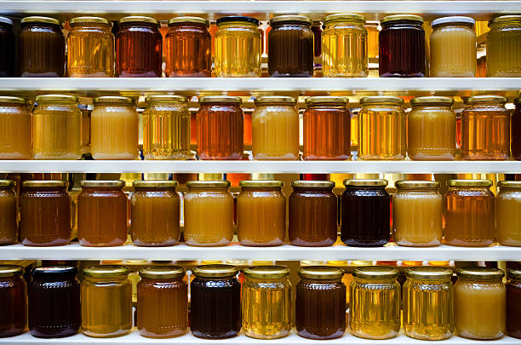
Type of HoneyPots

Slide 6
HoneyPots already available
KFSensor
Honeyd
Dionaea
Kippo
Cowrie

Slide 7
01
Fake Login Technique
HTTP-Based method

Slide 8
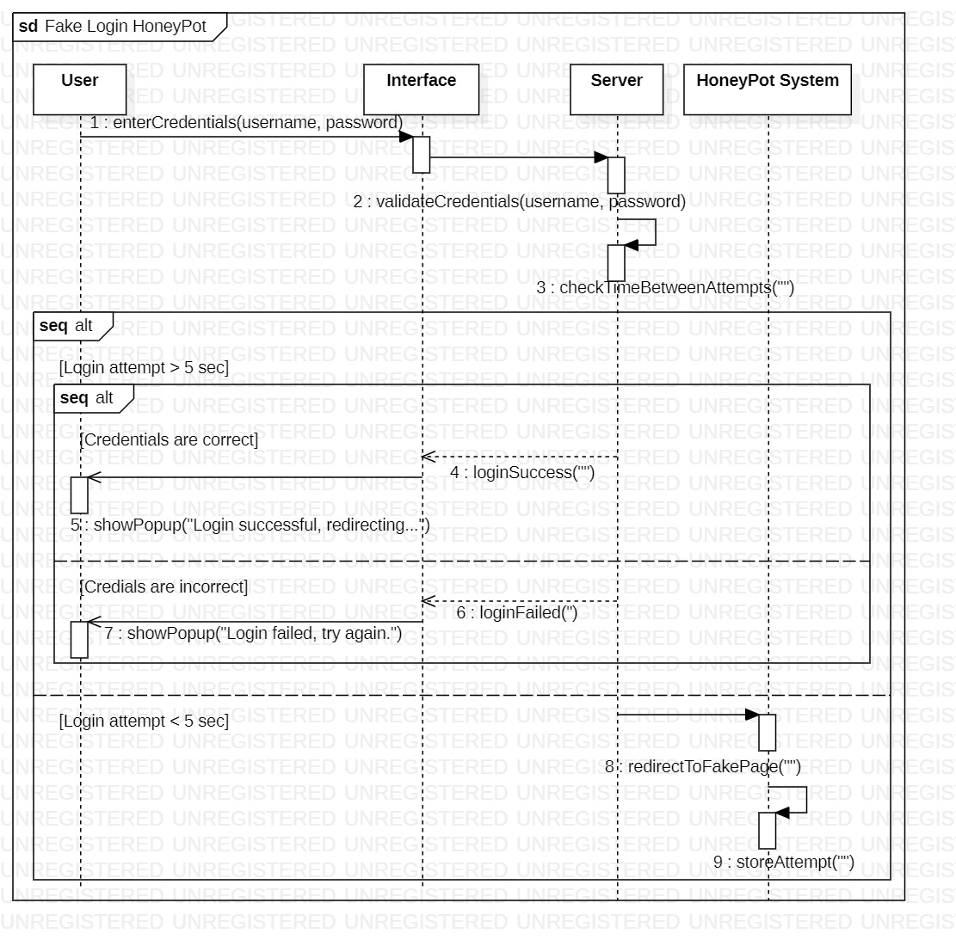

Slide 9
02
EndlessSSH service Architecture
SSH-Based method

Slide 10
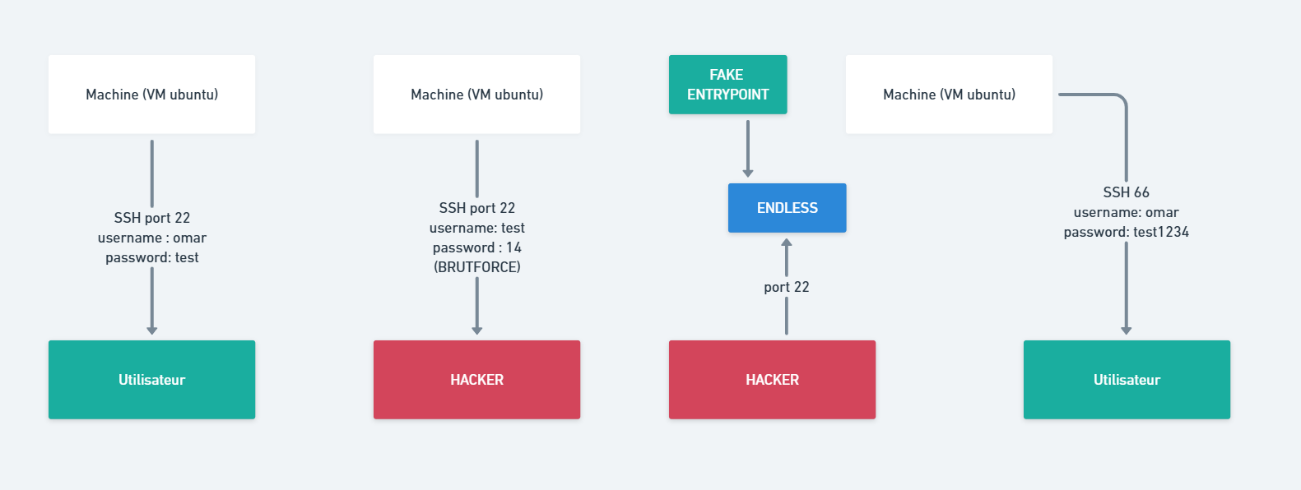

Slide 11
03
CowrieTechnique
SSH-Based method

Slide 12
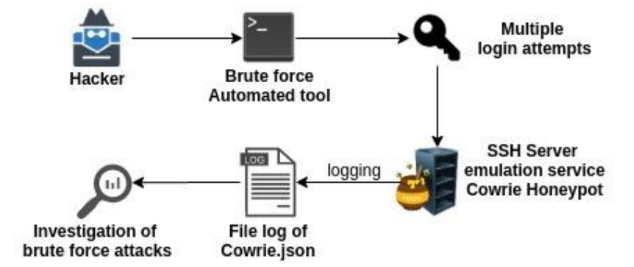

Slide 13

Conclusion

Slide 14
Thank you for your attention !
Do you have any questions ?

