Slide 1
Operations Research Lecture 2: Linear Programming: Mathematical Models Instructors: Dr. Safaa Amin Dr. Doaa Ezzat 2020/2021

Slide 2
formulating linear programm
The steps for formulating the linear programming are:
Identify the unknown decision variables to be determined and assign symbols to them.
Identify the objective or aim and represent it also as a linear function of decision variables.
Identify all the restrictions or constraints in the problem and express them as linear equations or inequalities of decision variables.
Construct linear programming model for the following problems:

Slide 3
Example 1
A retail store stocks two types of shirts A and B. These are packed in attractive cardboard boxes. During a week the store can sell a maximum of 400 shirts of type A and a maximum of 300 shirts of type B. The storage capacity, however, is limited to a maximum of 600 of both types combined. Type A shirt fetches a profit of Rs. 2 per unit and type B a profit of Rs. 5 per unit. How many of each type the store should stock per week to maximize the total profit? Formulate a mathematical model of the problem.

Slide 4
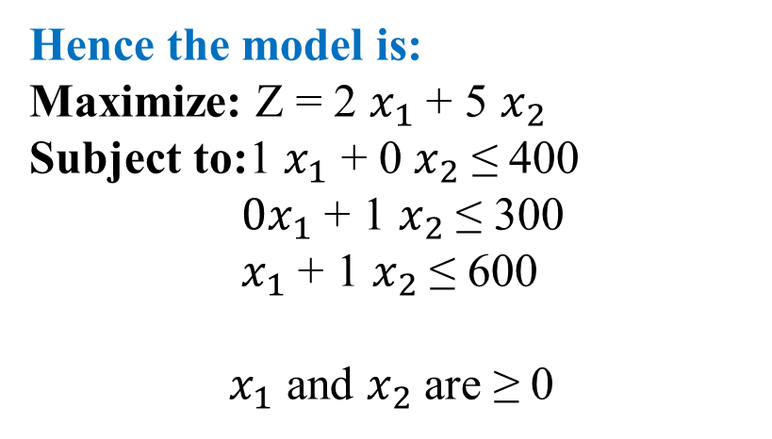

Step 1: Decision Var
Let ‘$x_{1}$’: the store stock units of A
and ‘$x_{2}$’ units of B.
Step 2: Objective function
As the profit contribution of A and B are Rs.2/- and Rs.5/- respectively,
objective function is: Maximize Z = 2 $x_{1}$+ 5 $x_{2}$
subjected to condition (s.t.) Structural constraints are, stores can sell 400 units of shirt A and 300 units of shirt B and the storage capacity of both put together is 600 units. Hence the structural constraints are:
${ x}_{1}\text{≤}$ 400
$x_{2}$ ≤ 300
for sales capacity and $x_{1}$ + $x_{2}$ ≤ 600
Hence the model is:
Maximize: Z = 2 $x_{1}$ + 5 $x_{2}$
Subject to:1 $x_{1}$ + 0 $x_{2}$ ≤ 400
${0x}_{1}$ + 1 $x_{2}$ ≤ 300
$x_{1}$ + 1 $x_{2}$ ≤ 600
$x_{1}$ and $x_{2}$ are ≥ 0

Slide 5
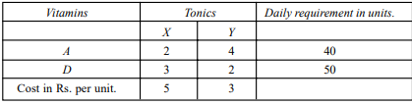
Example 2
patient consult a doctor to check up his ill health. Doctor examines him and advises him that he is having deficiency of two vitamins, vitamin A and vitamin D. Doctor advises him to consume vitamin A and D regularly for a period of time so that he can regain his health. Doctor prescribes tonic X and tonic Y, which are having vitamin A, and D in certain proportion. Also advises the patient to consume at least 40 units of vitamin A and 50 units of vitamin D Daily. The cost of tonics X and Y and the proportion of vitamin A and D that present in X and Y are given in the table below. Formulate l.p. to minimize the cost of tonics.

Slide 6
Example 2 cont.
Solution: Let x be the units of X that the patient buy
and y units of Y that that the patient buy .
Objective function:
Minimize Z = 5x + 3y
s.t. 2x + 4y ≥ 40
3x + 2y ≥ 50 and
Both x and y are ≥ 0.

Slide 7
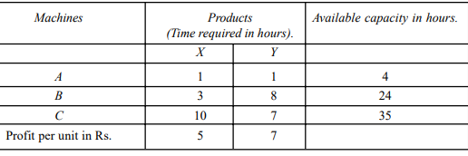
Example 3: A company manufactures two products, X and Y by using three machines A, B, and C. Machine A has 4 hours of capacity available during the coming week. Similarly, the available capacity of machines B and C during the coming week is 24 hours and 35 hours respectively. One unit of product X requires one hour of Machine A, 3 hours of machine B and 10 hours of machine C. Similarly one unit of product Y requires 1 hour, 8 hour and 7 hours of machine A, B and C respectively. When one unit of X is sold in the market, it yields a profit of Rs. 5 per product and that of Y is Rs. 7 per unit. Solve the problem by using graphical method to find the optimal product mix. The details given in the problem is given in the table below:

Slide 8
Example 3 cont.
Let the company manufactures x units of X and y units of Y, and then the L.P. model is:
Maximize Z = 5x + 7y
Subject to:
1x + 1y ≤ 4
3x + 8y ≤ 24
10x + 7y ≤ 35
Both x and y are ≥ 0.

Slide 9
Example 3 cont.
As we cannot draw graph for inequalities, let us consider them as equations.
Maximise Z = 5x + 7y
s.t. 1x + 1y = 4
3x + 8y = 24
10x + 7y = 35
and both x and y are ≥ 0

Slide 10
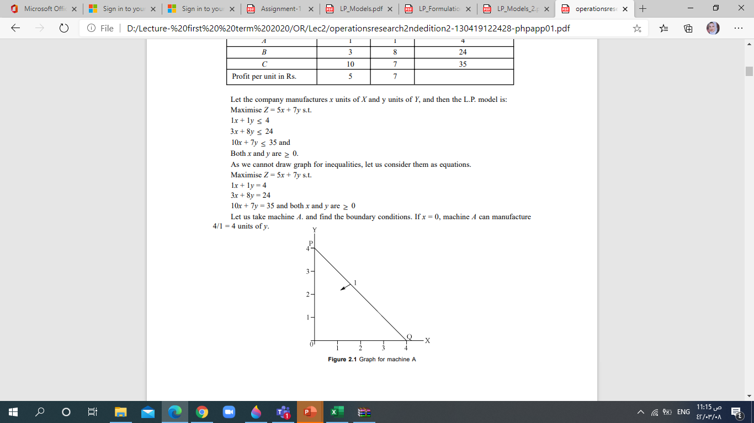
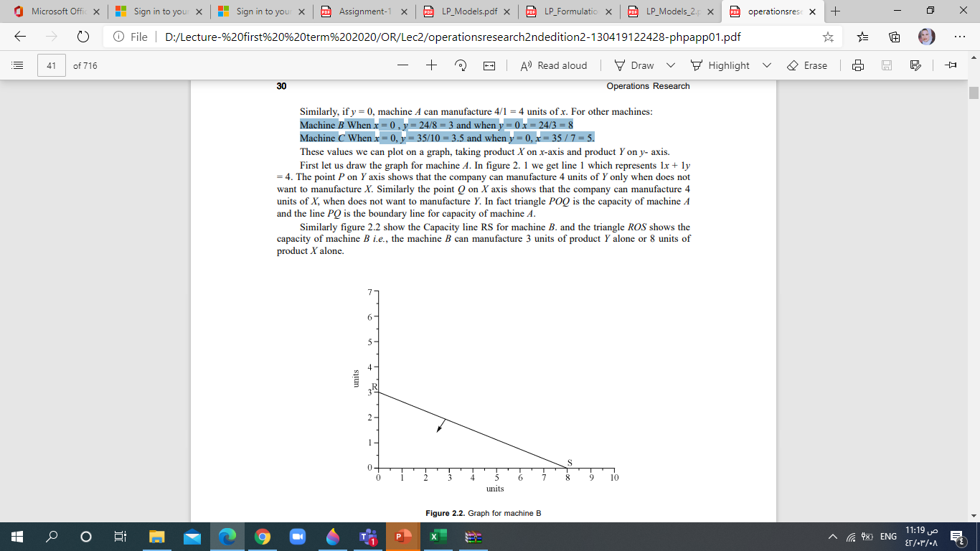
x + y = 4 Let us take machine A. and find the boundary conditions. If x = 0, machine A can manufacture 4 units of y Similarly, if y = 0, machine A can manufacture 4 units of x.
3x + 8y = 24
Machine B
When x = 0 , y = 3 and when y = 0 x = 8
10x + 7y = 35
Machine C When x = 0, y = 3.5 and when y = 0, x = 5.

Slide 11
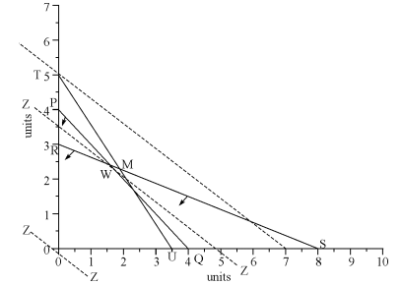
Graphical Solution to Example 3

Slide 12
Method 1. Here we find the co-ordinates of corners of the closed polygon ROUVW and substitute the values in the objective function.
In maximization problem, we select the co-ordinates giving maximum value.
And in minimisaton problem, we select the co-ordinates, which gives minimum value.
In the problem the co-ordinates of the corners are: R = (0, 3.5), O = (0,0), U = (3.5,0), V = (2.5, 1.5) and W = (1.6,2.4).
Substituting these values in objective function:
Z( 0,3.5) = 5 × 0 + 7 × 3.5 = Rs. 24.50, at point R
Z (0,0) = 5 × 0 + 7 × 0 = Rs. 00.00, at point O
Z(3.5,0) = 5 × 3.5 + 7 × 0 = Rs. 17.5 at point U
Z (2.5, 1.5) = 5 × 2.5 + 7 × 1.5 = Rs. 23.00 at point V
Z (1.6, 2.4) = 5 × 1.6 + 7 × 2.4 = Rs. 24.80 at point W
Hence the optimal solution for the problem is company has to manufacture 1.6
units of product X and 2.4 units of product Y, so that it can earn a maximum profit of
Rs. 24.80 in the planning period.

Slide 13
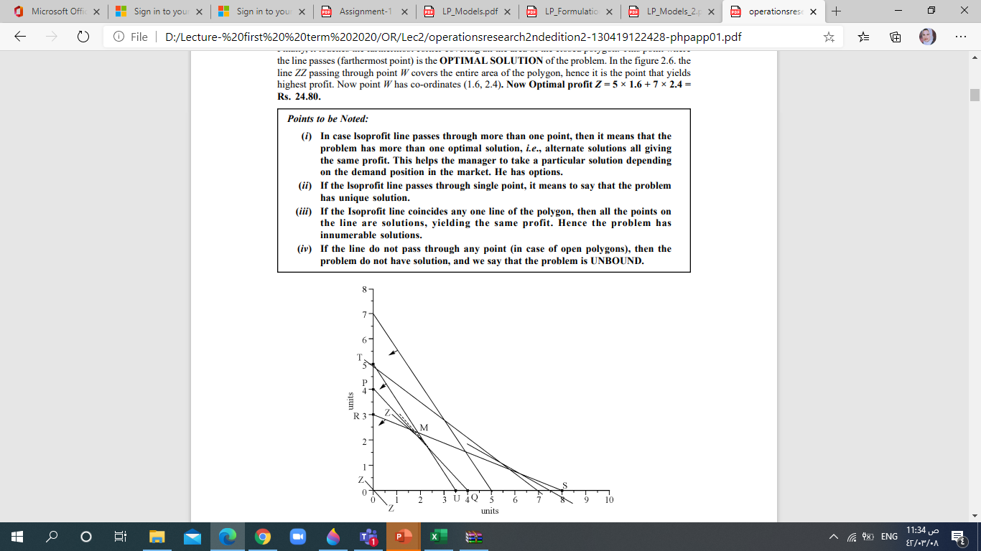
Method 2. profit Line Method: profit line, a line on the graph drawn as per the objective function, assuming certain profit. On this line any point showing the values of x and y will yield same profit. For example in the given problem, the objective function is Maximize Z = 5x + 7y. If we assume a profit of Rs. 35, to get Rs. 35, the company has to manufacture either 7 units of X or 5 units of Y.
Hence, we draw line Z (preferably dotted line) for 5x + 7y = 35. Then draw parallel line to this line Z at origin. The line at origin indicates zero rupees profit. No company will be willing to earn zero rupees profit. Hence slowly move this line away from origin. Each movement shows a certain profit, which is greater than Rs.0.00. While moving it touches corners of the polygon showing certain higher profit. Finally, it touches the farthermost corner covering all the area of the closed polygon. This point where the line passes (farthermost point) is the OPTIMAL SOLUTION of the problem. In the figure 2.6. the line ZZ passing through point W covers the entire area of the polygon, hence it is the point that yields highest profit. Now point W has co-ordinates (1.6, 2.4). Now Optimal profit Z = 5 × 1.6 + 7 × 2.4 = Rs. 24.80.

Slide 14
Points to be Noted:
If the profit line passes through single point, it means to say that the problem has unique solution.
If the profit line coincides any one line of the polygon, then all the points on the line are solutions, yielding the same profit. Hence the problem has infinite solutions.
If the line do not pass through any point (in case of open polygons), then the problem does not have solution, and we say that the problem is UNBOUND.

Slide 15
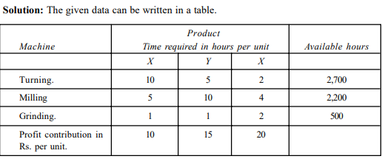
Example 4: Product Mix Problem
A company manufactures three products namely X, Y and Z. Each of the product require processing on three machines, Turning, Milling and Grinding. Product X requires 10 hours of turning, 5 hours of milling and 1 hour of grinding. Product Y requires 5 hours of turning, 10 hours of milling and 1 hour of grinding, and Product Z requires 2 hours of turning, 4 hours of milling and 2 hours of grinding. In the coming planning period, 2700 hours of turning, 2200 hours of milling and 500 hours of grinding are available. The profit contribution of X, Y and Z are Rs. 10, Rs.15 and Rs. 20 per unit respectively. Find the optimal product mix to maximize the profit.
Z

Slide 16
Example 4 cont.
Let the company manufacture x units of X, y units of Y and z units of Z Inequalities: Equations:
Maximize: Z = 10x + 15 y + 20 z
Subject to: 10 x+ 5y + 2z ≤ 2700
5x + 10y + 4z ≤ 2,200
1x + 1y + 2z ≤ 500
All x, y and z are ≥ 0

Slide 17
Example 5 : Manpower Problem
A truck company requires the following number of drivers for its trucks during 24 hours: According to the shift schedule, a driver works eight consecutive hours, starting at the beginning of one of the six periods. Determine a daily driver worksheet which satisfies the requirements with the least number of drivers. (Formulate the mathematical program only)
Period | 1 | 2 | 3 | 4 | 5 | 6
time | 00-04 | 04-08 | 08-12 | 12-16 | 16-20 | 20-24
Min required number | 5 | 10 | 20 | 12 | 22 | 8

Slide 18

Example 5 : Manpower Problem cont.
Period | 1 | 2 | 3 | 4 | 5 | 6
time | 00-04 | 04-08 | 08-12 | 12-16 | 16-20 | 20-24
Min required number | 5 | 10 | 20 | 12 | 22 | 8
Let${ x}_{i} is the number of drivers begining their shift at period i$
$$x_{1}+ x_{6}≥5$$
$$x_{1}+x_{2} ≥10$$
$${ x}_{2}+x_{3} ≥20$$
$x_{3}+x_{4} ≥12$
$${ x}_{4}+x_{5} ≥22$$
$${ x}_{5}+{ x}_{6} ≥8$$
With all variables $≥$0 and integer

Slide 19
Example 6: Transportation Problem
Four factories, A, B, C and D produce sugar and the capacity of each factory is given below: Factory A produces 10 tons of sugar and B produces 8 tons of sugar, C produces 5 tons of sugar and that of D is 6 tons of sugar. The sugar has demand in three markets X, Y and Z. The demand of market X is 7 tons, that of market Y is 12 tons and the demand of market Z is 4 tons. The following matrix gives the transportation cost of 1 ton of sugar from each factory to the destinations.
Find the optimal solution for least transportation cost.

Slide 20
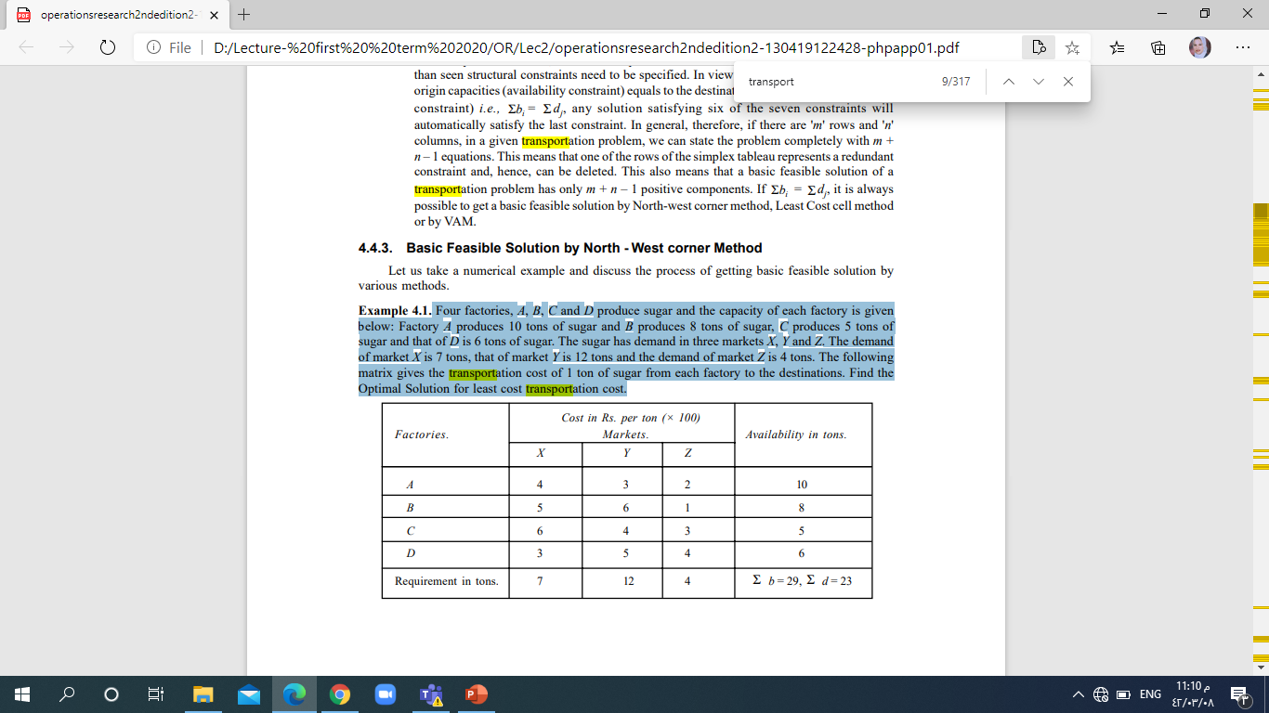


$$x_{ij}:the number of units to be transported from f_{i} to Market j$$
Minimize: Z=$4x_{11}+3x_{12}+2x_{13}$…+ 6$x_{31}+4x_{32}+3x_{33}+\text{3}x_{41}+5x_{42}+4x_{43}$
Subject to:
$$\left.\begin{aligned} x_{11}+x_{12}+x_{13}≤ 10 \\ x_{21}+x_{22}+x_{23}≤ 8 \\ \begin{aligned} x_{31}+x_{32}+x_{33}≤ 5 \\ x_{41}+x_{42}+x_{43}≤ 6\end{aligned}\end{aligned}\right\}$$
(because the sum must be less than or equal to the available capacity)
Supply constraints

Slide 21

Transportation Problem cont.
$$\left.\begin{aligned} x_{11}+x_{21}+x_{31}+x_{41}≥7 \\ x_{12}+x_{22}+x_{32}+x_{42}≥12 \\ \begin{aligned} x_{13}+x_{23}+x_{33}+x_{43}≥4 \end{aligned}\end{aligned}\right\}$$
$x_{ij}≥0$ where i=1,2,3,4 and j=1,2,3
Demand constraints
(This is because we cannot supply negative elements)
If the total Supply = the Total Demand then we can rewrite all the constraints as equal constraints

Slide 22
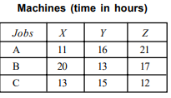
Example 7: Assignment Model
There are 3 jobs A, B, and C and three machines X, Y, and Z. All the jobs can be processed on all machines. The time required for processing job on a machine is given below in the form of matrix. Make allocation to minimize the total processing time.

Slide 23
Example 7: Assignment Model
A legal firm has accepted five new cases, each of which can be handled by any one of its five junior partners. Due to difference in experience and expertise, however, the junior partners would spend varying amounts of time on the cases. A senior partner has estimated the time required in hours as shown below
Determine the optimal assignment of cases to lawyers such that each junior partner receives a different case. And the total hours expected by the firm is minimized. Formulate the corresponding mathematical program.
 | Case1 | Case2 | Case3 | Case4 | Case5
Lawyer1 | 145 | 122 | 130 | 95 | 115
Lawyer2 | 80 | 63 | 85 | 48 | 78
Lawyer3 | 121 | 107 | 93 | 69 | 95
Lawyer4 | 118 | 83 | 116 | 80 | 105
Lawyer5 | 97 | 75 | 120 | 80 | 111

Slide 24



 | Case1 | Case2 | Case3 | Case4 | Case5
Lawyer1 | 145 | 122 | 130 | 95 | 115
Lawyer2 | 80 | 63 | 85 | 48 | 78
Lawyer3 | 121 | 107 | 93 | 69 | 95
Lawyer4 | 118 | 83 | 116 | 80 | 105
Lawyer5 | 97 | 75 | 120 | 80 | 111
$$x_{ij}:the number of times that Lawyeri assigned to case j$$
Minimize: Z=$145x_{11}+122x_{12}+130x_{13}$…+ 121$x_{31}+107x_{32}+93x_{33}+\text{118}x_{41}+83x_{42}+116x_{43}+{80x}_{44}+{105x}_{45}…+{111x}_{55}$
Subject to:
$$\left.\begin{aligned} x_{11}+x_{12}+x_{13}+x_{14}+x_{15}= 1 \\ x_{21}+x_{22}+x_{23}{+x}_{24}+x_{25}= 1 \\ \begin{aligned} x_{31}+x_{32}+x_{33}+x_{34}+x_{35}= 1 \\ x_{41}+x_{42}+x_{43}+x_{44}+x_{45}= 1 \\ x_{51}+x_{52}+x_{53}+x_{54}+x_{55}= 1\end{aligned}\end{aligned}\right\}$$
Each lawyer is assigned to one case
$$\left.\begin{aligned} x_{11}+x_{21}+x_{31}+x_{41}+x_{51}= 1 \\ x_{12}+x_{22}+x_{32}{+x}_{42}+x_{52}= 1 \\ \begin{aligned} x_{13}+x_{23}+x_{33}+x_{43}+x_{53}= 1 \\ x_{14}+x_{24}+x_{34}+x_{44}+x_{54}= 1 \\ x_{15}+x_{25}+x_{35}+x_{45}+x_{55}= 1\end{aligned}\end{aligned}\right\}$$
Each case is assigned to one lawyer
with all variables non-negative and integer

Slide 25
What if???
Number of Cases is Less than the number of Lawyers (3 cases and 5 lawyers)

Slide 26


3 cases and 5 Lawyers
$$\begin{aligned} x_{11}+x_{12}+x_{13}≤1 \\ x_{21}+x_{22}+x_{23}≤1 \\ \begin{aligned} x_{31}+x_{32}+x_{33}≤1 \\ x_{41}+x_{42}+x_{43}≤1 \\ x_{51}+x_{52}+x_{53}≤1\end{aligned}\end{aligned}$$
$$\left.\begin{aligned} x_{11}+x_{21}+x_{31}+x_{41}+x_{51}= 1 \\ x_{12}+x_{22}+x_{32}{+x}_{42}+x_{52}= 1 \\ \begin{aligned} x_{13}+x_{23}+x_{33}+x_{43}+x_{53}= 1 \\ \\ \end{aligned}\end{aligned}\right\}$$

Slide 27
Example 8: Inspection Model
A company has two grades of inspectors, I and II to undertake quality control inspection. At least 1,500 pieces must be inspected in an 8-hours day. Grade I inspector can check 20 pieces in an hour with an accuracy of 96%. Grade II inspector checks 14 pieces an hour with an accuracy of 92%. Wages of grade I inspector are $5 per hour while those of grade II inspector are $4 per hour. Any error made by an inspector costs $3 to the company. If there are, in all, 10 grade I inspectors and 15 grade II inspectors in the company, find the optimal assignment of inspectors that minimize the daily inspection cost (Formulate only the mathematical problem).

Slide 28
Example 8: Inspection Model
Let x the number of grade I that may be assigned the job of quality control inspection
Let y the number of grade II that may be assigned the job of quality control inspection

Slide 29
The objective is to minimize the daily cost of inspection
Two cost: wages paid by inspectors and the cost of inspector error
Grade II | Grade I
Check 14 pieces /h | Check 20 pieces /h
92% | 96% | Accuracy
0.08 | 0.04 | Error 3 costs
4 | 5 | Wages
15 | 10 inspectors | available
The cost of grade I inspector per hour
(5+3x0.04x20)=7.4
The cost of grade II inspector per hour
(4+3x0.08x14)=7.36
The objective function
Z=8 (7.4x+7.36y)

Slide 30

Example 8: Inspection Model
x$≤10$
$y≤15$
20*8x+14*8y$≥1500$
With all variable non-negative and integer

Slide 31


