Slide 1
Data Structures
Queues
Dr. Wedad Hussein
Information Systems Department
wedad.hussein@cis.asu.edu.eg
Dr. Asmaa Kassem
Computer Science Department
Asmaa.bahai@cis.asu.edu.eg

Slide 2
Course Contents
Pointers revision + Introduction to Classes.
Stacks
Queues
Array Lists
Linked Lists
Binary Search Trees
Hash Tables
STL
Graphs
Priority Queues

Slide 3
Templates

Slide 4
Problem?
Some algorithms are type independent (the logic does not depend on the data type of items processed).
It’s preferable to write the code once rather than recode it for each different type.
Achieved by using Templates:
Function Templates.
Class Templates.

Slide 5
Class Templates
Class templates are often used to make generic containers.
template <class N>
class rectangle
{
private:
N width;
N height;
public:
rectangle(N, N);
rectangle();
N area();
~rectangle(void);
};

Slide 6
Class Templates cont.
Member Functions:
template <class N>
N rectangle<N>::area()
{
return width*height;
}
Declaring Objects:
rectangle<float> r1(5.3,7.0);
rectangle<int> r1(5,7);

Slide 7

Queues

Slide 8
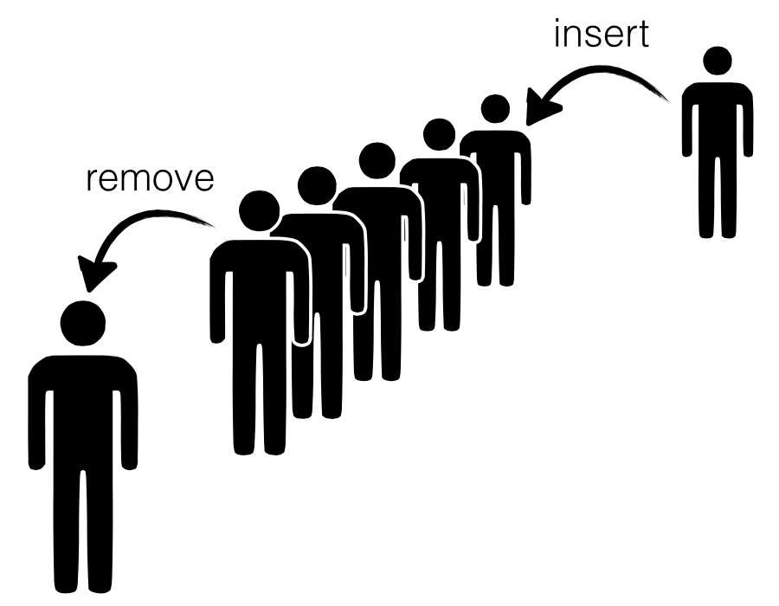
Queues

Slide 9
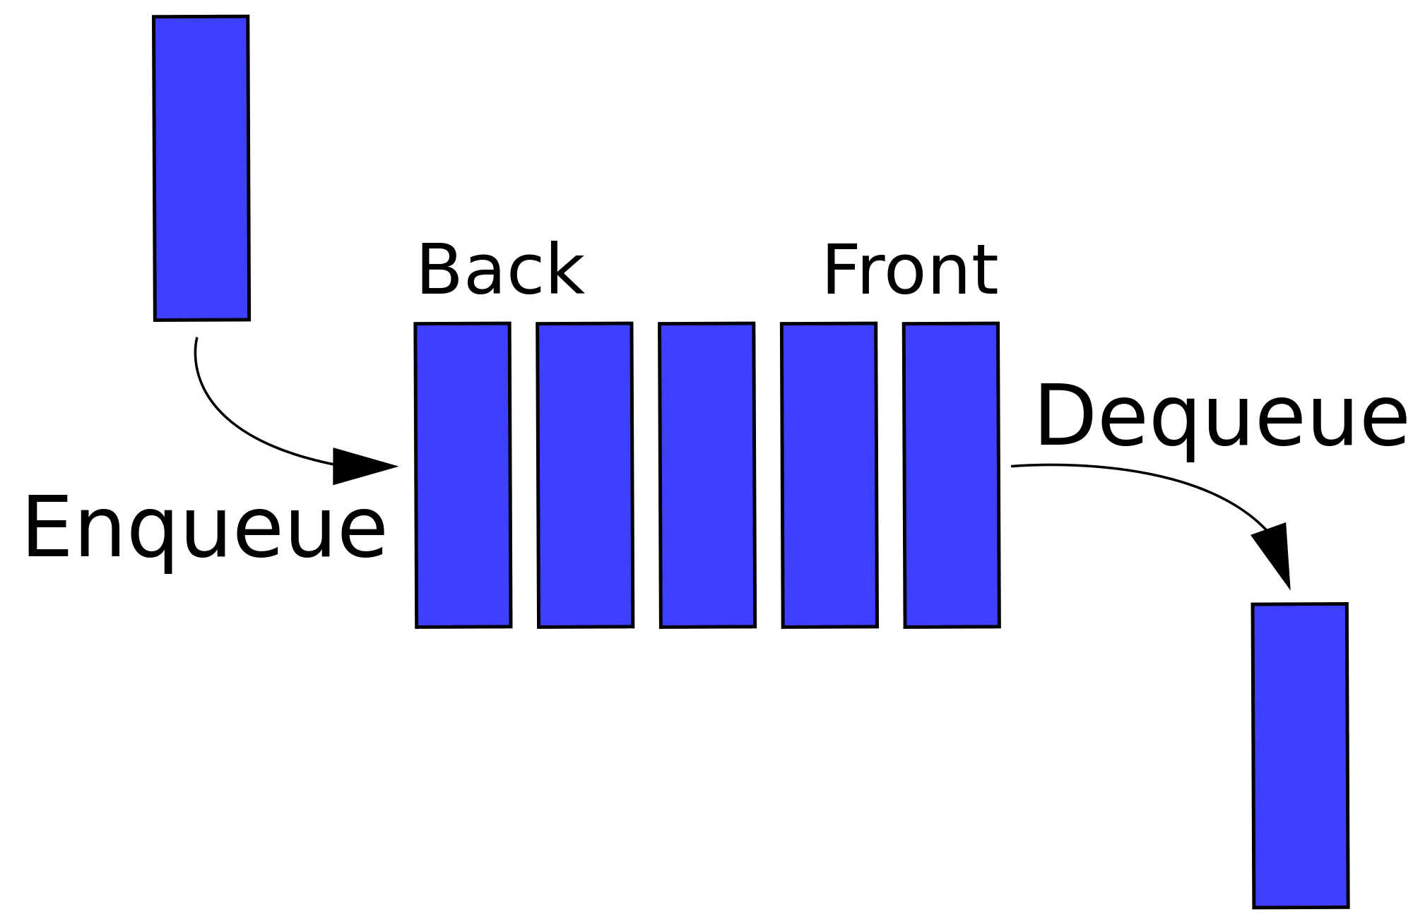
The Queue ADT
Like stacks, queues are lists. With a queue, however, insertion is done at one end whereas deletion is performed at the other end. (FIFO).

Slide 10
Applications
Job Scheduling: e.g. When jobs are submitted to a printer, they are arranged in order of arrival.
Call center customer calls.
Queuing theory:
deals with computing, probabilistically, how long users expect to wait on a line, how long the line gets, and other such questions.
The answer depends on how frequently users arrive to the line and how long it takes to process a user once the user is served.

Slide 11
Operations
Length: Returns the number of elements.
Enqueue: Adds an element to the end of the queue.
Dequeue: Removes the element at the front of the queue.
Front: Returns the front element.
Empty: Returns whether the queue is empty.

Slide 12

Implementation

Slide 13
Queue ADT Implementations
Using Linked Lists:
Front
Back
9
8
7
Using Dynamic Arrays:
Front
Back
 |  | 5 | 6 | 7 | 8 | 9

Slide 14
Array Implementation of Queues
After a few insertions and deletions
Front
Back
 |  | 7 | 6 | 5 | 4 | 3

Slide 15
Array Implementation of Queues
This could give and illusion of a full queue.
Front
Back
9 | 8 | 7 | 6 | 5 | 4

Slide 16
Circular Array Implementation
Enqueue(10)
Back
Front
9 | 8 | 7 | 6 | 5 | 4 |  |  | 10

Slide 17
Circular Array Implementation
Enqueue(11)
Back
Front
9 | 8 | 7 | 6 | 5 | 4 |  | 11 | 10

Slide 18
Circular Array Implementation
Dequeue()
Back
Front
9 | 8 | 7 | 6 | 5 |  |  | 11 | 10

Slide 19
Operations
Length: Returns the number of elements.
Enqueue: Adds an element to the end of the queue.
Dequeue: Removes the element at the front of the queue.
Front: Returns the front element.
Empty: Returns whether the queue is empty.

Slide 20
Queue STL

Slide 21
Queue STL
queue<T>
Operations:
empty
pop (= dequeue)
Push (= enqueue)
size
front
back

Slide 22
deque STL
deque<T>
Stands for: double ended queue
Operations:
empty
pop_back (remove last element)
pop_front (remove first element) (=dequeue)
push_back (= enqueue)
push_front (adds an element at the start)
size
front
back

Slide 23
Lecture Resources
Lecture Notes.
Lecture Code.
Text Book:
Chapter 1: 1.6
Chapter 3: 3.7.
Useful Links:
Queue Problem: https://uva.onlinejudge.org/index.php?option=onlinejudge&page=show_problem&problem=1876

Slide 24
Thank You

