Slide 1
Xilinx ISE Simulator installation and troubleshooting
2021

Slide 2
Outline
Install Guide
Online
Steps
License
Errors

Slide 3
Install Guide
1- Install Guide: Xilinx ISE 14.7 Windows10
https://www.youtube.com/watch?v=VMEIPCjqinA

Slide 4
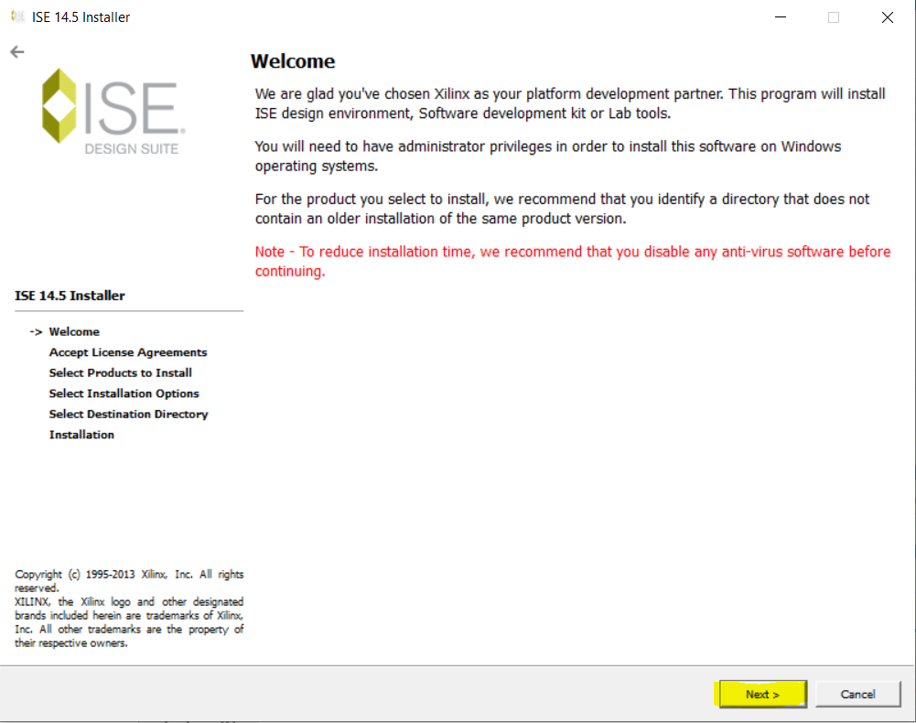
Install Guide

Slide 5
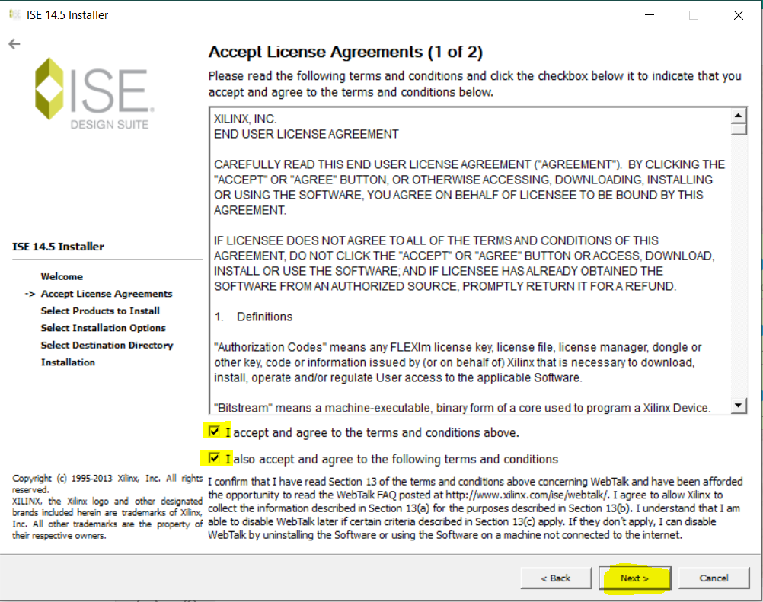
Install Guide

Slide 6
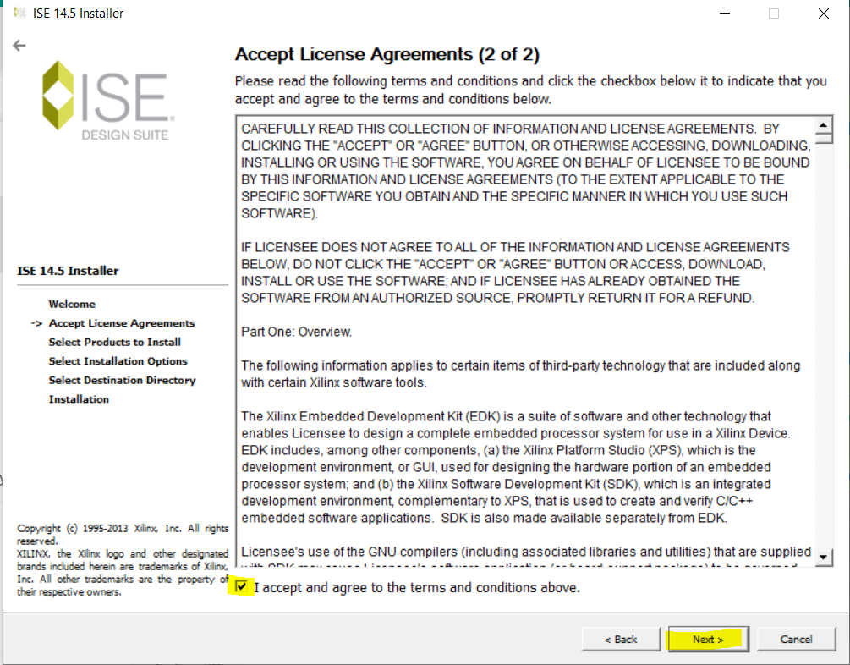
Install Guide

Slide 7
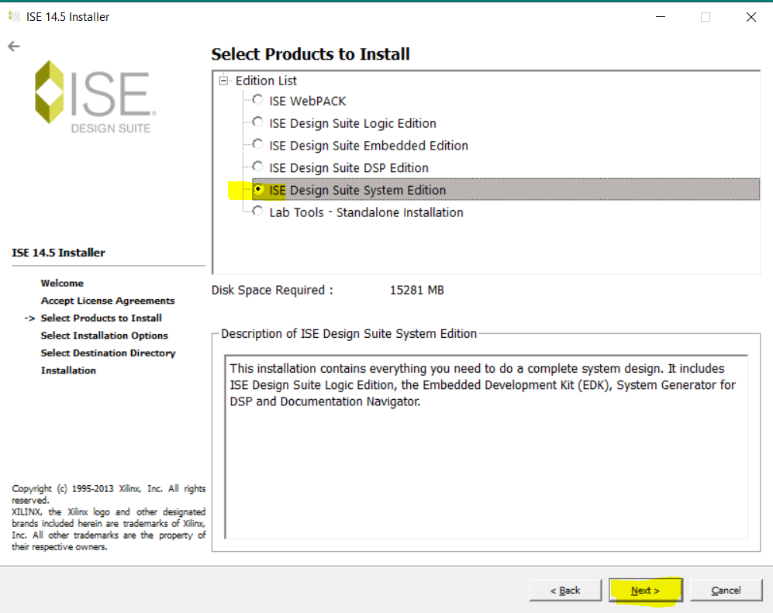
Install Guide

Slide 8
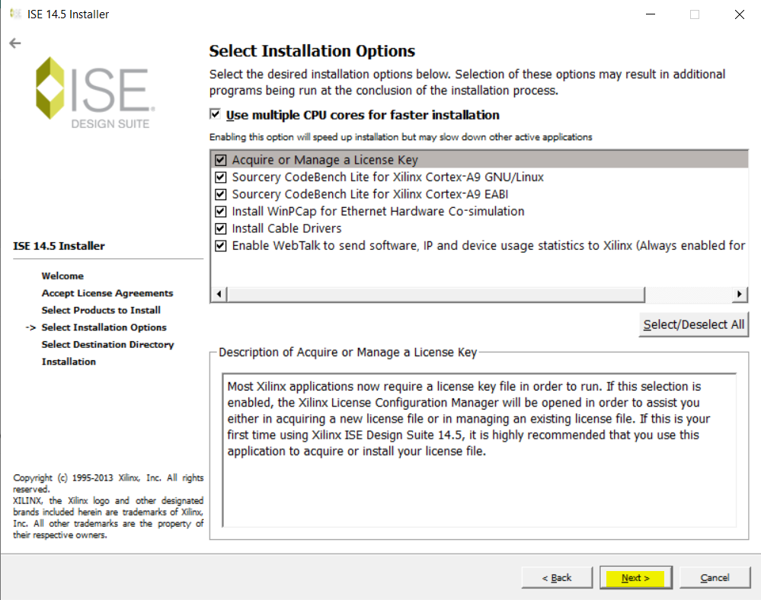
Install Guide

Slide 9
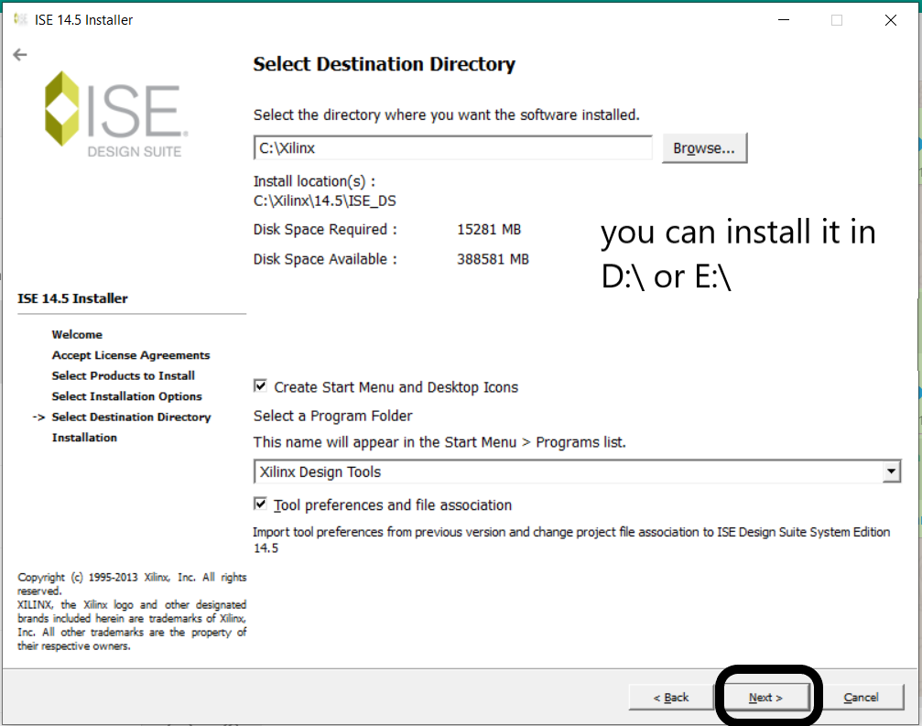
Install Guide

Slide 10
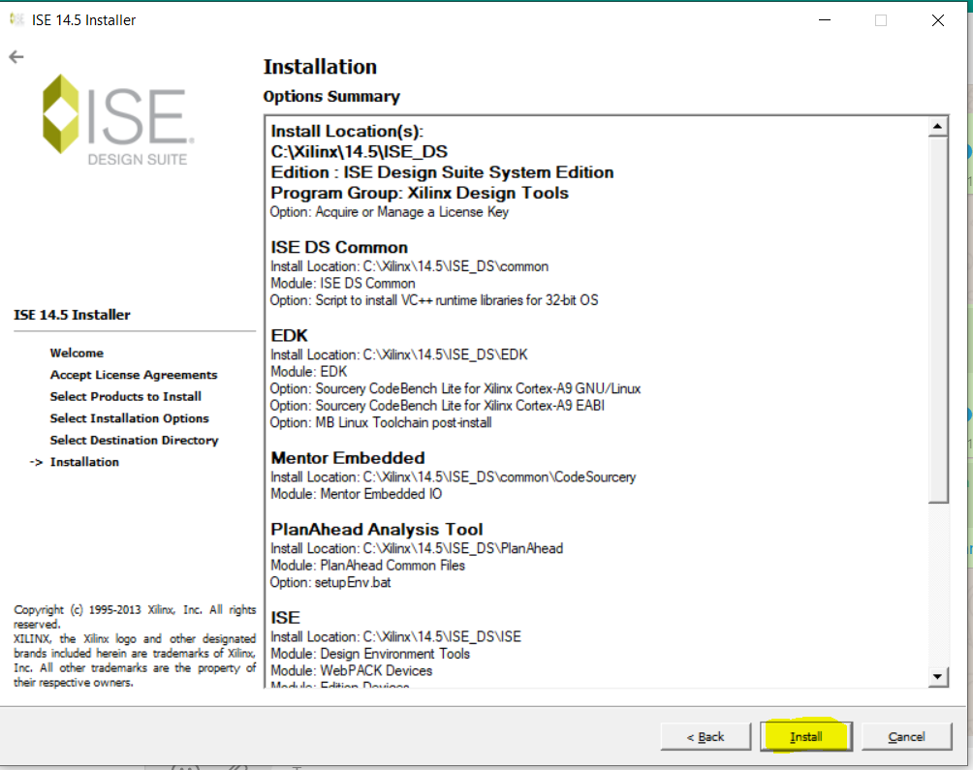
Install Guide

Slide 11
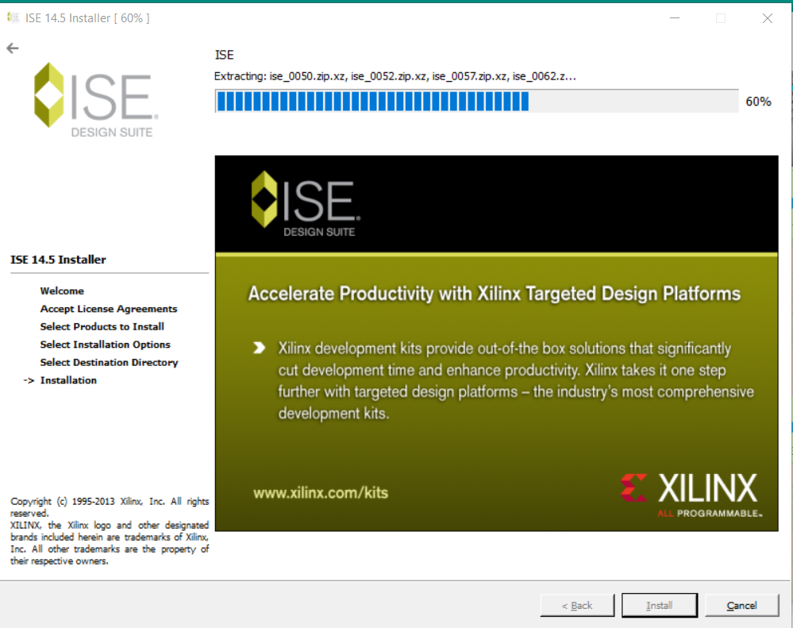
Install Guide

Slide 12
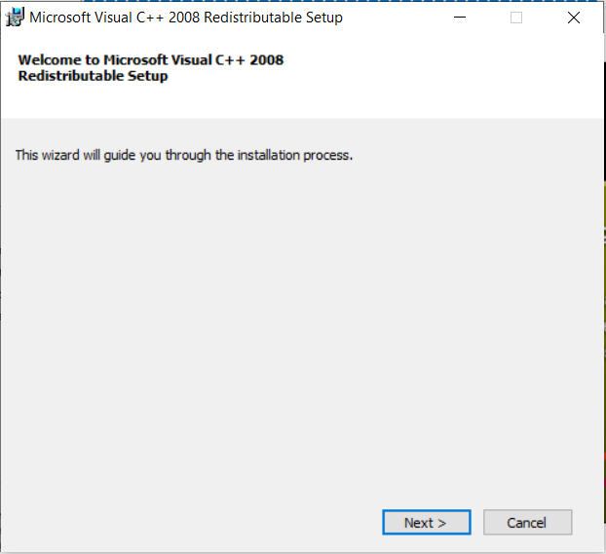
Install Guide

Slide 13
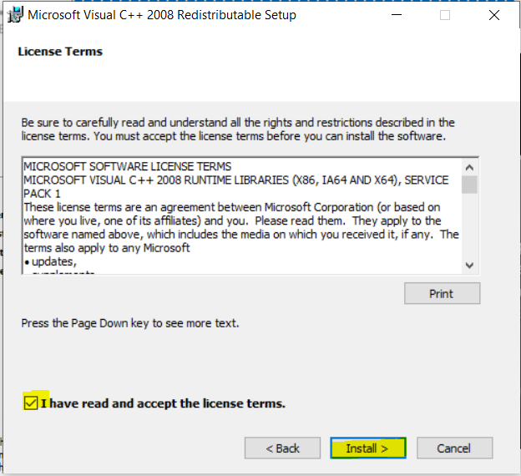
Install Guide

Slide 14
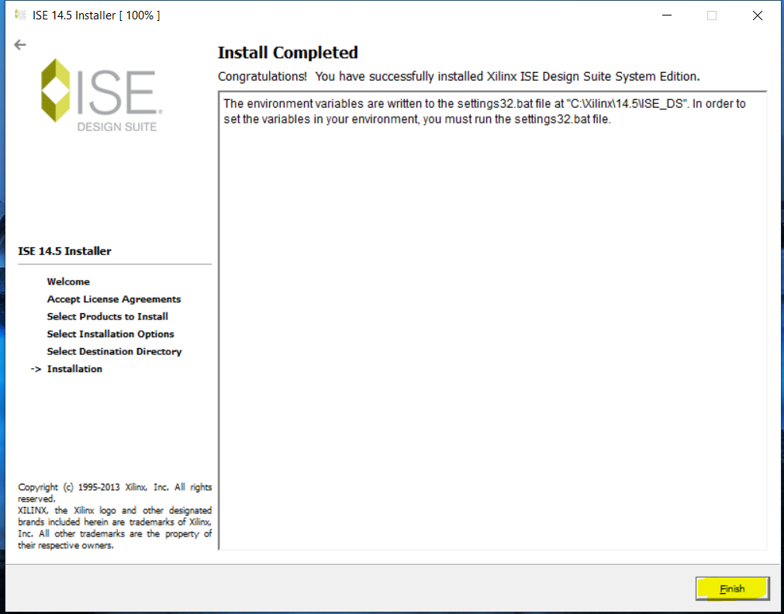
Install Guide

Slide 15
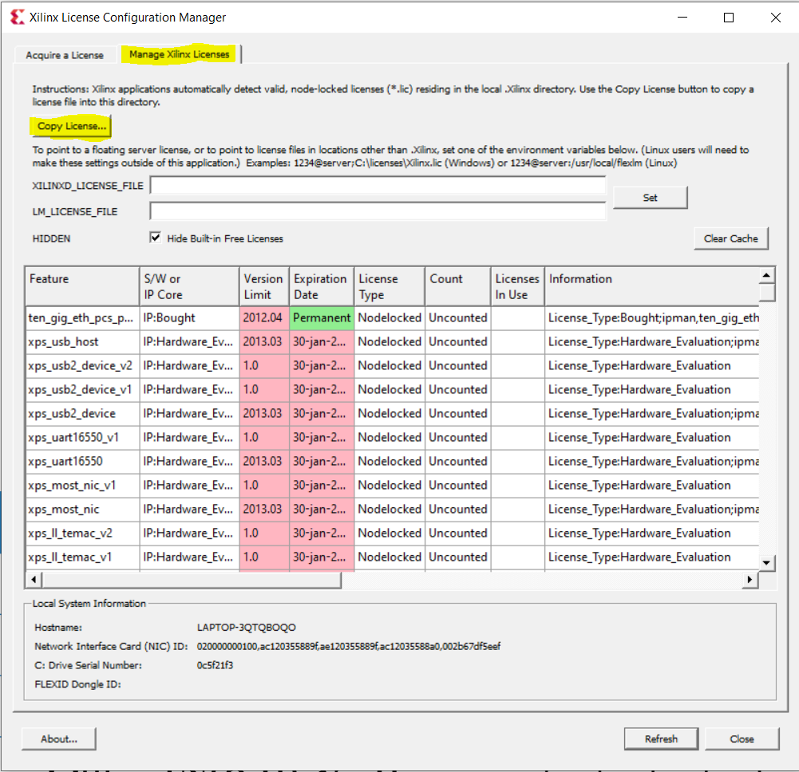
License

Slide 16
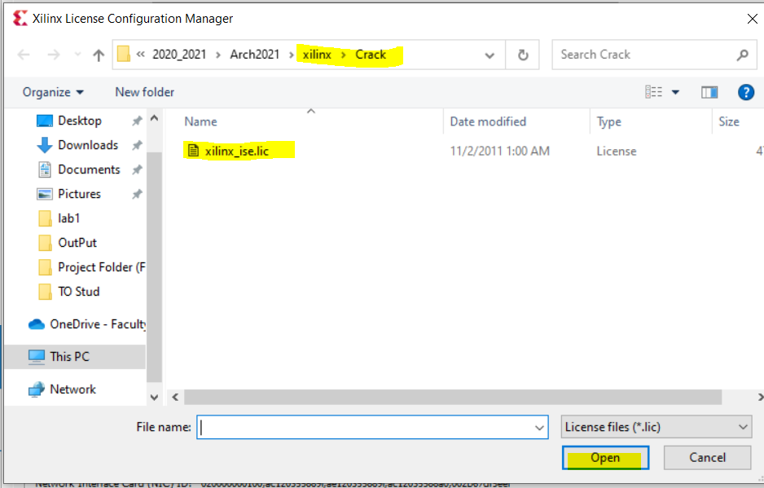
License

Slide 17
error
1- If xsetup.exe do nothing when clicking on it, try to open it from xilinx\bin\nt64\xsetup.exe

Slide 18
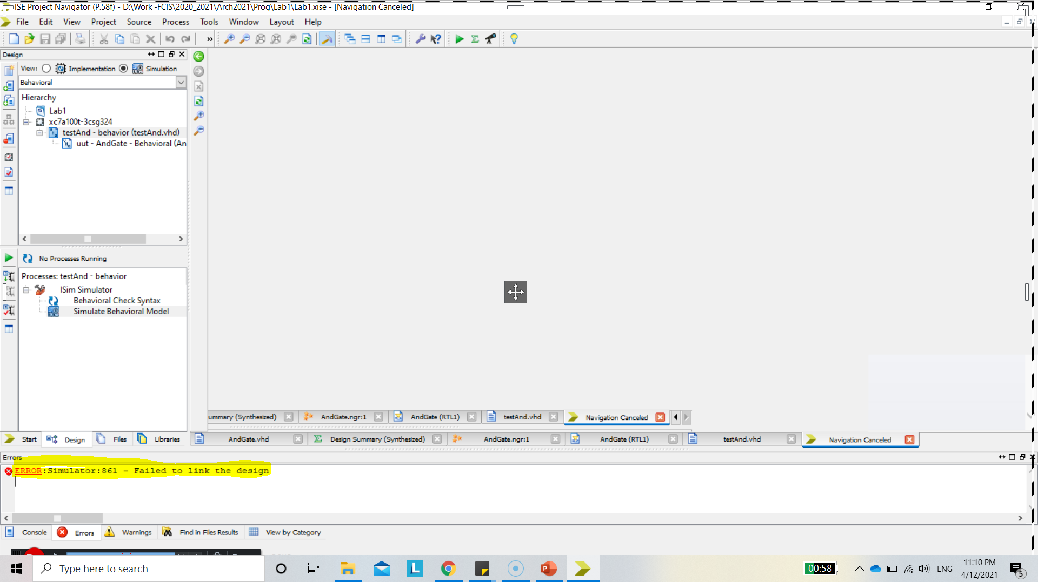
Error
2- failed to link the design
Permanent solution 1: on win 10 Find the "installation directory \ Xilinx \ 14.x \ ISE_DS \ ISE \ gnu \ MinGW \ 5.0.0 \ nt \ libexec \ gcc \ mingw32 \ 3.4.2 \ collect2.exe" and delete it and re-run the emulator, the problem resolved! !
Just delete this or cut and paste somewhere as else, now re-run the code or test bench it will work.
Resource : https://stackoverflow.com/questions/23033297/error-in-vhdl-xilinx-failed-to-link-the-design/46591663

Slide 19
Error
3- ISE 14.7 XCLM does not start on Windows 10:
In folder C:\Xilinx\14.7\ISE_DS\ISE\lib\nt64:
- Rename libPortability.dll to libPortability.dll.orig
- Make a copy of libPortabilityNOSH.dll and rename it to libPortability.dll
- Copy libPortability.dll to C:\Xilinx\14.7\ISE_DS\common\lib\nt64

