Slide 1
LAB 7 BINARY SEARCH TREE
Data Structures 2020-2021

Slide 2
AGENDA
What is BST ?!
Class TreeNode Declaration.
Class Tree Declaration.
Task1: Insert function.
Task2: Find function.
GetLevel function.
Main and testing.

Slide 3
BINARY SEARCH TREE (BST)
It is a binary tree where for each node x:
x’s left subtree values < x < x’s right subtree values
46
63
17
25
55
97
19

Slide 4
CLASS DECLARATION (TREENODE)
Class (TreeNode)
Has member variables of
A pointer to NODE ( left)
A pointer to NODE ( right)
Value of the data
Has One constructor
With parameters.

Slide 5
CLASS DECLARATION (TREENODE.H)
TreeNode.h
TreeNode.cpp
// Tree.h
template <class T>
class TreeNode {
public:
TreeNode<T>* left;
TreeNode<T>* right;
T data;
TreeNode(T);
};
// Tree.cpp
#include "Tree.h“
template<class T>
TreeNode<T>::TreeNode(T v) {
data=v;
left=NULL;
right=NULL;
}

Slide 6
CLASS DECLARATION (TREE)
Class (Tree)
Has member variables of
A pointer to NODE ( root)
Size of tree
Has One constructor
Default Constructor.

Slide 7
CLASS DECLARATION (TREE)
Tree.h
Tree.cpp
template<class T>
class Tree {
private:
TreeNode<T> *root;
int size;
public:
Tree();
};
template<class T>
Tree<T>::Tree() {
size = 0;
root = NULL;
}

Slide 8
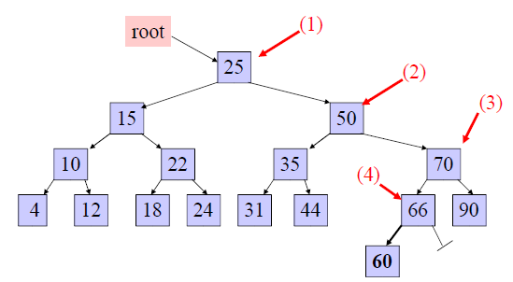
INSERT OPERATION
Example: insert 60 in the tree:
start at the root, 60 is greater than 25, search in right subtree
60 is greater than 50, search in 50’s right subtree
60 is less than 70, search in 70’s left subtree
60 is less than 66, add 60 as 66’s left child

Slide 9
INSERT OPERATION CONT.
Always insert new node as leaf node
Start at root node as current node
While the end of the tree is not reached
If new node’s data < current’s data
Then Search left
If new node’s key > current’s key
Then Search right
Else
Then, It already exists
End while
Add the node in its correct place, whether at the right or the left of the targeted subtree.
Increment the size.

Slide 10
INSERT OPERATION (TREE.H)
template<class T>
class Tree {
private:
TreeNode<T> * root;
int size;
public:
Tree();
void insert(T val);
};
30 minutes

Slide 11
Task 1: INSERT OPERATION (TREE.CPP)
template<class T>
void Tree<T>::insert(T val) {
if (root==NULL) {
root=new TreeNode<T>(val);
size++;
return;
}
TreeNode<T> * ptr = root;
TreeNode<T> * parentPtr = root;
while(ptr != NULL) {
if (val > ptr->data) {
parentPtr = ptr;
ptr = ptr->right;
} else if (val < ptr->data) {
parentPtr = ptr;
ptr = ptr->left;
}
else {
cout<<“The value is already exist"<<endl;
return;
}
}
ptr = new TreeNode<T>(val);
if(val > (parentPtr -> data)) {
parentPtr -> right = ptr;
} else {
parentPtr -> left = ptr;
}
size++;
}

Slide 12
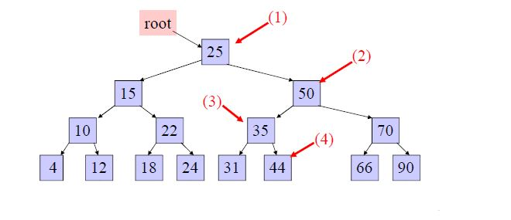
FIND OPERATION
Example: search for 45 in the tree
start at the root, 45 is greater than 25, search in right subtree
45 is less than 50, search in 50’s left subtree
45 is greater than 35, search in 35’s right subtree
45 is greater than 44 , but 44 has no right subtree so 45 is not in the BST

Slide 13
FIND OPERATION CONT.
Start at the root node as current node
While the node is not found and the tree did not end
If the value is less than the data in the current node
Then Search in the left sub tree
Else if the value is greater than the data in the current node
Then Search in the right sub tree
Else
Then, The node is found
End while

Slide 14
FIND OPERATION (TREE.H)
template<class T>
class Tree {
private:
TreeNode<T> * root;
int size;
public:
Tree();
void insert(T val);
bool find(T val);
};
20 minutes

Slide 15
FIND OPERATION (TREE.CPP)
template <class T>
bool Tree<T>::find(T val) {
TreeNode<T> * ptr = root;
while(ptr != NULL) {
if (val < ptr->data)
ptr = ptr->left;
else if (val > ptr->data)
ptr = ptr->right;
else
return true;
}
return false;}

Slide 16
GETLEVEL(VALUE) OPERATION
which takes the value and returns the level of the tree in which the value exists (the root is at level 0, children of the root are at level 1).

Slide 17
GETLEVEL(VALUE) OPERATION (TREE.H)
template<class T>
class Tree {
private:
TreeNode<T> * root;
int size;
public:
Tree();
void insert(T val);
bool find(T val);
int GetLevel(T val)
};

Slide 18

GETLEVEL(VALUE) OPERATION
template <class T>
int Tree<T>::GetLevel(T val)
{
TreeNode<T>* tmp= root;
int lvl =0;
while(tmp!= NULL)
{
if(tmp->value==val)
return lvl;
else if (val >tmp->value) {
tmp=tmp->right;
lvl++;
}
else {
tmp=tmp->left;
lvl++; } }
return -1; }

Slide 19
THE “MAIN” FUNCTION
#include "Tree.cpp“
#include <iostream>
using namespace std;
void main() {
Tree<int> BST;
BST.insert(10);
BST.insert(5);
BST.insert(15);
BST.insert(25);
cout<<BST.GetLevel(100)<<endl;
if(BST.find(7)== true)
cout<<"Found 7"<<endl;
else cout<<“Not Found"<<endl;
if(BST.find(10)== true)
cout<<"Found 10"<<endl;
else cout<<“Not Found"<<endl; }

Slide 20

Thank You ☺

