Slide 1
Data Structures
Hash Tables
Dr. Wedad Hussein
wedad.hussein@gmail.com
Dr. Nivin Atef
Nivin.atef@cis.asu.edu.eg
Information Systems Department

Slide 2
Grades Sheets
General
https://docs.google.com/spreadsheets/d/1GZJxJBYoljrUFFRA1F3oPs0AwmuMM5WhlomLPUZqDgg/edit?usp=sharing
Bioinformatics
https://docs.google.com/spreadsheets/d/1b2Y6Rh3GSJVA3M2UppXNpqmMj87_WMY3sxYPt5wW63A/edit?usp=sharing
Software Engineering and New Programs
https://docs.google.com/spreadsheets/d/1ImV0gFyQSmrf68uP16rTwmK1vUY76aqafy9bnfmfZDc/edit?usp=sharing

Slide 3
Course Contents
Pointers revision + Introduction to Classes.
Stacks
Queues
Array Lists
Linked Lists
Binary Search Trees
Hash Tables
STL
Graphs
Priority Queues

Slide 4
Maps
Sometimes referred to as “dictionary” or “associative array”.
The map ADT:
stores key-value (k,v) pairs.
there cannot be duplicate keys.
The key is used to decide where to store the object in the structure.
In other words, the key associated with an object can be viewed as the address for the object.

Slide 5
Map Functions
Size: returns the number of elements.
isEmpty: returns whether the map is empty.
get(k): returns entry with key k.
put(k,v): add entry (k,v) to the map.
remove(k): removes entry with key k from map.

Slide 6

Possible Implementations

Slide 7
Map Implementations
Linked List Implementation:
get(k): hop through the list until found.
put(k): need to make sure the value does not exist.
remove(k): need to make sure the value exists.
All operations are O(n).

Slide 8
Map Implementations
It could be done using:
Linked Lists: Operations are O(n).
Binary Search Trees: Operations are O(log n) on average.
Could the operations be achieved with O(1)?
Hash Tables are your answer.

Slide 9

Hash Tables

Slide 10
Hash Tables
The implementation of hash tables is frequently called hashing.
Hashing is a technique used for performing insertions, deletions, and finds in constant average time.
The ideal hash table data structure is merely an array of some fixed size containing the items.

Slide 11
Hashing
If we have a table of size T.
Each key is mapped into some number in the range 0 to T− 1 and placed in the appropriate cell.
The mapping is called a hash function.
Essentially, a hash function is just a function that takes things from one space (say strings of arbitrary length) and maps them to a space useful for indexing (integers, say).

Slide 12
Hash Table Components
0
Ahmed 25000
Amal 45300
Hussein 15000
Key
Value
1
Hash Index
2
3
h(“Ahmed”)
Ahmed
4
Key
5
Hash Function
6
7

Slide 13
Hash Table Applications
Symbol table in compilers.
Accessing tree or graph nodes by name
E.g. city names in Google maps
Dictionary lookups
Spell checkers.
Natural language understanding.

Slide 14
Hash Table Terminology
Hash Function: A function that maps the key value to a position within the array.
Hash Value: the value returned by the hash function.
Collision: The situation where two keys are mapped to the same value.
Load Factor (ʎ): (n/T) The number of stored elements compared to the array size.

Slide 15
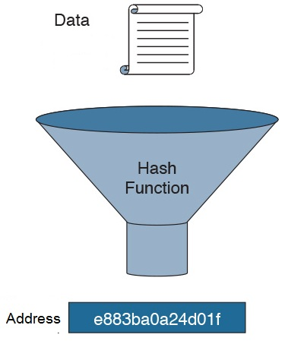
Hash Function

Slide 16
What Makes a Good Hash Function?
The hash value is fully determined by the data being hashed.
The hash function "uniformly" distributes the data across the entire set of possible hash values.
Must return a value within the table bounds.
Given the same key, it should always return the same value.

Slide 17
Hash Function Examples
Is this a good hash function?
int hashCode(int key)
{ return 17; }
Answer: No because this function will map all keys to one value.

Slide 18
Hash Function Examples
Key: National ID
Value: Person’s Name.
Which will make a better hash function:
First 3 digits?
Last 3 digits?

Slide 19
Hash Function Examples
Is this a good hash function?
int hashCode(int key)
{ return key % 10; }
Answer: No.
Collisions will happen a lot.
It might lead to values outside array bounds or use just a small portion of the array.

Slide 20
Hash Function Examples
Better hash function (assuming integer keys):
h(Key) = Key % TableSize
Distributes values evenly over the table.
Better if TableSize is a prime number

Slide 21
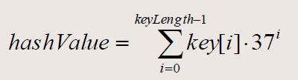
Hashing String Values
key is the string .
key[i] is the i^{th} character of the string.
keyLength is the length of the string.
Take hashValue %= TableSize

Slide 22
Why the function works
Spreads out the impact of each character (words having the same characters (“add” and “dad”) will not collide.
Why 37?
Is prime which helps avoid collisions.
Covers all the letters, numbers, and a space.
Making it as large or larger than the alphabet helpto avoid collisions.

Slide 23
Common Hash Functions
Modular Hashing:
We choose the array size T to be prime.
For any positive integer key k, compute the remainder when dividing k by T.
Effective in dispersing the keys evenly between 0 and T-1.

Slide 24
Common Hash Functions
The Folding Method:
Begins by dividing the item into equal-size pieces.
These pieces are then added together to give the resulting hash value.
Example: phone number (436-555-4601).
Divide into groups (43,65,55,46,01).
After the addition, 43+65+55+46+01, we get 210.
Hash value = 210 % TableSize

Slide 25
Perfect & Minimal Perfect Hashing
Perfect Hashing
Key Set
Hash Table
Minimal Perfect Hashing
Key Set
Hash Table

Slide 26
Challenges
Finding the perfect hash function is not possible.
You will mostly be faced with collisions.
A good hash function yields fewer collisions.
An efficient technique is needed to handle collisions.

Slide 27

Handling Collisions

Slide 28
Collision Resolution
There are basically two techniques for collision resolution:
Chaining (Closed Addressing):
Each slot of the hash table contains a link to another data structure (i.e. linked list), which stores key-value pairs with the same hash.
Open Addressing (Probing):
When a collision occurs, open addressing algorithm calculates another location (i.e. next one) to locate a free slot.

Slide 29

1. Chaining

Slide 30
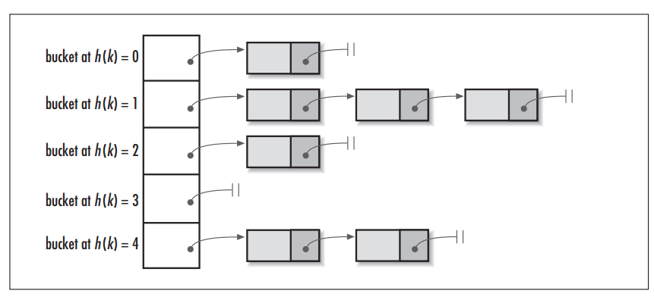
Separate Chaining

Slide 31
Evaluation
Advantages:
It allows an unlimited number of collisions to be handled.
Doesn't require prior knowledge of how many elements are contained in the collection.
Performance is not highly degraded with more collisions.
Disadvantages:
Having to search the linked list sequentially to find required key or to insert.
Potentially more memory is used because of the links.

Slide 32
2. Open Addressing

Slide 33
A. Linear Probing
One of the simplest re-hashing functions is +1 (or -1).
i.e. on a collision, look in the neighboring slot in the table.
The function is implemented with a wraparound (return to 0 when reaching the end of the array).
Re-hash Index (i): The number of collisions occurring at the position.
It calculates the new address extremely quickly.
NewHash(Key) = [Hash(Key)+ i] % T

Slide 34
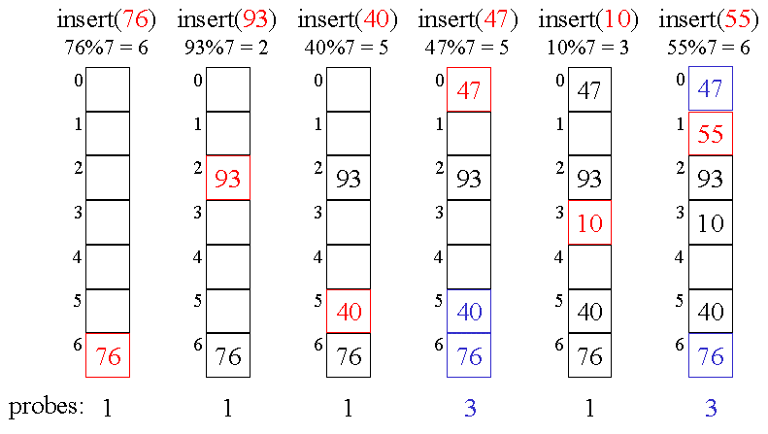
Linear Probing Example

Slide 35
Deletion with Linear Probing
If an empty bucket is created where a full bucket once was, searches will incorrectly fail.
A simple solution would be to mark a bucket as deleted in such a way so that searches will not fail.

Slide 36
Clustering
In linear probing, keys tend to cluster.
That is, several parts of the table may become full quickly while others remain completely empty.
The larger the cluster, the longer the search.
This leads to even more collisions occurring.

Slide 37
Clustering: Worst Case
If you have a really bad hash function.
For example, every key hashes to array index 0.
Then all keys are clustered.
With linear probing you get O(N) time to insert / search an element.

Slide 38
B. Quadratic Probing
Better behavior is usually obtained with quadratic probing.
the secondary hash function depends on the re-hash index.
Quadratic probing can prevent clustering.
Why? First it tries the next cell, then, 4 cells away, then 9, etc.
NewHash(Key) = [Hash(Key)+ i²] % T

Slide 39
C. Double Hashing
Double hashing uses two independent hash functions:
The first hash function is used as usual.
The second hash function is used to create a step size.
If there is a further collision, we re-hash until an empty "slot" in the table is found.
Because the key itself determines the step size, clustering is avoided.

Slide 40
C. Double Hashing cont.
NewHash(Key) = [Hash(Key)+ f(i)] % T
f(i) = i*Hash2 (Key)
Rules for double hashing to work correctly:
The second hash cannot ever return 0 or there will be an infinite loop.
Like linear probing, the table size must be prime.

Slide 41
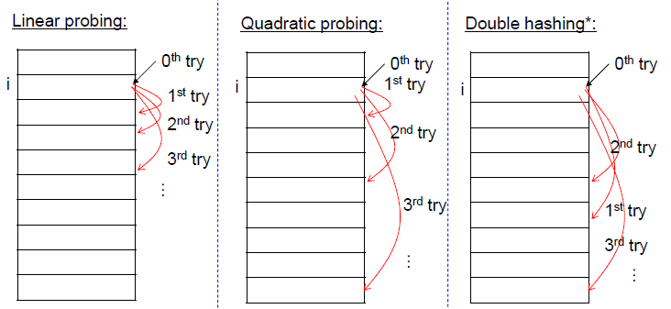
Open Addressing Comparison

Slide 42
Summary
Disadvantages | Advantages | Organization
Overhead of multiple linked lists | Unlimited number of elements. Unlimited number of collisions | Chaining
Maximum number of elements must be known. Increased probability of multiple collisions. | Fast recalculation. Fast access through use of main table space | Open Addressing

Slide 43

Performance

Slide 44
General Notes
A hash table has O(1) performance in the best case.
You need to ensure that the best case is also the average case by choosing a good hash function that minimizes collisions.
But this is not generally achievable.
The average expected performance of a hash table is somewhere between O(1) and O(log N).
The worst case performance is O(N).

Slide 45
Hash Function Effect
If the hash function is poor then there will be excessive collisions and performance will quickly approach O(N).
Also, some hash functions are slower than others.
A slow hash function could increase the constant for O(1) due to expensive operations.
This could cause the hash table to be slower than other data structures that are theoretically slower.

Slide 46
Collision Resolution Strategy Effect
Only separate chaining can easily handle deletion of a key.
The open addressing schemes do not lend themselves well to deleting a key.
Separate chaining is also the only collision resolution strategy that can easily handle duplicate keys:
You only need to search the chain.
For Linear Probing: search the whole cluster.
For Quadratic Probing: search the whole table.

Slide 47
Load Factor Effect
The biggest factor in the performance of a hash table, if the hash function is good, is the load factor of the table.
All collision resolution strategies perform equally well when the load factor is 0.5.
Each begins to degrade as the load factor increases.
The general recommendation is to maintain a 0.5 load factor when possible, and never to go above a 0.7 load factor.

Slide 48
Rehashing
Occasionally, because the operation is very slow, a table needs to be resized.
The only way to do this is to take every key out of the table and rebuild it completely from scratch.
Naturally, this process is very slow compared to other operations, so it should be performed very rarely.

Slide 49
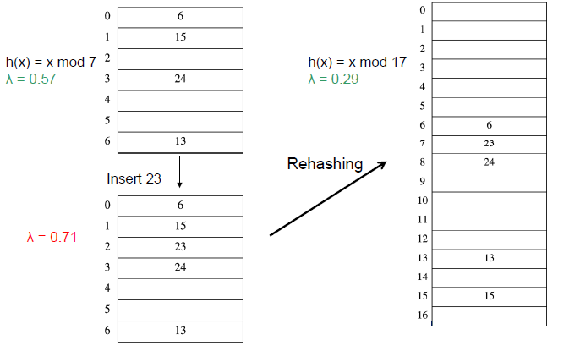
Rehashing Example

Slide 50
Rehashing Analysis
Rehashing takes time to do N insertions.
When to rehash?
When load factor reaches some threshold (typically ʎ > 0.5)
When an insertion fails.
The same technique applies over all collision resolution strategies.

Slide 51
Hash Tables
in STL

Slide 52
unordered_map
Declared as:
You can use the ([]) operator to access or add elements:
unordered_map<key type, value type>
unordered_map<string,string> jobs;
jobs["Ali"]="Engineer";
jobs["Salma"]="Doctor";
jobs["Dina"]="Teacher";
cout<< jobs["Salma"]<<endl;

Slide 53
Iterator
You can use an iterator to access values.
unordered_map<string,string>::iterator it;
it=jobs.begin();
while(it!= jobs.end())
{
cout<<it->first<<" "<<it->second<<endl;
it++;
}

Slide 54
unordered_map functions
at(k): returns the value associated with key k (works the same way as [] operator).
begin(): returns an iterator pointing at the start of the table.
bucket(k): Returns the bucket number where the element with key k is located.
bucket_count(): returns the number of buckets in the table.
bucket_size(bucket number): returns the number of elements in a certain bucket.

Slide 55
unordered_map functions
end(): Returns an iterator pointing to the past-the-end element.
empty(): Returns a bool value indicating whether the container is empty
erase(k): removes the element with key k.
find(k): Searches the container for an element with k as key and returns an iterator to it if found, otherwise it returns an iterator to unordered_map::end .

Slide 56
unordered_map functions
insert(pair): inserts the key-value pair given as a parameter into the table.
load_factor(): returns the load factor of the table.
jobs.insert(make_pair("Mohamed",“SWE"));

Slide 57
unordered_set
unordered_set: stores values in a hash table data structure.
It has the same functions as the unordered_map.
The difference is that the value of the elements is at the same time its key (no pairs).

Slide 58
Competition (4 points)
Write a template class for a hash table with the following properties:
Keys are integers.
It implements a modular hash function.
Use quadratic probing to handle collisions.
Include only the following functions:
isEmpty().
Get(key).
Put(key, value).

Slide 59
Lecture Resources
Lecture Notes.
Text Book:
Chapter 5

Slide 60
Thank You

