Slide 1
Data Structures
Stacks
Dr. Wedad Hussein
Information Systems Department
wedad.hussein@gmail.com

Slide 2
Classes
Recap ☺
Class?
Class vs. Object.
Constructors.
Destructors.

Slide 3
Course Contents
Pointers revision + Introduction to Classes.
Stacks
Queues
Array Lists
Linked Lists
Binary Search Trees
Hash Tables
STL
Graphs
Priority Queues

Slide 4
Dynamic Arrays

Slide 5
Problems with Static Arrays
Exceeding maximum:
Choosing a real maximum is often impossible.
Declaring very large arrays can be extremely wasteful of memory.
No expansion.

Slide 6
Creating Dynamic Arrays
Create a pointer to the array:
int* arr = new int[5];
It points at the first element in the array.
Elements are stored in consecutive positions.
Use the delete operator:
delete[] arr;

Slide 7
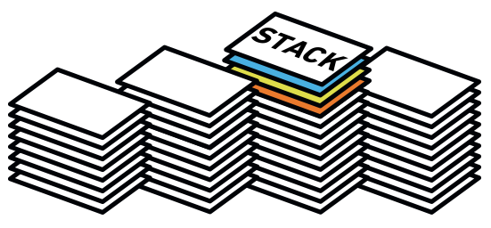
Stacks

Slide 8
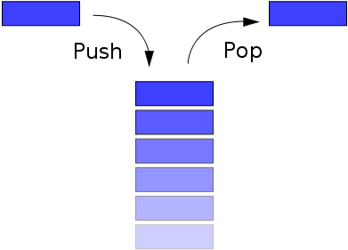
The Stack ADT
A stack is a list with the restriction that insertions and deletions can be performed in only one position, the end of the list (LIFO).

Slide 9
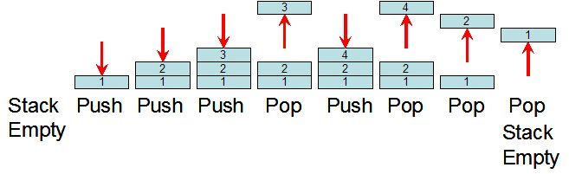
Push and Pop Operations

Slide 10
Stack Operations
Length: Returns the number of elements.
Push: adds an element to the top of the stack.
Pop: removes the top element.
Top: returns the top element.
Empty: returns whether the stack is empty.

Slide 11

Implementation

Slide 12
Abstract Data Types
An abstract data type (ADT) is a set of objects together with a set of operations.
An ADT is fully described by a domain of values together with a set of operations to manipulate these values.
E.g. set: a collection of distinct objects, Operations: add, remove, size, and contains.
There is no mention on how the set of operations are implemented.
ADT vs. Data Structure

Slide 13
Stack ADT Implementations
Using Linked Lists:
Top
9
8
7
Using Dynamic Arrays:
Top
 |  | 5 | 6 | 7 | 8 | 9

Slide 14
Stack Operations
Length: Returns the number of elements.
Push: adds an element to the top of the stack.
Pop: removes the top element.
Top: returns the top element.
Empty: returns whether the stack is empty.

Slide 15
Stack STL

Slide 16
STL
Standard Template Library.
It is a C++ library of container classes and algorithms.
It provides many of the basic algorithms and data structures of computer science.

Slide 17
Stack STL
stack<T>
Operations:
empty
pop
push
size
top

Slide 18
Applications

Slide 19
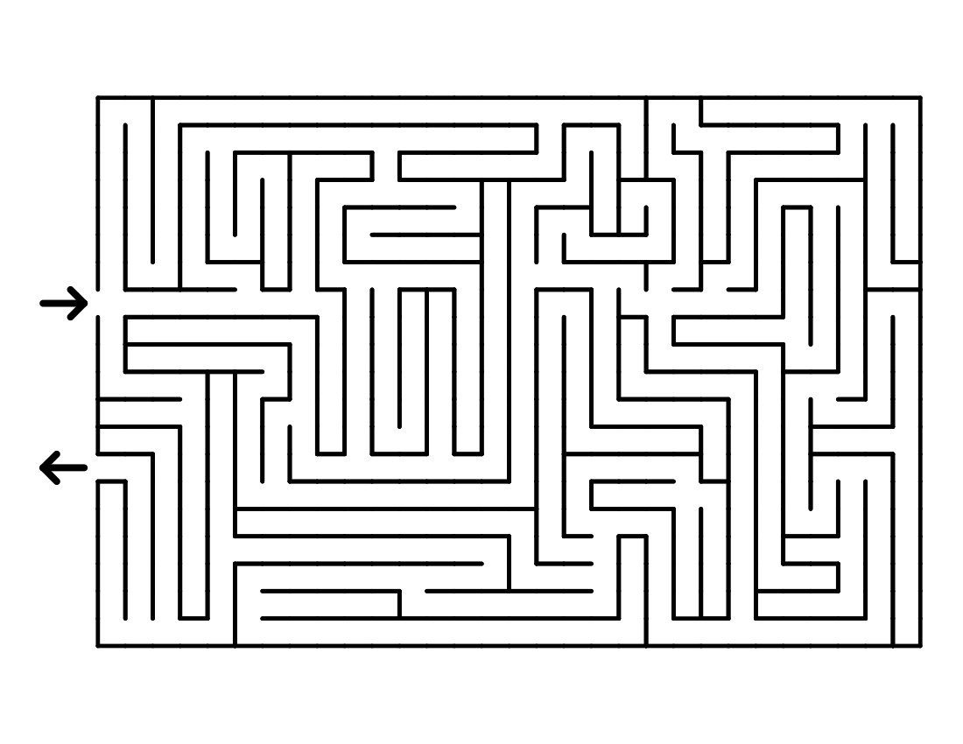

1. Undo operations and Backtracking

Slide 20
2. Balancing Symbols
Compilers should check whether everything is balanced.
Thus, every right brace, bracket, and parenthesis must correspond to its left counterpart.
Steps:
Read characters until end of file.
If the character is an opening symbol, push it onto the stack.
If it is a closing symbol and the stack is empty, report an error.
Otherwise, pop the stack.
If the symbol popped doesn’t match, report an error.
At end of file, if the stack is not empty, report an error.

Slide 21
3. Call Stack
On calling a function, it is important to save the address of next instruction that needs to be executed in the program.
For saving a return address, it needs to be put somewhere in the memory.
The conventional method is to push in to the stack.
Also, a function needs to save the parameters before executing its instructions, which will also be pushed in the stack.
This forms the call stack.

Slide 22
4. Evaluating Postfix Expressions
E.g.: 6 5 2 3 + 8 * + 3 + *
Equivalent to: 6*(5+(2+3)*8+3)
Easier to be evaluated.
Could be evaluated using a stack.
Also called “Reverse Polish Notation”.
Steps:
Operands are pushed into the stack.
When an operator is encountered the last 2 operands are popped and replaced with the result.

Slide 23
4. Evaluating Postfix Expressions cont.
6 5 2 3 + 8 * + 3 + *
3
2
5
6

Slide 24
4. Evaluating Postfix Expressions cont.
6 5 2 3 + 8 * + 3 + *
3
2
5
6
5
5
6

Slide 25
4. Evaluating Postfix Expressions cont.
6 5 2 3 + 8 * + 3 + *
8
5
5
6

Slide 26
4. Evaluating Postfix Expressions cont.
6 5 2 3 + 8 * + 3 + *
8
5
5
6
40
5
6

Slide 27
4. Evaluating Postfix Expressions cont.
6 5 2 3 + 8 * + 3 + *
40
5
6
45
6

Slide 28
4. Evaluating Postfix Expressions cont.
6 5 2 3 + 8 * + 3 + *
3
45
6

Slide 29
4. Evaluating Postfix Expressions cont.
6 5 2 3 + 8 * + 3 + *
3
45
6
48
6

Slide 30
4. Evaluating Postfix Expressions cont.
6 5 2 3 + 8 * + 3 + *
48
6
288

Slide 31
5. Infix to Postfix Conversion
We can also use a stack to convert an expression in standard form into postfix.
E.g. a + b * c + ( d * e + f ) * g
Postfix:
a b c * + d e * f + g * +

Slide 32
5. Infix to Postfix Conversion
When an operand is read, output it
When an operator is read
Pop until the top of the stack has an element of lower precedence
Then push it
When ) is found, pop until we find the matching (.
( has the lowest precedence when in the stack but has the highest precedence when in the input.
When we reach the end of input, pop until the stack is empty

Slide 33
Competition (2 points)
Write a program that uses a stack to convert postfix expressions into infix.
Delivery Method: Send by email before next week’s lecture.

Slide 34
Lecture Resources
Lecture Notes.
Lecture Code.
Text Book:
Chapter 3: 3.6.
Useful Links:
Stack Problem: https://uva.onlinejudge.org/index.php?option=com_onlinejudge&Itemid=8&category=354&page=show_problem&problem=614
Visualization Site: https://visualgo.net/en

Slide 35
Thank You

