Slide 1
Oracle Database 11g
PL SQL – Part III

Slide 2
Controlling PL/SQL Flow of Execution
Change the logical flow of statements by using
control structures:
Conditional control structures (IF statement)
Loop control structures
  Basic loop
  FOR loop
  WHILE loop

Slide 3
The IF Statement: Syntax
END IF is two words.
At most, one ELSE clause is permitted.
ELSIF is one word.
IF condition THEN
statements;
[ELSIF condition THEN
statements;]
[ELSE
statements;]
END IF;

Slide 4
IF-THEN-ELSIF Statements: Example
IF-THEN-ELSIF Statements: Example
Categorize the employees according to their salary into three groups, one for employees who earn more than 5000, one for employees who earn more than 3000, and one for the rest.
...
IF sal > 5000 THEN
dbms_output.put_line (‘Category one’);
ELSIF sal > 3000 THEN
dbms_output.put_line (‘Category two’);
ELSE
dbms_output.put_line (‘Category three’);
END IF;
Notes:
dbms_output.put_line (‘’) is a Pl/SQL command
Doesn’t work in sql*plus
--------------------------------------------------------------------------------
When working with nulls, you can avoid some common mistakes by keeping in mind the following rules:
Simple comparisons involving nulls always yield NULL.
Applying the logical operator NOT to a null yields NULL.
In conditional control statements, if the condition yields NULL, its associated sequence of statements is not executed.
You can handle null values with the IS NULL operator.
Any arithmetic expression containing a null value evaluates to NULL.
Concatenated expressions with null values treat null values as an empty string.

Slide 5
Basic Loop: Syntax
Iterate through your statements with a basic loop.
Without the EXIT statement, the loop would be infinite.
LOOP
statement1;
. . .
EXIT [WHEN condition];
END LOOP;
  -- delimiter
  -- statements
  -- EXIT statement
  -- delimiter

Slide 6
Basic Loop: Example
Insert the first ten new items for order number 101.
declaer
v_ord_id s_item.ord_id%TYPE := 101;
v_counter NUMBER(2) := 1;
BEGIN
...
LOOP
INSERT INTO s_item (ord_id, item_id)
VALUES (v_ord_id, v_counter);
v_counter := v_counter + 1;
EXIT WHEN v_counter > 10;
END LOOP;
...

Slide 7
FOR Loop: Syntax
Use a FOR loop to shortcut the test for the number of iterations.
Do not declare the index; it is declared implicitly.
FOR index in [REVERSE]
lower_bound..upper_bound LOOP
statement1;
statement2;
. . .
END LOOP;

Slide 8
FOR Loop Example
BEGIN
FOR i IN 1 .. 10 LOOP
DBMS_OUTPUT.PUT_LINE(i);
END LOOP;
END;
BEGIN
FOR i IN REVERSE 1 .. 10 LOOP
DBMS_OUTPUT.PUT_LINE(i);
END LOOP;
END;
Notes:
The first example will loop 10 times. The counter will start at 1 and end at 10
The second example will loop 10 times. The counter will start at 10 and end at 1. (loops backwards)

Slide 9
FOR Loop: Example
Guidelines
Reference the index within the loop only; it is undefined outside the loop.
Use an expression to reference the existing value of an index.
Index is read only, do not reference the index as the target of an assignment.

Slide 10
WHILE Loop: Syntax
Use the WHILE loop to repeat statements while a condition is TRUE.
WHILE condition LOOP
statement1;
statement2;
. . .
END LOOP;
Condition is
evaluated at the
beginning of
each iteration.

Slide 11
WHILE Loop: Example
Insert the first ten new items for order number 101.
. . .
v_ord_id s_item.ord_id%TYPE := 101;
v_counter NUMBER(2) := 1;
BEGIN
. . .
WHILE v_counter <= 10 LOOP
INSERT INTO s_item (ord_id, item_id)
VALUES (v_ord_id, v_counter);
v_counter := v_counter + 1;
END LOOP;
. . .

Slide 12
Cursors
cursors are used to select Multiple rows inside PL/SQL block
No
DECLARE
OPEN
FETCH
Yes
CLOSE
EMPTY?
Create a named SQL area
Define the query
Execute the query
Identify the active set
Load the current row into variables
Test for existing rows
Release the active set
Return to FETCH if rows are found
Notes:
Controlling Explicit Cursors
Now that you have a conceptual understanding of cursors, review the steps to use them.
Controlling Explicit Cursors
1. Declare the cursor, in the declarative section of a PL/SQL block, by naming it and defining the structure of the query to be associated with it.
2. Open the cursor. The OPEN statement executes the query and binds any variables that are referenced. Rows identified by the query are called the active set and are now available for fetching.
3. Fetch data from the cursor. In the flow diagram shown in the slide, after each fetch you test the cursor for any existing row. If there are no more rows to process, then you must close the cursor.
4. Close the cursor. The CLOSE statement releases the active set of rows. It is now possible to reopen the cursor to establish a fresh active set.

Slide 13
Controlling Cursors
    Declare the cursor. In the declarative section of a PL/SQL block, by naming it and defining the structure of the query to be associated with it.
    Open the cursor. In the executable section of block. The OPEN statement executes the query. Rows identified by the query are called the active set and are now available for fetching.
    Fetch data from the cursor. After each fetch, you test the cursor for any existing row. If there are no more rows to process, then you must close the cursor.
    Close the cursor. The CLOSE statement releases the active set of rows. It is now possible to reopen the cursor to establish a fresh active set.

Slide 14



Controlling Cursors
1
Open the cursor.
Cursor
pointer
2
Fetch a row.
Cursor
pointer
3
Cursor
pointer
Close the cursor.
Notes:
Controlling Explicit Cursors (continued)
A PL/SQL program opens a cursor, processes rows returned by a query, and then closes the cursor. The cursor marks the current position in the active set.
1. The OPEN statement executes the query associated with the cursor, identifies the active set, and positions the cursor to the first row.
2. The FETCH statement retrieves the current row and advances the cursor to the next
row until either there are no more rows or until a specified condition is met.
3. The CLOSE statement releases the cursor.

Slide 15
Declaring the Cursor
CURSOR cursor_name IS
select_statement;
Syntax:
Example:
DECLARE
CURSOR emp_cursor IS
SELECT employee_id, last_name FROM employees
WHERE department_id =30;
The active set of a cursor is determined by the SELECT statement in the cursor declaration.
It is mandatory to have an INTO clause for a SELECT statement in PL/SQL. However, note that the SELECT statement in the cursor declaration cannot have an INTO clause.
If processing rows in a specific sequence is required, use the ORDER BY clause in the query.
Notes:
Declaring the Cursor
The syntax to declare a cursor is shown in the slide.
In the syntax:
cursor_name Is a PL/SQL identifier
select_statement Is a SELECT statement without an INTO clause
The active set of a cursor is determined by the SELECT statement in the cursor declaration. It is mandatory to have an INTO clause for a SELECT statement in PL/SQL. However, note that the SELECT statement in the cursor declaration cannot have an INTO clause. That is because you are only defining a cursor in the declarative section and not retrieving any rows into the cursor.
Note
Do not include the INTO clause in the cursor declaration because it appears later in the FETCH statement.
If processing rows in a specific sequence is required, use the ORDER BY clause in the query.

Slide 16
Opening the Cursor
DECLARE
CURSOR emp_cursor IS
SELECT employee_id, last_name
FROM employees
WHERE department_id =30;
...
BEGIN
OPEN emp_cursor;
  The OPEN statement :
    executes the query associated with the cursor
    identifies the active set
    positions the cursor pointer to the first row
  The OPEN statement is included in the executable section of the PL/SQL block.
Notes:
Opening the Cursor
The OPEN statement executes the query associated with the cursor, identifies the active set, and positions the cursor pointer to the first row. The OPEN statement is included in the executable section of the PL/SQL block.
OPEN is an executable statement that performs the following operations:
1. Dynamically allocates memory for a context area
2. Parses the SELECT statement
3. Binds the input variables—sets the values for the input variables by obtaining their memory addresses
4. Identifies the active set—the set of rows that satisfy the search criteria. Rows in the active set are not retrieved into variables when the OPEN statement is executed. Rather, the FETCH statement retrieves the rows from the cursor into the variables.
5. Positions the pointer to the first row in the active set.

Slide 17
Fetching One Record from the Cursor
SET SERVEROUTPUT ON
DECLARE
CURSOR emp_cursor IS
SELECT employee_id, last_name
FROM employees
WHERE department_id =30;
empno employees.employee_id%TYPE;
lname employees.last_name%TYPE;
BEGIN
OPEN emp_cursor;
FETCH emp_cursor INTO empno, lname;
DBMS_OUTPUT.PUT_LINE( empno ||' '||lname);
END;
How many records are fetched here?
Only 1
Notes:
Fetching Data from the Cursor
The FETCH statement retrieves the rows from the cursor one at a time. After each fetch, the cursor advances to the next row in the active set. You can use the %NOTFOUND attribute, to check if the entire active set has been retrieved.
Consider the example shown in the slide. Two variables, empno and lname, are declared to hold the fetched values from the cursor. Observe the FETCH statement.
You have successfully fetched the values from the cursor into the variables. However, there are six employees in department 30. Only one row has been fetched. To fetch all the rows, you have to make use of loops. You will see how a loop is used to fetch all the rows in the next slide.
The FETCH statement performs the following operations:
1. Reads the data for the current row into the output PL/SQL variables.
2. Advances the pointer to the next row in the active set.

Slide 18
Fetching Data from the Cursor
SET SERVEROUTPUT ON
DECLARE
CURSOR emp_cursor IS
SELECT employee_id, last_name FROM employees
WHERE department_id =30;
empno employees.employee_id%TYPE;
lname employees.last_name%TYPE;
BEGIN
OPEN emp_cursor;
LOOP
FETCH emp_cursor INTO empno, lname;
EXIT WHEN emp_cursor%NOTFOUND;
DBMS_OUTPUT.PUT_LINE( empno ||' '||lname);
END LOOP;
...
END; /
cursor attribute %NOTFOUND is used to test for the exit condition.
Notes:
Fetching Data from the Cursor (continued)
Observe that a simple LOOP is used to fetch all the rows. Also, the cursor attribute %NOTFOUND is used to test for the exit condition.

Slide 19
Closing the Cursor
SET SERVEROUTPUT ON
DECLARE
CURSOR emp_cursor IS
SELECT employee_id, last_name FROM employees
WHERE department_id =30;
empno employees.employee_id%TYPE;
lname employees.last_name%TYPE;
BEGIN
OPEN emp_cursor;
LOOP
FETCH emp_cursor INTO empno, lname;
EXIT WHEN emp_cursor%NOTFOUND;
DBMS_OUTPUT.PUT_LINE( empno ||' '||lname);
END LOOP;
CLOSE emp_cursor;
...
END; /
Notes:
Closing the Cursor
The CLOSE statement disables the cursor, releases the context area, and undefines the active set. Close the cursor after completing the processing of the FETCH statement. You can reopen the cursor if required. A cursor can be reopened only if it is closed. If you attempt to fetch data from a cursor after it has been closed, then an INVALID_CURSOR exception will be raised.

Slide 20
Close Cursor
  The CLOSE statement disables the cursor
  You can reopen the cursor if required
  A cursor can be reopened only if it is closed
  If you attempt to fetch data from a cursor after it has been closed, then an INVALID_CURSOR exception will be raised.

Slide 21

Cursor: Complete Example
SET SERVEROUTPUT ON
DECLARE
CURSOR emp_cursor IS
SELECT employee_id, last_name FROM employees
WHERE department_id =30;
empno employees.employee_id%TYPE;
lname employees.last_name%TYPE;
BEGIN
OPEN emp_cursor;
LOOP
FETCH emp_cursor INTO empno, lname;
EXIT WHEN emp_cursor%NOTFOUND;
DBMS_OUTPUT.PUT_LINE( empno ||' '||lname);
END LOOP;
CLOSE emp_cursor;
END;

Slide 22
Cursors and Records
Process the rows of the active set by fetching values into a PL/SQL RECORD.
DECLARE
CURSOR emp_cursor IS
SELECT employee_id, last_name
FROM employees
WHERE department_id =30;
emp_record emp_cursor%ROWTYPE;
BEGIN
OPEN emp_cursor;
LOOP
FETCH emp_cursor INTO emp_record;
...
    You can define a record based on the selected list of columns in an explicit cursor.
Notes:
Cursors and Records
You have already seen that you can define records that have the structure of columns in a table. You can also define a record based on the selected list of columns in an explicit cursor. This is convenient for processing the rows of the active set, because you can simply fetch into the record. Therefore, the values of the row are loaded directly into the corresponding fields of the record.

Slide 23
Cursor FOR Loops
Syntax:
  The cursor FOR loop is a shortcut to process cursors.
  Implicit open, fetch, exit, and close occur.
  The record is implicitly declared.
FOR record_name IN cursor_name LOOP
statement1;
statement2;
. . .
END LOOP;
Notes:
Cursor FOR Loops
You have learned to fetch data from cursors by using simple loops. You will now learn to use a cursor FOR loop. A cursor FOR loop processes rows in an explicit cursor. It is a shortcut because the cursor is opened, a row is fetched once for each iteration in the loop, the loop exits when the last row is processed, and the cursor is closed automatically. The loop itself is terminated automatically at the end of the iteration where the last row is fetched.
In the syntax:
record_name Is the name of the implicitly declared record
cursor_name Is a PL/SQL identifier for the previously declared cursor
Guidelines
Do not declare the record that controls the loop because it is declared implicitly.
Test the cursor attributes during the loop, if required.
Supply the parameters for a cursor, if required, in parentheses following the cursor name in the FOR statement.

Slide 24
Cursor FOR Loops
It is a shortcut because: the cursor is opened, a row is fetched once for each iteration in the loop, the loop exits when the last row is processed, and the cursor is closed automatically.
The loop itself is terminated automatically at the end of the iteration where the last row is fetched.

Slide 25
Cursor FOR Loops
SET SERVEROUTPUT ON
DECLARE
CURSOR emp_cursor IS
SELECT employee_id, last_name
FROM employees
WHERE department_id =30;
BEGIN
FOR emp_record IN emp_cursor LOOP
DBMS_OUTPUT.PUT_LINE(
emp_record.employee_id
||' ' ||emp_record.last_name);
END LOOP;
END;

Slide 26
Cursor Attributes
Obtain status information about cursor.
Attribute Type Description
%ISOPEN
Boolean
Evaluates to TRUE if the cursor is open
%NOTFOUND
Boolean
Evaluates to TRUE if the most recent fetch does not return a row
%FOUND
Boolean
Evaluates to TRUE if the most recent fetch returns a row; complement of %NOTFOUND
%ROWCOUNT
Number
Evaluates to the number of rows returned so far
Notes:
Explicit Cursor Attributes
As with implicit cursors, there are four attributes for obtaining status information about a cursor. When appended to the cursor variable name, these attributes return useful information about the execution of a cursor manipulation statement.
Note: You cannot reference cursor attributes directly in a SQL statement.

Slide 27
The %ISOPEN Attribute
  Fetch rows only when the cursor is open.
  Use the %ISOPEN cursor attribute before performing a fetch to test whether the cursor is open.
Example:
IF NOT emp_cursor%ISOPEN THEN
OPEN emp_cursor;
END IF;
LOOP
FETCH emp_cursor...
Notes:
The %ISOPEN Attribute
You can fetch rows only when the cursor is open. Use the %ISOPEN cursor attribute to determine whether the cursor is open.
Fetch rows in a loop. Use cursor attributes to determine when to exit the loop.
Use the %ROWCOUNT cursor attribute for the following:
To process an exact number of rows
To fetch the rows in a loop and determine when to exit the loop
Note: %ISOPEN returns the status of the cursor: TRUE if open and FALSE if not.

Slide 28
Example of %ROWCOUNT and %NOTFOUND
SET SERVEROUTPUT ON
DECLARE
empno employees.employee_id%TYPE;
ename employees.last_name%TYPE;
CURSOR emp_cursor IS
SELECT employee_id,
last_name FROM employees;
BEGIN
OPEN emp_cursor;
LOOP
FETCH emp_cursor INTO empno, ename;
EXIT WHEN emp_cursor%ROWCOUNT > 10 OR
emp_cursor%NOTFOUND;
DBMS_OUTPUT.PUT_LINE(TO_CHAR(empno)
||' '|| ename);
END LOOP;
CLOSE emp_cursor;
END ;
Notes:
Example of %ROWCOUNT and %NOTFOUND
The example in the slide retrieves the first ten employees one by one. This example shows how %ROWCOUNT and %NOTFOUND attributes can be used for exit conditions in a loop.

Slide 29
Practice1
Use cursor to display the employee number and name for all employees in department 50

Slide 30
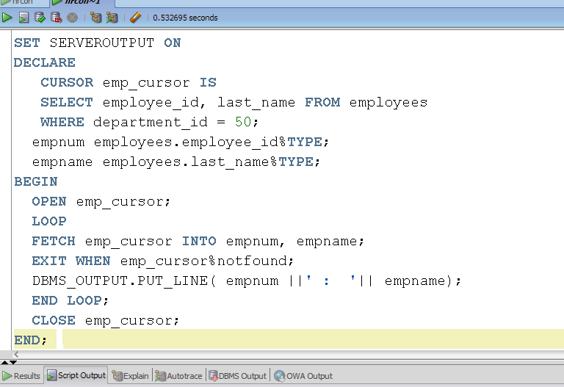

Slide 31
Practice 2
Create a function that calculates the number of employees working in a specific department that will be provided by the user.
Then execute this function for department 10

Slide 32
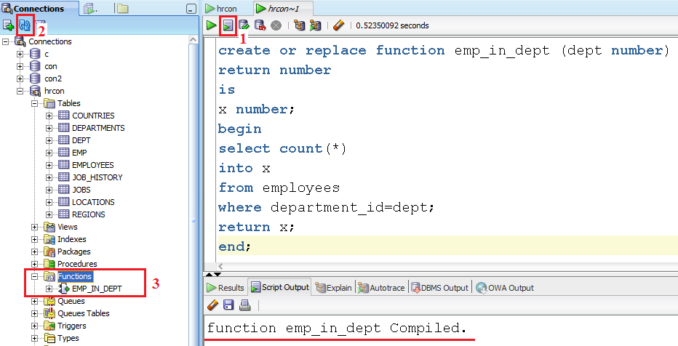
Creating Function
Notes:
set_window_property ('WINDOW1', window_state, maximize);

Slide 33
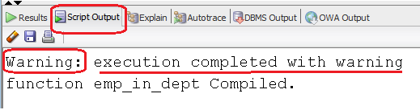
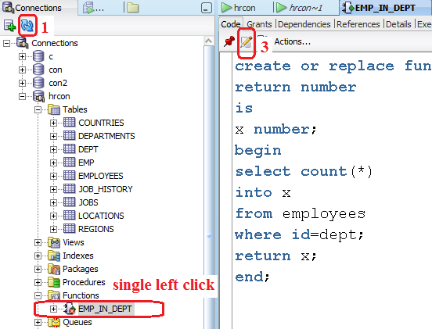
Correcting errors in functions

Slide 34
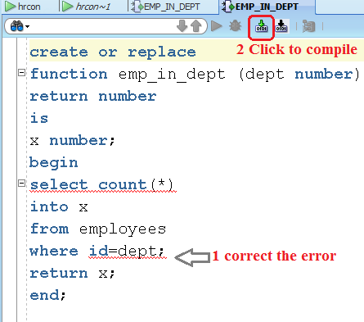

Slide 35
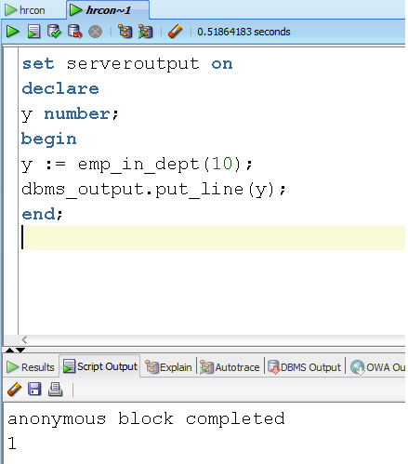
Executing function

Slide 36
Practice 3
Create a procedure that displays the number of employees who have a manager.

Slide 37
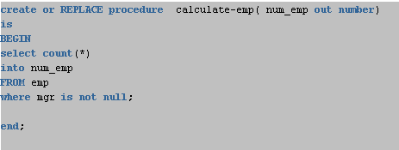
Creating Procedure with OUT parameter

Slide 38
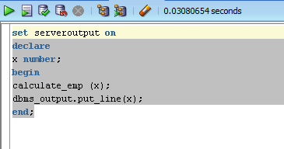
Executing Procedure with OUT parameter

