Slide 1
Software Engineering Lab
Oracle Developer 11g
Part 1

Slide 2
Oracle Developer
The aim is to introduce the concepts and techniques of forms, and to learn how to build single and multiple form applications, using database and graphical user interface (GUI) features

Slide 3
Form Module
There are many types of objects that you can create in a form module:
  Item
  Block
  Canvas
  Trigger
  Other Objects ( i.e. Alerts)

Slide 4
Form Objects
1- Item
Object to represent data values to the user or let the user interact with the form
Member of a block
Items are logically grouped into blocks
Items are visibly arranged on canvas

Slide 5
Form Objects
2- Block
Logical owner of items. Owned by the form module
There is no practical limit to the number of blocks that can be defined

Slide 6
Block Types
  Block Types: Data blocks and control blocks
Data block:
  Data block is associated with data (table columns) within a database
  By default, the association between a data block and the database allows operators to automatically query, update, insert, and delete rows within a database
  Data blocks can be based on database tables, views, procedures, or transactional triggers

Slide 7
Block Types (cont.)
Control block:
  Control block is not associated with the database
  Items in a control block do not relate to table columns within a database

Slide 8
Form Objects
3- Canvas (page)
The surface where visual objects are arranged
Content Canvas:
  Specifies that the canvas should occupy the entire content area of the window to which it is assigned. Most canvases are content canvases

Slide 9
Form Objects
4- Triggers
A program unit (a PL/SQL block) that is executed due to an event

Slide 10
Form Minimum Requirements
1 Canvas
1 Block
1 Item

Slide 11
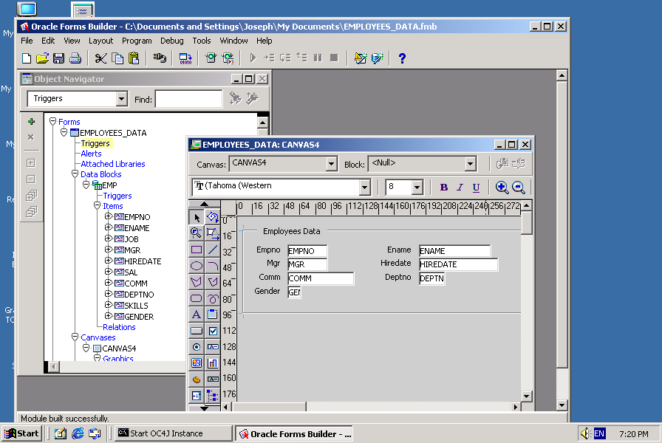

Oracle Forms Builder

Slide 12
Layout Editor
Graphical design facility for creating and arranging interface items in a form
  F2 → Layout editor
  F3 → object Navigator

Slide 13
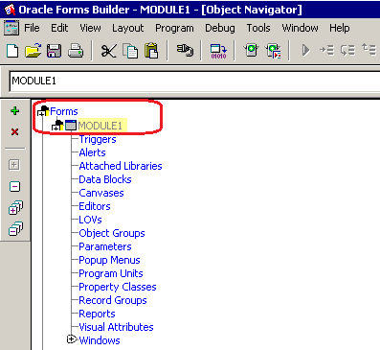
Lab Practice: Creating Form

Slide 14
Lab Practice: Data Block
We will create a form which contains one database block associated with EMP table.
Database block Creation:
  Click the object navigator entry block
  (you should use the wizard for creating the data block)
  OR
  Click the create icon in the object navigator

Slide 15
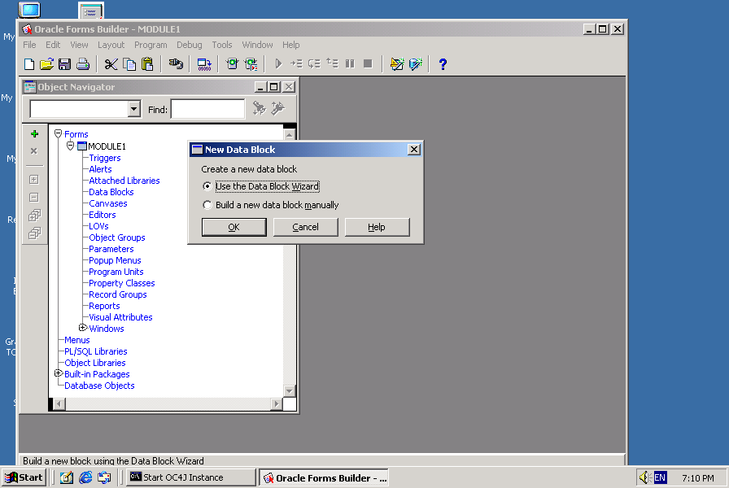
Data Block Wizard

Slide 16
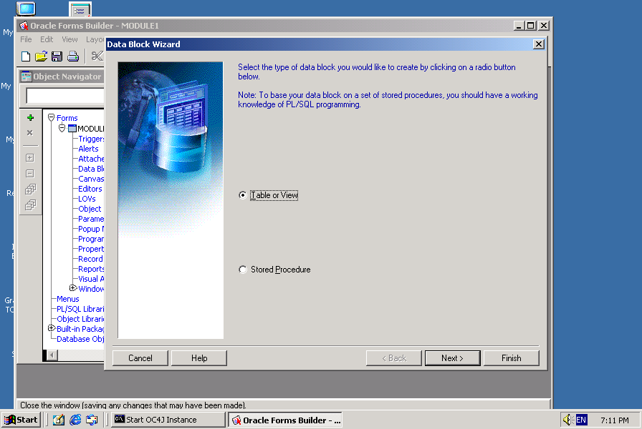
Data Block Wizard (cont.)
Notes:
Database block is based on a table/view or stored procedure

Slide 17
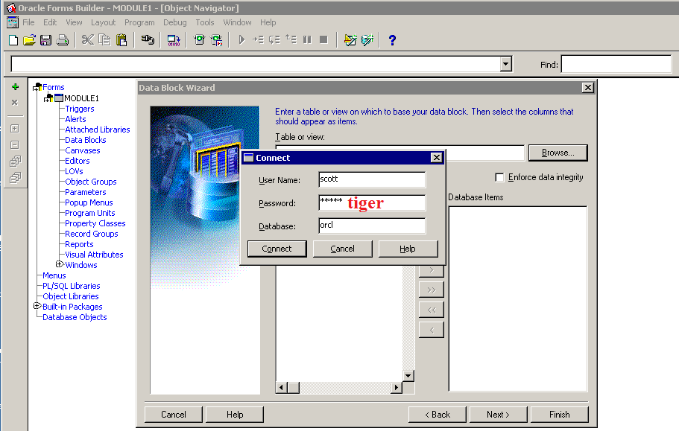
Data Block Wizard (cont.)
Notes:
Connect to the database to choose table/view

Slide 18
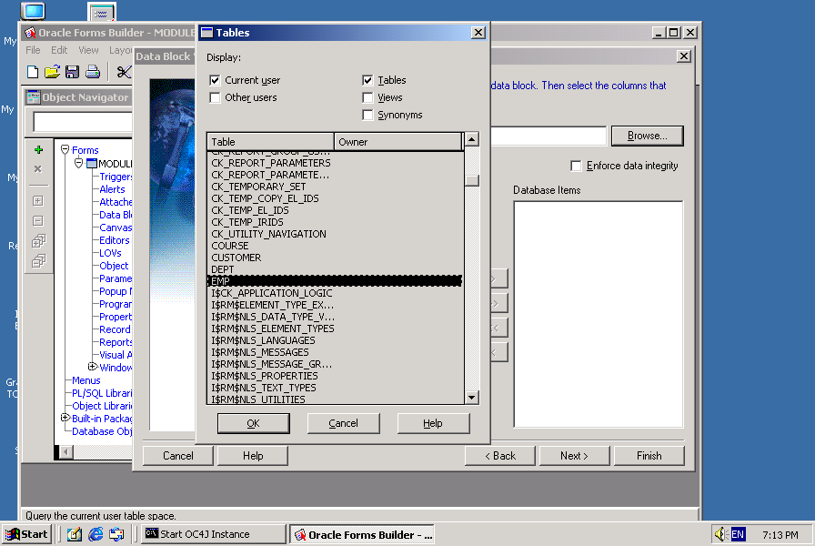
Data Block Wizard (cont.)
Notes:
Choose EMP table

Slide 19
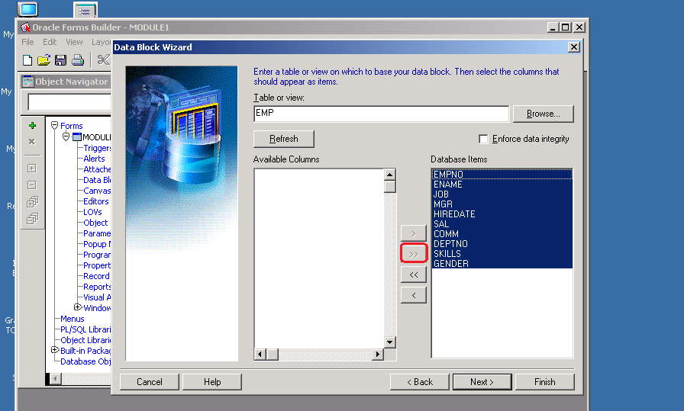
Data Block Wizard (cont.)
Notes:
Include table columns to generate database items on data block

Slide 20
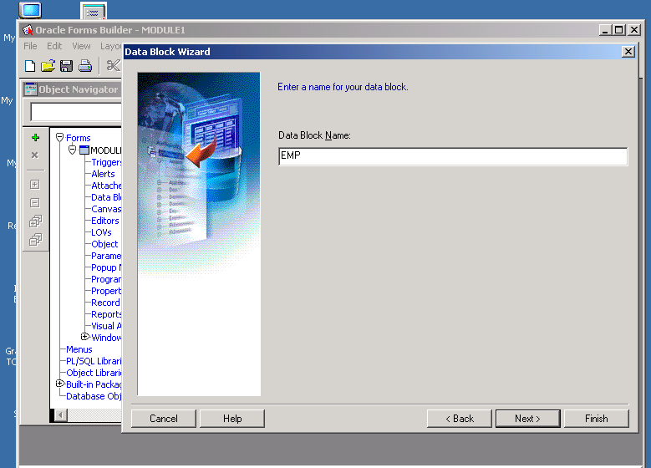
Data Block Wizard (cont.)

Slide 21
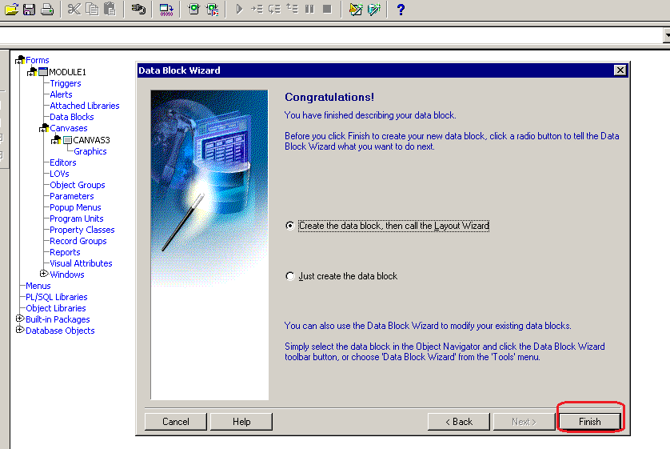
Data Block Wizard (cont.)

Slide 22
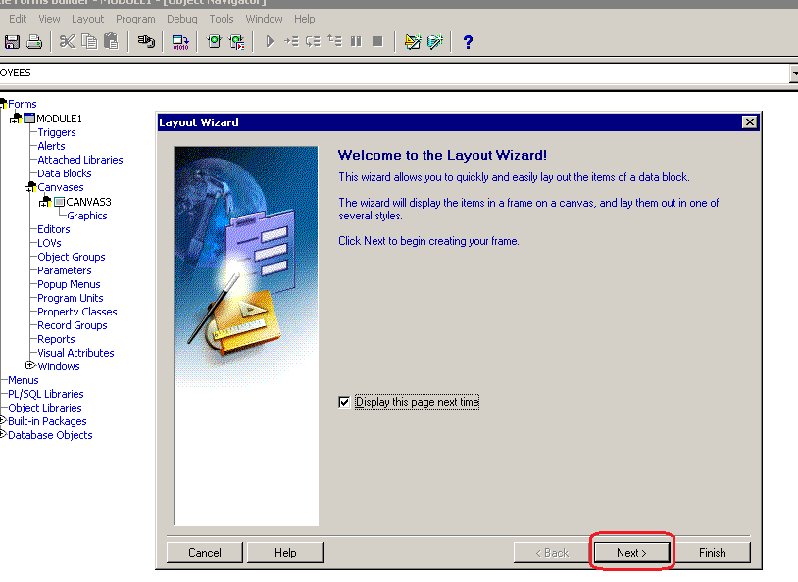
Data Block Creation: Layout Wizard

Slide 23
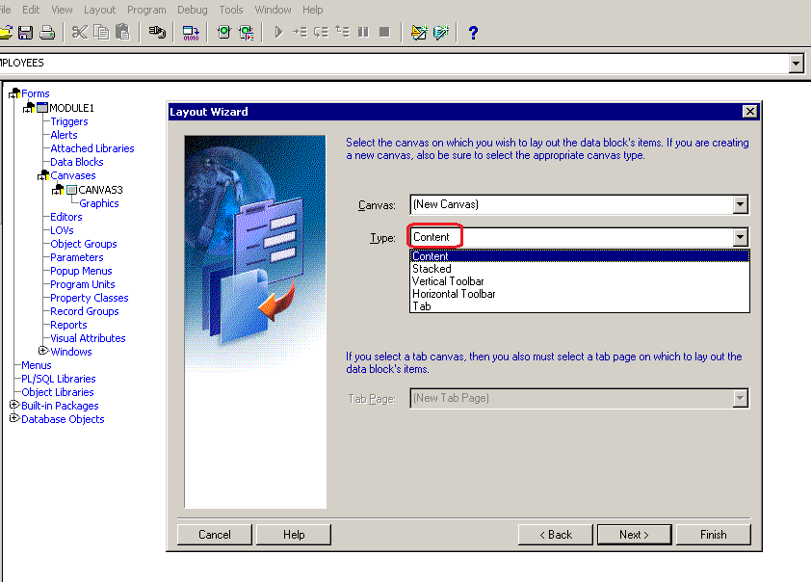
Data Block Creation: Layout Wizard
Notes:
Create a new canvas for your form
Default canvas type is: content

Slide 24
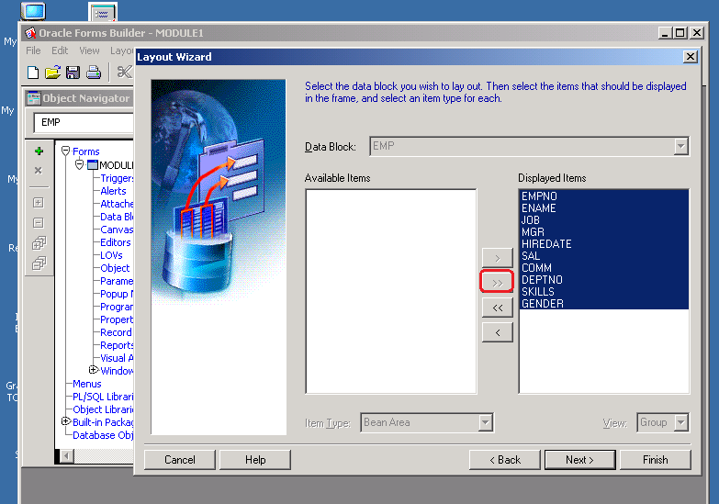
Data Block Creation: Layout Wizard
Notes:
Include items to be displayed on the canvas

Slide 25
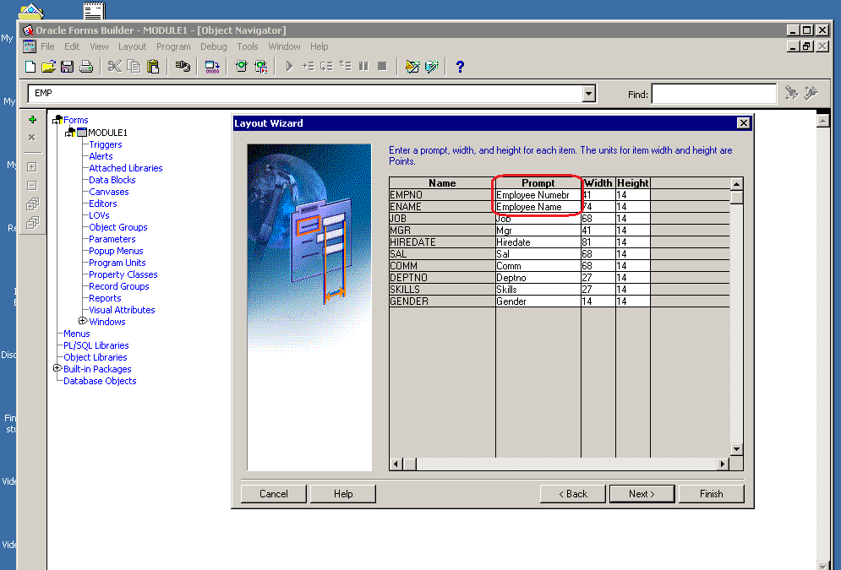
Data Block Creation: Layout Wizard
Notes:
Change prompt (label), width and height of items

Slide 26
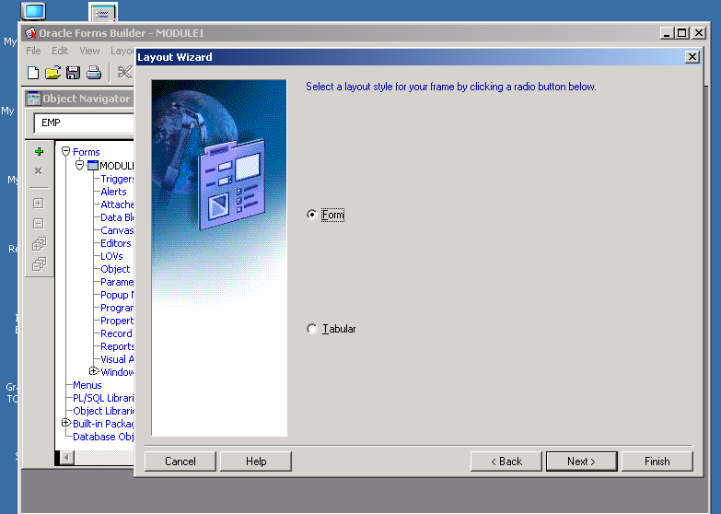
Data Block Creation: Layout Wizard
Notes:
Choose layout style either form or tabular

Slide 27
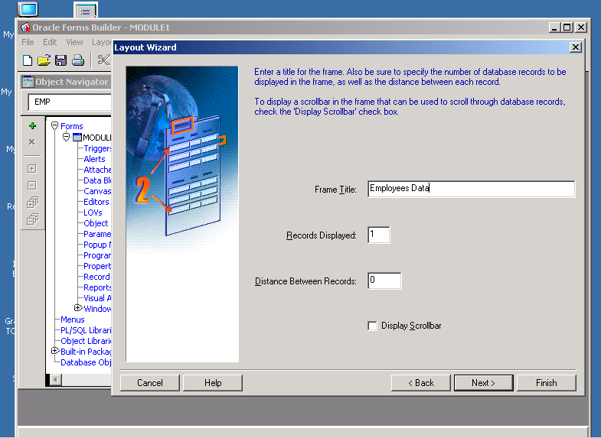
Data Block Creation: Layout Wizard

Slide 28
Before running the form
For the Form to run; Oracle HTTP Server listener receives the request when web browser starts. Oracle HTTP Server listener forwards the request to the Oracle WebLogic Server Oracle Developer. So there must be a weblogic server started.
  Write in the windows search box:
  Start Web Logic Admin Server
Once the weblogic server is running, you can minimize it and continue working (design/ run) in the form builder.
When you are finished, and the weblogic server is no longer needed, you may stop it
  Write in the windows search box:
  Stop Web Logic Admin Server
Notes:
WebLogic Server is an application server: a platform for developing and deploying multitier distributed enterprise applications. WebLogic Server centralizes application services such as Web server functionality, business components, and access to backend enterprise systems. It uses technologies such as caching and connection pooling to improve resource use and application performance. WebLogic Server also provides enterprise-level security and powerful administration facilities.
WebLogic Server operates in the middle tier of a multitier (or n-tier) architecture. A multitier architecture determines where the software components that make up a computing system are executed in relation to each other and to the hardware, network, and users. Choosing the best location for each software component lets you develop applications faster; eases deployment and administration; and provides greater control over performance, utilization, security, scalability, and reliability.
WebLogic Server implements J2EE, the Java Enterprise standard. Java is a network-savvy, object-oriented programming language, and J2EE includes component technologies for developing distributed objects. This functionality adds a second dimension to the WebLogic Server application architecture—a layering of application logic, with each layer selectively deployed among WebLogic Server J2EE technologies.
Reference:
https://docs.oracle.com/cd/E13222_01/wls/docs61/intro/chap1.html

Slide 29
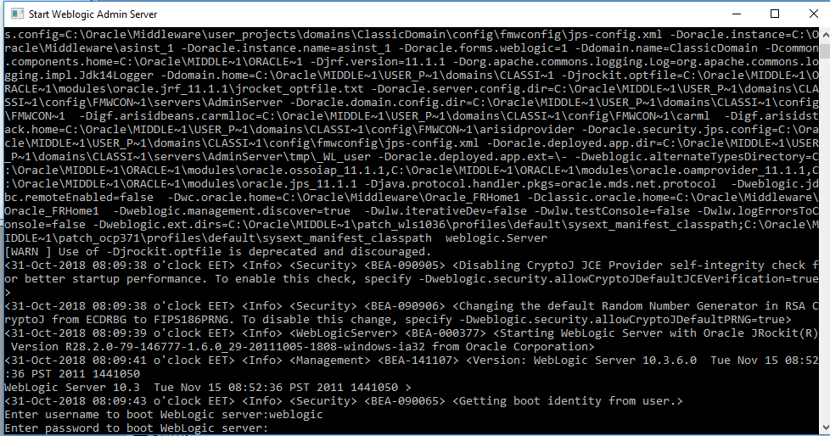
  Username:weblogic and Password: Administrator1
  Note that the password is INVISIBLE, so it is better to write it in a notepad and copy it then paste in the web logic window

Slide 30
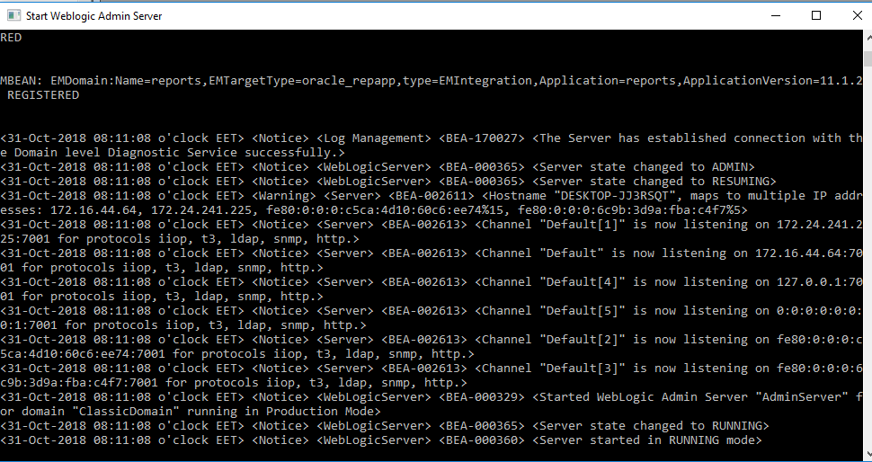

Slide 31
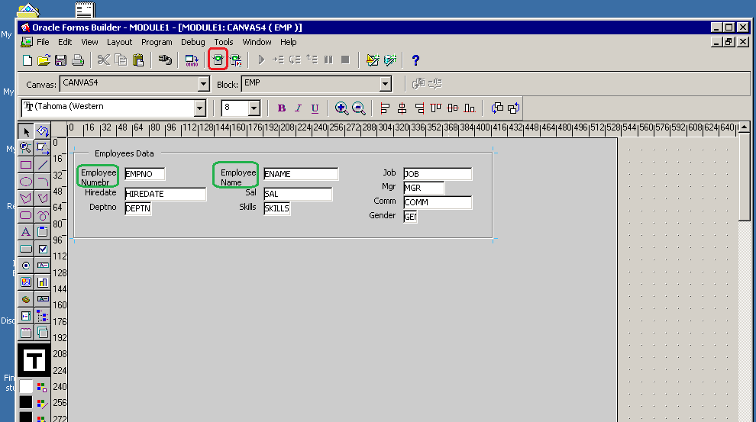
Running the form

Slide 32
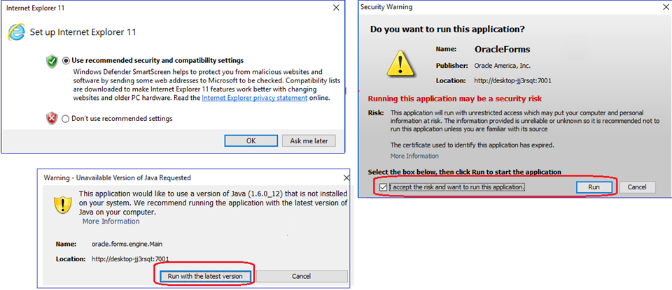
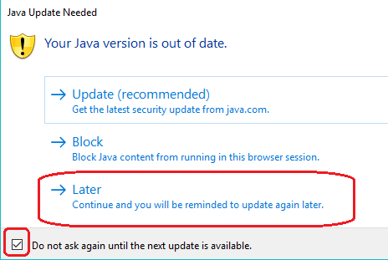
Running the form for the first time

Slide 33
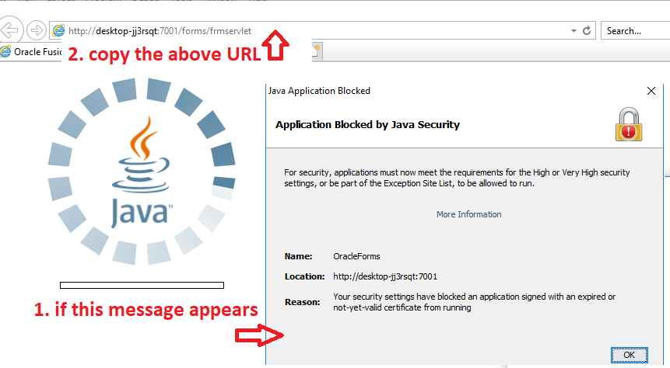
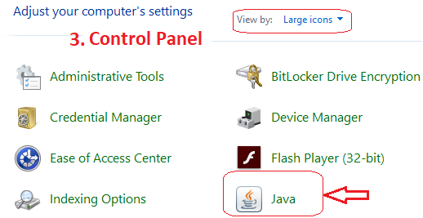
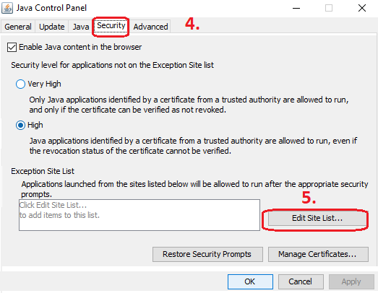
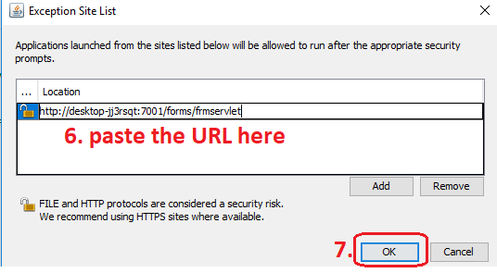
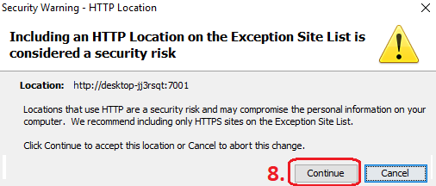
Running the form for the first time
Notes:
If the message (step 1.) in the above slide did not appear, then skip all the steps in this slide

Slide 34
Lab Practice: Running Form
Run your form from the toolbar, click on Run
Insert new, update, and delete employees
Retrieving data (unrestricted query)
  => press Execute Query

Slide 35
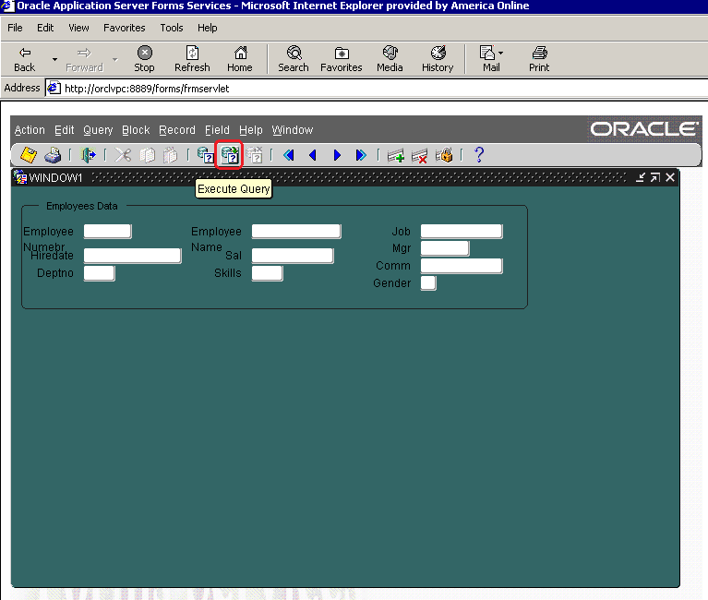
Select all employees

Slide 36
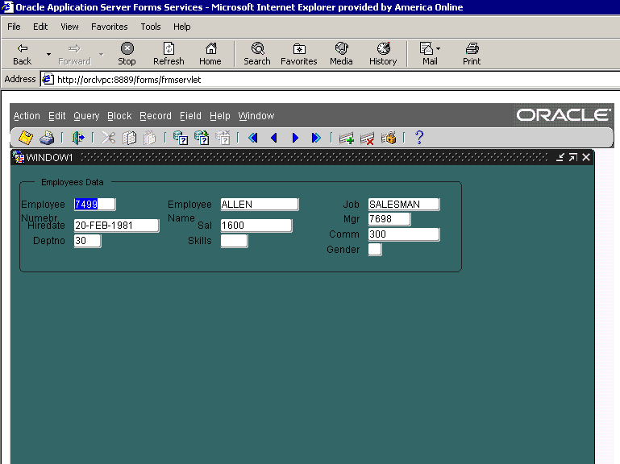
Select all employees
Use navigation keys (those blue arrows) to display next or previous record

Slide 37
Lab Practice: filter data based on condition (restricted query)
Retrieving data (restricted query)
you can use matching values, matching patterns (wildcards)
  Select from Menu => Query =>Enter
  OR press icon enter query from form menu
  Enter your query
  ex: enter 10 in the deptno text box
  3. Press Execute Query
Data of employees working in dept 10 only is displayed

Slide 38
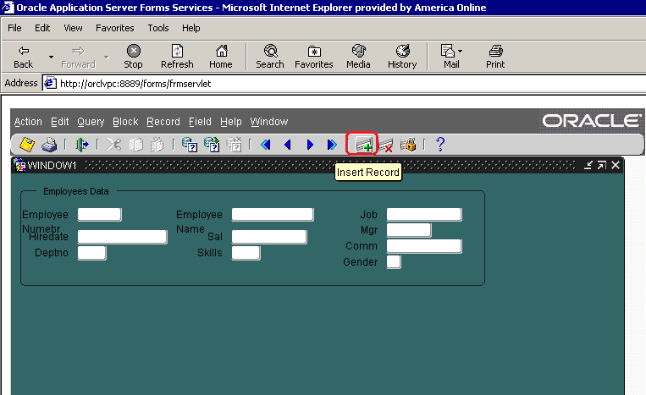
Insert Record

Slide 39
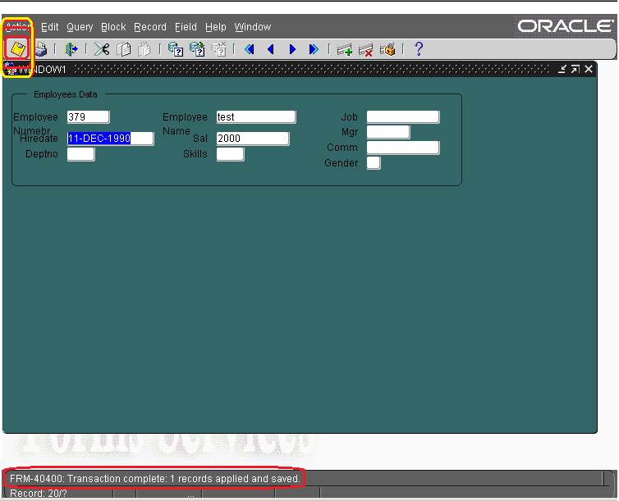
Insert Record

Slide 40
Delete record

Slide 41
Delete Record
After the record is deleted, it automatically displays next record on the form

Slide 42
Lab Practice: Buttons
Draw a button from the toolbox and open its property palette by:
  Double-click the object icon OR
  Select the button then press F4 OR
  Right click then choose property palette
  Label property: label that appears on the button at runtime
  Tool tip property: short help text that displays info about item when you navigate to it with the mouse

Slide 43

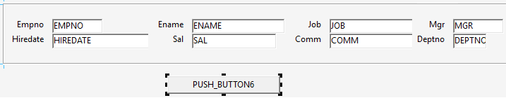
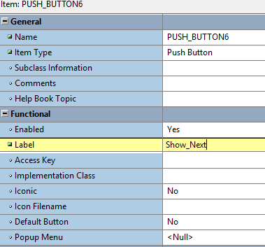
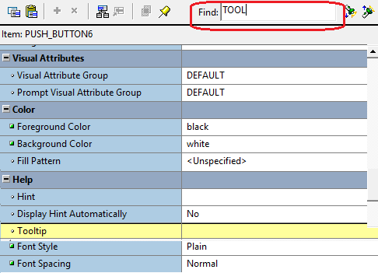
Lab Practice: Buttons
Press F2 to go to the Layout Editor
Double Click on the button to open the property pallet

Slide 44
Lab Practice: Triggers
Item level:
  A Trigger fires when this item is the current item
  In the layout editor, create a button, right click, and choose
  Smart Triggers => ‘When_button_pressed’
  Edit PL/SQL:
      1- Next_record; 2- Previous_record;
      3- First_record; 4- Last_record;
      5- Commit;
  Compile and close
Notes:
Button should belong to the same data block as the emp columns

Slide 45
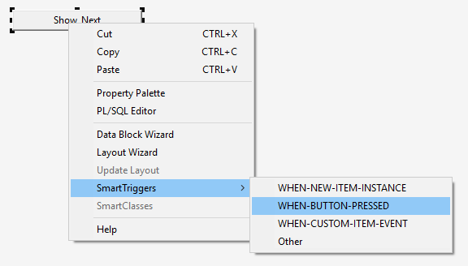
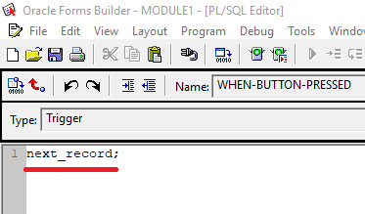
Lab Practice: Triggers

Slide 46
Before we start
You need to connect to SQL Developer with user name: scott and password: tiger then write these SQL statements in :
  Alter table emp
  add ( skills char(3), gender char(1));
  Update emp set skills = 'yes' , gender='M'
  where empno between 7300 and 7839;
  Update emp set skills = 'no' , gender='F'
  where empno between 7844 and 8000;
  Commit;
User scott already contains tables emp and dept similar to employees and departments of user hr

Slide 47
Create New form based on Emp table

Slide 48
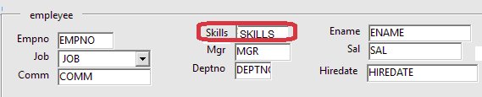
Lab Practice:
Check Box
In the layout editor, select the skills item, enter property palette:
  Change item type into Check Box
  Set value when checked => yes
and value when unchecked => no
  Set check box mapping of other values:
  this determines how data values other than specified are processed, not allowed property makes the form ignore the entire record during the query processing
  Set initial value => yes
Notes:
-- you need to write these SQL statements in SQL Developer before you perform the steps in the slide:
alter table emp add ( skills char(3), gender char(1));
update emp set skills ='YES' , gender='M' where empno in (7788,7839);
update emp set skills ='NO' , gender='F' where empno in (7844,7876);

Slide 49
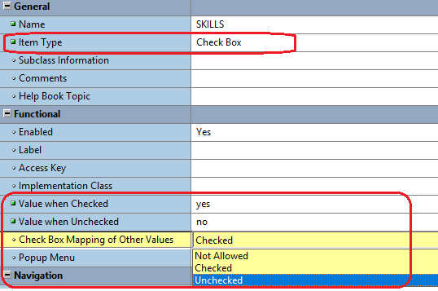
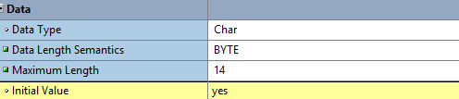
Lab Practice: Check Box

Slide 50
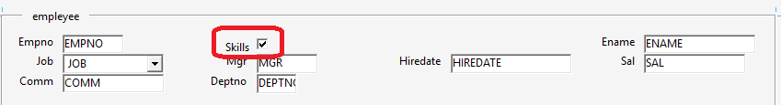
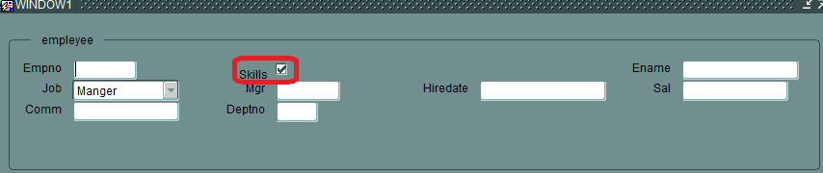
Lab Practice: Check Box
Form layout (design)
Form Run

Slide 51
Lab Practice: Radio Group
A radio group is a set of radio buttons, each represents a different value. These values are mutually exclusive
In the layout editor, select the gender item, enter property palette
  Change item type property into radio group. It disappears from layout editor
  In the object navigator, expand the gender node => radio buttons node => click the create icon, and create two radio buttons
  Enter the property palette of the radio buttons:
    Change label into Female, radio button value => F
    Change label into Male, radio button value => M

Slide 52
Lab Practice: Radio Group (cont.)
  In layout editor, radio buttons are placed on the top left corner above each other. Drag them, add a frame
  Enter the property palette of the radio group, that is, the gender item itself.
    Set initial value => F
  Leaving the radio group’s mapping of other values property blank makes the form ignore the entire row during query processing. Associate it with one of the existing radio buttons by writing M

Slide 53
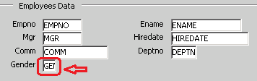
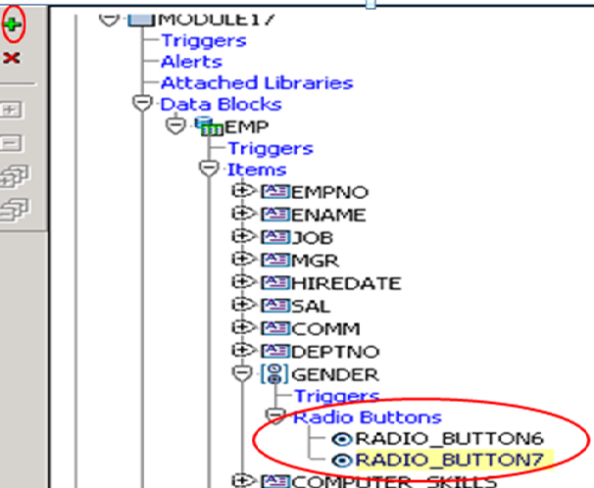
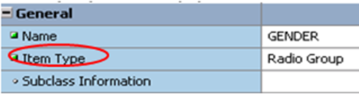
Lab Practice: Radio Group
1. Double click on the Gender Item
2. Change item type property
3. Press F3 then Add two radio buttons

Slide 54
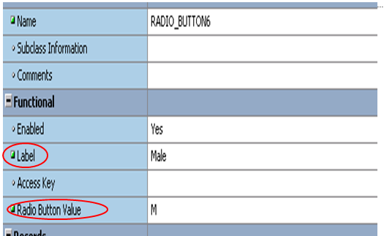
Lab Practice: Radio Group
4. Open the property pallet of the first radio button and change the following
5. Do the same for FEMALE the second radio button

Slide 55
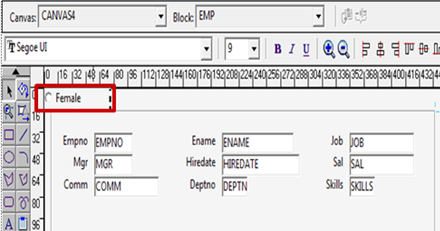
Lab Practice: Radio Group
6- Press F2 then you will find both radio buttons above each other

Slide 56
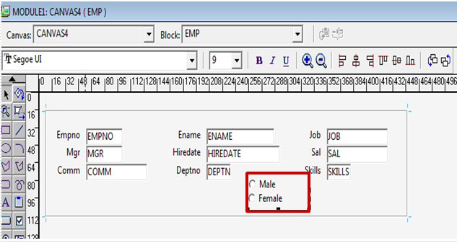
Lab Practice: Radio Group

Slide 57
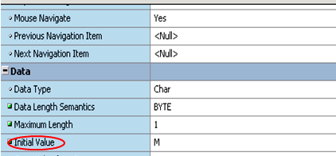
Lab Practice: Radio Group
7. Open the property pallet of the Gender item
  Initial Value: M
  Mapping of other Values: M

Slide 58
Thank You

