Slide 1
Spark case study
Team members:
Eslam Fayez
Mahmoud hatem
Omar ramadan
Shrorouk abdelraouf

Slide 2
Table of contents
01
02
03
04
05
Introduction
Bronze layer
Silver layer
Gold layer
Business requirments

Slide 3
01
Introduction

Slide 4
Project description
1 - This projects involve handling data from a retail company
2- This is the shape of the received data :
Source system pushes 3 files every hour (branches file, sales
agents file, sales transactions file). For the sales transactions
file, it contains both branches and online sales.

Slide 5
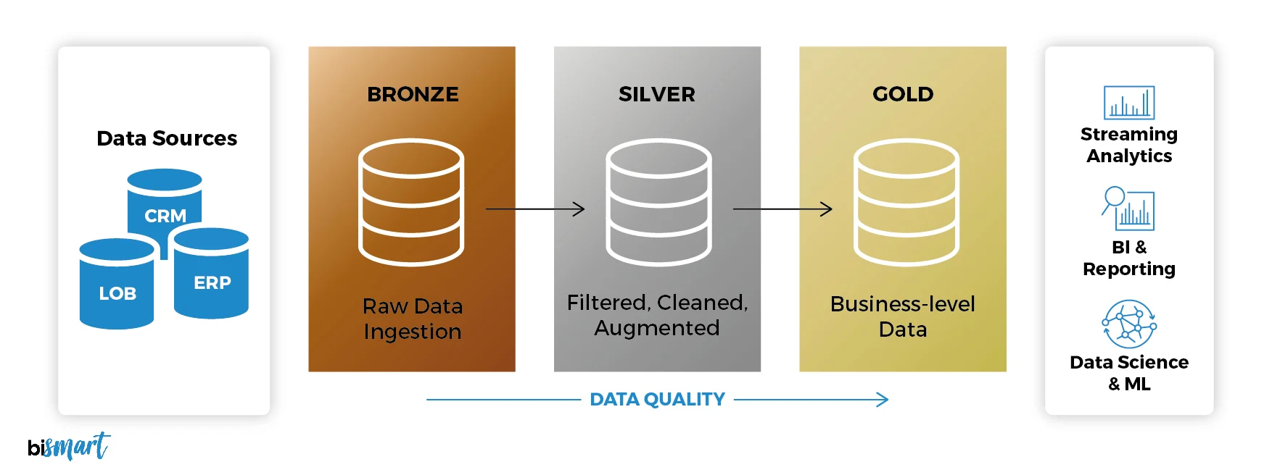
Medallion architecture

Slide 6
02
Bronze layer

Slide 7
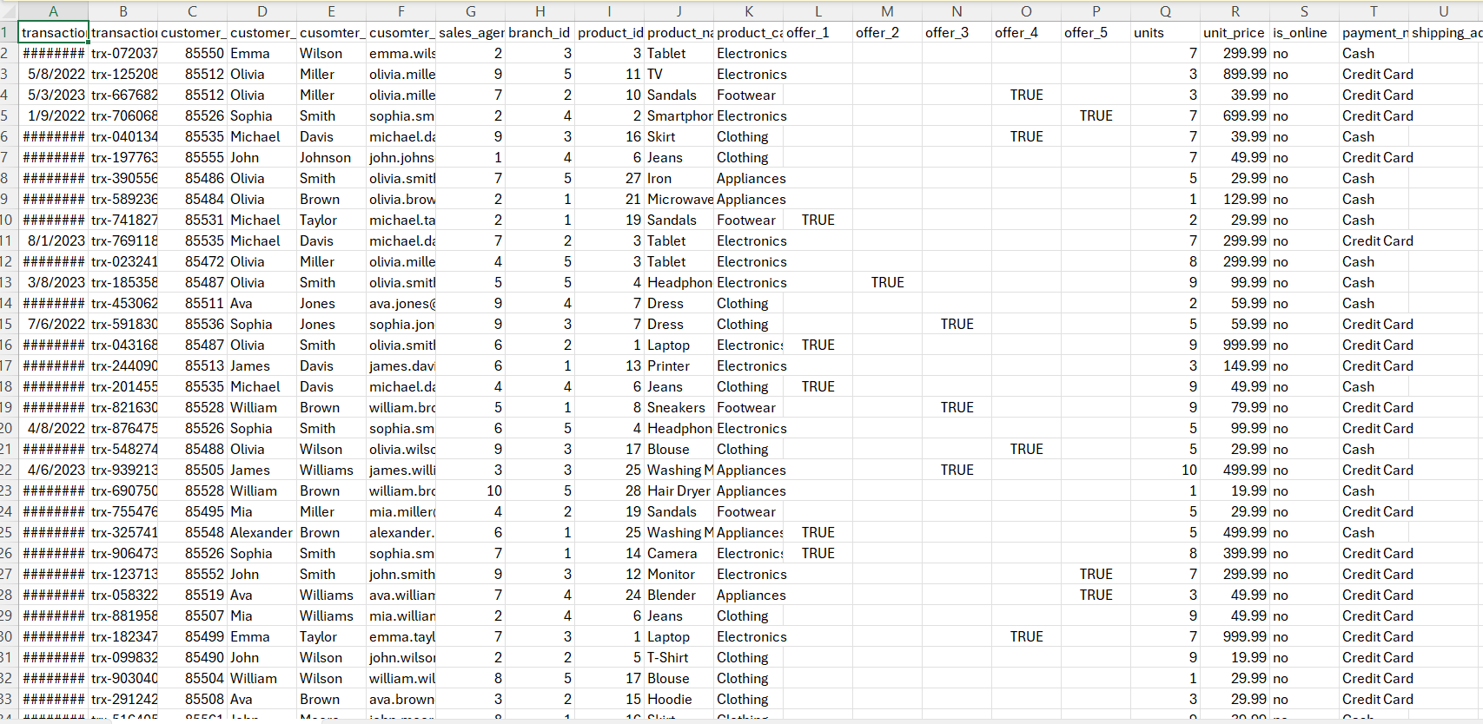
Bronze layer

Slide 8
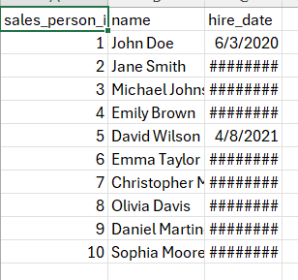
Bronze layer

Slide 9
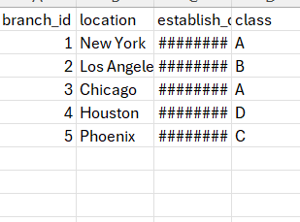
Bronze layer

Slide 10
Bronze layer
- we move the files in its raw format from the local file path to the hdfs every hour using a crontab job which makes the
script( move_hdfs.py) running in an automated way every one hour
- Checking for the file name and storing it in a specific directory in hdfs

Slide 11
03
Sliver layer

Slide 12
Sliver layer
Using (fact.py) job we achieve the next :
Checking if the file is already processed or not
-Applying some transformations on the unprocessed file like :
1 – transform the email
2- extracting the address details
3 – create a new column for offer
4 – calculating the total price
5 – dropping the useless columns
- Writing the file name in the checkpoint file to remark as processed

Slide 13
04
Gold layer

Slide 14
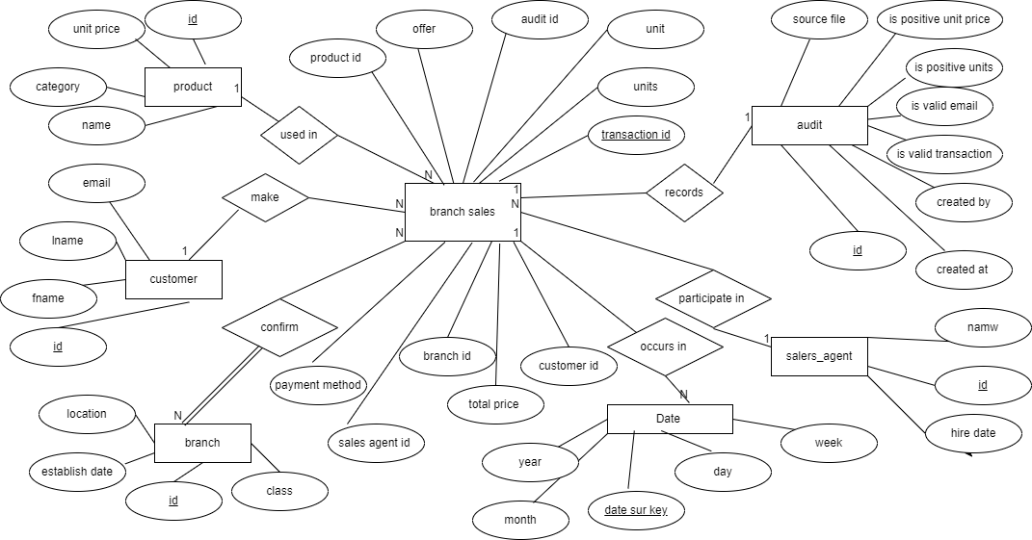
Super data mart

Slide 15

branch data mart

Slide 16
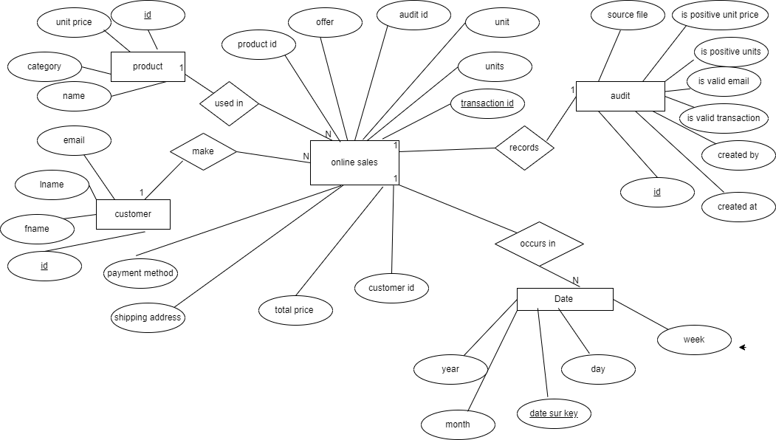
Online data mart

Slide 17
05
Business requirements

Slide 18
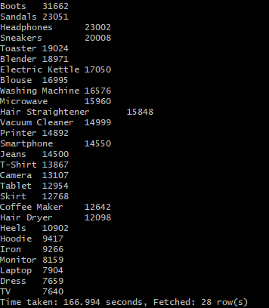
Most Selling Products

Slide 19
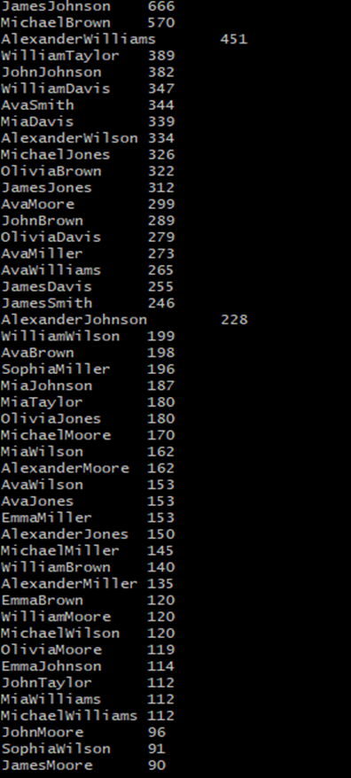
Most Redeemed Offers per Customer

Slide 20
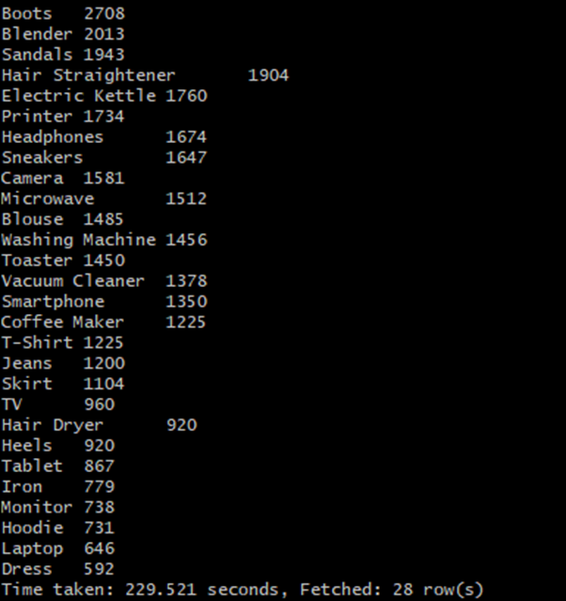
most redeemed offers per product

Slide 21
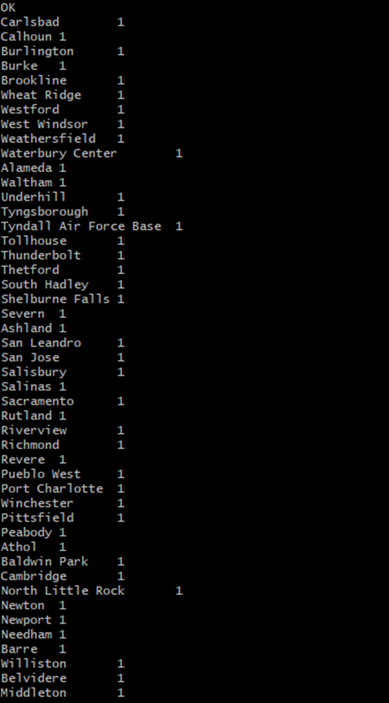
lowest cities in online sales

Slide 22

most used payment method

Slide 23
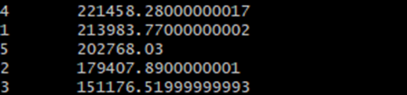
Highest Branch In Sales

Slide 24
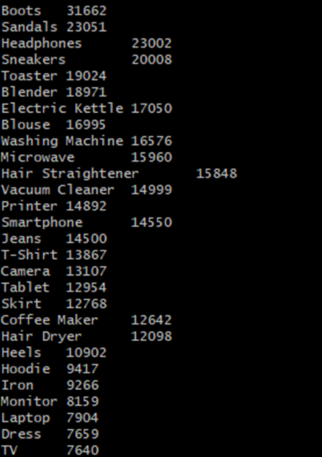
Most Product Sold By Quantity

Slide 25
Thanks

