Slide 1
Analysis of Country Indicators

Slide 2

Agenda
1 -Data preparation
2- Description of dashboards

Slide 3
Data preparation
My data source is World bank website
I focused on the data of only 2 countries : Germany and Spain
I extracted 3 different datasets : Economy and growth , Health and external debt
I applied some transformations on the data ( pivoting , unpivoting and replacing some nulls ) then I joined the 3 datasets on tableau using the Year column .
The final dataset has a set of different 31 indicator in the boundaries of 1990 - 2022
I created 3 groups on Year column to get aggregated insights

Slide 4
Description of dashboards
Clarifying every dashboard’s insights

Slide 5
First dashboard
- The first KPI indicates the total of current GDP in (US$)
- The second KPI indicates the average of annual GDP growth percentage
- The third KPI indicates the average revenue percentage of GDP
- A bar chart shows that Germany (2011-2022) has the highest Avg exports (% of GDP) and Spain (1990-1999) has the lowest of the same indicator
- A highlighted table indicates that Spain (2011-2022) has the highest Sum of Expenses (% of GDP) and Germany at the same period has the lowest of it .

Slide 6
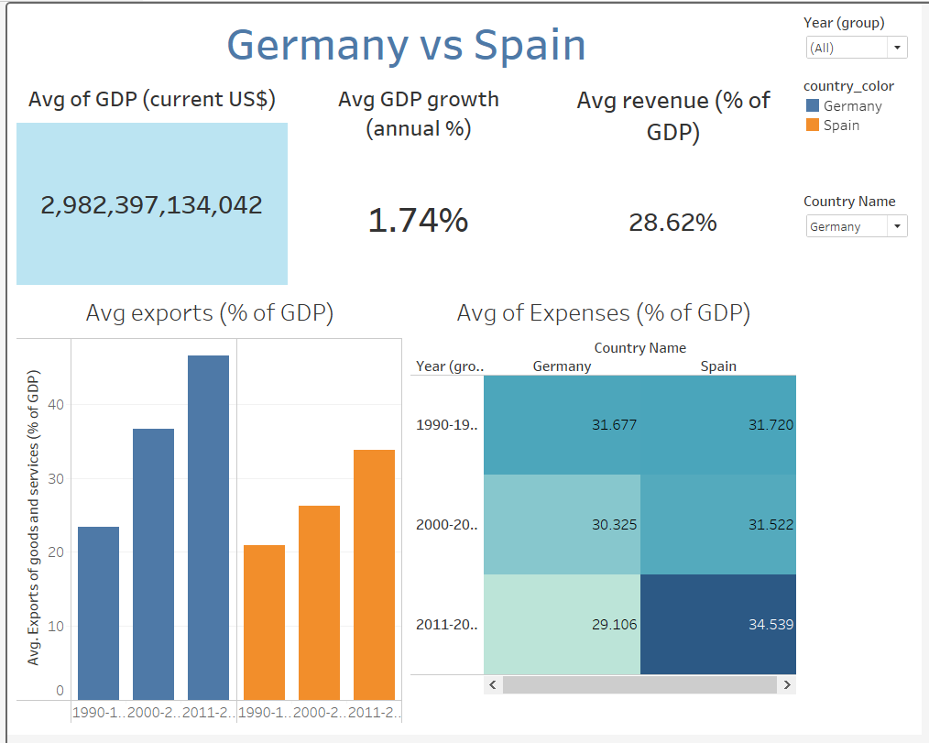

Slide 7
Second dashboard
- A line chart shows that the Avg birth rate for both countries is getting smaller over the 30 years.
- A heat map indicates that the highest Avg annual percentage of inflation has occurred in
Spain (1990-1999) and the lowest occurred in Germany ( 2000 – 2010)
A pie chart indicates that Hospital beds per 1000 person in Spain is less than half of the same indicator in Germany

Slide 8
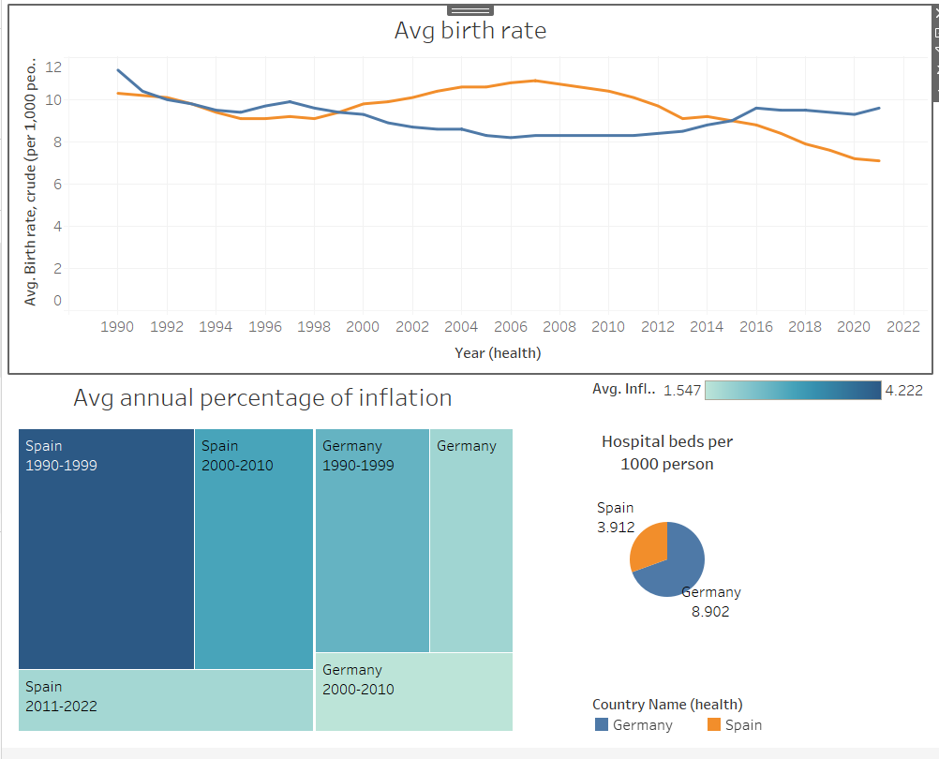

Slide 9
Third dashboard
A bar chart shows that The highest Avg gross savings (% of GDP) occurred in Germany ( 2011 – 2022)
and the lowest of the same indicator occurred in Spain (2011-2022)
- A highlighted table indicates that the highest Avg of Fertility rate (% of GDP) occurred in Germany ( 2011-2022) and the lowest occurred in Spain(1990 – 1999)
A line chart indicates that the highest Avg annual population growth occurred in Spain (2003)
and the lowest of the same indicator occurred in Germany ( 2011 )

Slide 10
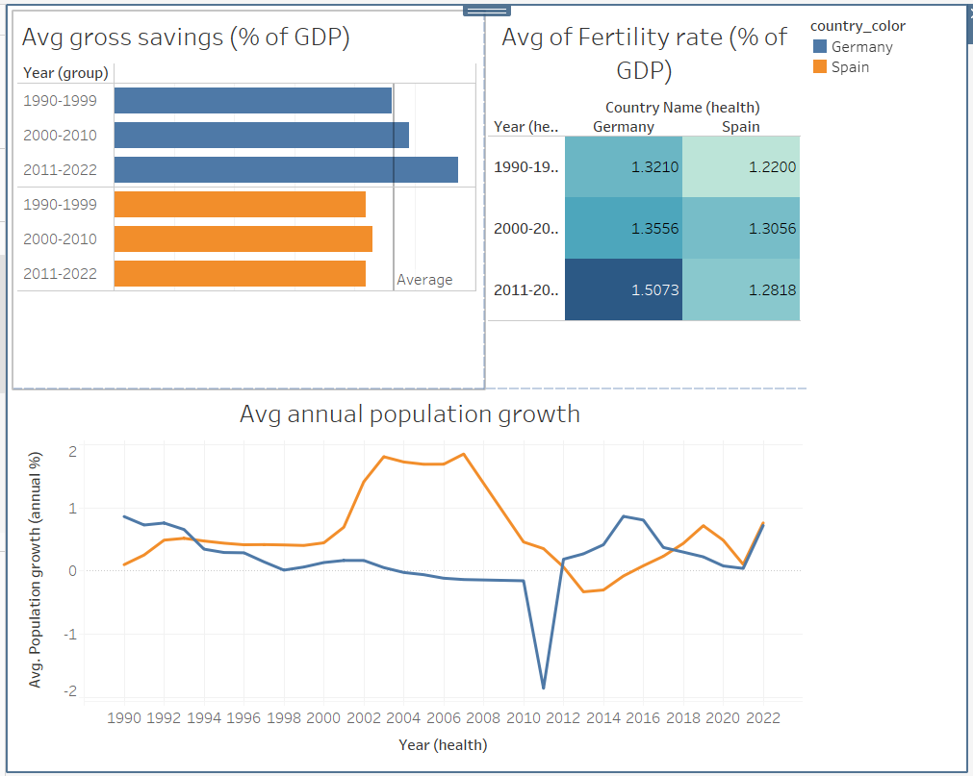

Slide 11
Fourth dashboard
A bar chart shows that Spain has the largest change of Annual GDP growth per capita from (1990 -1999) to (2011-2022)
and the lowest of the same indicator occurred in Spain (2011-2022)
- A bubble chart indicates that Germany(2011-2022) has the highest of Sum of Expenses (% of GDP) and Spain (1990-1999 ) has the lowest of the same indicator
A circle chart indicates that Avg life expectancy is very similar in both countries but Spain has a little improvement than Germany over all time periods.

Slide 12
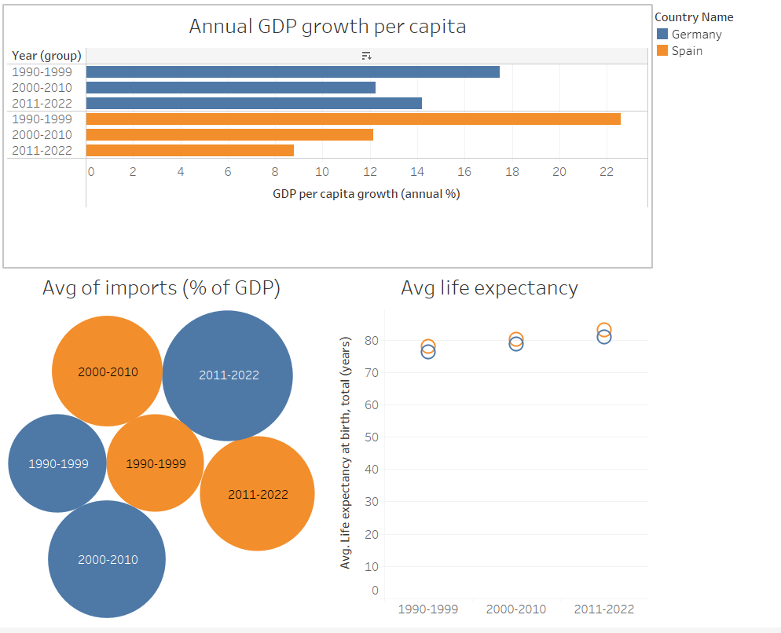

Slide 13
Fifth dashboard
A highlighted table indicates that both countries has a little Value added of agriculture ( % of GDP).
and the lowest of the same indicator occurred in Spain (2011-2022)
- A highlighted table indicates that Germany(2011-2022) has the highest of Value added of indusry ( % of GDP) but both countries has a value between third and quarter over time periods
A line chart shows that Germany has higher Avg death rate than Spain over all time periods.
A bar chart indicates that Germany(2011-2022) has the highest of Avg dependency ratio (% of working age population) and Spain(2000-2010) has the lowest os the same indicator

Slide 14
