Slide 1

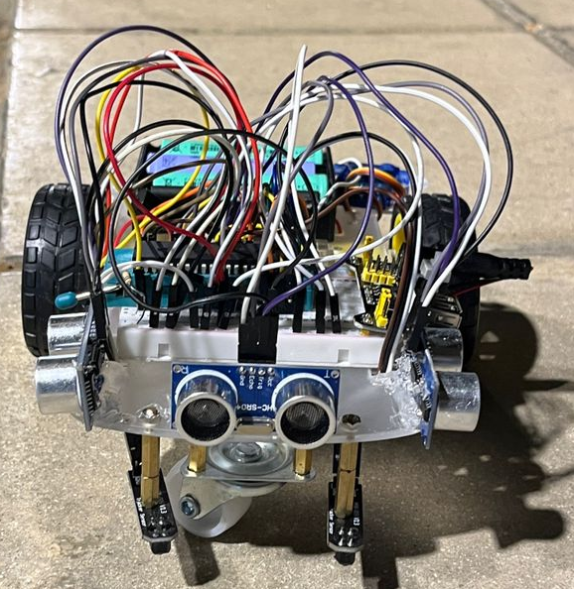
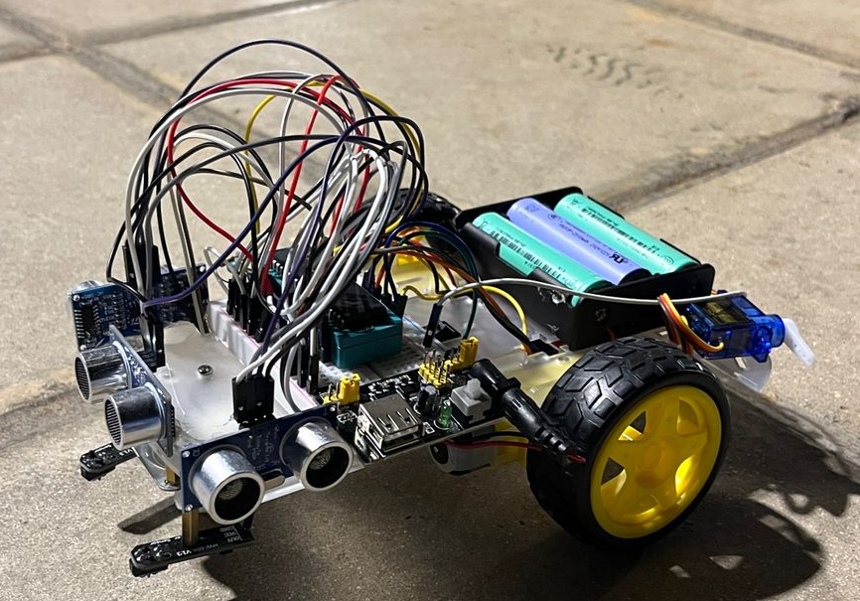
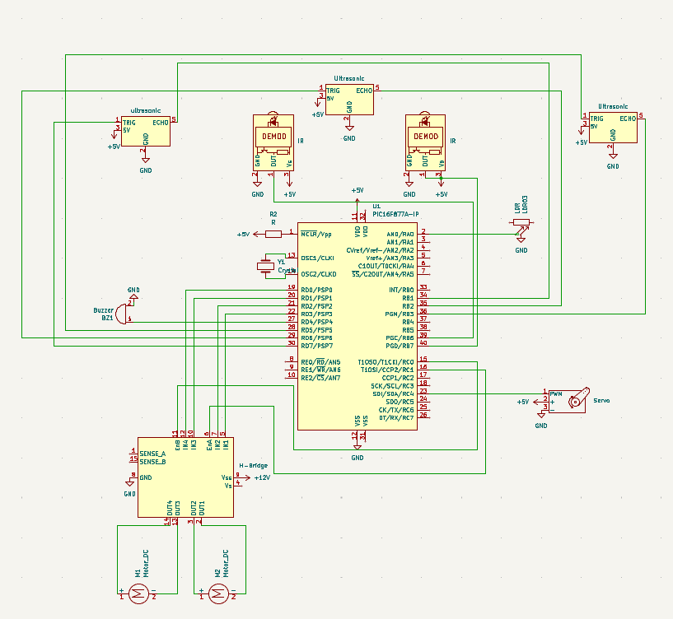
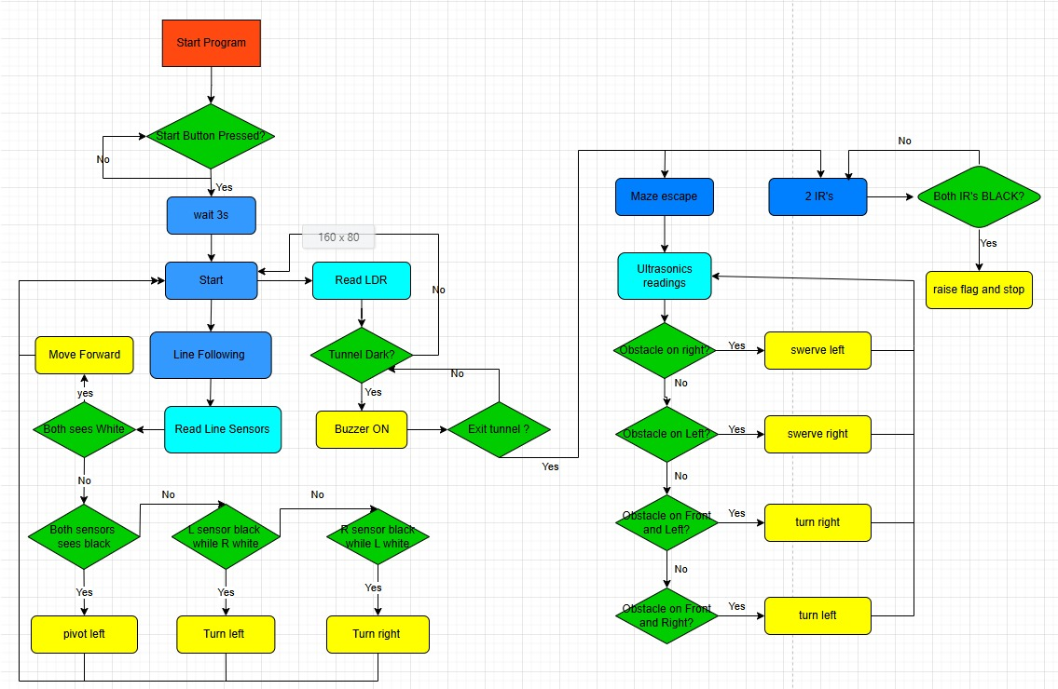
Autonomous Maze Escape Robot
O. Darweesh, M. Alhawari, and W. Abu Namous
Supervisor: Dr. Belal Sababha Embedded Systems Final Design Project, Spring 2026 King Abdullah II School of Engineering
Princess Sumaya University for Technology
Introduction
Engineering relies heavily on autonomous mobile robots, which are used in intelligent transportation, logistics, and industrial automation. This project describes the design and development of an autonomous escape robot using the PIC16F877A microcontroller running at 8 MHz. The robot completes a four-stage task autonomously: following a defined line, detecting and crossing a dark tunnel, navigating an ultrasonic-guided maze, and arriving at a predetermined finish line. The system offers reliable real-time navigation without the need for human interaction by merging numerous sensor modalities and a state-machine driven software architecture. The combination of sensor fusion, modular software architecture, and PWM motor illustrates how complicated autonomous behavior may be implemented using low-cost embedded technology.
Results
The autonomous maze escape robot accomplished all four difficulty stages without human assistance. The IR-based line-following algorithm maintained consistent tracking throughout Stage 1. The LDR tunnel detection system correctly recognized tunnel entrance and exit utilizing hysteresis thresholds (enter: ADC > 850, exit: ADC < 400), triggering the buzzer within the tunnel. The robot was steered through maze corridors by the three-sensor ultrasonic maze navigation system, which used priority-based wall avoidance. The finish line detection system, which is protected by a 50-loop grace period and a sustained 10-count black detection threshold, prevents false triggers and consistently stops the robot at the endpoint.
Figure 3: Robot front view
Figure 4: Robot side view
Design
The robot is based on a two-wheeled DC motor chassis powered by a motor driver, with speed regulated by PWM signals from the PIC16F877A hardware module. The sensor suite consists of two IR line sensors for line tracking and finish detection, one LDR module for tunnel light-level sensing, and three HC-SR04 ultrasonic sensors located at the front, left, and right for wall detection during labyrinth navigation. An active buzzer offers audible feedback within the tunnel. The program is designed as a four-state machine. Stage 1 employs IR sensors to navigate along the indicated line; Stage 2 triggers when the LDR detects darkness, triggering the buzzer and moving through the tunnel; Stage 3 uses ultrasonic-based maze navigation; and Stage 4 detects prolonged black on both IR sensors and stops the robot at the finish line.
Figure 1: Hardware Design — Robot Chassis, Sensor Placement, and Wiring.
Figure 2: Software State Machine — Four-Stage Navigation Flowchart.
Conclusion
This study illustrates how a small, low-cost autonomous robot can consistently navigate a complicated multi-stage environment using excellent sensor and modular embedded software design. By combining IR sensors, an LDR module, and three HC-SR04 ultrasonic sensors under the control of a PIC16F877The robot, powered by a microprocessor, successfully completed line following, tunnel identification, maze navigation, and finish line recognition without the need for human involvement.
The findings support the efficacy of state-machine control, PWM motor speed regulation, and Timer1-based ultrasonic timing for real-time autonomous navigation. The value of this study resides in demonstrating that strong multi-stage autonomous behavior may be obtained with little, easily available hardware. These techniques are immediately applicable to real-world systems like autonomous inspection robots, warehouse navigation vehicles, and competitive robotics platforms.

