Slide 1

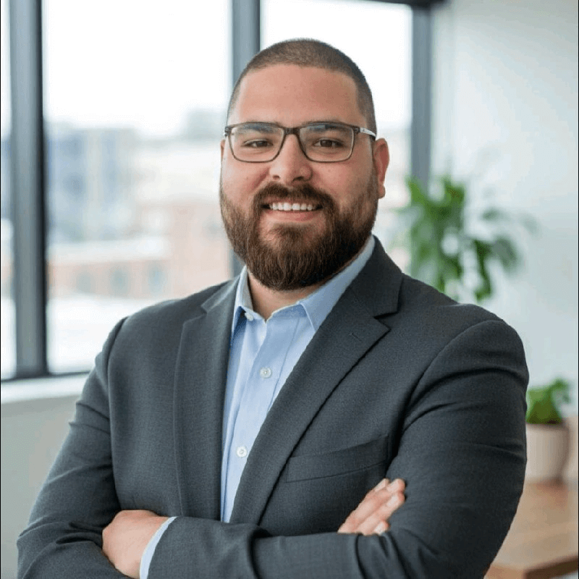
Omar N. Saab
CTO
Technology strategy, scalable architecture, and hands-on execution for companies that need a builder who can also lead.
🏆 Recognized by 10+ customers for delivering transformative Technology outcomes.
120+
10,000+
500+
Websites & applications delivered
Concurrent-user infrastructure exposure
Requests / second API exposure
BANKING • HEALTHCARE • LOGISTICS • RETAIL • AVIATION • EDUCATION • PUBLIC SECTOR
omarsaab.net | omar.saab.96@gmail.com | +961 70 433863 | linkedin.com/in/omarsaab96
Notes:
[Sources] - Visual style reference: user-provided deck "Trupti_Product+Growth_CPGO.pptx". - Contact details, title, profile summary, industries: https://omarsaab.net/ (web refs turn3view0 L2-L18, L52-L55, L56-L265). - Metrics and experience details: https://omarsaab.net/omarsaab_cv.pdf (web ref turn6search1). - Headshot image used on cover sourced from The Org profile for Omar Saab at Born Interactive: https://theorg.com/org/born-interactive/org-chart/omar-saab (web ref turn14image1).

Slide 2
Table of contents
1. The CTO Mandate
2. Why a CTO Is Needed
3. My Expertise & Capabilities
4. How I Operate
5. Executive Evidence
6. Contact & Closing
Notes:
[Sources] - Visual structure inspired by the user-provided deck "Trupti_Product+Growth_CPGO.pptx".

Slide 3

1. The CTO Mandate
Notes:
[Sources] - Divider styling inspired by the user-provided deck "Trupti_Product+Growth_CPGO.pptx".

Slide 4
What Does a CTO Own?
Strategy
Architecture
People
Business-aligned technology vision, roadmap choices, and prioritization
Scalable systems, integration patterns, and platform direction
Hiring, mentoring, standards, and engineering culture
CTO mandate
Turn technology into a durable business advantage by aligning product, platform, and people around scalable execution.
Data & AI
Security
Execution
Instrumentation, analytics, automation, and decision support
Reliability, access control, resilience, and risk management
Cadence, governance, delivery confidence, and accountability
A strong CTO creates clarity across business priorities, technical decisions, and delivery discipline — not just code.
Notes:
[Sources] - Framing adapted to CTO responsibilities requested by the user. - Supporting profile evidence from https://omarsaab.net/ (turn3view0 L15-L18) and https://omarsaab.net/omarsaab_cv.pdf (turn6search1).

Slide 5
2. Why a CTO Is Needed
Notes:
[Sources] - Divider styling inspired by the user-provided deck "Trupti_Product+Growth_CPGO.pptx".

Slide 6
Why a CTO Is Needed
Align technology with business goals
Build systems that can scale
Lead people and execution
✓ Translate company vision into an executable technical roadmap
✓ Prioritize architecture, budget, platform, and build-vs-buy choices
✓ Keep technology tied to growth, efficiency, and customer value
✓ Architect for performance, security, maintainability, and expansion
✓ Reduce technical debt while preserving delivery speed
✓ Introduce engineering discipline, observability, and quality gates
✓ Raise technical quality through standards, mentoring, and review culture
✓ Create accountability for timelines, outcomes, and ownership
✓ Partner with founders, product, design, and operations
Where I add the most value as a CTO profile
✓ Founder-led or growth-stage companies that need stronger technical direction
✓ Organizations modernizing legacy systems without slowing down delivery
✓ Product teams that need tighter alignment between architecture, engineering, and outcomes
✓ Businesses moving from freelance/vendor execution to a true engineering operating model
Notes:
[Sources] - User requested a deck that showcases CTO suitability rather than specific projects. - Positioning supported by Omar Saab profile summary and cross-functional delivery evidence: turn3view0 L15-L18; turn6search1.

Slide 7
3. My Expertise & Capabilities
Notes:
[Sources] - Divider styling inspired by the user-provided deck "Trupti_Product+Growth_CPGO.pptx".

Slide 8
Expertise & Capabilities
Technology Strategy & Architecture
Platform Engineering & Delivery
Data, Security & Scale
✓ Technical vision, target-state planning, and roadmap thinking
✓ System design, modular architecture, APIs, and integrations
✓ Build-vs-buy evaluation and modernization tradeoffs
✓ Future-proof thinking across web, platforms, and enterprise systems
✓ Frontend and backend development across modern JavaScript stacks
✓ Release discipline, maintainable code, and lifecycle ownership
✓ Performance optimization and user experience awareness
✓ Hands-on delivery from concept through deployment
✓ Dashboards, instrumentation, and metrics-driven decision support
✓ High-throughput APIs and scalable back-end infrastructure exposure
✓ Access control, security-minded implementation, and data protection
✓ Operational thinking for resilience, uptime, and scale
Core technologies called out in the CV and portfolio
React
Angular
Vue
Next.js
Node.js
Express
Laravel
REST APIs
SQL / MySQL
TypeScript
Tailwind
Git
Notes:
[Sources] - Technical stack and expertise from CV: https://omarsaab.net/omarsaab_cv.pdf (turn6search1). - Portfolio summary from https://omarsaab.net/ (turn3view0 L15-L18).

Slide 9
Core technologies called out in the CV and portfolio
Frontend
React
Angular
Vue
Next.js
HTML
CSS
SCSS
JavaScript
TypeScript
Bootstrap
Tailwind
jQuery
AJAX
Axios
Mobile
React native
Flutter
Backend
Node.js
Express JS
Laravel
PHP
REST APIs
CRUD Operations
JSON
.Net
.Net Core
Databases
SQL
MySQL
Database Administration
MongoDB
phpMyAdmin
MariaDB
Engineering Foundations
Object-Oriented Programming
Complexity Analysis
Design Patterns
Data Structures & Algorithms
Tools, Workflow, Productivity & Growth
Git
GitHub
Postman
Visual Studio
Figma
Jira
SEO
Microsoft Office
Adobe
Google Workspace
Notes:
[Sources] - Technical stack and expertise from CV: https://omarsaab.net/omarsaab_cv.pdf (turn6search1). - Portfolio summary from https://omarsaab.net/ (turn3view0 L15-L18).

Slide 10
Expertise & Capabilities
Leadership & Team Building
Business & Cross-Functional Partnership
Industry Breadth Without Being Project-Locked
✓ Mentored junior developers and improved code quality and efficiency
✓ Comfortable setting standards, review habits, and delivery expectations
✓ Able to lead lean teams while still contributing hands-on
✓ Strong owner mentality from idea to implementation
✓ Translate requirements into executable plans and technical decisions
✓ Collaborate with product, design, marketing, and operations
✓ Support launches, conversion performance, and digital growth goals
✓ Communicate tradeoffs clearly to non-technical stakeholders
✓ Banking & finance, insurance, fintech, retail, healthcare
✓ Cargo & shipping, airports, logistics, education, public sector
✓ Exposure to both enterprise environments and fast-moving delivery teams
✓ Useful for CTO roles that require range, not just one vertical
Qualifications snapshot
B.S. Computer Science • Lebanese American University • Arabic / English / French • Remote and cross-border delivery experience
Notes:
[Sources] - Mentoring and cross-functional evidence from CV: turn6search1. - Industry breadth from portfolio categories on https://omarsaab.net/ (turn3view0 L52-L55, L56-L265). - Education and languages from CV: turn6search1.

Slide 11
4. How I Operate
Notes:
[Sources] - Divider styling inspired by the user-provided deck "Trupti_Product+Growth_CPGO.pptx".

Slide 12
My Operating Model (How I Operate)
1. Assess
2. Align
3. Architect
4. Execute
5. Scale
Current stack, delivery bottlenecks, technical debt, risk, team capability
Business priorities, ownership, roadmap, KPIs, build-vs-buy decisions
Target architecture, platform standards, data flows, security guardrails
Delivery cadence, reviews, quick wins, release discipline, communication
Automation, documentation, hiring, monitoring, continuous improvement
This is the operating model I would bring into a CTO role: assess fast, align clearly, architect thoughtfully, execute hands-on, and scale with discipline.
Notes:
[Sources] - Operating model is a strategic synthesis created for this deck based on the user request and Omar Saab's end-to-end delivery background documented in turn6search1 and turn3view0 L15-L18.

Slide 13
My Working Models
💼 Full-Time CTO Embedded leadership, long-term vision
💎 Fractional CTO Part-time, high-impact leadership
🛠 Freelance/Consulting Project-based, execution-driven
🕒 Hourly/Part-Time Flexible, targeted problem-solving
🛠 Volunteer-Based Supporting early-stage ideas and mission-driven teams
💎 Equity-Based Partnering with startups in exchange for ownership and long-term growth

Slide 14
5. Executive Evidence
Notes:
[Sources] - Divider styling inspired by the user-provided deck "Trupti_Product+Growth_CPGO.pptx".

Slide 15
Executive Evidence & Qualifications
Delivery & scale
Growth & performance
Leadership signals
✓ 120+ responsive websites and applications delivered
✓ 99% reported user satisfaction across delivered work
✓ 10,000+ concurrent-user infrastructure exposure
✓ 500+ requests/second API workload exposure
✓ Landing pages generating 7,000 new leads per month
✓ Average 38% landing-page conversion performance
✓ 56% web traffic lift through SEO execution
✓ 80+ business metrics represented in dashboard work
✓ Mentored and led 3 junior developers
✓ End-to-end ownership from concept to deployment
✓ Cross-border delivery for enterprise and regional clients
✓ Comfort with architecture, delivery, and stakeholder communication
Why this translates into CTO readiness
✓ Strong engineering foundation with architecture, APIs, performance, security, and delivery experience
✓ Business-facing mindset shaped by conversion, SEO, dashboarding, and cross-functional execution
✓ Cross-industry exposure reduces dependency on a single domain and improves decision quality
✓ Build-first profile suited to startups, scale-ups, and digital transformation environments that need a practical CTO
Notes:
[Sources] - Metrics, mentoring, experience, education, and languages sourced from CV: https://omarsaab.net/omarsaab_cv.pdf (turn6search1). - Industry breadth sourced from https://omarsaab.net/ (turn3view0 L52-L55, L56-L265).

Slide 16
I Execute!
Unlike traditional CTOs who only set strategy, I take ownership of execution and drive measurable results.
✅ Hands-on Execution I don’t just define the roadmap - I make sure it delivers impact.
✅ End-to-End Ownership From ideation to market, I execute across Technical management life cycle.
✅ No Resources? No Problem! With experience as a Founding Team Member, I can step in and handle execution when teams are lean.
✅ Adaptable & Versatile Whether it’s strategy, execution, or scaling, I play any role within the Technical umbrella to ensure success.
I don’t just plan. I execute, iterate, and drive real business growth! 🚀

Slide 17
6. Contact & Closing
Notes:
[Sources] - Divider styling inspired by the user-provided deck "Trupti_Product+Growth_CPGO.pptx".

Slide 18
Let’s Connect
Ready to help a company scale its product, platform, and engineering organization with clarity, speed, and technical rigor.
Email: omar.saab.96@gmail.com
Phone: +961 70 433863
LinkedIn: linkedin.com/in/omarsaab96
Location: Beirut, Lebanon
Best fit for
✓ Scale-ups
✓ Founder-led companies
✓ Product teams
✓ Digital transformation
Omar N. Saab
CTO candidate • Full-stack technology leader
Thank you for your time.
Notes:
[Sources] - Contact details from https://omarsaab.net/ (turn3view0 L2-L10). - Headshot image on this slide sourced from The Org profile for Omar Saab at Born Interactive: https://theorg.com/org/born-interactive/org-chart/omar-saab (turn14image1).

Slide 19
Thank you!
Technology leadership is most valuable when it turns business vision into scalable execution.
Omar Saab • omarsaab.net • omar.saab.96@gmail.com
Notes:
[Sources] - Contact details from https://omarsaab.net/ (turn3view0 L2-L10).

