Slide 1
Minimax Algorithm
The minimax algorithm is a recursive algorithm for choosing the next move in a game with two (or more) players. It works backwards, from the final positions towards the current position.
1. Expand the complete game sub-tree below the current position.
2. Determine the value (i.e., O wins, draw, X wins) of each final position.
3. Propagate these values backwards, under the assumption that each player will choose the move that’s best for him.

Slide 2
Minimax Algorithm
2
4
Max
2
4
Min
9
2
4
7
Max
3
9
1
2
-1
4
2
7

Slide 3
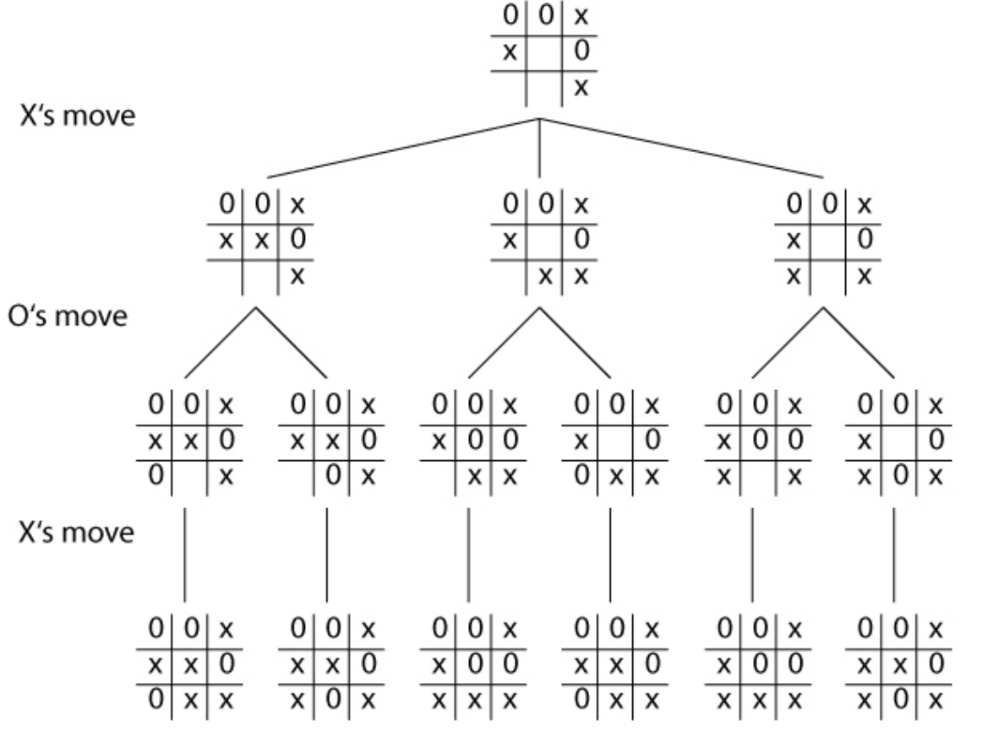
1
Example:-
Max
Max
Put score : 1
If X will win
Put score : -1
If O will win
Put score : 0
The Result is Draw
0
0
1
Min
0
1
1
0
1
1
Max
0
1
1
0
1
1

