Slide 1

Carbon Footprint Calculator
Team 9
Omar Sánchez
Kenzo Matoo
Alexis Vargas

Slide 2

Introduction
We are targeting to the 13th Sustainable Development Goal, which is ”Climate Action”. This because we tought it is important to raise awareness in global warming.
What is a carbon footprint?
The total amount of greenhouse gases generated by our actions, expressed in CO2 equivalents.
Those are generated mainly by transportation, energy used and consumption habits
Obviously there are several ways to "attack" the problem, and we think that a good idea would be to create a carbon footprint calculator, since this can make the user encourage the responsible consumption, and empower individuals to take action.

Slide 3
The Calculator
The purpose of the calculator to help individuals measure their carbon footprint.
This works in the following way:
1.- The user inputs data: Transportation habits, the housing energy consumption, dietary preferences and the generation of waste.
2.- Calculator analyzes data and estimates CO2 emissions.
3.- A Pie Chart that shows the breakdown of the user’s carbonfootprint
With this the user can see where they generate the most CO2 and try to make changes in their daily life.

Slide 4
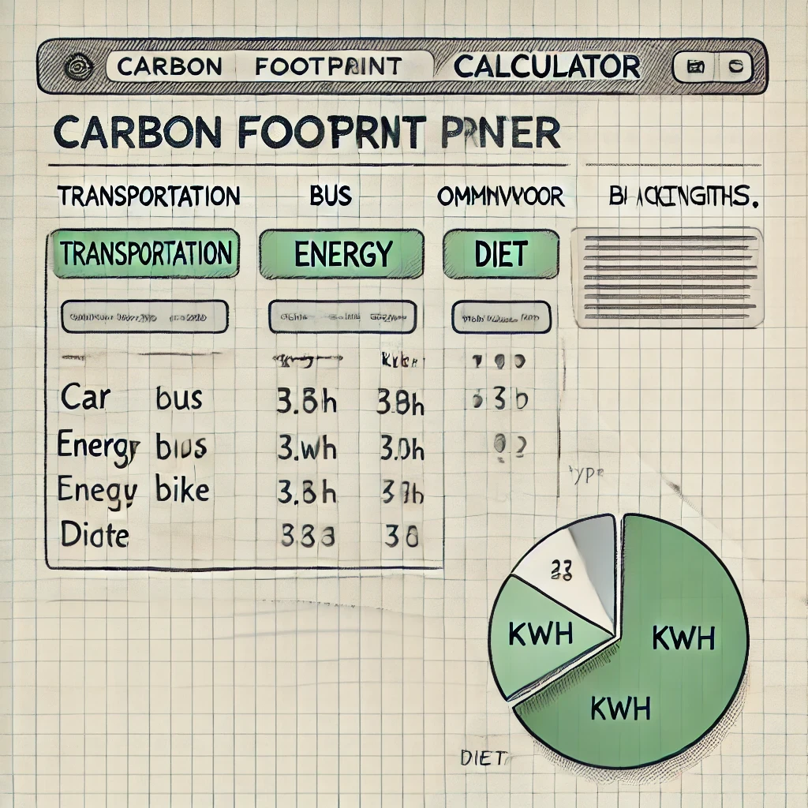
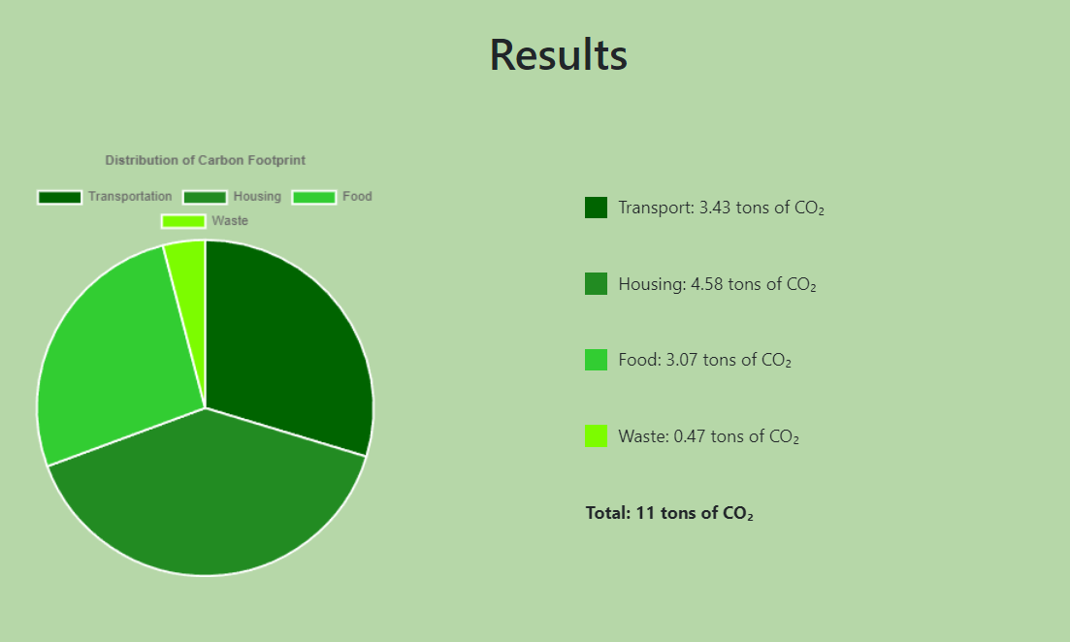
Layout of the solution

Slide 5
Evolution of the solution
To tell the truth, there are already several pages on the web that emulate the same thing that we wanted to do, so it was easy for us to get inspiration from these web pages.
So since we started with the website, we knew that a "Form" would be the easiest way to receive the user's data, and then we wanted the results to be in a graph that showed all the categories.
And although it sounds like an easy job, the truth is that we were changing several components until it was what we really wanted.

Slide 6
Challenges and how were they solved
Of course, there were several challenges, among them for the first delivery were the styles of the page and how we had to make it match the theme of the project.
Already in the second installment, which dealt with the functionality of the project, we had a bit of a challenge at the time of the calculations, since we did not know if the formula we were using was the one that was wrong, or that perhaps it did not receive the values ​​correctly. And we also made some improvements to the aesthetics.
And finally, the challenge of now moving everything to react, personally I honestly did not understand why we should migrate everything to react, and why ejs was going to become obsolete.

Slide 7
Challenges and how were they solved
And how we solved the problems that we were having, I think it was the same in most of your cases, you have to go to the documentation that exists on the topics, rely on your colleagues, which is one of the most important parts , since we are talking about teamwork and that is why communication is very important.
And clearly another very important tool was to do the tutorials and the portfolio work that the teacher left us, since with the tools that were used there you could basically solve most of the essential things.

Slide 8
Presentation of the final product
https://carbon-footprint-project.onrender.com/

Slide 9
Q&A

