Slide 1



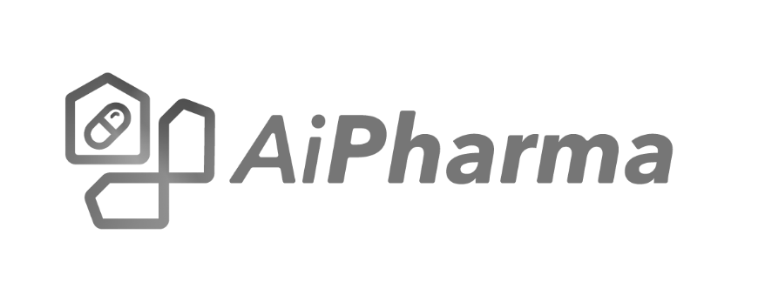
Intelligent Pharmacy Benefit Management
:
© Copyright 2018-2025 for TachyHealth. - All rights reserved
Riyadh - Dubai - Delaware

Slide 2

Agenda
AiPharma Overview
Key Value Pillars
AiPharma Logics
AiPharma Features
Live Demo: AiPharma in Action
What’s Next

Slide 3
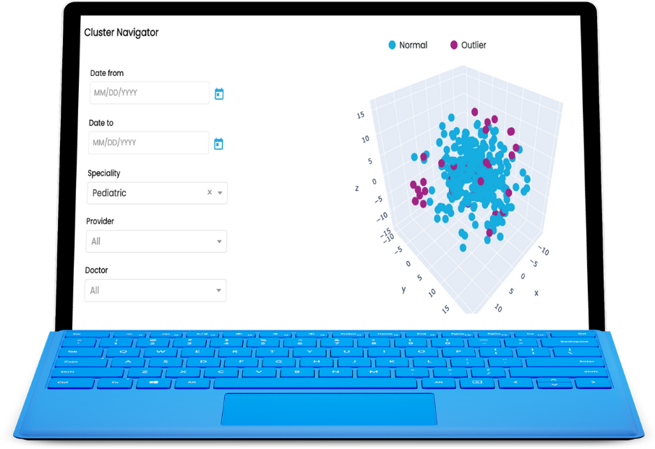
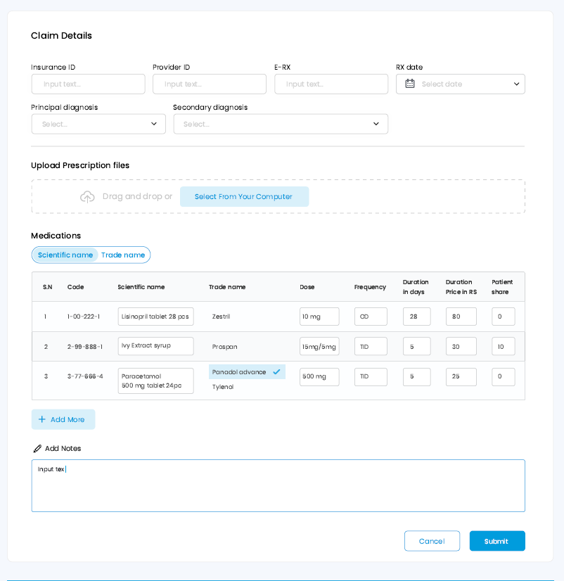
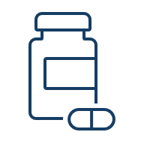


Delivering the best-in-class pharmacy management solutions blended within our insurance flagship
Our PBM solution, integrated within AiReview, harnesses the power of artificial intelligence and data science in the adjudication and analytics of the medication related claims, authorizations, and FWA. It encompasses multiple components to provide a comprehensive solution including rebate management, network management, advanced analytics, and comes with the ability to connect with providers and members through portals.
Optimize medication management
Reduce costs
Improve patient
Outcomes
Notes:
References for the system

Slide 4


Delivering Measurable Value
Transform pharmacy benefit management with AI-powered intelligence
💰
🛡️
📈
Reduce Costs
Optimise formulary and prevent unnecessary prescriptions
Improve Safety
Real-time rejection to prevent adverse drug events
Better Outcomes
Evidence-based protocols improve care quality
Regulatory Compliance
Seamless Integration
Built-in FDA, CHI, and Saudi FDA guidelines ensure adherence to local and international standards
Integrated with API for unified claims processing and authorization workflows

Slide 5
AiPharma Architecture
AiPharma is designed to match Saudi framework for pharmacy submissions on three different areas for e-prescriptions, approval and claims
Processing mechanism is harmonized and built based on different stages of submission (e.g. Refill too soon layer depends on approval info for claims adjudication)
Saudi Market Dynamic
Architecture Dependency
AiPharma enables payers and end-users to overwrite and cancellation engine decisions through additional API endpoints for more comprehensive communication between payers and PBM engine matching Saudi framework for pharmacy submissions
Overwrite Mechanism

Slide 6
What Makes Ai Pharma Different
Transforming pharmacy benefit management from reactive to proactive care.
+81 Thousands drug available in our database and are continually updated to reflect latest FDA information as well as Saudi FDA and CHI
+3.1 checks linked to diseases & symptoms to provide clear indication and contraindication rules with explainability based on references
+1 Million DDI covering even experimental drugs, OTCs, and herbal supplements categorized into major, moderate and minor with explanation of risk
Ensure safe medication usage during pregnancy by checking FDA pregnancy medication categories across 4 different levels
Drug Database
Drug-Condition Checking
Drug-Drug Interactions
Pregnancy Safety
Provide Blackbox warnings linked to gender, age, and co-morbidities with references from FDA
Check for duplicate medications ,special logics for antibiotics (usage on local sites and children). Also, it checks the medical device versus conditions and procedures
Provide guidance in the use of multiple medications within the same therapeutic class or a across related classes to prevent unnecessary polypharmacy
Optimize treatment safety and efficacy by medications that should be avoided or used cautiously based on patient-specific factors
Black Box Warnings
Medical Utilization
Therapeutic Duplication
Drug-Disease Contraindications

Slide 7
What Makes Ai Pharma Different
Transforming pharmacy benefit management from reactive to proactive care.
Identify potential cross-reactivity between prescribed medication and documented allergens in the medical records (if available using NLP)
Enforce limits on total daily drug dose (DDD) for medications and ensure that submitted quantity aligns with expected days of the supply
Provide consolidated early refill alerts for patients on multiple medications and chronic conditions to avoid misuse or stockpiling.
Risk Evaluation and Mitigation Strategies (REMS) enforced by the US FDA to ensure that the benefits of certain medications outweigh their risks to help ensure safe use
Drug-Allergy Interactions
Quantity Limits
Refill Too Soon
High-Risk Medications
Identify patients at high risk for adverse drug events and duplication therapy due to concurrent use of multiple medications from multi prescriptions
Check the step therapy protocols that prioritize first-line or preferred medications to provide proper treatment plan
Ensure selection of age-appropriate medication formulations for pediatrics based on age and weight. Also encourage the use of easier to consume forms e.g. liquids, chewable
Ensure the appropriate selection of medications for elderly based on conditions, age-related changes, risk of fall, and potential medication interactions
Multiple Pharmacy Management Edits
Stepwise care edits
Pediatric Dosing Edits
Geriatric Dosage Management

Slide 8
Ai Pharma Implemented Logics
Transforming pharmacy benefit management from reactive to proactive care.
Implementing Dates validation on service level
Dosage Form Restriction Validation (Age/ Gender)
Drug Age/ Gender Validation
Boxed Warning
ICD10 Drug Validation
Excluded diagnosis validation
Insulin validation
Drug-Disease Contraindications
Geriatric Dosage Management
DDI (Drug To Drug Interaction)
Drugs Duplication
Pregnancy Validation
Duplicate Therapy
Children Antibiotic Validation
Eye Ear Antibiotic Validation
Refill Too Soon
Quantity for Adult/ Pediatric
Parallel with Medication validation in case of medical device in request
Medical Device- ICD10 validation
Medical Device Duplication check

Slide 9
References
Current used references
National Institute of Medicine PubMed guidelines
Malacards data
CHI guidelines
SFDA dataset
IDF (Insurance drug Formulary)
Drug Bank drug database based on FDA updates
Merck Sharp & Dohme guidelines
MedScape guidelines
Drug.com Guidelines
Medline plus guidelines
WHO ATC/DDD medication
Future to be used references
Risk Evaluation and Mitigation Strategies (REMS)
Centers for Disease control and preventions (CDC) Guidelines
Morphine Milligram Equivalents (MMEs)
Beers Criteria Medications
Healthcare Effectiveness Data and Information Set (HEDIS) High-Risk Medications from the CMS guidelines
STOPP/START criteria for potentially inappropriate medications/potential prescribing omissions in older people
European medication Agency
New Hampshire Medicaid Quantity Limit Program
American College of Physicians (American Family Physicians)
Centers for Disease control and preventions Guidelines

Slide 10
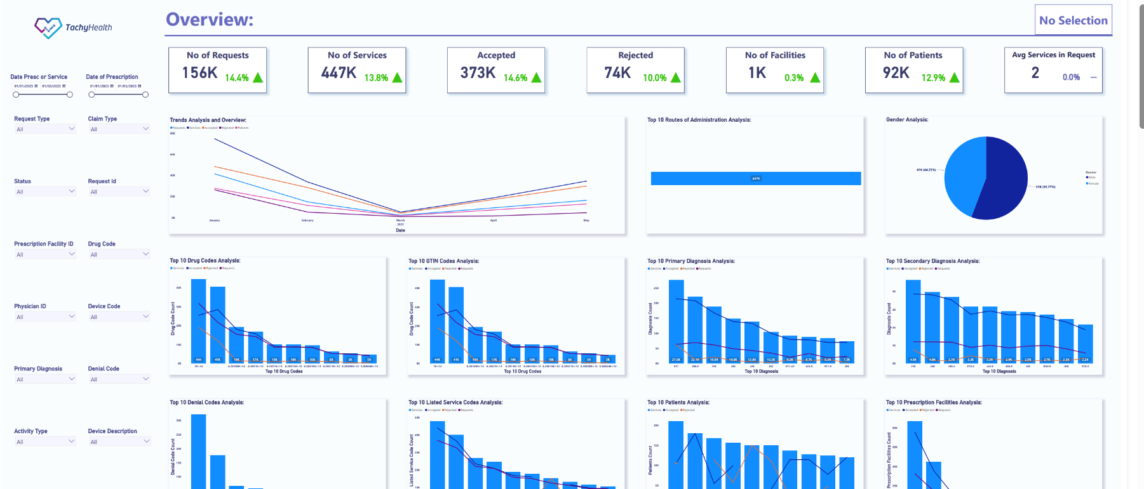
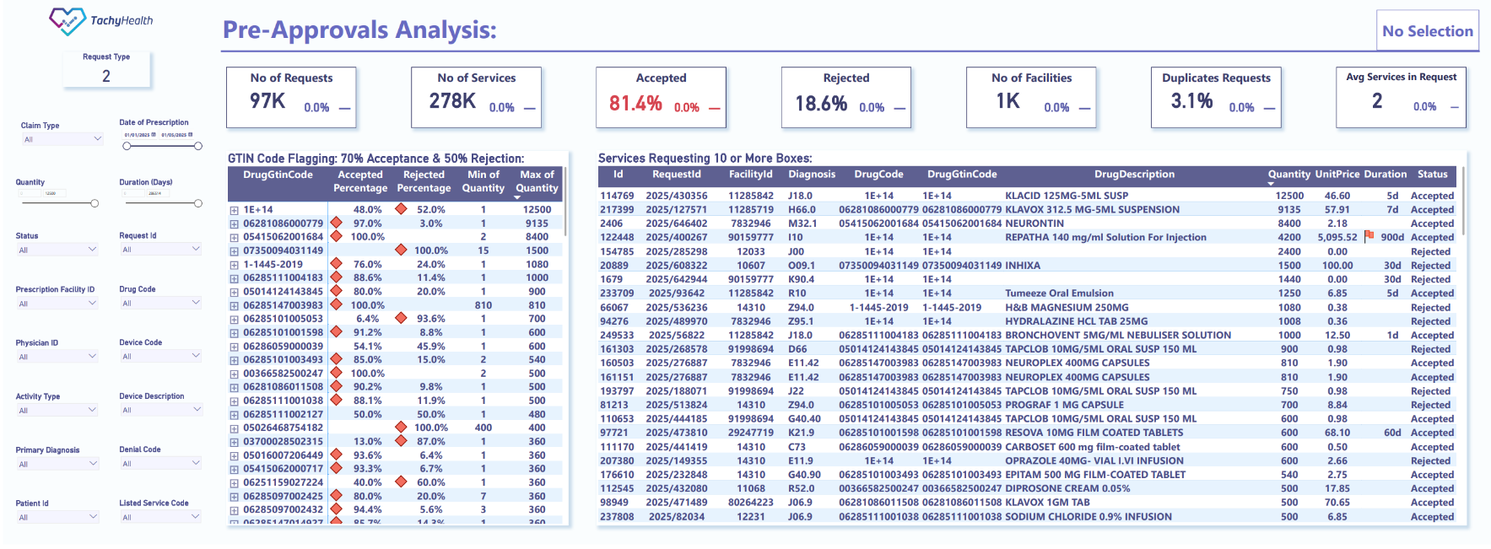
Interactive Analytical Dashboard
Real-time and modular dashboard
Insights about medication utilization
Monitor drug utilization review
Helicopter view of medication and pharmacy utilization trends over time, providing in-depth understanding of usage patterns
The dashboard offer insights into network utilization, medication classes, rejection per provider, associated diagnoses, and others
It enable users to drill down into specific performance metrics, pharmacies, or therapeutic categories
Explore drug categories and their interrelationships (inter-class and intra-class utilization)
Track controlled, high-cost and high-alert medications across claims and authorizations
Detailed insights into the various types of generics and their consumption patterns

Slide 11
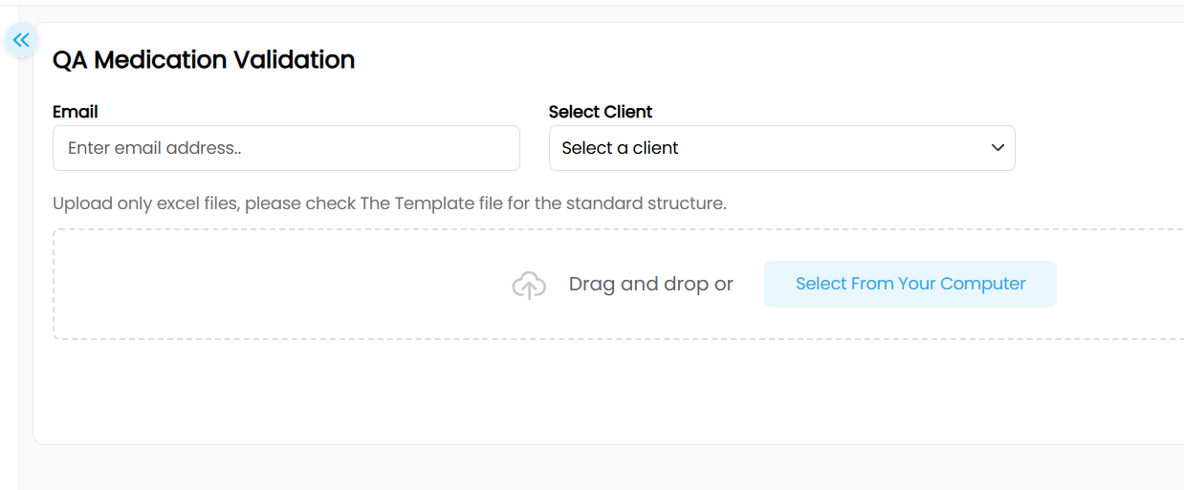
QA Medication Validation Tool For POC
AiPharma QA Tool automatically checks your medication data sample using the same rules defined in our API documentation, and validates each record with the same backend engine we use in production for claims and medication checks. You then get instant feedback with analytics, and the processed file is sent to your email within seconds.

Slide 12
Minimum Dataset Requirement
E-Prescription – Mandatory
Core & Provider: bundleId, requestId, requestType, prescriptionPhysicianID, prescriptionFacilityID
Patient & Policy: patientID, dateOfBirth, gender, policyNumber, policyEffectiveDate, policyExpiryDate, dateOfPrescription, isNewBorn, isMaternity
Diagnosis: primaryDiagnosisCode
Medications:drugCode, drugGTINCoderefillCountserviceLineNo, quantitydurationOfTherapy, durationOfTherapyUnitfrequency, frequencyUnitstrength, strengthUnit, routeOfAdministration
Medical Devices (if any): deviceDescription, serviceLineNo
Approval – Mandatory
Core & Provider: bundleId, requestId, requestType, prescriptionFacilityID
Patient & Policy: patientID, dateOfBirth, gender, policyNumber, policyEffectiveDate, policyExpiryDate, dateOfPrescription, isNewBorn, isMaternity
Diagnosis: primaryDiagnosisCode
Medications:drugCode, drugGTINCodeunitPriceserviceLineNo, quantity
Medical Devices (if any): deviceDescription, unitPrice, patientShare, serviceLineNo
Claim – Mandatory
Core & Provider: bundleId, requestId, requestType, dispensingPharmacyID, prescriptionFacilityID
Dates & Financials: dateOfMedicationClaim, claimSubmissionDate, claimedAmount
Patient & Policy: patientID, dateOfBirth, gender, policyNumber, policyEffectiveDate, policyExpiryDate, dateOfPrescription, isNewBorn, isMaternity
Diagnosis: primaryDiagnosisCode
Medications:drugCode, drugGTINCodeunitPriceserviceLineNo, dateOfService, quantity
Medical Devices (if any): deviceDescription, unitPrice, patientShare, dateOfService, serviceLineNo

Slide 13


Thank You
For further information, contact us.
info@TachyHealth.com
www.TachyHealth.com

