Slide 1

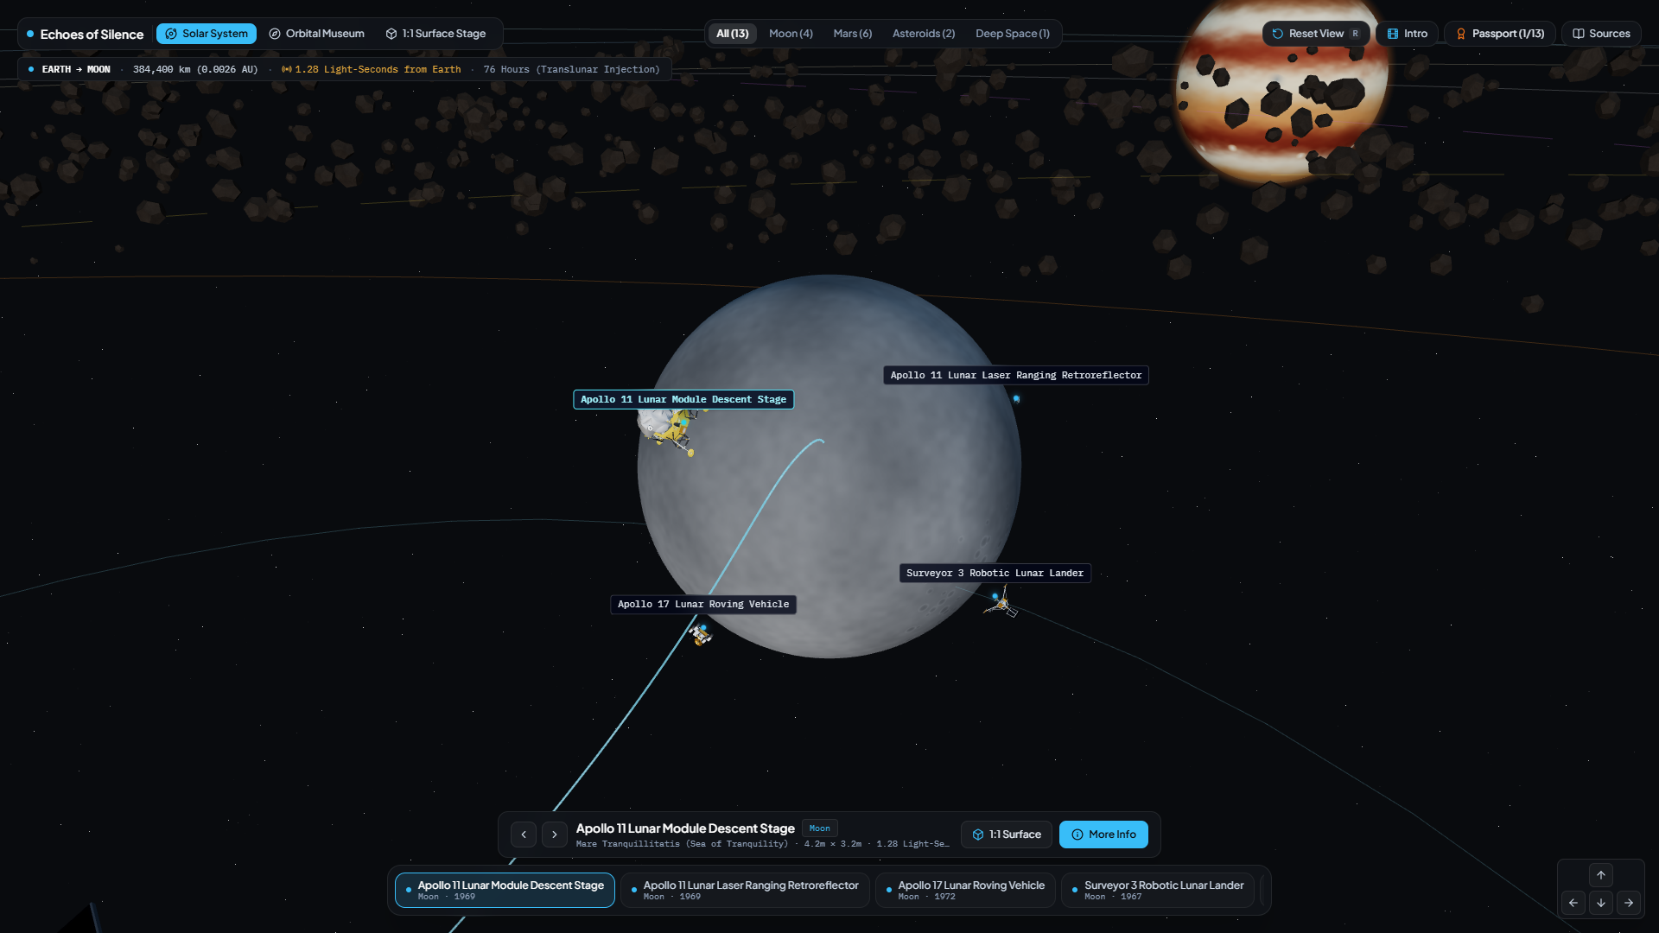
NASA SPACE APPS CHALLENGE CAIRO 2026
ECHOES OF SILENCE
Turning Silent NASA Spacecraft Across the Moon, Mars, and Deep Space into a Living 1:1 3D Museum
TEAM: SPAGHETTI CODERS
MEMBERS: Omar, Bashar, Youssef
github.com/omarsh4114/nasa-abandoned-not-forgotten-404

Slide 2

The Problem: Priceless Scientific Monuments
PIONEERS
ENGAGEMENT
SCALE
The Youth Disconnect (Ages 10–14)
Silent Pioneers Across 5 Worlds
Invisible Scale & Distance
Decades of exploration left landers and rovers on the Moon, Mars, Eros, Ceres, and Deep Space.
Technical archives make historic machines feel like "space trash" to students.
Students cannot picture true metric sizes or the vast light-delay across the system.
How do we turn silent NASA hardware into living, first-person teachers for the next generation of explorers?
"SPACE EXPLORATION IS A JOURNEY OF DISCOVERY, NOT A DESTINATION OF DEBRIS."

Slide 3

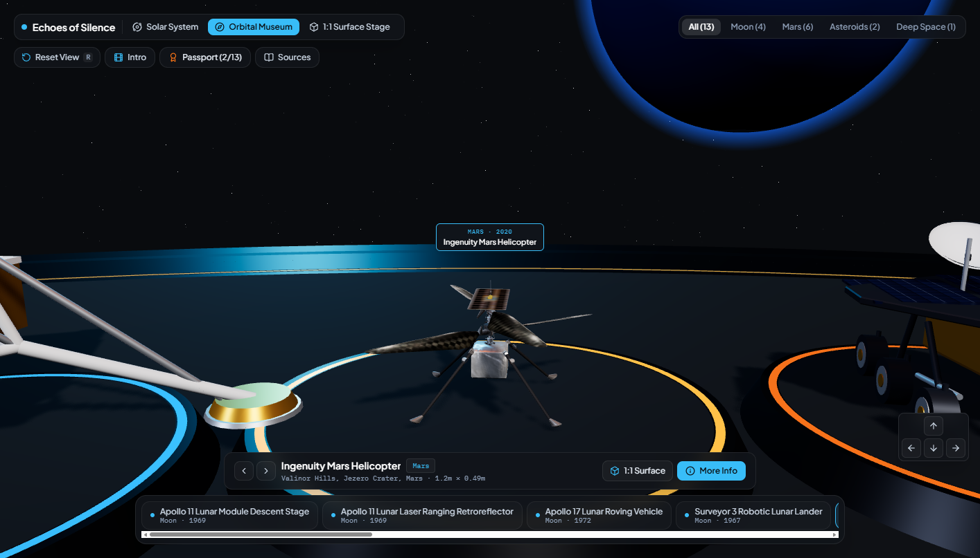
Our Solution: 3-Tier Interactive 3D Web Exhibition
MODE 1
Solar System Explorer
Trace mission trajectories (Translunar, Hohmann) and visualize real-time radio light-delay from Earth.
MODE 2
Orbital Museum Deck
Compare all 13 spacecraft side-by-side on an architectural exhibition platform.
MODE 3
1:1 Surface Stage & AR
ARCHITECTURAL COMPARISON MODE
Walk around spacecraft at true metric scale next to an astronaut reference or in mobile AR.
"CONNECTING THE PAST TO THE FUTURE THROUGH INTERACTIVE SPATIAL DATA."

Slide 4

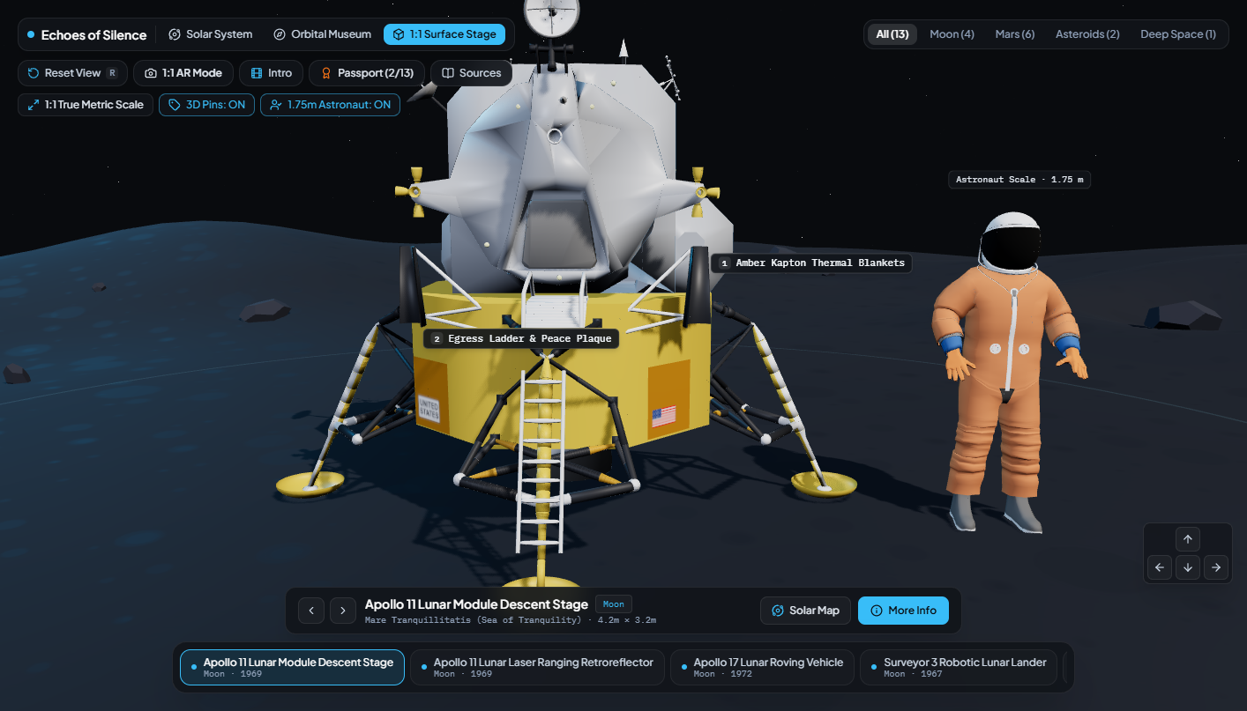
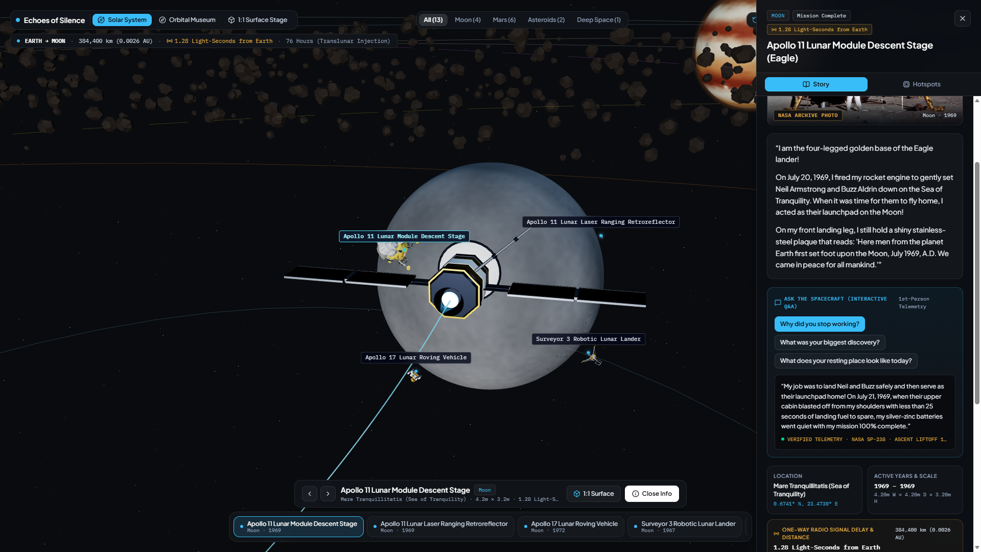
How It Works: From 1:1 3D Inspection to Storytelling
STEP 01
Inspect at 1:1 Human Scale
Select spacecraft, toggle Astronaut reference, and click 3D engineering pins.
STEP 02
Compare "Then vs. Now"
Switch between historic mission photos and modern orbital recon (LROC/HiRISE).
STEP 03
"Ask the Spacecraft" Q&A
Click question pills to read first-person answers with verified NASA telemetry tags.
"TRANSFORMING ABSTRACT COORDINATES INTO FIRST-PERSON HUMAN STORYTELLING."

Slide 5

Powered by 6 Official NASA Open Data Repositories
NASA NSSDCA
NASA 3D RESOURCES
NASA LROC
Verified spacecraft catalog IDs, launch/end dates, and true metric dimensions for all 13 missions.
Official glTF/GLB spacecraft geometry for Apollo LM, Ingenuity, InSight, Viking, and Dawn.
Lunar coordinates and NAC orbital frames for Apollo 11 Eagle, LRV-3, and Surveyor 3.
MARS HIRISE
NASA PDS
NASA IMAGE LIB
Martian coordinates and orbital imagery for Ingenuity, Opportunity, Spirit, and Sojourner.
Geotechnical reports, InSight SEIS Marsquake logs (1,319 events), and Small Bodies Node data.
Public-domain mission photography and Kepler transit discovery records for 2,662 exoplanets.

Slide 6

Prototype Status & Tech Transparency
WHAT WORKS NOW
LIMITS & DISCLOSURE
TECH STACK:
CURRENT LIMITS:
React 19, TypeScript, Three.js, React Three Fiber, GLSL Shaders, Tailwind CSS v4.
Artistic orbital anchors used for framing; 7 exhibits use procedural assemblies for fast loading.
FUNCTIONAL:
AI DISCLOSURE:
All 3 spatial modes & 13 unified exhibits
Google Antigravity & Gemini assisted with 3D code/shaders; Manus AI structured this deck. Science data/photos are unmodified NASA records.
39 3D engineering pins & interactive cards
One-way radio light-delay telemetry
1:1 WebRTC AR camera mode
"WE CONCEIVED THE PROJECT INDEPENDENTLY; AI SERVED AS OUR TECHNICAL CO-PILOT."

Slide 7
Impact & Future Roadmap: Inspiring Space Archaeologists
FUTURE ROADMAP
EDUCATIONAL BENEFITS
1
Live NASA JPL Horizons Ephemeris API: Real-time orbital dates.
For Students (Ages 10–14):
Transforms abstract telemetry into an emotional journey with rewards like the "Explorer Passport Certificate."
2
Bilingual Arabic & English Mode: Full localization and worksheets.
For Teachers & Museums:
3
Outer Solar System Expansion: Cassini, Huygens, Galileo, and Voyager.
Zero-install browser exhibition for any device with no login or data collection walls.
"ECHOES OF SILENCE: ABANDONED BUT NOT FORGOTTEN."

