Slide 1
Credit Score Classification
Project Abstraction
Cleansing Process
Feature Engineering Process
EDA Process
Data Analysis
Business Insights
Model Decision
Preprocessing Process
Modeling and Evaluation
Hyper Tuning
Deploytment

Slide 2
Project Abstraction
In our recent years banks represent special role during our daily transactions wether you buy or sell and it is very important to choose your customer carefully if you want to buy some thing , As retails or B2C companies they need to make sure about the inancial matters of the client in the future so bankers create a smart index called 'I Score' which referes to the future credit score classification .¶
This index save too much cost and time for customer selection and make the decision of installment for each client very easy
Hence we are coming to the role of machine learning and computational systems not only show the score of the client but also predict this score in the future
Our goal is : building strong predictive model allows us later to use it with coming data for prediction purposes .

Slide 3
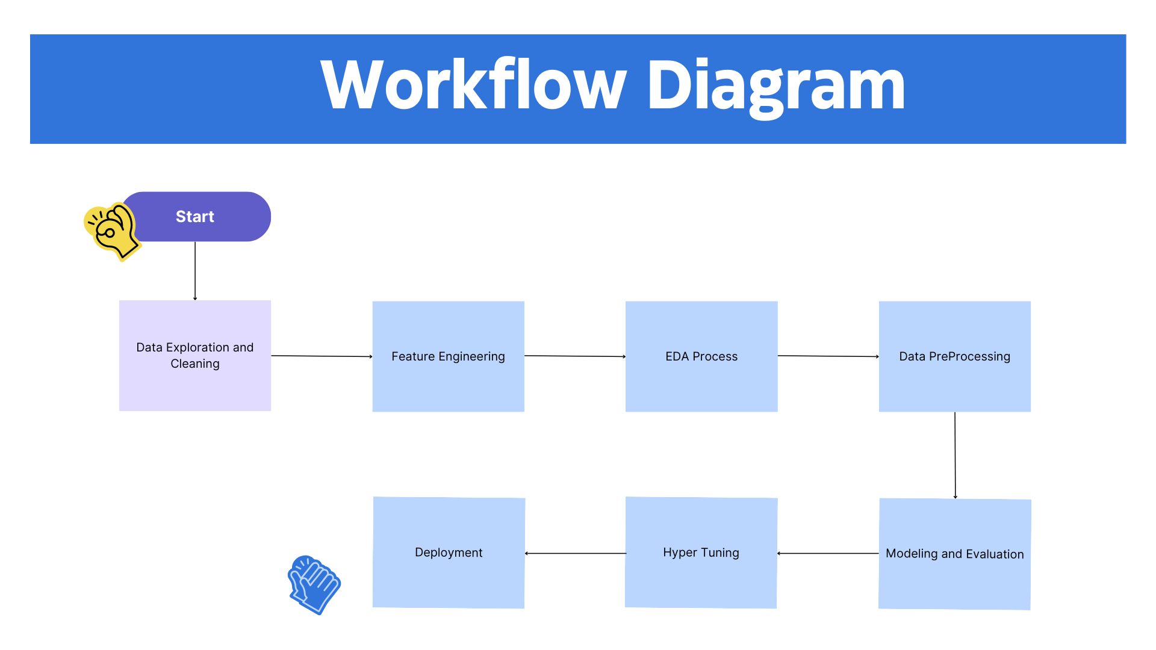
Project Structure

Slide 4
Data Description
ID: An identifier for each record in the dataset.
Customer_ID: Identifier for individual customers.
Month: The month associated with the data entry.
Name: Customer's name.
Age: Customer's age.
SSN: Social Security Number or some other form of identification.
Occupation: Customer's occupation or job title.
Annual_Income: Customer's annual income.
Monthly_Inhand_Salary: The amount of money the customer receives as salary on a monthly basis.
Num_Bank_Accounts: Number of bank accounts the customer has.
Num_Credit_Card: Number of credit cards the customer possesses.
Interest_Rate: The interest rate associated with some financial aspect (e.g., loans or credit cards).
Num_of_Loan: Number of loans the customer has.
Type_of_Loan: The type of loan(s) the customer has (e.g., mortgage, personal loan, etc.).
Delay_from_due_date: Delay in payments from the due date.
Num_of_Delayed_Payment: Number of delayed payments.
Changed_Credit_Limit: Indicates if the customer has changed their credit limit.

Slide 5
Num_Credit_Inquiries: Number of credit inquiries made by the customer.
Credit_Mix: The mix of different types of credit accounts (e.g., credit cards, loans).
Outstanding_Debt: The amount of outstanding debt.
Credit_Utilization_Ratio: The ratio of credit used to the total credit limit.
Credit_History_Age: The age of the customer's credit history.
Payment_of_Min_Amount: Payment behavior regarding minimum required payments.
Total_EMI_per_month: Total Equated Monthly Installment (EMI) payments made by the customer.
Amount_invested_monthly: The amount the customer invests on a monthly basis.
Payment_Behaviour: Behavior related to payments, possibly indicating patterns or trends.
Monthly_Balance: The customer's monthly balance in their financial accounts.
Credit_Score: The credit score associated with the customer's creditworthiness.

Slide 6
Cleaning Phase
Cleaning notebook
The aim of this first notebook is explore data , inversting it very well , invest its data types or logic , extract pattern and fill missing values
The data scientists spend most of thier time with this phase and i considre it the most important phase in our project
The challanges for this project is how to go in deep with data and understand its complexity

Slide 7
Feature Engineering Phase
The aim of this notebook is to apply feature enginnering and prepare data for the next step
This includes to find new features with domain knowledge feature then apply date and time features then string operations to avoid the redunant strings keeping our data clean

Slide 8
EDA Phase
The aim of this notebook is to apply EDA ,EDA means exploratory data analysis ,It is very important phase we know more about our data ,its pattern applying univariate and bivariet anlysis then detecting and handling outliers
The importance of EDA not only apply analytics and have bussiness insights but also know which model suits us for machine learing and thus we reduce the time and space complexity of the next phases¶

Slide 9
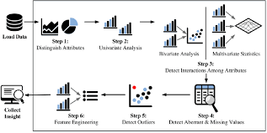
EDA Structure

Slide 10
Preprocessing Phase
The aim of this notebook is to apply preprocessing so we can prepare data for machine learning phase by encoding
Machine undestand only 0 and 1 (numbers) so we need to convert all columns to this formula even if they were categorical¶

Slide 11
Modeling and Evaluation Phase
The aim of this notebook is to apply differenct classical machine learning algorithms on our preprocessed data
We need to get train and test accuracies with high scores
We need to avoid overfitting and underfitting
Criteria of model choice is depending on less time with high scores
In case of any overfitting happens we will move to hyper tuning phase and apply some feature selection see which redunant features and which is more important¶

Slide 12
Hyper Tuning Phase
The aim of this notebook In case of any overfitting happens we will move to hyper tuning phase and apply some feature selection see which redunant features and which is more important
We need to upgrade performance of our model beacause previous scores are not satisfying
After we got new features we will apply grid search to upgrade performance more
We work with agile SDLC so we can get back again to any phase adding more features without affecting the old phases

Slide 13
Hyper Tuning Phase
The aim of this notebook In case of any overfitting happens we will move to hyper tuning phase and apply some feature selection see which redunant features and which is more important
We need to upgrade performance of our model beacause previous scores are not satisfying
After we got new features we will apply grid search to upgrade performance more
We work with agile SDLC so we can get back again to any phase adding more features without affecting the old phases

Slide 14
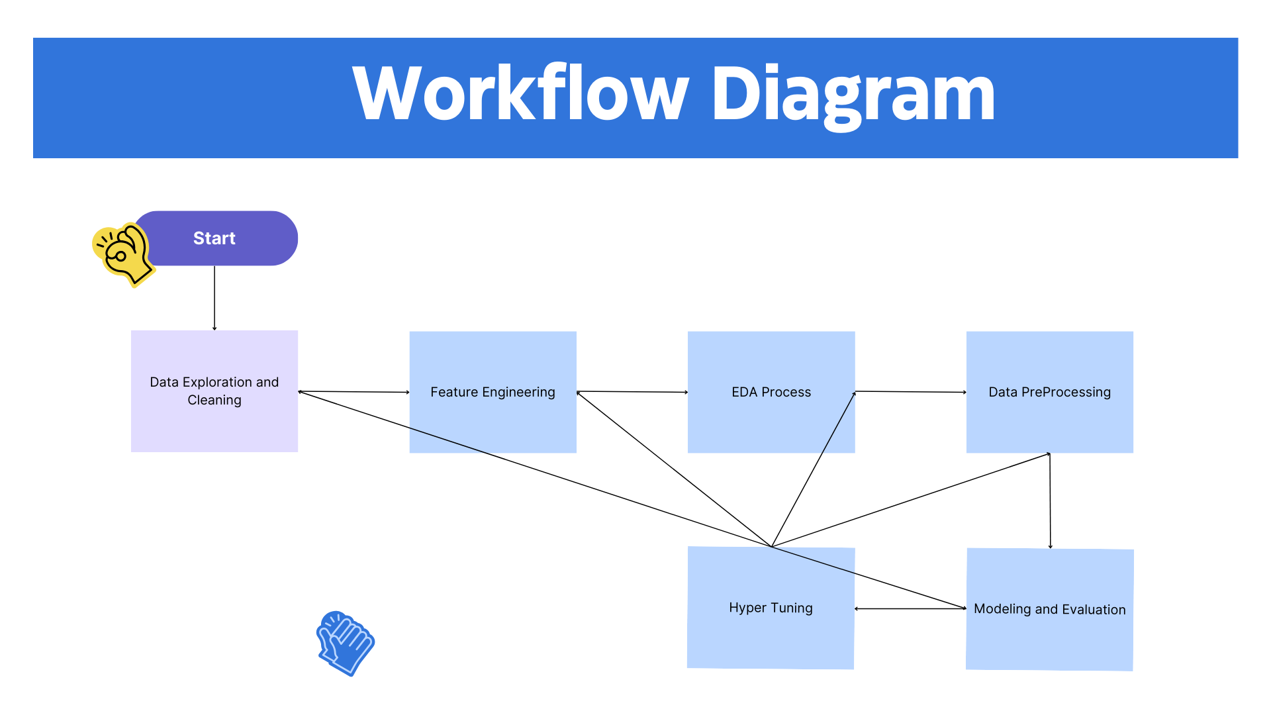
Hyper Tuning Flow

Slide 15
Deloyment Phase
The aim of this notebook is to deploy our data in web app online so that it will be able to apply soft code and make our model applicable and more dynamic
• Our online link for this local host application "https://webappfinalproject-samcc5ldyserhfhxqoarel.streamlit.app "
• The flow will be as following :
• Creat streamlit web app
• Create login form to autheniticate the super admin only for secuirty purpose
• Move to page with upload button to upload csv file
• The last page for dashboard which containes predictions and alot of visuals with side bar has filters¶

Slide 16
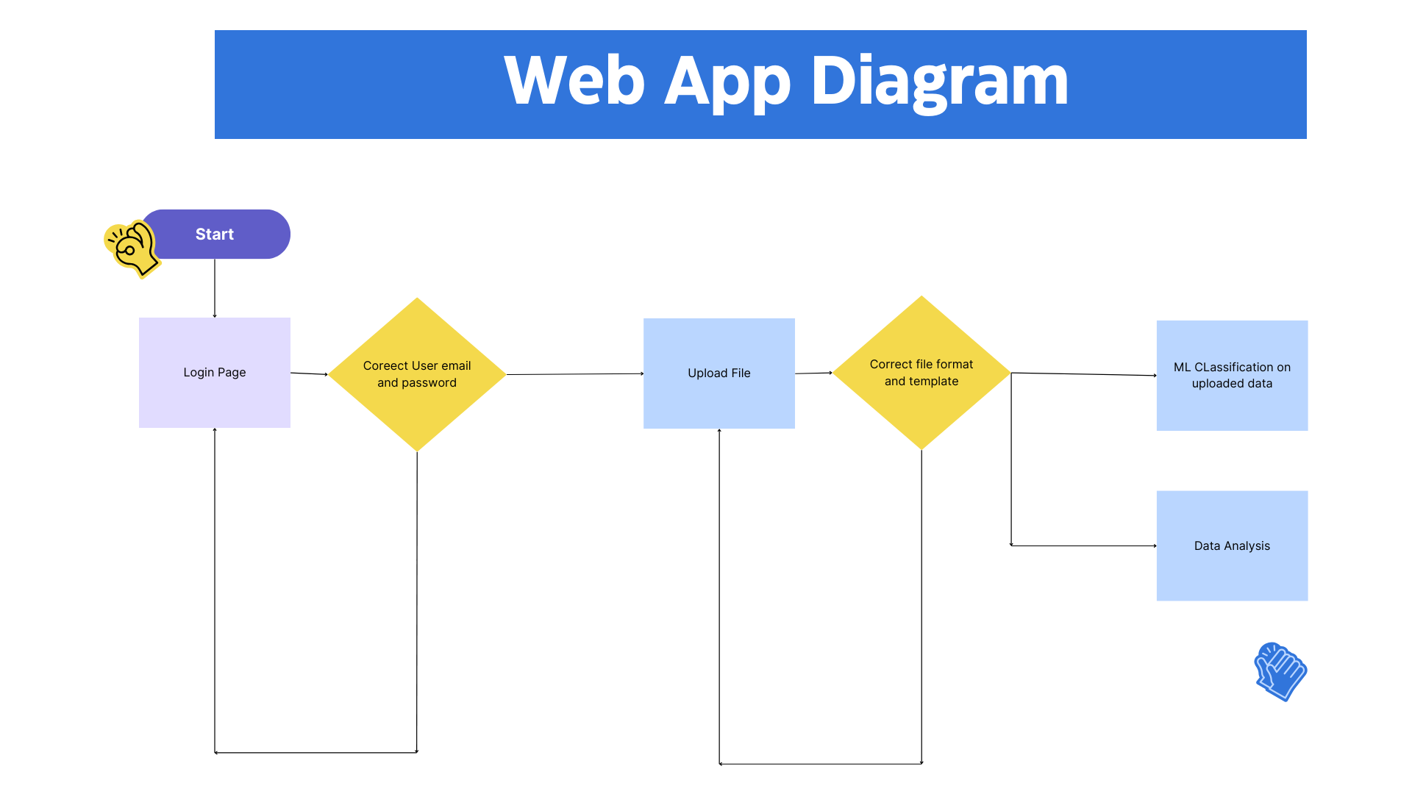
Deployment Flow

