Slide 1
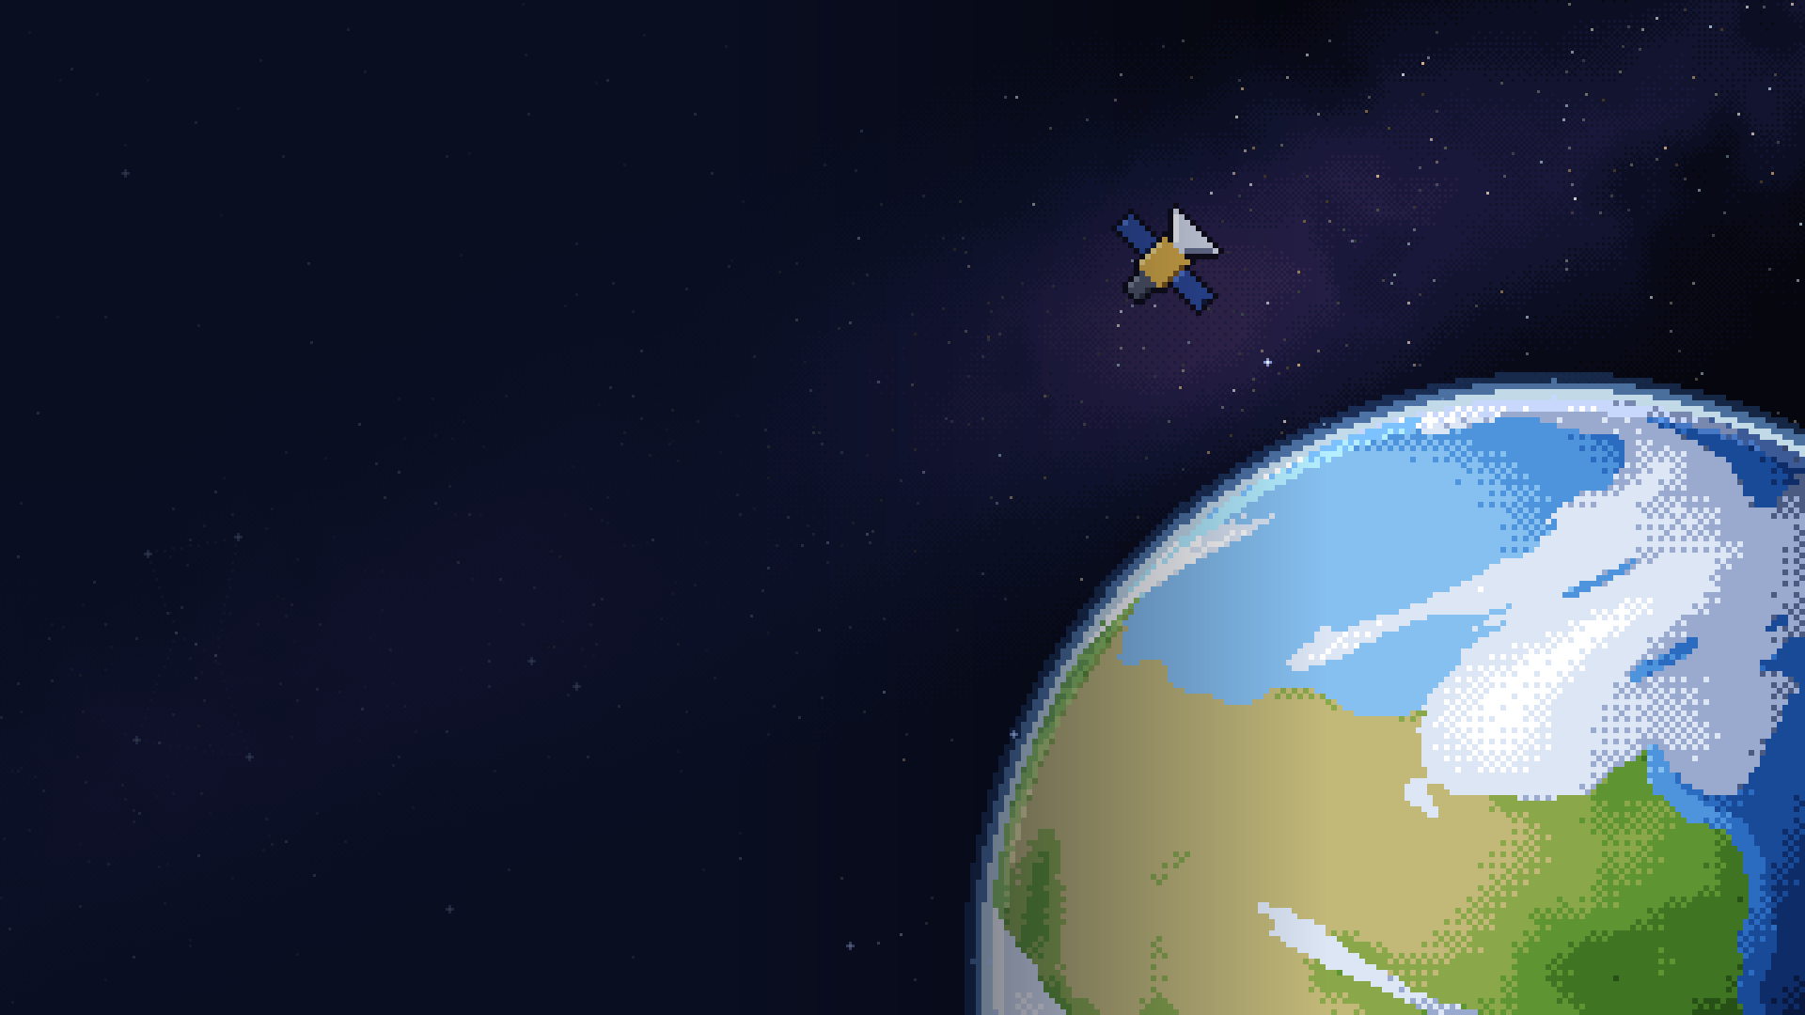

// MISSION BRIEFING
Build a spacecraft. Fly the whole mission.
See how every part depends on every other.
TEAM SHAY RAFE3
SPACE MISSION DESIGN GAME
RAMALLAH
Alameen Abu Fkheida · Omar Takhman · Omar Shobaki
Mohammad Humaidan · Mahdi Al Sheikh · Ahmad Taweel
NASA SPACE APPS CHALLENGE 2026
Notes:
TIME 0:00-0:05 (5 s) SPEAKER: ______
"We're Team Shay Rafe3 from Ramallah."
(Click straight to the next slide: the hook is the three numbers.)

Slide 2
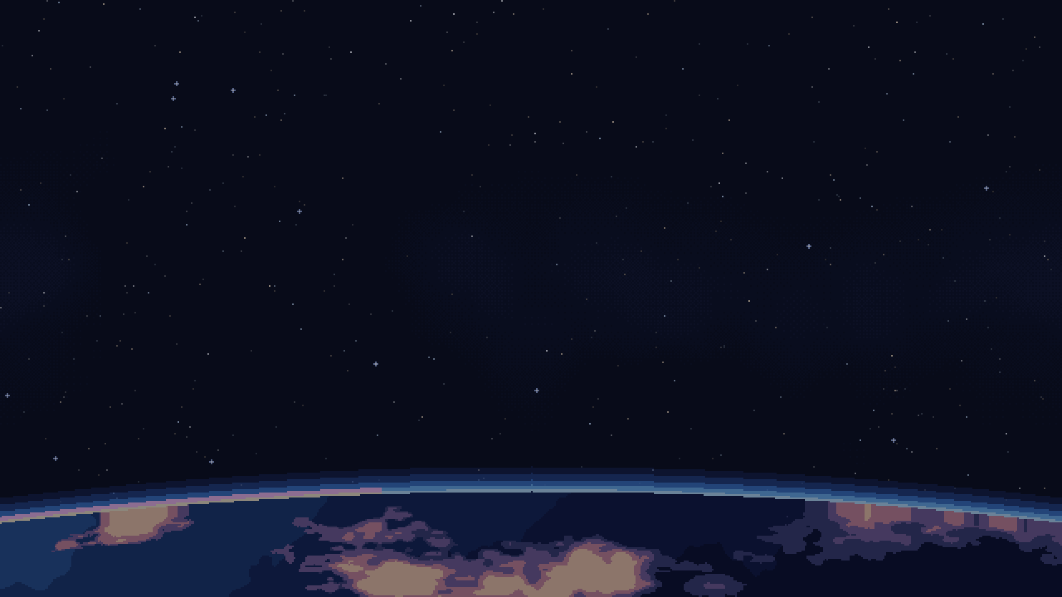



Millions love space. Few see how a mission works
// 02 THE HOOK · THE PROBLEM
IMPACT
149M
406.8M
114,000+
views of NASA's Artemis II coverage, 2026
follows of NASA's social accounts, 2024
registered for NASA Space Apps 2025
BUT TODAY, ALL THEY CAN DO IS...
WATCH
READ
PLAY
Livestreams show the launch, not the hundreds of choices behind it
Courses teach one topic at a time, mostly at university
Games focus on flying, rarely on budget, power and data
Few tools let you run a whole mission, from first idea to final result.
Sources: NASA Artemis II streaming report, 2026 (views, not people); NASA 2024 year in review (account follows, not unique people); NASA Space Apps 2025 metrics
Notes:
TIME 0:05-0:50 (45 s) SPEAKER: ______ THE HOOK
(Point at each number as you say it. Slow down.)
"149 million views of NASA's Artemis II coverage this year. 406 million follows of NASA's accounts. 114,000 people signed up for Space Apps last year.
The world loves space. But how many of those people have ever designed a mission themselves?
Today they can watch a launch, but not the hundreds of decisions behind it. They can study one topic at a time: orbits, then power, then radios. Or they can play games that are mostly about flying, rarely about budget, power and data.
Few tools let you run a whole mission yourself, from the first idea to the final result."
Honest wording if asked: views and follows are not unique people.

Slide 3



In Palestine, the gap is even wider
// 03 CLOSE TO HOME
IMPACT
Few aerospace study paths
we found no aerospace engineering degree at a Palestinian university
The curiosity is here.
Tools should be too.
A trip to NASA for a lucky few
the best-known path takes a small group of teens to NASA Goddard
Mission design is hard to try
astronomy clubs do great work; we add a free mission lab to it
Notes:
TIME 0:50-1:20 (30 s) SPEAKER: ______
"Here in Palestine, that gap is even wider. We found no aerospace engineering degree at our universities. The best-known way into NASA is a trip for a handful of teenagers. Our astronomy clubs do great work, but trying mission design yourself is hard.
Young Palestinians are as curious about space as anyone. We want to add to what already exists.
The curiosity is here. The tools should be too."
CHECK the facts before the pitch (script PDF, section 6). Soften any you can't confirm.

Slide 4
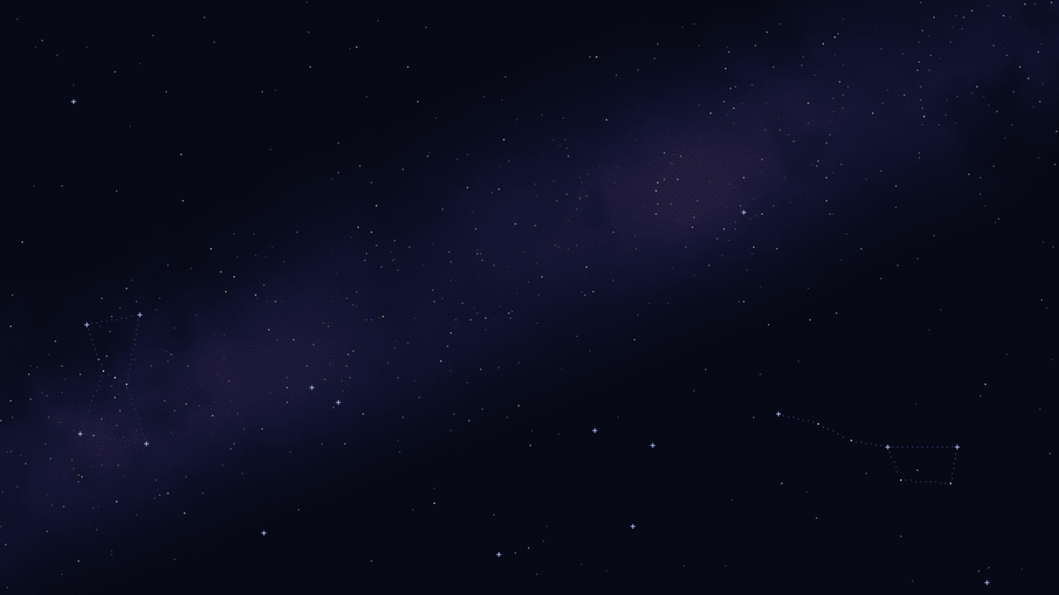
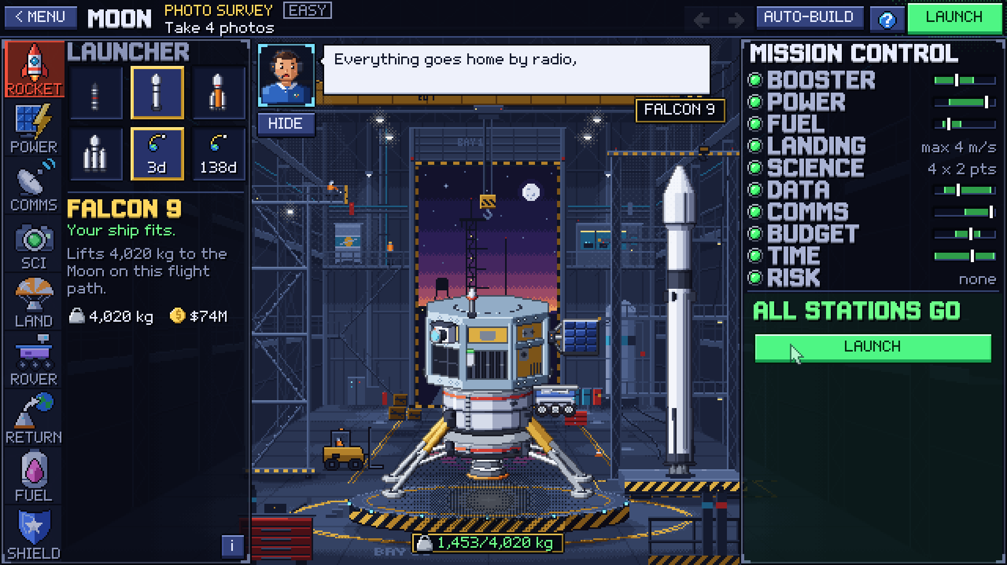
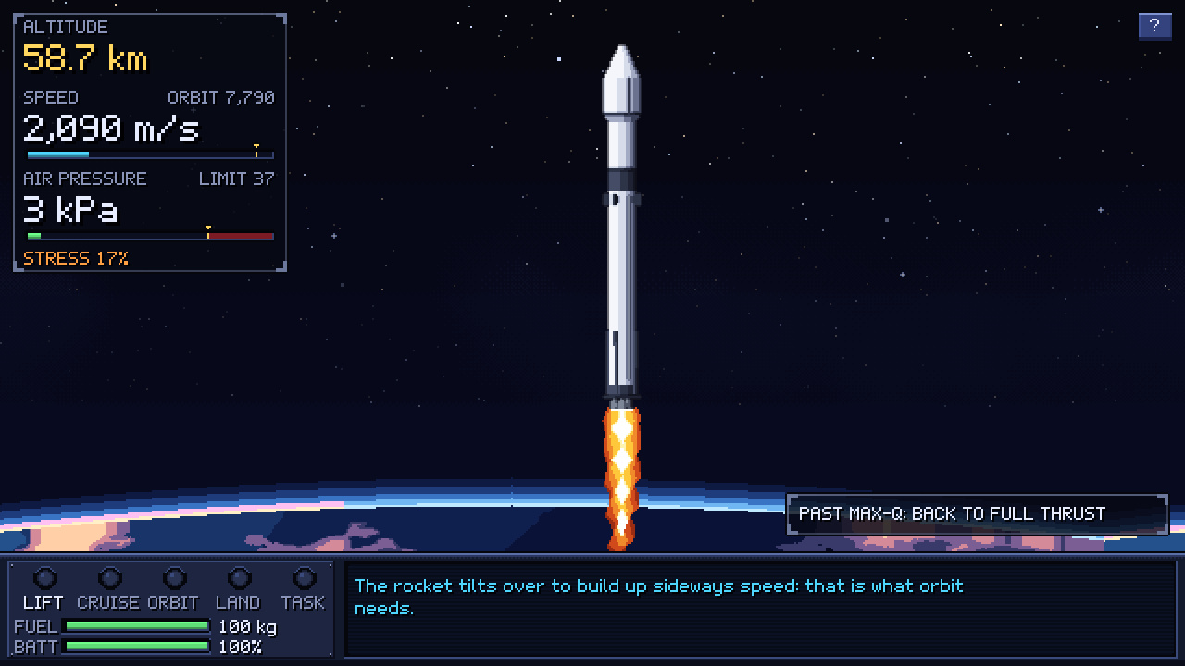
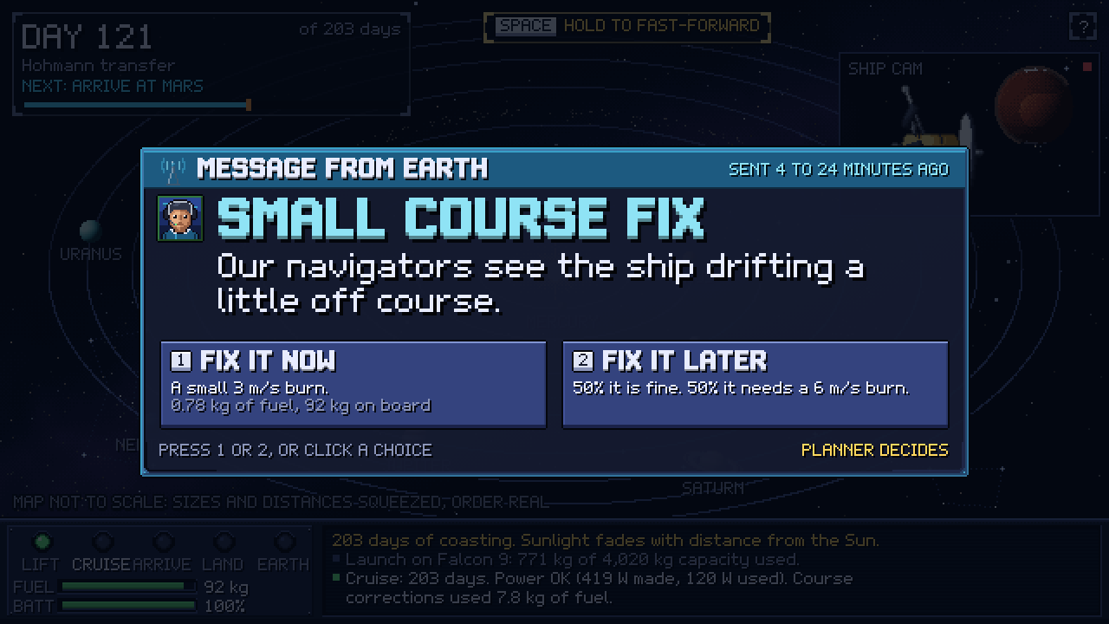
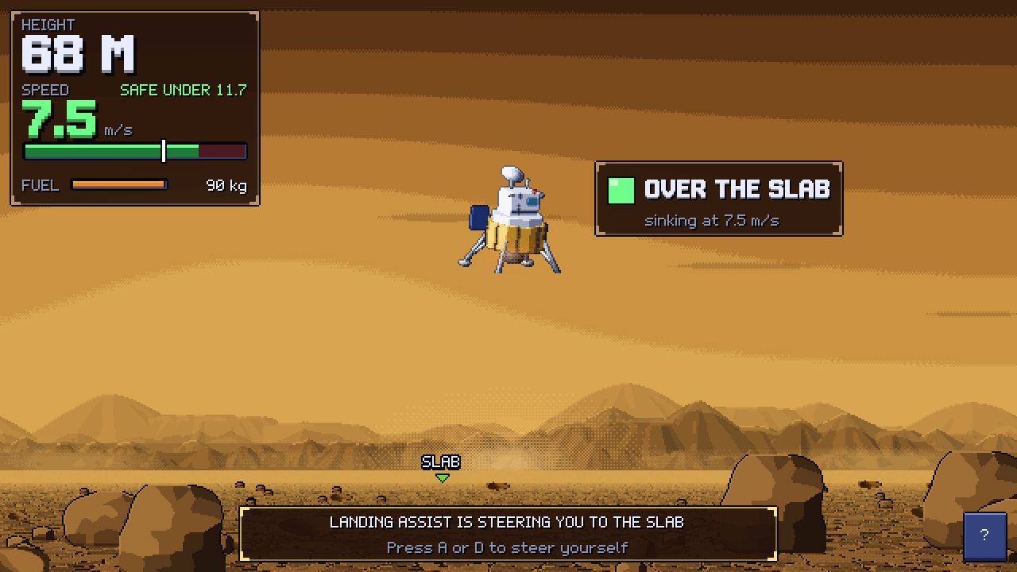
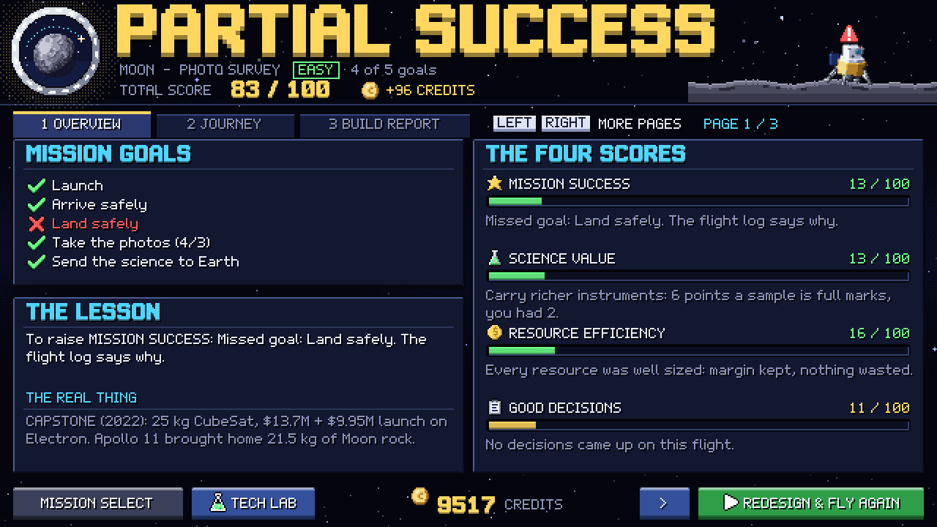
AstroPixel: a whole mission, in any browser
// 04 OUR SOLUTION
CREATIVITY
RELEVANCE
1
2
3
LAUNCH: fly through max-Q
CRUISE: real-mission events
4
5
BUILD: 29 parts based on real hardware, resources live
LAND: Venus, 92 bar, 464 °C
LEARN WHY: the cause chain
WHAT PLAYERS DISCOVER
+1 camera: +3 kg, +7 W ▸ +5 kg fuel ▸ more data ▸ maybe a bigger battery or rocket ▸ more cost
Notes:
TIME 1:20-1:55 (35 s) SPEAKER: ______
"So we built AstroPixel: a whole mission, in your browser.
You pick one of 8 worlds and a task, and build your spacecraft from 29 parts based on real hardware while Mission Control tracks every resource live. You launch, cruise through events inspired by real missions and real 2024 solar storms, and land in each world's gravity. When something fails, the report tells you exactly why, so you fix it and fly again, alone or as a team of four roles.
And players discover what engineers know: add one camera, and mass, power, data and fuel all change. Sometimes you need a bigger battery or even a bigger rocket, and that costs money."
Numbers on the banner (Moon direct plan): the 3 kg, 7 W camera adds about 5 kg of fuel before reserve. Don't say every instrument always needs a bigger rocket.

Slide 5
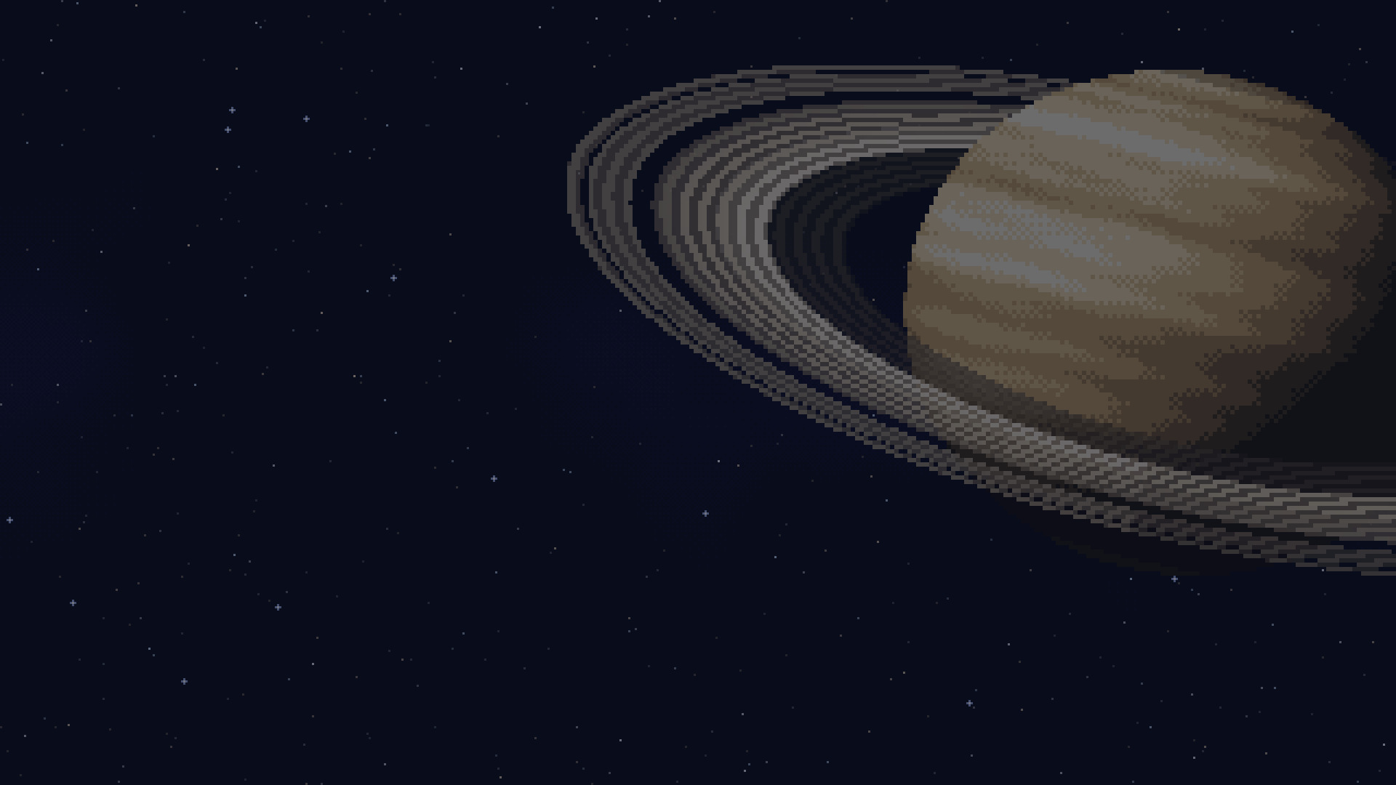




Real physics, NASA data, honest game rules
// 05 THE SCIENCE + NASA DATA
RELEVANCE
VALIDITY
ROCKET EQUATION
SUNLIGHT ∝ 1/d²
Δv = Isp·g₀·ln(m₀/m₁)
Mars 43% · Saturn 1.1%
Moon: 1,000 kg dry → 1,706 kg fuel
Weak far out, so RTGs win in-game
NASA Glenn · Isp 300 s, a GMAT default
NASA Fact Sheets · MMRTG ~110 W at start
SIGNAL
DESIGN MARGINS
delay = distance / c (one way)
35% spare lift · 25% budget
Mars 3–22 min · Saturn ~79 min
JPL-inspired, our own stated rules
NASA Mars Relay Network · MRO 3 m dish
JPL CML checklist (adapted) · Discovery AO
REAL EVENTS
15 stored NASA DONKI storm records (2024), e.g. 10 May, Kp 9. Damage odds are our game rules, and labelled as such.
Notes:
TIME 1:55-2:30 (35 s) SPEAKER: ______ (the person who studied the science sheet)
"Underneath, it's real science. The game runs the rocket equation: on our Moon plan, a 1,000 kg ship needs about 1,700 kg of fuel. Sunlight fades with distance squared: Mars gets 43% of Earth's, Saturn about 1%, so a nuclear RTG becomes the smart choice. Radio signals take 3 to 22 minutes to reach Mars, and 79 minutes from Saturn.
Our green lamps are inspired by JPL's design margins, and we label which thresholds are our own game rules. The storms come from stored NASA DONKI records, like May 2024."
Avoid saying: "every number is a NASA number", "we run GMAT", "solar is impossible at Saturn", "3 dB means twice the data", "DONKI gives radiation at Saturn".
Study sheet: section 3 of the script PDF.

Slide 6
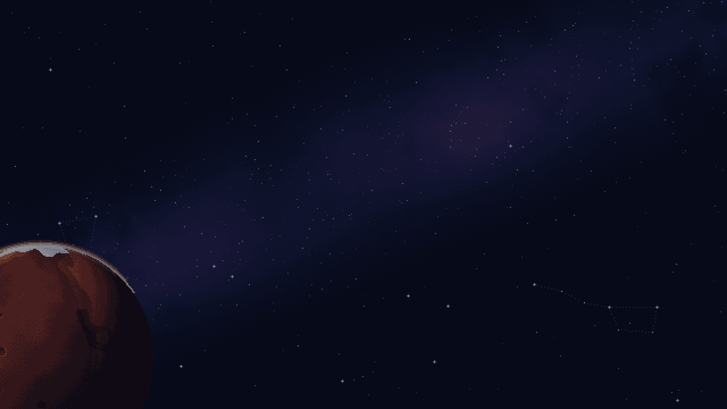
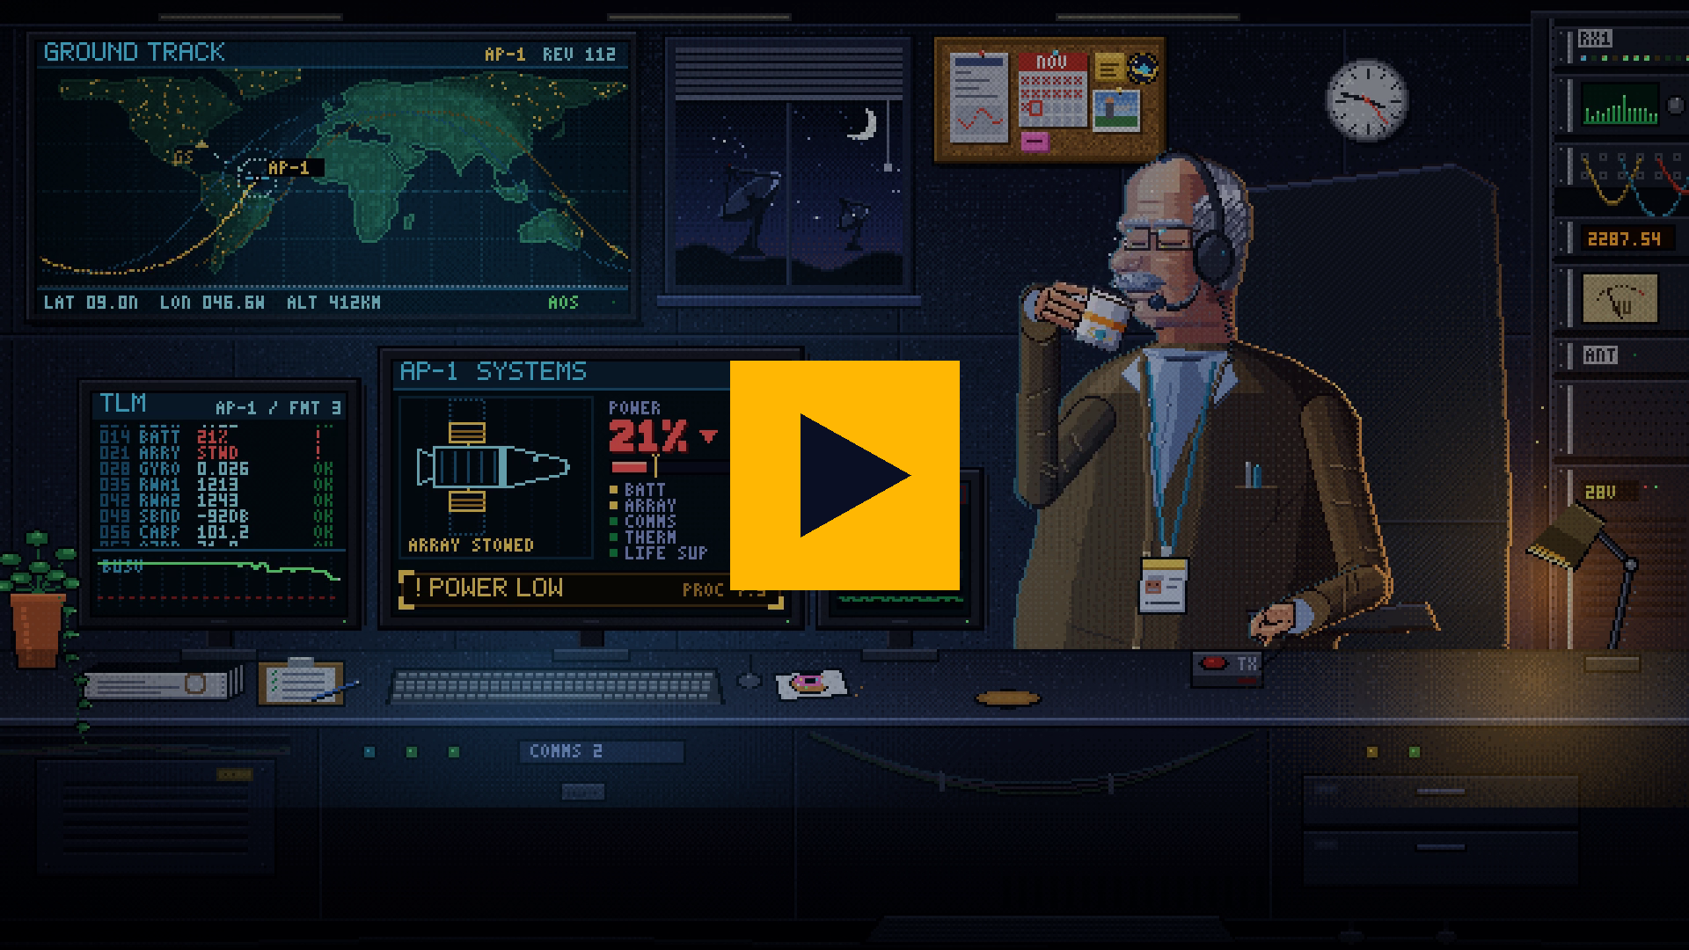

See it fly
// 06 DEMO
VALIDITY
PRESENTATION
SCAN TO PLAY
free · no install · no login
8 worlds × 3 tasks
1–4 players, one role each
omarshobaki-png.github.io/Shay-Rafe3-Nasa-Space-App-Challenge/play/
Notes:
TIME 2:30-3:15 (45 s: 5 s intro + 40 s video) SPEAKER: demo driver
Say only: "Let's see it fly." Then play the video and stay quiet.
The video is embedded in this slide: click it (or press Space) to play. Keep an offline copy of the video file on the laptop and a USB stick as backup.

Slide 7
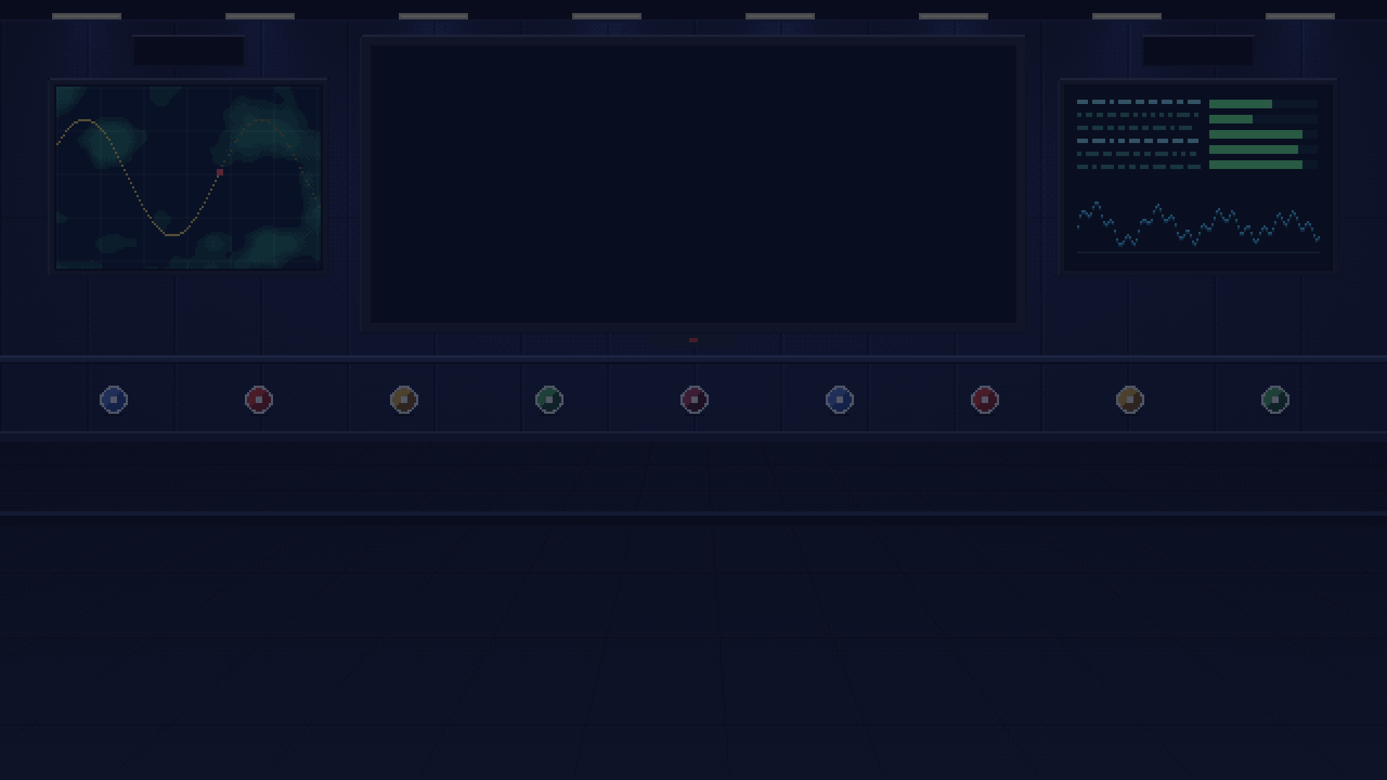

Lose your first spacecraft here, for free
// 07 IMPACT · NEXT STEPS · TEAM
IMPACT
VALIDITY
Students and space fans
Teachers and schools
Palestinian learners
Learn mass, power, data and comms by using them, from zero knowledge
One free link for a class: teams of 4 roles, a report that explains every result
Any browser on a school PC: no install, no account, no travel
PLAYTESTERS SAID
TEAM SHAY RAFE3 // THE CREW
“It's so detailed.”
“It teaches so much about missions and NASA data.”
Alameen Abu Fkheida
Omar Takhman
Creative game design & logic
Video trailer, design & research
NEXT STEPS
1
Pilot with one school class in Ramallah
Omar Shobaki
Mohammad Humaidan
Website, presentation & research
Mobile, presentation & research
2
Act on playtest notes · add NASA photos
HONEST LIMITS
Mahdi Al Sheikh
Ahmad Taweel
Simplified crew tasks · stored flight paths, no live GMAT · fixed planet distances · English only
Primary game developer
Website design, game logic & pitch
AI disclosure: the idea and game design are ours; AI helped write code and draft this deck. No AI images, video or audio: all art comes from our own scripts.
Notes:
TIME 3:15-3:40 (25 s) SPEAKER: ______
"AstroPixel is free and runs in any browser: no install, no account, no travel. We already put it in front of players, and the feedback was positive: they told us it's so detailed and teaches them so much about missions and NASA data. Next, we'll test it with a school class here in Ramallah and add real NASA images.
Lose your first spacecraft here, for free, and learn why. Thank you."
(Stop. Smile. Q&A.)

