Slide 1
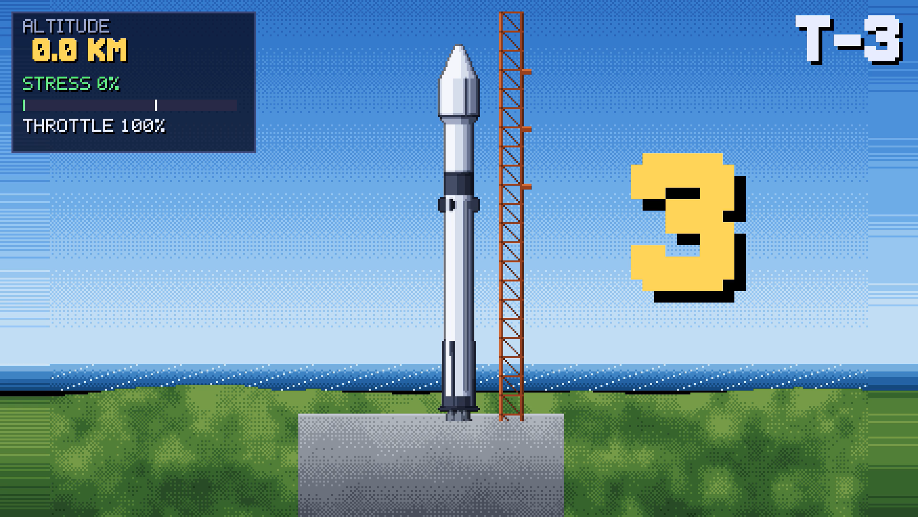
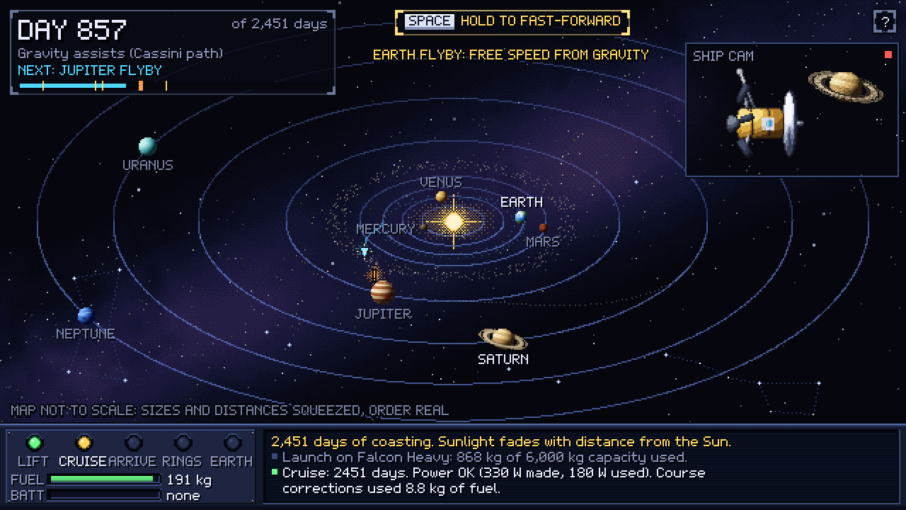

Design a spacecraft, launch it and fly the whole mission,
as a team of up to 4, with real NASA numbers.
When it fails, the game tells you why.
Team Shay Rafe3 · Challenge: Space Mission Design Game · Ramallah local event
Omar · Ahmad · Ameen · Mahdi
Notes:
INTRO 0:00–0:20, then TITLE 0:20–0:30
WHAT HAPPENS: the slide opens and the rocket clip plays by itself (11 s, with sound): countdown, liftoff, max-Q alarm, explosion. It holds on MISSION FAILED.
SKIT (about 9 s, three of us, lines are a draft, make them yours):
Teammate A (staring at the screen): "...What just happened?"
Teammate B: "I think our calculations were wrong!"
You (turning to the judges): "But which ones? The mass? The fuel? The throttle? When a real mission fails, students never find out why. So we built a game that tells you."
CLICK ONCE: the video fades out and this title fades in.
TITLE (10 s): "We're Team Shay Rafe3, and we took the Space Mission Design Game challenge. This is AstroPixel Mission Designer: design a spacecraft, launch it and fly the whole mission, as a team of up to four, with real NASA numbers. And when it fails, the game tells you why."
The cause is really in the clip: THROTTLE stays at 100% while STRESS climbs past the line at max-Q. We pay it off on the demo slide.
Rehearse the skit with the timer. If the intro runs past 20 s, cut the skit lines, not the clip.

Slide 2
Most student satellites never finish the mission
2 / 7 · THE PROBLEM
IMPACT
1 in 4
🧩
Tools teach one topic
Orbits, rocket design or launches on their own. Nobody shows how the parts affect each other.
university satellites finished their full mission
244 university smallsats launched 2000–2015. Nearly 30% were dead on arrival.
❓
Failure without a reason
A mission fails on mass, power, data or one missing part. Without the why, it just feels random.
3 in 5
1 in 3
👥
Real missions are teamwork
satellites lost by teams on their first 1–3 tries
CubeSat failures with no known cause
NASA designs missions as a team of specialists who must agree. Most learning games are solo.
Source: Swartwout (Saint Louis Univ.) and Langer (TU Munich), in The Space Review, 22 Aug 2016
Notes:
0:30–0:55 (speaker: ___)
The person is US (the skit just showed it). Draft:
"That explosion isn't just a joke. Of 244 satellites built by universities, only one in four finished its mission. Teams on their first tries lost three out of five. Experience is what fixes that, but today the only way to get it is to lose a real spacecraft. We're students: we learned orbits, rockets and power in separate courses, and never once ran a whole mission where every choice affects the others."
Source if a judge asks: Jeff Foust, "CubeSats: faster and cheaper, but better?", The Space Review, 22 Aug 2016, quoting Michael Swartwout (Saint Louis University, 244 university smallsats 2000–2015) and Martin Langer (TU Munich, a third of CubeSat failures have no known cause).
Optional: swap "We're students" for one teammate's real one-line story (name, university).

Slide 3
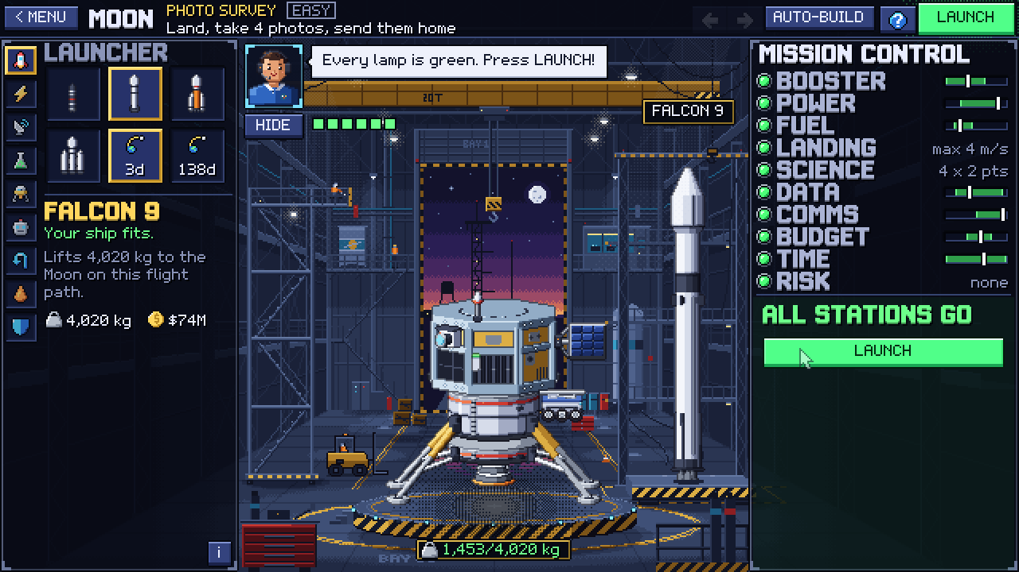
One game. The whole mission. A real team.
3 / 7 · OUR SOLUTION
CREATIVITY
RELEVANCE
8
28
worlds × 3 tasks
real parts
4
37
player roles
real-mission events
What's new
Unlike Kerbal Space Program, every choice costs budget, power, data, comms and time, and every number has a NASA source.
Unlike NASA's Webb game (one telescope, solo), you fly 8 destinations as a team of 4 who must sign off together.
The hangar: parts snap onto the ship; Mission Control lamps turn green only when NASA's margins are kept.
Notes:
0:55–1:20 (speaker: ___)
"AstroPixel is one game for the whole mission. Pick a world and a task, build a ship from real NASA-sourced parts, pass Mission Control's GO / NO-GO, then fly it: launch, cruise, land or orbit, explore, and send the science home.
Unlike Kerbal Space Program, every choice costs budget, power, data and time, with a NASA source behind each number. Unlike NASA's Webb game, you play as a team of four: Planner, Engineer, Scientist and Comms, and everyone has to sign off before launch."
Training: show the value first, not the feature list or the tech stack.

Slide 4
NASA data drives every result
4 / 7 · HOW IT WORKS + NASA DATA
RELEVANCE
VALIDITY
NASA DATA
GAME RULES
WHAT THE PLAYER LIVES
DONKI
2024 geomagnetic storms (GST), up to Kp 9
NSSDCA Planetary Fact Sheets
gravity, sunlight, distance
JPL Concept Maturity Level 4
35% margins, 3 dB link
GMAT
engine Isp 300 s, solar ageing
MMRTG · Small Spacecraft Tech
real power parts
Rocket equation
heavier ship → more fuel → heavier ship
Sunlight ∝ 1 / distance²
Saturn gets ~1% of Earth's
Radio ∝ 1 / distance²
far worlds need a big dish
Margins
lamp is green only with NASA's margin
Events eat margin
no margin → first surprise ends it
A real storm in cruise
no shielding → 70% chance a part fails
Solar ship at Saturn
goes dark: needs nuclear power
Mars landing
heat shield + parachute, real gravity
The report
4 scores + the cause chain: why
Redesign
and fly again
▶
▶
Δv = Isp · g₀ · ln(m₀ / m₁) Every number lives in one file with its source. Values we chose for gameplay are labelled "game rule".
Notes:
1:20–1:50 (speaker: ___)
Name the datasets exactly (training: "We used NASA data" with no names loses Relevance points).
"Gravity, sunlight and distance for all 8 worlds come from NASA's planetary fact sheets. Design margins follow JPL's Concept Maturity Level 4: 35% on mass and power, 3 dB on the radio link. Engine numbers are GMAT defaults. And in cruise, real 2024 geomagnetic storms from NASA's DONKI database hit your ship: up to Kp 9, the 10 May 2024 storm.
These run through real physics: the rocket equation, and power and radio falling with the square of the distance. So a solar ship goes dark at Saturn. Without the NASA data, the physics stops being real."
Likely judge question: "Which NASA datasets, and what breaks without them?"

Slide 5
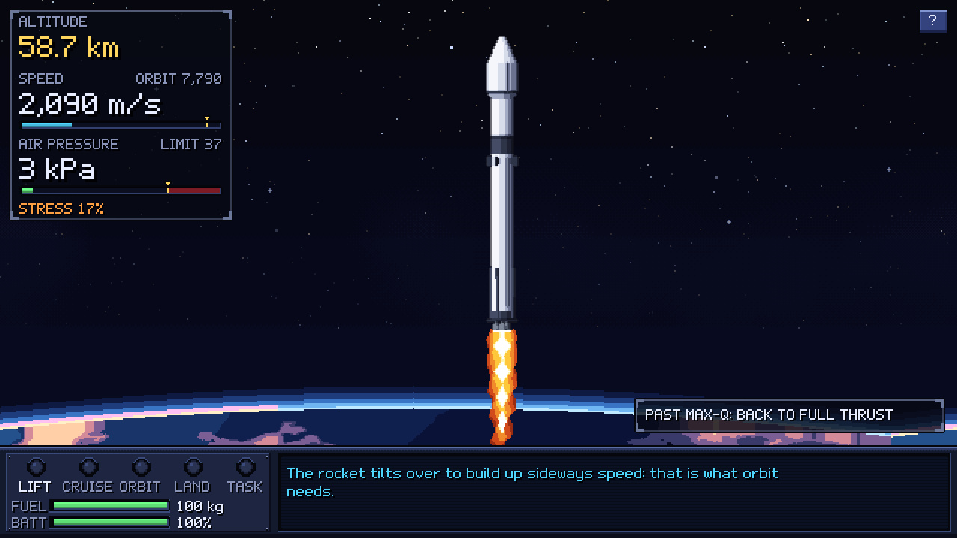
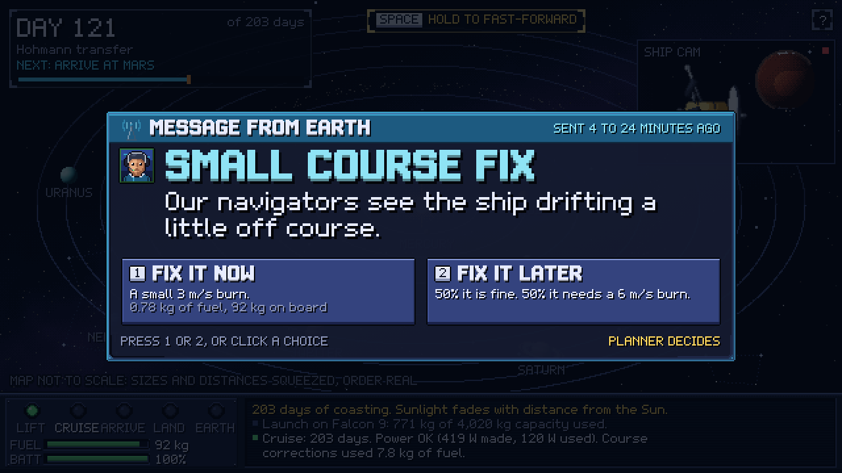
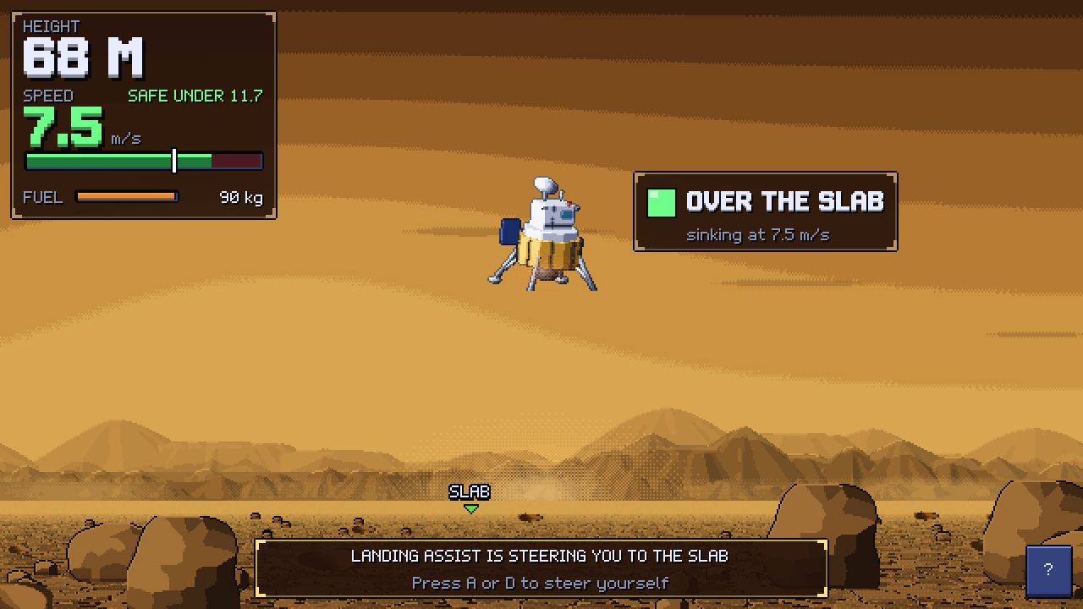

Play it now, in any browser
5 / 7 · DEMO
VALIDITY
PRESENTATION
1 Fly the launch: throttle back through max-Q, stage, deploy
2 Decide: events from real missions, each role owns some
3 Land in real gravity: Venus, 464 °C and 92 bar
Scan to play
free · no install · no login
WORKS TODAY
All 8 worlds × 3 tasks playable start to finish
Free web build on GitHub Pages: no install, no login
Multiplayer for 1–4 roles, tested in 2 browsers on a local server
PLANNED
Public relay server so judges can join online games
Full GMAT trajectory runs instead of real-mission Δv
Real NASA photos (LRO, HiRISE, Cassini) in the report
Notes:
1:50–2:25 (speaker + one person driving the demo)
CALLBACK TO THE INTRO: point at the launch screenshot: "Remember our rocket? It kept full throttle through max-Q. In AstroPixel, Mission Control warns you: throttle back to 80%, air pressure is rising, just like real rockets do."
Live: menu → Moon Easy → AUTO-BUILD → LAUNCH → throttle through max-Q → one event card → landing. Keep it under 35 s.
BACKUP: an offline screen recording on the laptop and the USB stick, in case the Wi-Fi dies (training: "a live demo that dies when the Wi-Fi does").
Check before the pitch: the QR opens https://omarshobaki-png.github.io/Shay-Rafe3-Nasa-Space-App-Challenge/play/ with no login. Be honest about what works vs planned; "PLANNED" items must be true when we say them.

Slide 6
Who it helps, and how
6 / 7 · IMPACT
IMPACT
🎓
🏫
🚀
Students and new engineers
Teachers and schools
Space clubs and hackathons
Learn mass, power, data and comms by using them, in plain words, from zero knowledge up.
One free link for a whole class: 4 roles per team, a report that explains every result.
Team play over the network: negotiate trade-offs like a real NASA design team.
LOCAL ANGLE
Runs in any browser on a school PC or a phone-tethered laptop: no install, no account, no cost.
Built in Ramallah, for students who rarely get hands-on space engineering.
TESTED, THEN REBUILT
Playtest of our early version: the builder's list of +/- counters was "too complicated".
So we rebuilt it: click a slot on the ship, pick a real part, and a hint names the part that fixes the problem.
Notes:
2:25–2:45 (speaker: ___)
"Three groups: students learning from zero, teachers who need one free link for a whole class, and space clubs who want to play as a team. It runs in any browser, on a school PC, with no account. And we test with players: our first playtest said the builder was too complicated, so we rebuilt it around the ship itself."
If you run a first-timer playtest tonight, replace the evidence card with their real quote and one number (e.g. "built a working Moon ship in 2 minutes without help"). Never invent it.
Avoid "this will help millions" (training: common mistake).

Slide 7
From a 48-hour build to a classroom
7 / 7 · FUTURE, LIMITS AND TEAM
VALIDITY
IMPACT
1
Deploy the relay server
so anyone can play online as a team
HONEST LIMITS
Robotic missions only: no crew, no life support
Flight times and Δv from real missions, not full GMAT runs
Online play needs our relay server
2
Pilot with one class
and fix what first-timers trip on
THE TEAM · SHAY RAFE3 · RAMALLAH
3
Full GMAT runs + NASA photos
for exact flight paths and real images
Omar
Ahmad
Ameen
Mahdi
Play: https://omarshobaki-png.github.io/Shay-Rafe3-Nasa-Space-App-Challenge/play/ · AI disclosure: the idea and game design are ours; AI helped write code and draft this deck. No AI images, video or audio.
Notes:
2:45–3:00 (speaker: ___)
"Next: we deploy the relay so anyone can play as a team, pilot it with one class, and add full GMAT trajectories and real NASA photos. Our limits: robotic missions only, and flight paths come from real missions rather than full GMAT runs. We're Omar, Ahmad, Ameen and Mahdi, Team Shay Rafe3. Thank you. Questions?"
Optional: give each step a month and an owner, and a role under each name, if the team agrees on them.
Training: being honest about limits builds trust (Zumorroda-X, 2025 Art & Technology winner). Avoid "future work: add AI".
Q&A prep (answer in 3 beats, max 20 s: one sentence → evidence → back to impact):
- Impact: who uses it and how does it reach them? → students; schools and clubs; a free link.
- Creativity: what exists? → KSP and NASA's Webb game; our one-line difference.
- Validity: what's real, what's mocked? → every number sourced in data.gd; "game rule" labels.
- Relevance: which datasets, and what breaks without them? → DONKI, fact sheets, JPL CML, GMAT.
- Presentation: one sentence → the tagline.

