Slide 1













Fake News Detection
Presented by: Omar Ahmed Shoman
Rawan Mohamed Majed

Slide 2

Project Idea
Fake news is a big problem on the internet today. It spreads quickly and can cause confusion or harm.
In this project, we build a smart system using machine learning to check if a news article is real or fake.
We use the title and text of the news to help the model learn and make predictions.

Slide 3
Data Preprocessing
01
02
03
04
05
The training and testing datasets were combined into a single unified dataset for consistency.
1.Removed unnecessary duplicate rows and extra values
1.-Reset the index to start organizing the data from a clean structure.
1.-Used TF-IDF Vectorizer to convert text to numerical features
1.-Split data into training and testing sets

Slide 4

Modelling and Algorithms
• I started the modeling phase by applying different algorithms. First, I used Random Forest, Decision Tree, Logistic Regression, and Multinomial Naive Bayes, which achieved the highest accuracy with our text data
-Then I tested K-Nearest Neighbors (KNN) and Support Vector Machine (SVM), but their performance was significantly lower.This is because text data, after vectorization, becomes high-dimensional and sparse — making distance-based algorithms like KNN less effective, and SVM often requires extensive parameter tuning and more computational resources

Slide 5

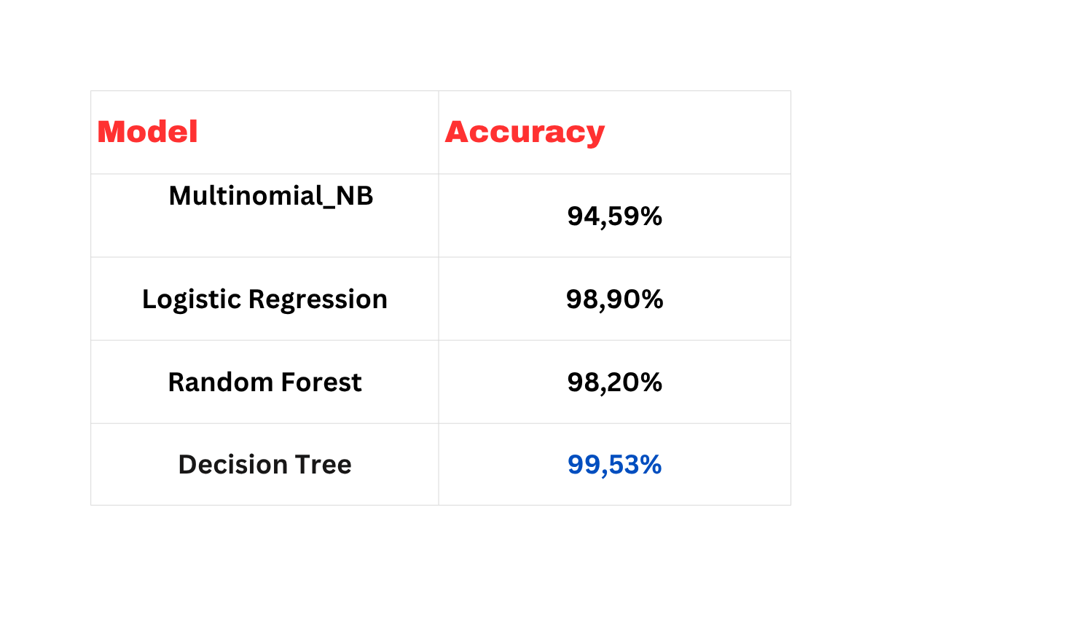
Model Evaluation & Results
Model | Accuracy
Multinomial NB | 93.30%
Random Forest | 96.53%
Decision Tree | 93.97%
Logistic Regression | 98.05%
KNN | 87.34%
SVC | 98.69%

Slide 6
Overfitting: Decision Tree hit 99%+ on training but less on test data. Fixed by tuning max_depth, min_samples_leaf, and validating with GridSearchCV.
01.
Data Leakage: Real articles all contained the word "Reuters", so the model learned to detect that word instead of real patterns. Removed it before retraining.
Challenges & Fixes
02.
Final Model: Logistic Regression was selected for deployment, balancing strong accuracy with better generalization than the Decision Tree.
03.

Slide 7
1-Use deep learning models like LSTM or BERT for better understanding of language context
01.
2-Try more advanced vectorization techniques such as Word2Vec or transformer embeddings
Future Work:
02.
3-Collect a larger and more diverse dataset to improve model generalization
03.

Slide 8
Thank you very much!

