Slide 1
CAPL
CAN ACCESS PROGRAMING LANGUAE
BY: Omar Slimeni

Slide 2
Related TERMS
CAPL program placement can target two areas : one for simulation and the other for analysis
Any number of nodes may be simulated in a canoe envirement but its limited by the PC hardawre interfaces
Canoe supports multiple CAN network system simulations
CAPL program blocks can be insrted into the analysis branch of canoe

Slide 3
The data base file (dbc arxml or ldf) is a lookup table that allows decoding of the bus rawdata into symbolic interpretations (edited by candb++ Editor)
Network : is bus (CAN) that contains multiple ECUs exchange Data.
ECUs : distributed processing units within a network that use NODES (network interface of ECU ) to transmit and receive data from the bus
Envirement variables : input and output varibales of network nodes such as switch position (ECU1_switch_set = 1 or 0)

Slide 4
CAPL used to observe the communication behavior of CAN, CAN_FD,LIN and flexray
C is object/sturcture oriented language but CAPL is event procedure language.
CAPL program consist of two parts:declaration of global variables and declaration of user defined functions and event procedures
In CAPL message or frame is defined with the keyword message and the declaration use the message name or the massage id
The procedure is something which followed as instructions

Slide 5
Event procedure is steps/instructions for some event trigged
In Canoe there are envirement variables and system variables
The envirement variable describes external input/output signal of a node and they are used for communication of signals between nodes in real network
The system varibale help to modify and analyze the internal parameter
Used also to transmit and receive data between external application and evirement nodes( canoe node)

Slide 6
On timer is a function which used to specify the event or action to be execute with specific time difined once C AN communication is ON
We can declare variable with multiple data types in CAPL ; integers floats charcters ,message and timers
We can logging when capl execution is done by enabling the logging block
We have two modes of execution in canoe : online mode and offline mode
The process of executing the script and save the log in any applicable format is called online mode

Slide 7
Examples
We can read the signals using CAPL
We can access signals values with $ in front of the signal name
int value
value = $ Engine_Speed;
We can set a value to the signal with $
$ Engine_temp = 14.0;
if ( $ Engine_tem >= 15.0 ) write (‘stop engine’)

Slide 8
Decalaration
Include{}
Variable{
Message 0x100 msg;
Mstimer tmr100ms
}
On start{
Settimercyclic(tmr100ms,100);
}
On timer tmr100ms{
Output(msg)
}
On start the timer will be execute every 100ms because tmr100ms is declared with Mstimer then when the timer is trigged we output the msg

Slide 9
CAPL
INPUTS
OUTPUTS
Panels
Timers
Keyboard
Recived messages
Start stop of the tool
Panels
Transmitted messages
File
Error frame

Slide 10
Algorithm :Calculate key from seed
1) Rotate seed value right by 1 and store it in result
2) Store the LSB of the Seed to MSB of the result
3) Exor result with the constant 0xCD2BCC2A and store it in seed
3) Perfrom 1,2 and 3 for times on the upated seed value
5) After 35 operations the value in seed will be sent in key

Slide 11
Seed = data [] ( seed is 4 bytes => dword unsigned 4 bytes , stored in data[] 4 rows of 1 byte)
dword calkey(byte data[])
dword temporary;
dword result;
int i;
temporary = data[0];
temporary <<= 8;
temporary += data[1];
temporary <<= 8;
temporary += data[2];
temporary <<= 8;
temporary += data[3];
Example seed AABBCCDD
Temporary take
AA
AA00
AABB
AABB00
AABBCC
AABBCC00
AABBCCDD

Slide 12
for (i = 0 ; i<34 ; i++)
{ int rotationbit;
rotationbit = temporary & 0x0001;
result = temporary >>1;
if (rotationbit>0)
{
result += 0x80000000;
}
temporary = result ^ constant;
}
return temporary;
}

Slide 13
Key calculation
include{}
variable
{
message message_of_request msgreq;
long const 0xCD2BCC2A;
byte databyte[4];
}
//in client session
on key 'd'
{
msgreq.byte(0) = 0x02;
msgreq.byte(1) = 0x27;
msgreq.byte(2) = 0x61;
msgreq.byte(3) = 0x00;
msgreq.byte(4) = 0x00;
msgreq.byte(5) = 0x00;
msgreq.byte(6) = 0x00;
msgreq.byte(7) = 0x00;
output(msgreq);
}

Slide 14
on message response
{if (this.byte(0) == 0x06 && this.byte(1) == 0x67 && this.byte(2) == 0x61)
{
dword returnvalue;
databyte[0] == this.byte(3);
databyte[1] == this.byte(4);
databyte[2] == this.byte(5);
databyte[3] == this.byte(6);
returnvalue = calckey(databyte);
}
msgreq.byte(0) = 0x06;
msgreq.byte(1) = 0x27;
msgreq.byte(2) = 0x62;
msgreq.byte(3) = returnvalue >> 24;
msgreq.byte(4) = (retrunvalue >> 16) & 0xFF;
msgreq.byte(5) = (returnvalue >> 8) & 0xFF;
msgreq.byte(6) = returnvalue & 0xFF;
msgreq.byte(7) = 0;
output(msgreq);
}

Slide 15
Algorithm of filtering test
The ECU1 should receive just the expected frames
Send all frame ids from 0 to 2047 except the expected received frames.
If the frame is is not expected and received by the ecu a flag should be set in ude tool

Slide 16
includes{}
variable
{
word i = 0x00;
int j = 0;
Wordtab[10]={0x20,0x5A,0xAA,0xBB,0x11,0xAB,0x44,0xCD,0xCC,0x22}
int State =0;
message *msg ={DLC=8};
msTimer timer_50ms;
const int cycleTime = 50;
}

Slide 17
on start
{
setTimerCyclic(timer_50ms,cycleTime);
}
on Timer timer_50ms
{
i = ((i++ < 2048 ? i:0);
for (j=0;j<10;j++)
{
if i == tab[j])
{State =1;
break;}
else (State = 0);
}
if (State == 0)
{
msg.id= i;
output(msg);
}
}

Slide 18
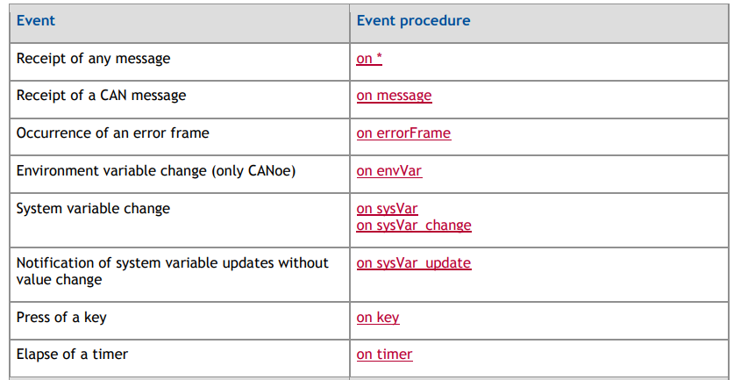
CAPL instructions

Slide 19
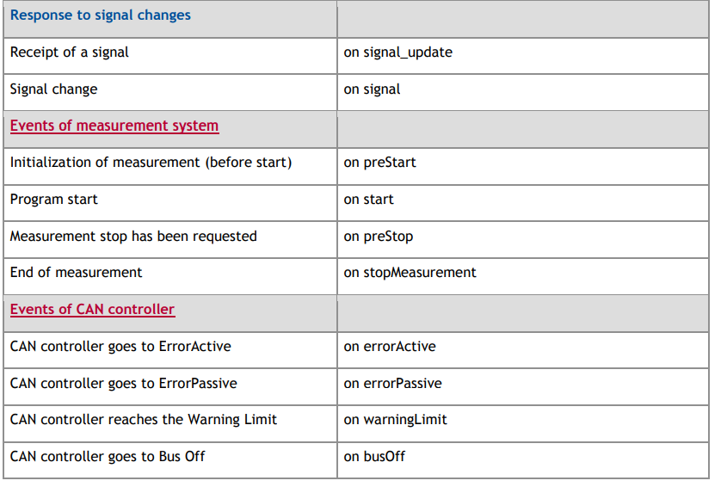

Slide 20
Other examples

