Slide 1



NEUROEVOLUTION
A Differential Evolution-based Optimizer for Neural Networks

Slide 2
Gradient-based approaches such as back-propagation have drawbacks such as:
being sensitive to the initial weights
tendency to get stuck in local optima
Population-based metaheuristic algorithms (PBMH) is capable to over come these problems, Examples of it:
Particle Swarm Optimisation
Differential Evolution
human mental search

Slide 3

This problem is a free optimization problem that we solve using three approaches
DE (DIFFERENTIAL EVOLUTION)

Slide 4
WHAT IS DE?
DE is a powerful optimization algorithm that mimics the process of natural selection to find the best solutions to complex problem .Has three main operators: mutation, crossover, and selection

Slide 5
DE generates new individuals by combining information from three randomly selected individuals within the population. The formula
vi = xr1 + F * (xr2 - xr3) calculates the mutant vector, where xr1, xr2, and xr3 are randomly chosen individuals
MUTATION
The crossover operator combines elements from the mutant vector (vi) and the original target vector (xi) to create a trial vector (ui). we use crossover strategy binomial crossover, where each element of the trial vector ui is determined by a random probability CR and a random index jrand.
CROSSOVER
The selection operator compares the trial vector (ui) with the target vector (xi) and selects the better-performing vector to proceed to the next generation. This selection is typically based on evaluating the fitness
SELECTION

Slide 6
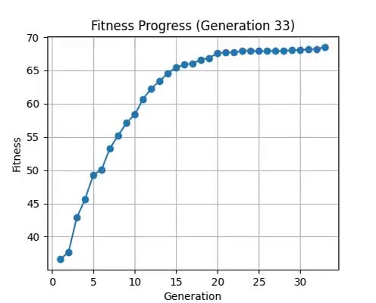
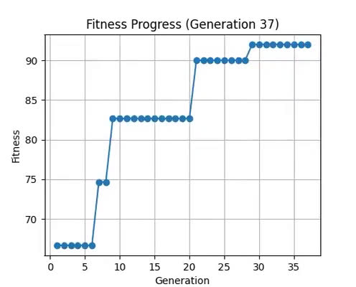
DE(UNIFORM GLORT INTIALIZATION)
Second Data(Iris)

Slide 7
This problem is a free optimization problem that we solve using three approaches
DE (DIFFERENTIAL EVOLUTION)
CENDE-DOBL

Slide 8
WHAT IS CENDE-DOBL?
differential evolution (DE),centroid-based strategy (Cen-S),dynamic opposition-based learning (DOBL)

Slide 9
is a technique used in optimization algorithms to enhance performance. In OBL, the concept of opposition is utilized, where an "opposite" individual is created based on the original individual's position in the search space. This opposite individual is generated using the lower and upper bounds of the search space, along with the original individual's . xˉi​=ai​+bi​−xi​
OBL
DOBL
is a variant of OBL employing quasi-opposition numbers, and is dynamic since the maximum and minimum values of the individuals are employed to create an opposite individual
Centre-based sampling is a concept based on the centroid
of individuals to improve a metaheuristic algorithm .CenDE-DOBL benefits from a centroid based individual that is created based on the N best individuals. In our proposed algorithm, all individuals except one are updated based on standard operators, while the last individual is the centroid of the N best individuals
CEN

Slide 10
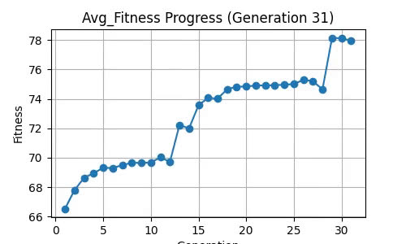
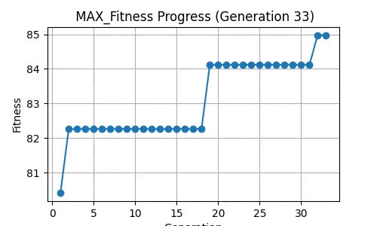
SECOND
(CENDE-DOBL)
First Data(Breast Cancer)

Slide 11
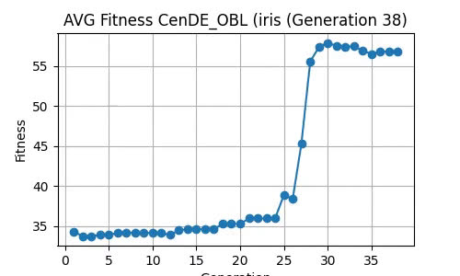
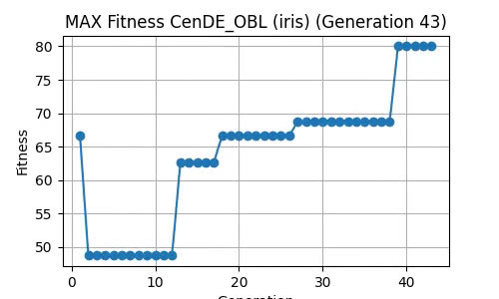
SECOND
(CENDE-DOBL)
Second Data(Iris)

Slide 12
This problem is a free optimization problem that we solve using three approaches
CENDE-DOBLWITH ADDITIONAL ENHANCEMENTS
DE (DIFFERENTIAL EVOLUTION)
CENDE-DOBL
we used Extinction and the adaptive mutation

Slide 13
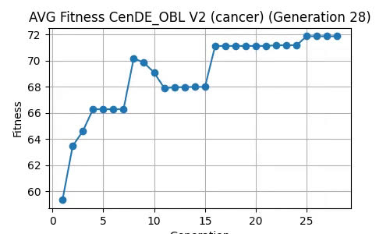
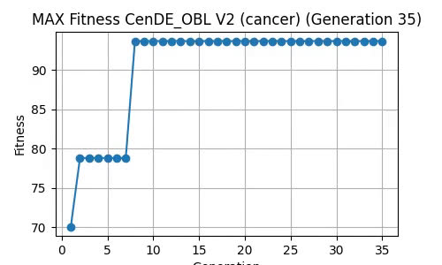
(CENDE-DOBL WITH MODIFICATIONS)
First Data(Breast Cancer)

Slide 14
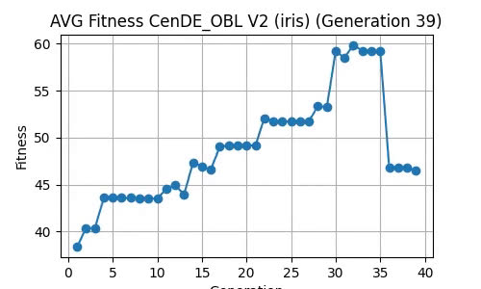
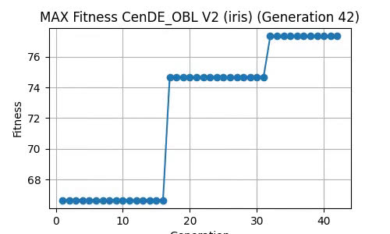
(CENDE-DOBL WITH MODIFICATIONS)
Second Data(Iris)

Slide 15
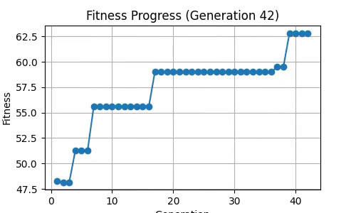
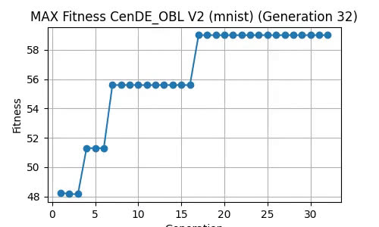
(CENDE-DOBL WITH MODIFICATIONS)
third Data(Mnist)

Slide 16
REFERENCES
REFERENCES 1 :DIFFERENTIAL EVOLUTION – A SIMPLE AND EFFICIENT HEURISTIC FOR GLOBAL OPTIMIZATION OVER CONTINUOUS SPACES
REFERENCES 2:OPPOSITION-BASED LEARNING: A NEW SCHEME FOR MACHINE INTELLIGENCE
REFERENCES 3:QUASI-OPPOSITIONAL DIFFERENTIAL EVOLUTION

Slide 17
REFERENCES
REFERENCES 4:DIFFERENTIAL EVOLUTION-BASED NEURAL NETWORK TRAINING INCORPORATING A CENTROID-BASED STRATEGY AND DYNAMIC OPPOSITION-BASED LEARNING
REFERENCES 5:VIABILITY EVOLUTION: ELIMINATION AND EXTINCTION IN EVOLUTIONARY COMPUTATION
REFERENCES 6:SELF-ADAPTATION IN EVOLUTIONARY ALGORITHMS

Slide 18
DATA SET
iris dataset
Breast Cancer Wisconsin
Minst

Slide 19
Development platform
Google Coolab
Kaggle
PYTHON

