Slide 1
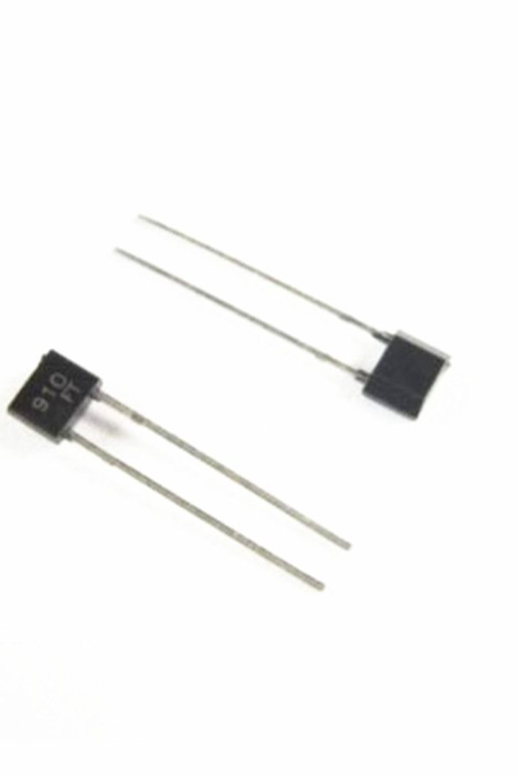

Varactor Diode
A varactor diode is a type of diode that exhibits a capacitance that varies with the applied voltage. In this presentation, we will explore the working, applications, and future developments of varactor diodes.

Slide 2
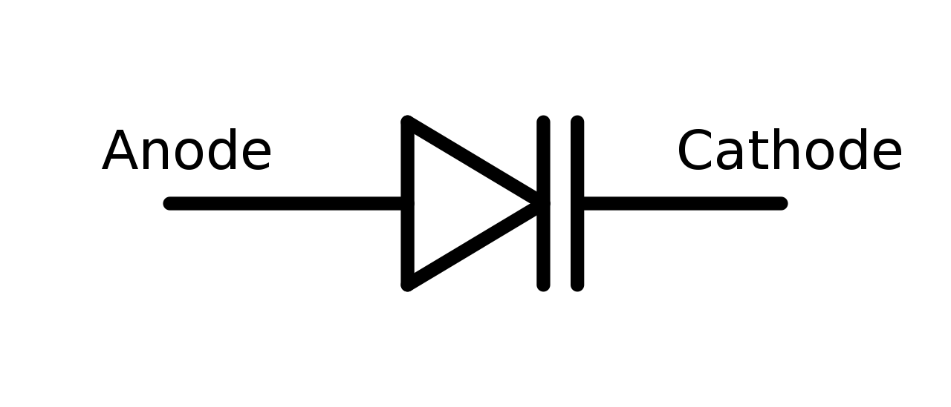
What is a Varactor Diode?
A varactor diode is a semiconductor device widely used in electronic circuits for its variable capacitance property. It is commonly used for tuning and frequency control in electronic systems.

Slide 3
How does a Varactor Diode work?
Varactor diodes work based on the principle of a P-N junction diode. The variable capacitance is achieved by changing the width of the depletion region between the P and N regions under the applied voltage. This capacitance variation is used for various electronic applications.

Slide 4
Applications of Varactor Diodes
Varactor diodes find extensive use in frequency synthesizers, voltage-controlled oscillators (VCOs), phase-locked loops (PLLs), mobile communication systems, radar systems, and television tuners. Their capacitance variation allows for precise frequency tuning and modulation.

Slide 5

Advantages and disadvantages of Varactor Diodes
Advantages
Disadvantages
High tuning range, low cost, small size, and high reliability.
Non-linear characteristics, limited quality factor (Q-factor), and sensitivity to temperature changes.

Slide 6

Characteristics of Varactor Diodes
1
Capacitance Range
2
Reverse Bias
The capacitance range of varactor diodes typically varies from a few picofarads to a few hundred picofarads.
A varactor diode operates under reverse bias to achieve the desired capacitance variation.
3
Frequency Range
The frequency range of varactor diodes spans from a few kilohertz to several gigahertz.

Slide 7
Varactor Diode Tuning Circuits
Varactor diode tuning circuits employ different circuit configurations such as series tuning, parallel tuning, and capacitance multiplier circuits to achieve precise frequency control and tuning.

Slide 8

Future Developments in Varactor Diode Technology
Ongoing research and development focus on improving varactor diodes' linearity, Q-factor, and temperature stability, enabling more advanced applications in wireless communication, radar systems, and other frequency-dependent systems.

